Slide 1
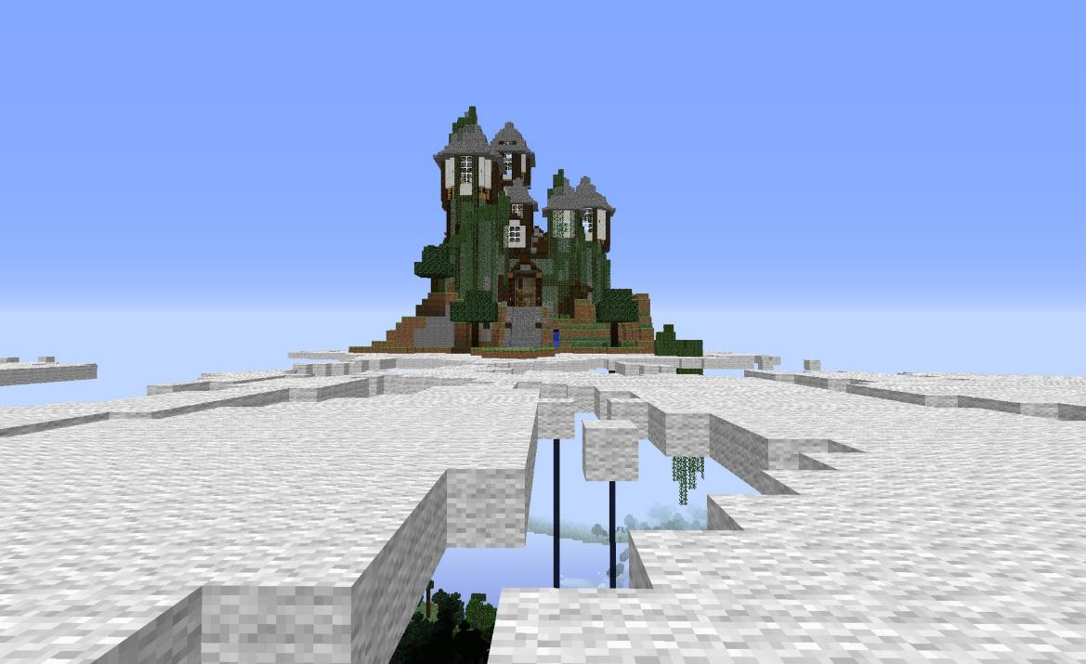
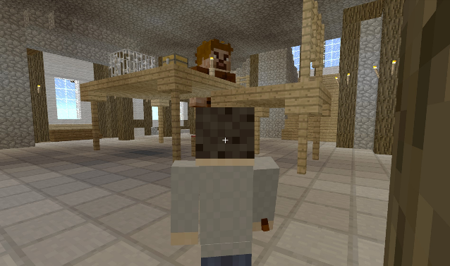
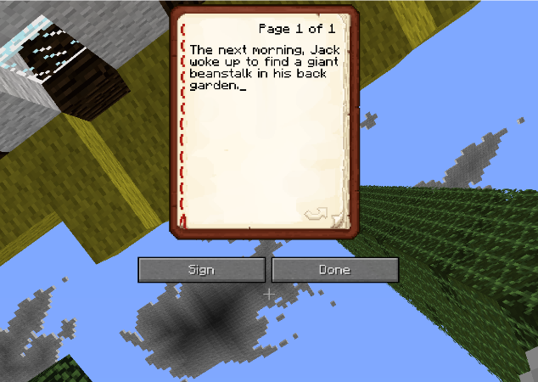
Tell a story using Minecraft…

Slide 2
Sentence Starters
Although . . .
As . . .
As I see it . . .
At one point . . .
Despite the fact that . . .
Even though . . .
Finally . . .
For example . . .
Furthermore . . .
Gradually . . .
I believe that . . .
If . . .
In addition . . .
In conclusion . . .
In general . . .
In my view . . .
In spite of . . .
Meanwhile . . .
Moreover . . .
Nevertheless . . .
So . . .
Subsequently . . .
Therefore . . .
Whilst . . .
Later that day . . .
After a while . . .

Slide 3
Verbs – Some verbs to use in your story.
Black 3 | Dark 3 | Malevolent 5 | Shimmering 4 | Blank 4
Evil 4 | Musty 4 | Dusty 3 | Glistening 5 | Dangerous 3
Grey 3 | Menacing 5 | Lifeless 5 | Sharp 3 | Crimson 5
Still 4 | Motionless 4 | Cold 3 | Bloody 4 | Ominous 5
Silent 5 | Threatening 5 | Frightening 4 | Dull 3 | Dreary 4

Slide 4
Adverbs – Some adverbs to describe actions in your story.
accidentally | bravely | courageously | energetically | gallantly
admiringly | calmly | convincingly | equisitely | generously
adoringly | carefully | decisively | erratically | gently
aggressively | carelessly | defiantly | excitedly | gingerly
angrily | caringly | desperately | expressively | gracefully
anxiously | casually | determinedly | ferociously | graciously
assuredly | cautiously | disrespectfully | firmly | gratefully
awkwardly | clumsily | ecstatically | foolishly | harshly
beautifully | confidently | eloquently | forcefully | hesitantly
boldly | continually | emphatically | frankly | Hysterically
imaginatively | menacingly | persistently | sarcastically | thoughtlessly
impatiently | modestly | persuasively | sensitively | timidly
impressively | needlessly | promptly | spitefully | urgently
insensitively | negatively | proudly | surreptitiously | vaguely
instantly | nervously | pessimistically | suspiciously | viciously
instinctively | Nonchalantly | rapidly | sympathetically | Violently
lazily | optimistically | reluctantly | tantalizingly | willingly
loosely | painstakingly | resentfully | tenderly | wisely
maliciously | patiently | resourcefully | theatrically | wistfully
majestically | perilously | respectfully | thoughtfully | worriedly

Slide 5
Prepositions
Behind | Below | Above | Through | Near
Around | Under | During | Across | Into
On | Before | In | Up | Beneath

Slide 6
Imperative verbs (bossy words)
Time Connectives
Add | Fetch | Attach
Flip | Move | Push
Take | Rotate | Point
Place | Plug | Get
Hold | Stick | Turn
Firstly | Next | After that
Finally | To begin | Then
Eventually | First of all | At this point
Initially | After a while | Meanwhile
Before | While | Earlier

