Slide 1
Compare and contrast these 2 rectangles

Slide 2
Why is this rectangle=(6x4)+(4x4)

Slide 3
Why is this rectangle=4x(6+4)

Slide 4
Compare and contrast
(AxB)+(AxC) = Ax(B+C)

Slide 5
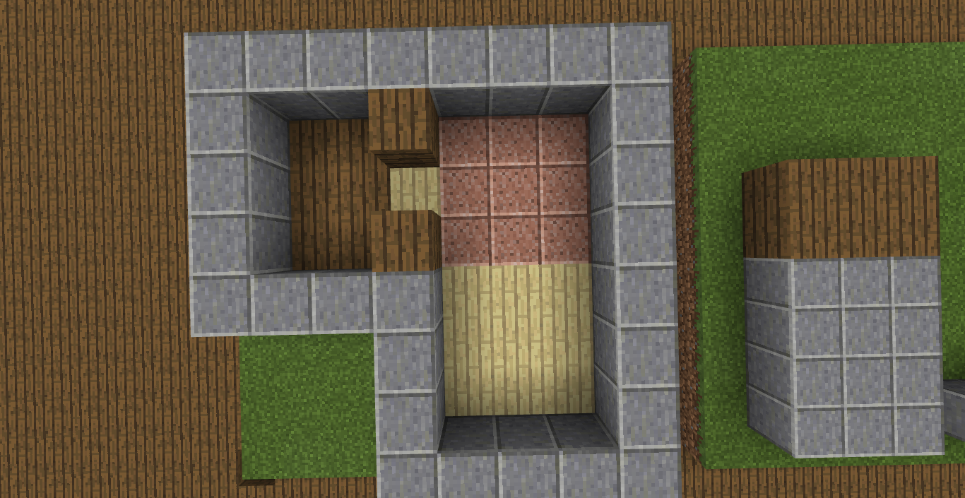
What is the area of the floor space?
Don’t include walls or door spaces
6
9
9
6+9+9=24

Slide 6
What do these math models have in common
(AxB)+(AxC)

Slide 7
What is the perimeter of this home?
8+8+5+5=26

Slide 8
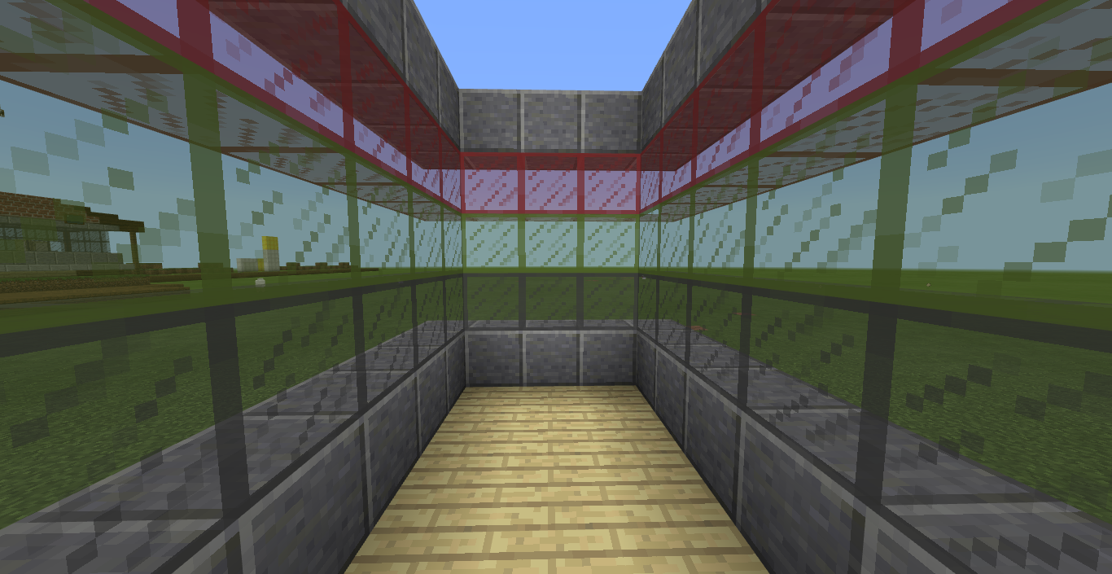
To build the walls just stack up loops of the perimeter, use glass loops for windows. DON’T COUNT THE FLOOR.
How many blocks are in the walls?
26+26+26+26=64

Slide 9
Why do the walls equal perimeter x height?
Walls=PxH

Slide 10
The Big Idea:
Math is needed to create buildings and measuring the area and perimeter of shapes are its tools.

