Slide 1
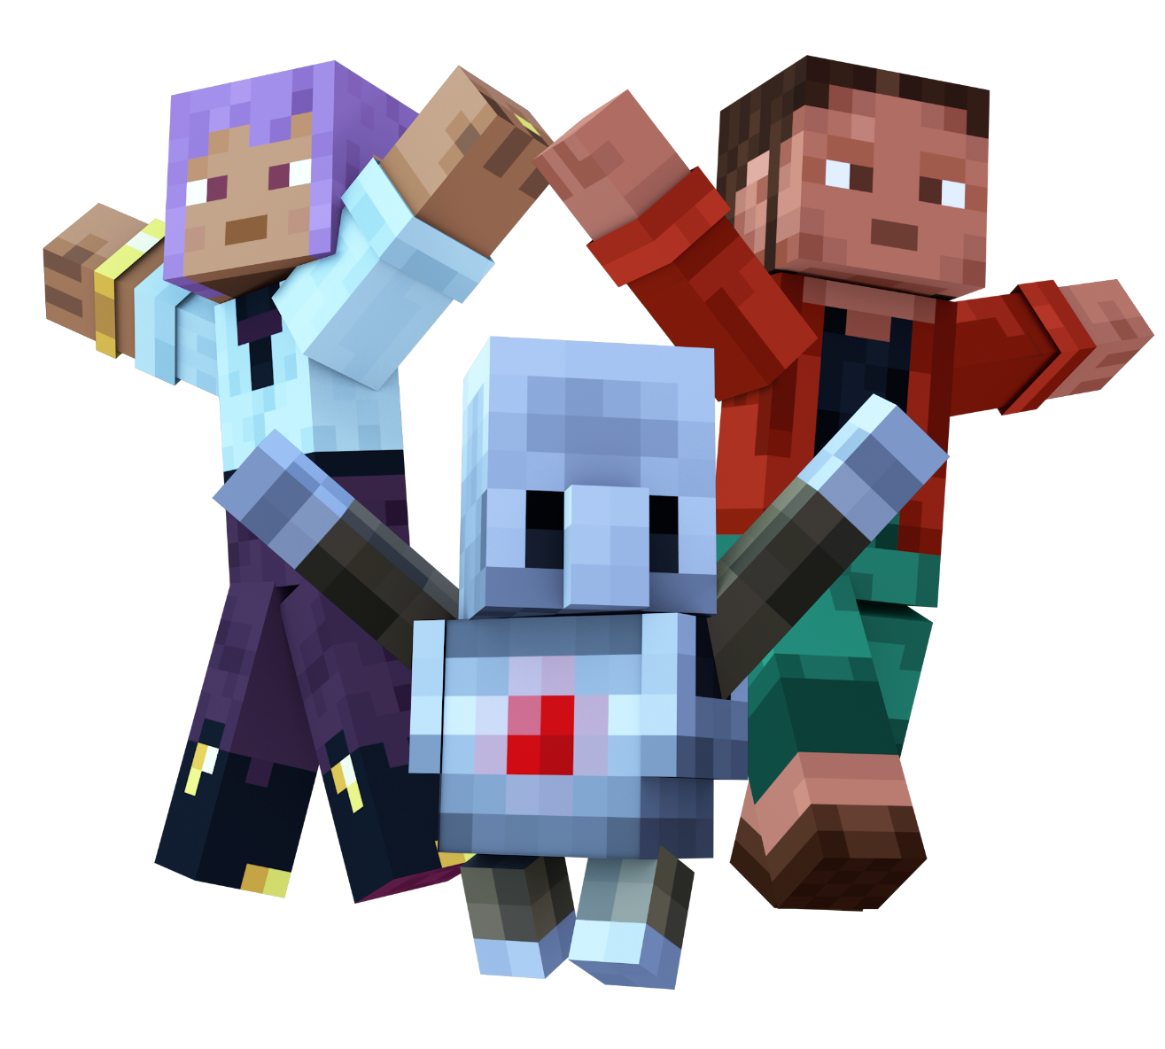
Hour of AI:
The First Night
Kickoff Slides for Students

Slide 2
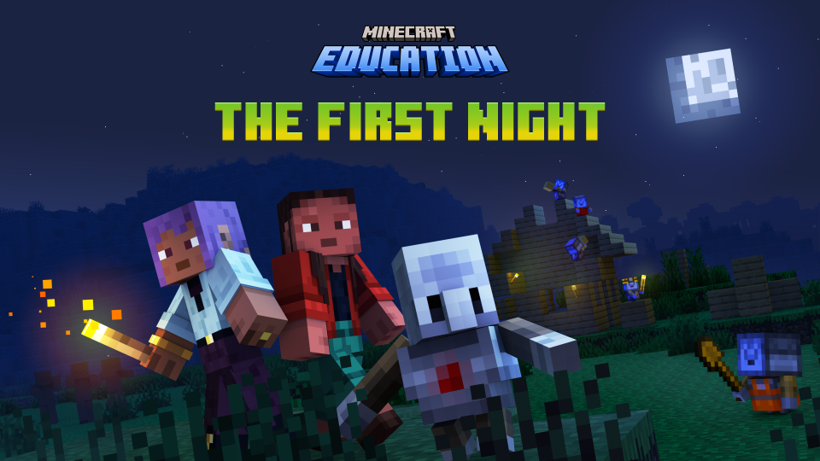

Slide 3

Let’s Discuss
What do you think a robot (or AI) can learn to do?
What is one thing you would like to train an AI to complete for you?
2
Have you ever used AI or a smart device?
1
3

Slide 4
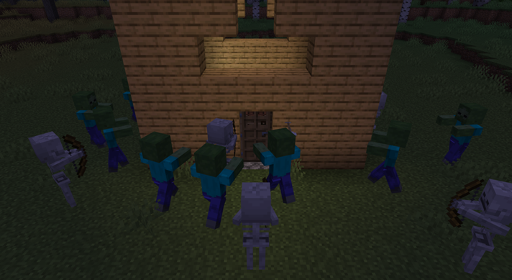
Getting started
Can you survive the night in Minecraft?!

Slide 5
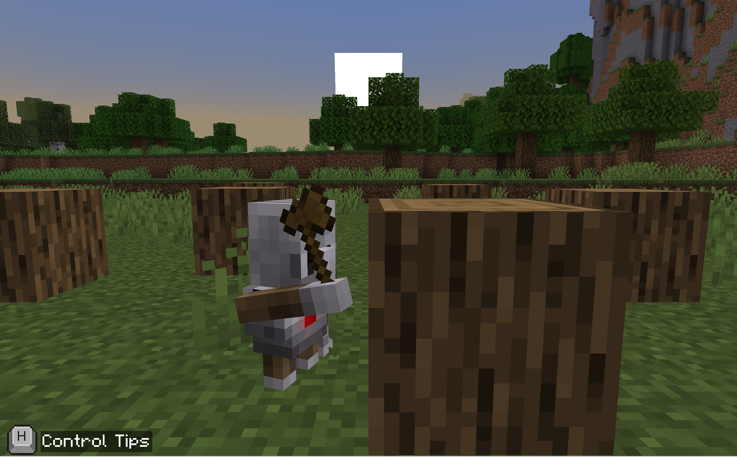
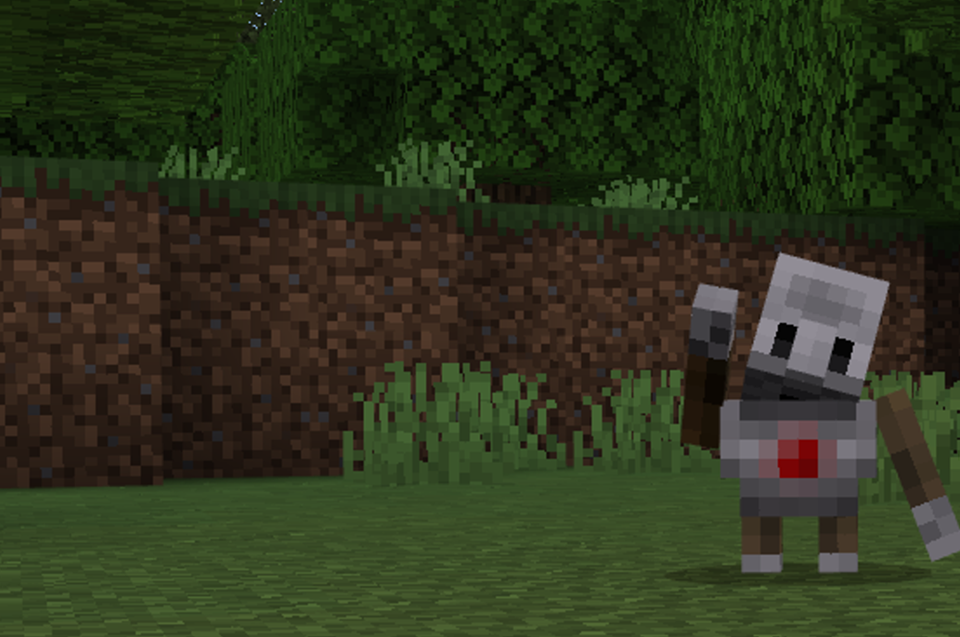
Preparing for the Night
In Minecraft, there are some specific things that you must do in order to survive…
You won’t be alone in the adventure… you will have the Agent to help you!

Slide 6
What will we do Today?
  Today, we will:
  Learn about different types of AI
  Think like a computer to understand how AI works
  Practice teaching an AI and testing its answers
  Practice using skills from one project to help with other tasks and become a better teammate

Slide 7
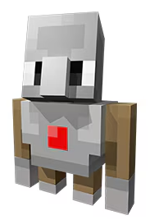
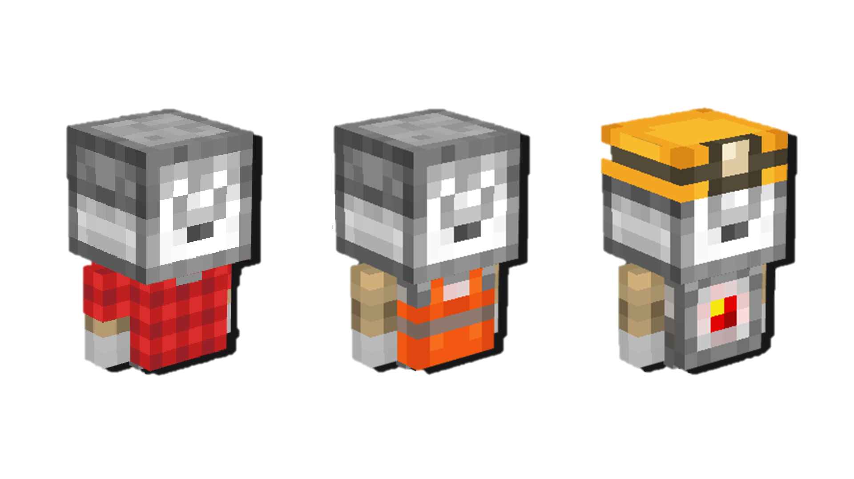
Vocabulary Words
Artificial Intelligence (AI)
Classification
.
Pattern Recognition
Orchestration
“Human-in-the-loop”
A computer that has the ability to copy human-like actions such as learning new things and solving problems
Putting things into groups. AI learns how to sort data into the right category
Finding a pattern. AI looks at examples and figures out what’s similar or new.
Working together like a team. AI makes sure different parts do their jobs at the right time so everything runs smoothly—like a coach or a conductor
Humans help AI. People check the work, fix mistakes, and make sure the rules are right.

Slide 8


Slide 9
Let’s play!
Log into Minecraft Education

Slide 10
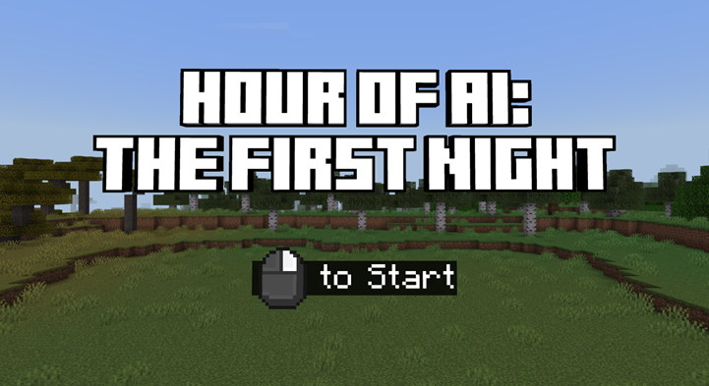
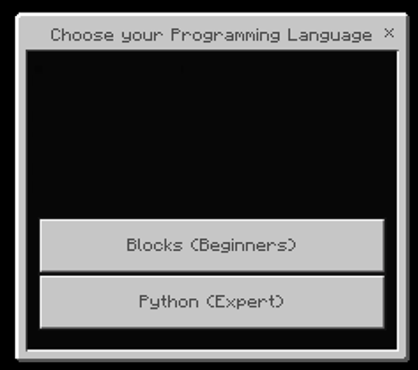
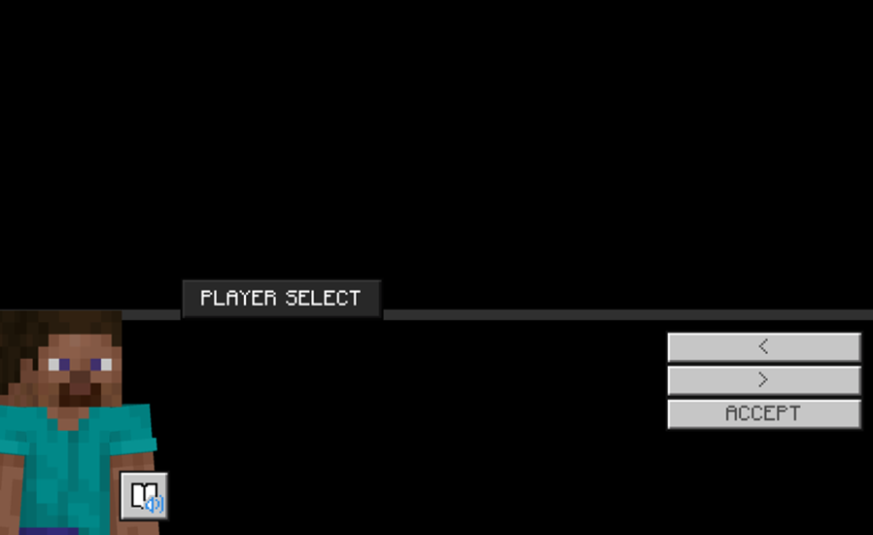
Beginning Game Play
You will spawn into the world.
You will need to click to begin the map.
Then, you will be asked to select your coding language:
Blocks
Python (Expert)
Next, you will select a skin.
In Minecraft, a skin is an image that determines what your character looks like in the game.
Watch the opening cinematic scene to find out about what your AI adventure is going to be about today!

Slide 11
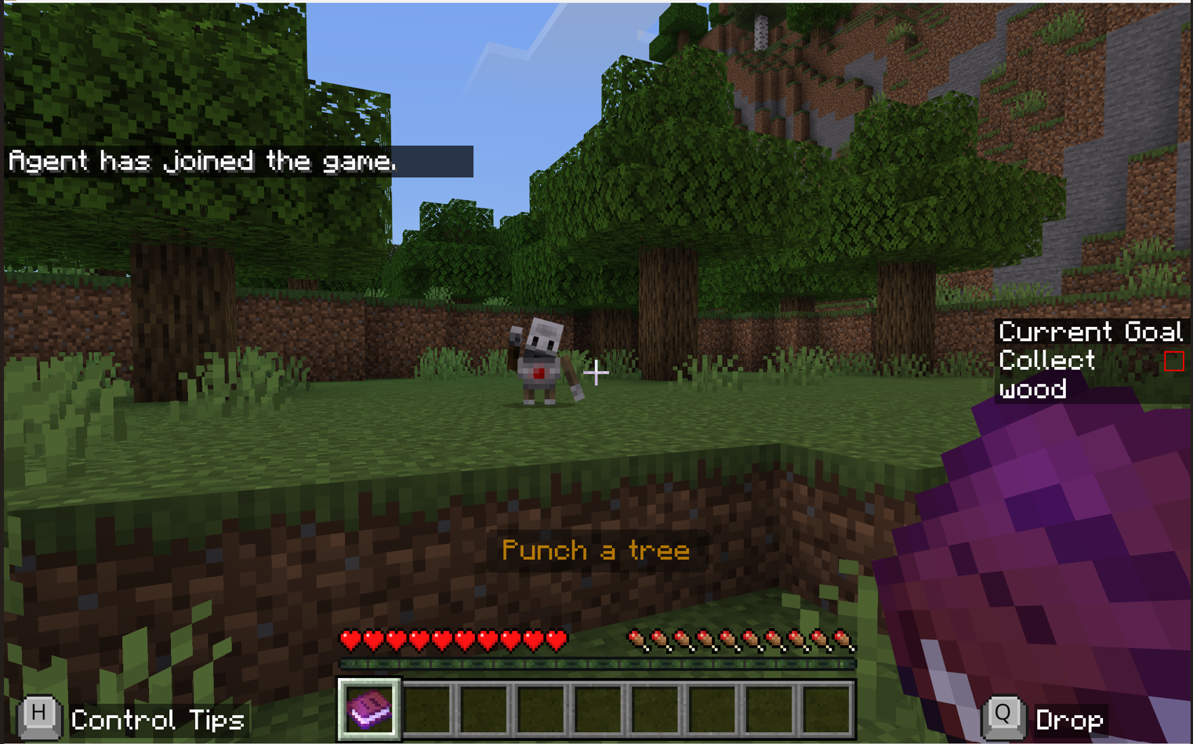
The Agent can Help!
Your goal is to survive the night in Minecraft…
There are several steps to build a complete shelter.
Your Agent will help you, but you will need to train the Agent in the process!
The Agent is an AI player.
The Agent can copy human-like actions, such as learning new things and solving problems.

Slide 12
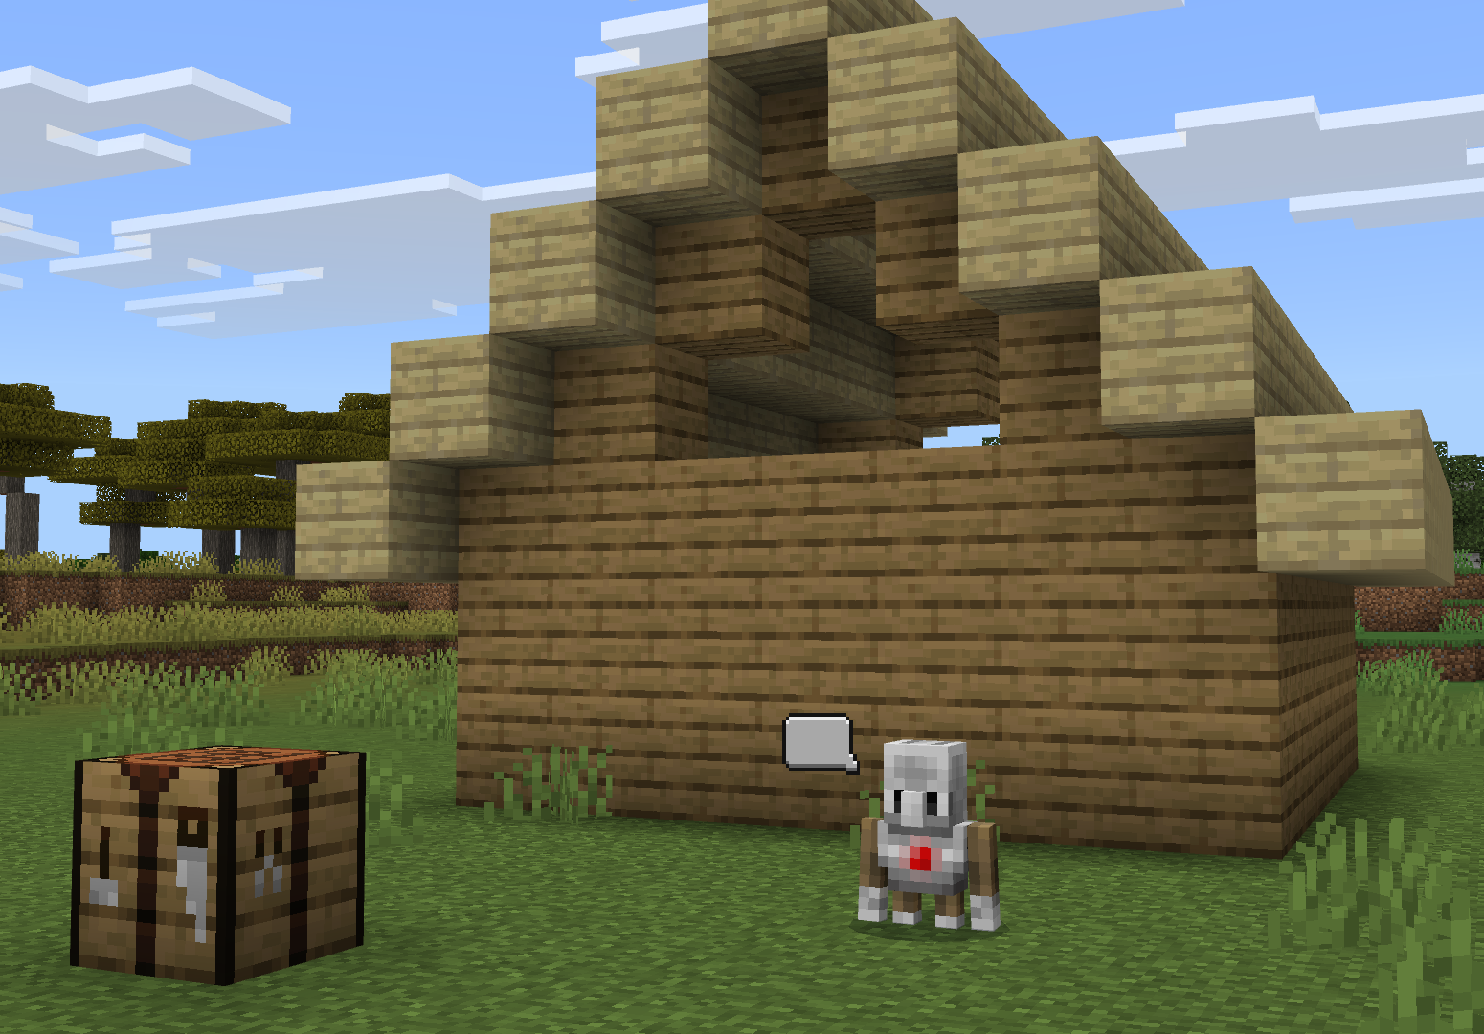
specific tasks to complete
To survive the night, you must:
Collect wood.
Make tools.
Build a shelter.
Craft a door.
Add light to the room.
Make a bed.
Sounds easy enough, right?

Slide 13

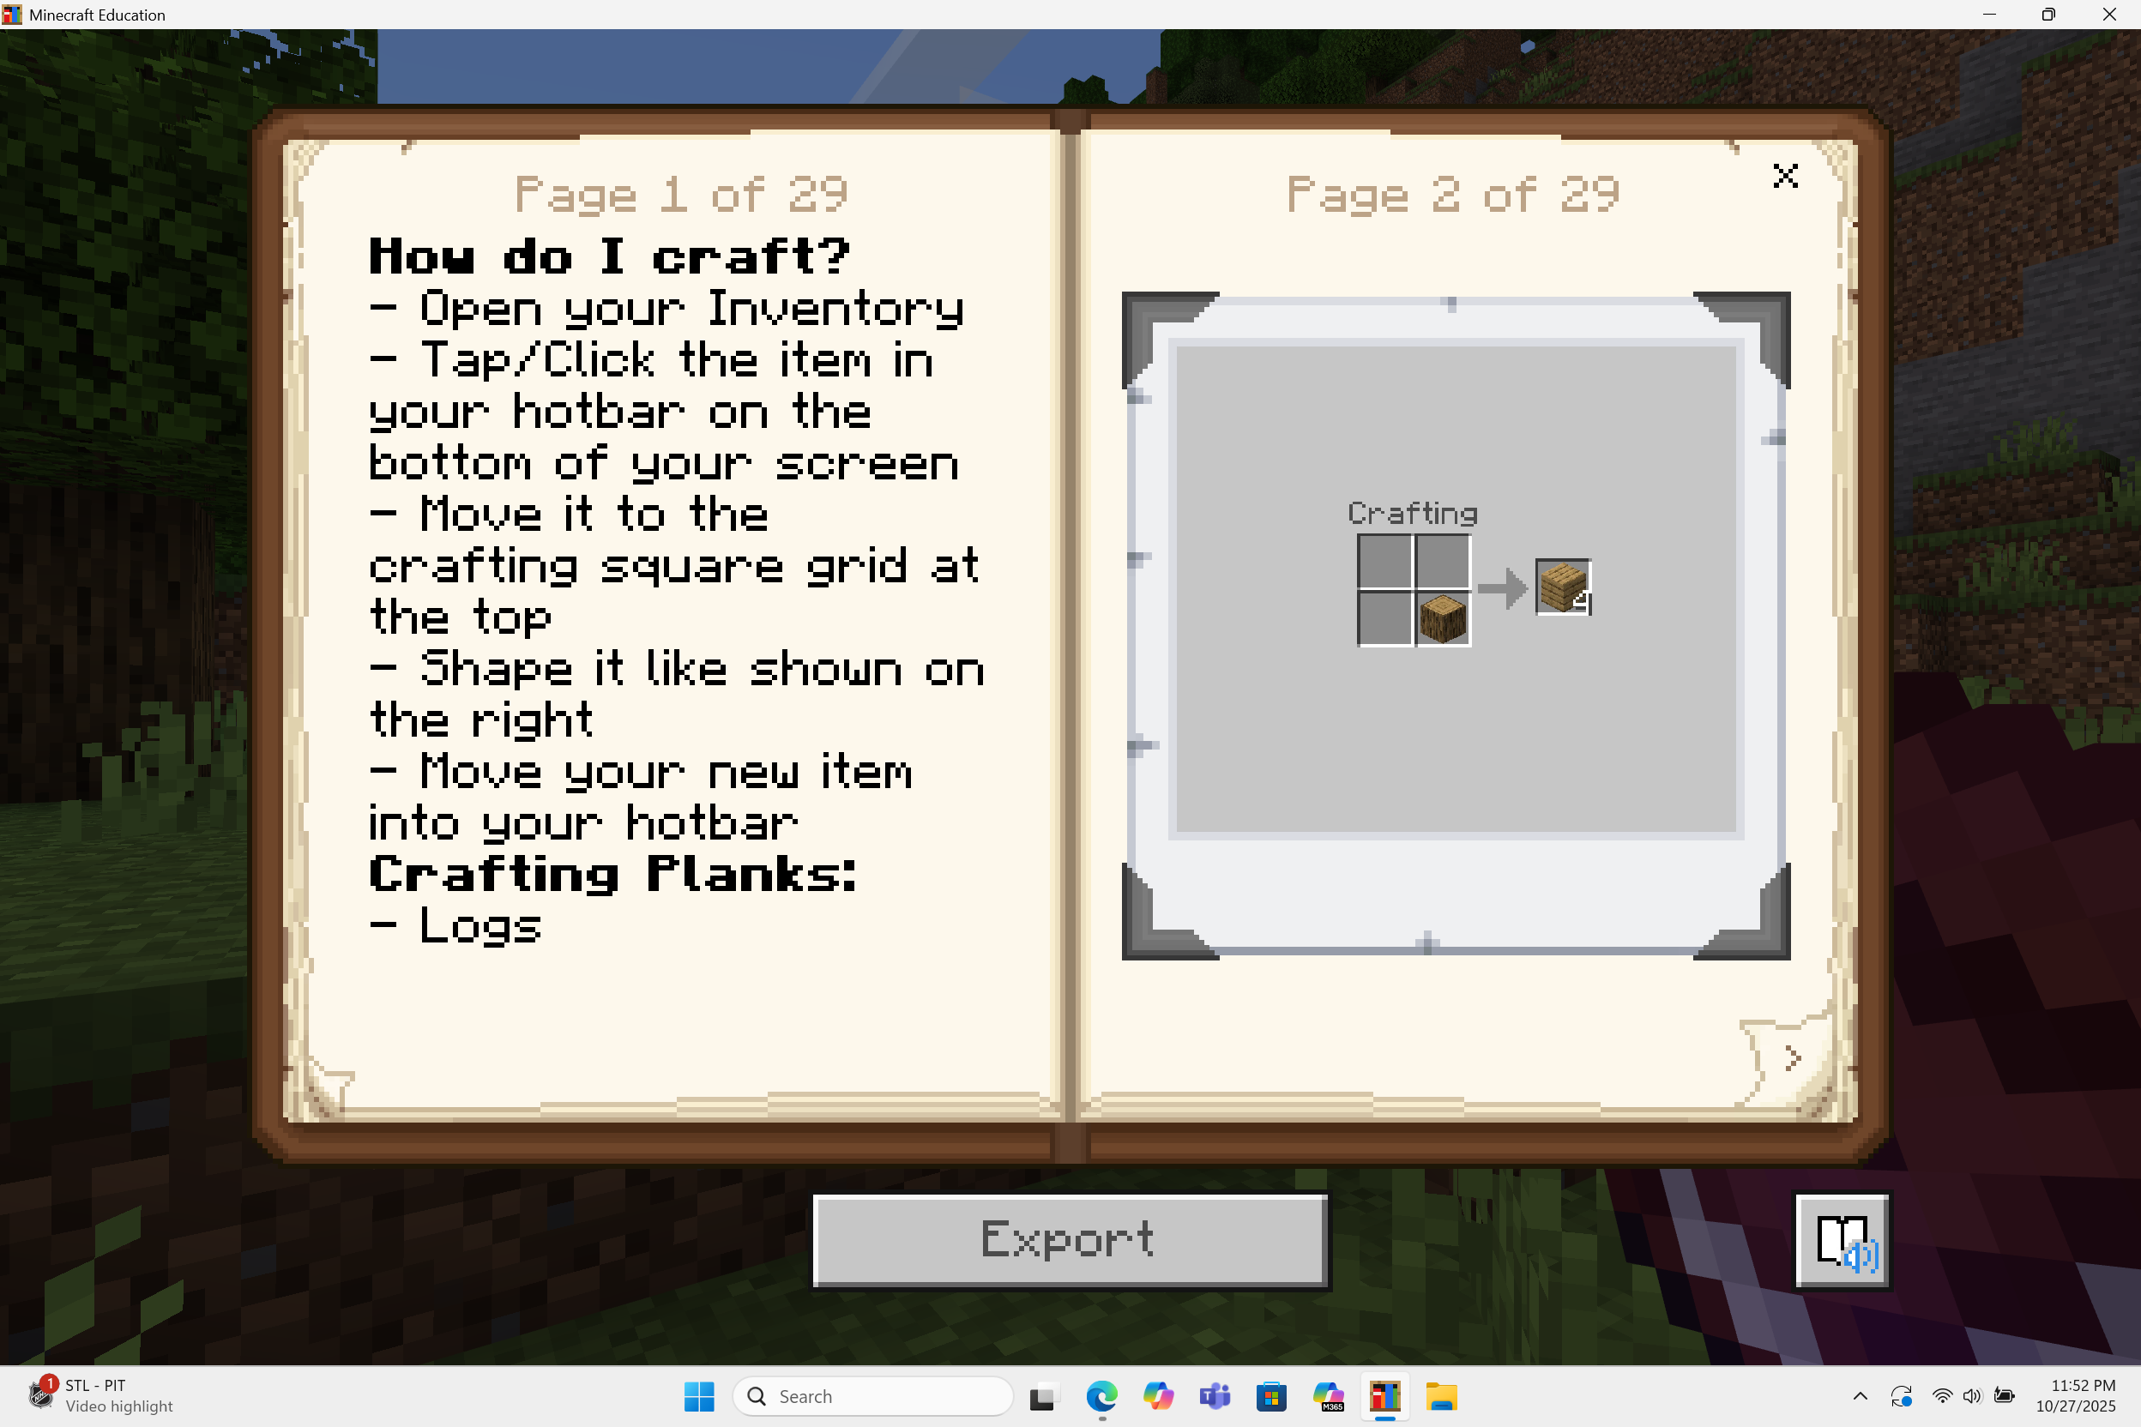
Use Your book
In your hotbar, you have received a book:
“Player’s Guide to the First Night in Minecraft”
This will teach you how to craft and help you progress!

Slide 14
Activities

Slide 15
1 - Collect Wood

Slide 16
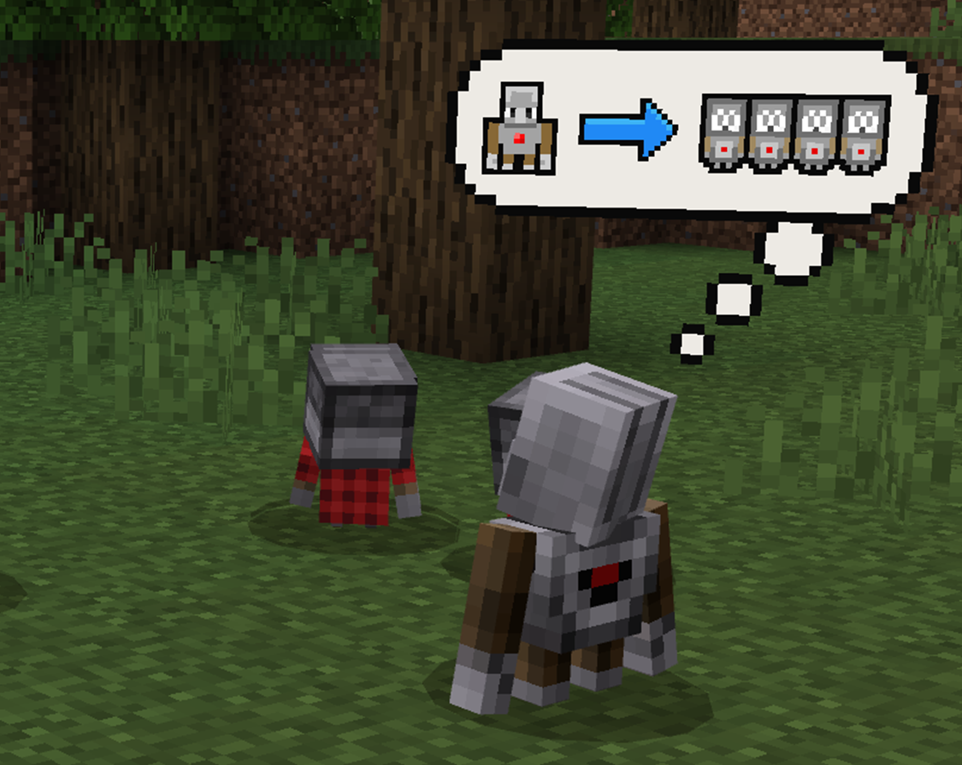
Task: Collect Wood
Welcome to your Minecraft world!
Meet the Agent…
Now, you will need to train the Agent to collect wood.

Slide 17
Action items
We need to complete the following tasks to collect wood:
Punch a tree
Collect the wood that falls from the tree
Train the Agent to classify oak log as wood (through coding)
Deploy the mini-Agents to collect a lot of oak wood for the player
Train the Agent to classify birch log as wood (through coding)
Deploy the mini-Agents to collect a lot of birch wood for the player
Train the Agent to classify acacia log as wood (through coding)

Slide 18
2 - Make Tools

Slide 19
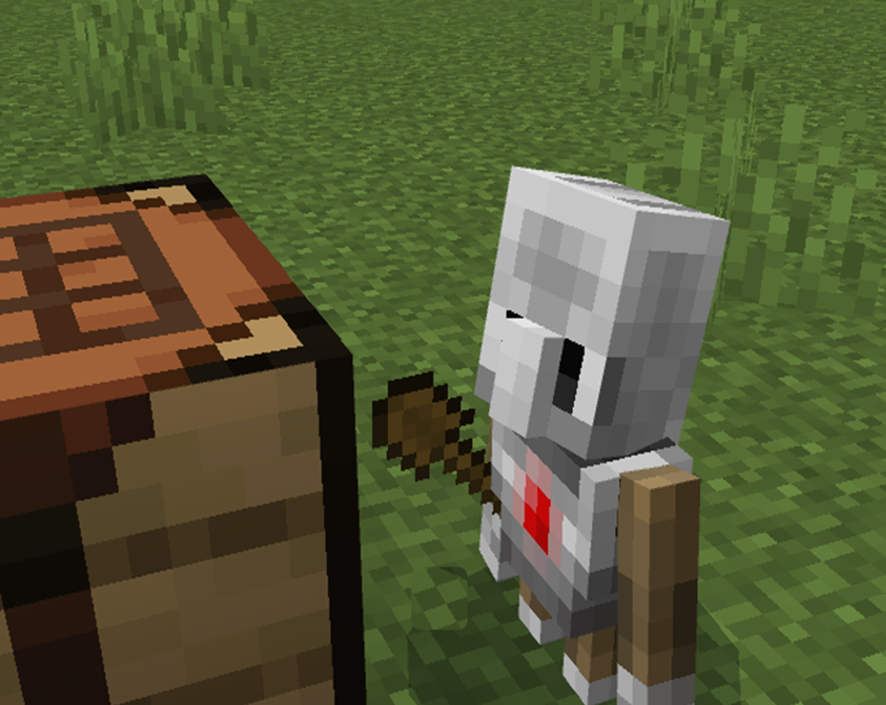
Task: Make Tools
We need to make tools.
To make tools, you will need to use a crafting table.
A crafting table is an item that is a 3x3 crafting grid and helps you make a wide variety of items and blocks.
To build a crafting table, you will need wood planks.
You can make wood planks out of logs.

Slide 20
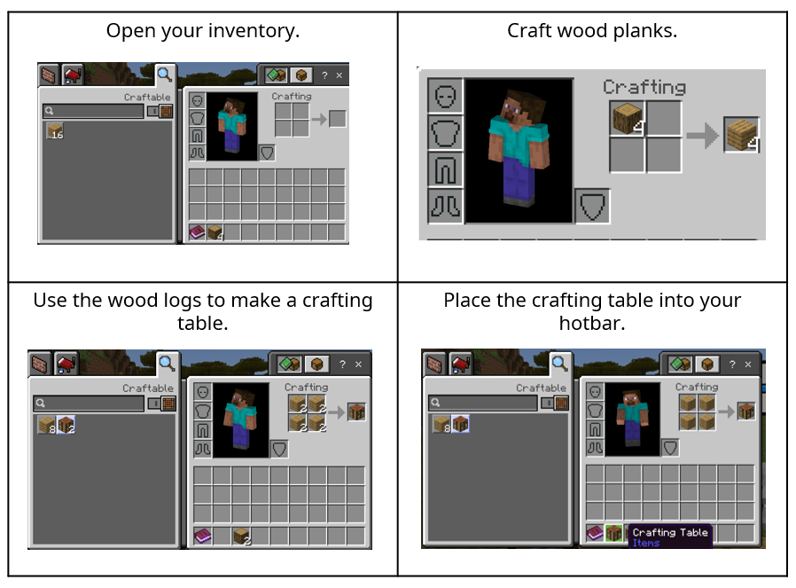
Make a Crafting Table

Slide 21
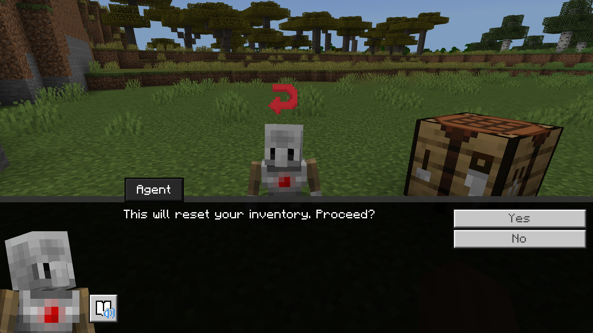
RESET YOUR INVENTORY - Helpful Hint
Sometimes, you may end up crafting unnecessary items or even craft too much of a certain item!
When the crafting "stage" starts, it will start a countdown of 10 seconds.
After 10 seconds, you should see a "red arrow" above the Agent, indicating the inventory can be reset.
On interacting with the Agent, they will ask if you are sure about wanting to reset your inventory.
If you say yes, your inventory will reset to the start of that crafting stage.

Slide 22
Action items
We need to complete the following tasks to make tools:
Train the Agent to make wood planks (through coding)
Train the Agent to make a crafting table (through coding)
Use the crafting table to make sticks
Train the Agent on how to craft sticks (through coding)
Use the crafting table to make a wooden axe, wooden shovel, and wooden pickaxe. Place them into your hotbar.
Train your Agent to make the wooden tools (through coding)

Slide 23
Action items
We need to complete the following tasks to upgrade our tools:
Collect stone using your tools.
Deploy the mini-Agents to collect a lot of stone for you.
Use the crafting table to make a stone axe, stone shovel, and stone pickaxe.
Place your stone axe, stone shovel, and stone pickaxe into your hotbar.
Train the Agent on how to upgrade your tools (through coding).

Slide 24
3 – Build a Shelter

Slide 25
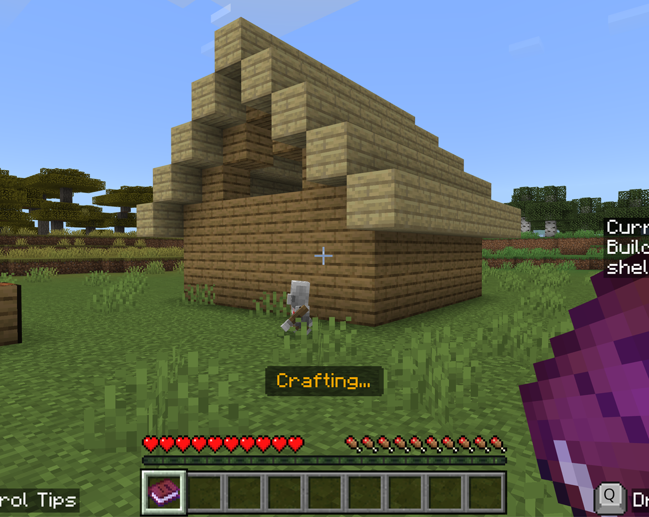
Task: Build a Shelter
We need to build our shelter!
The Agent will build the structure for you!
Train the Agent to classify cobblestone and wood as building materials (through coding).
Then, ask the Agent to craft the shelter for you!
Make sure to verify the work of the AI – does this shelter have a way to enter the structure?

Slide 26
4 – Craft a door

Slide 27
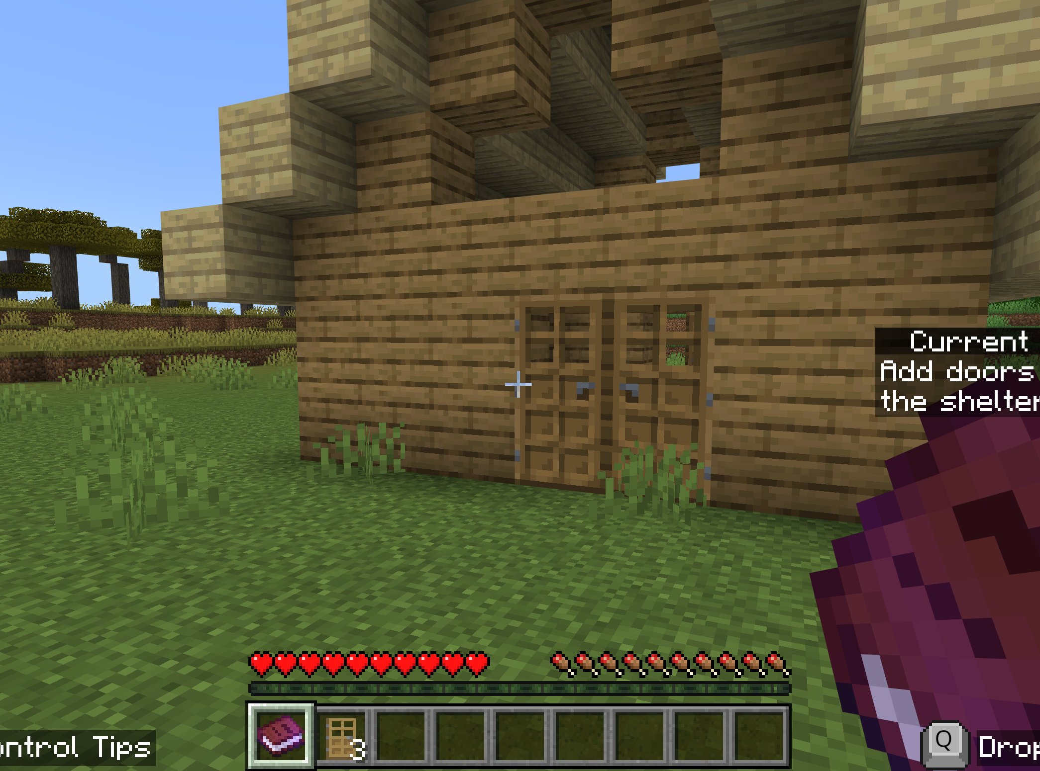
Task: Craft a door
Our shelter is missing a door!
Use the crafting table to make a door.
Move it to your hotbar.
Train the Agent to craft a door (through coding).
Then, ask the Agent to place the doors on the shelter for you.

Slide 28
5 – Add light

Slide 29
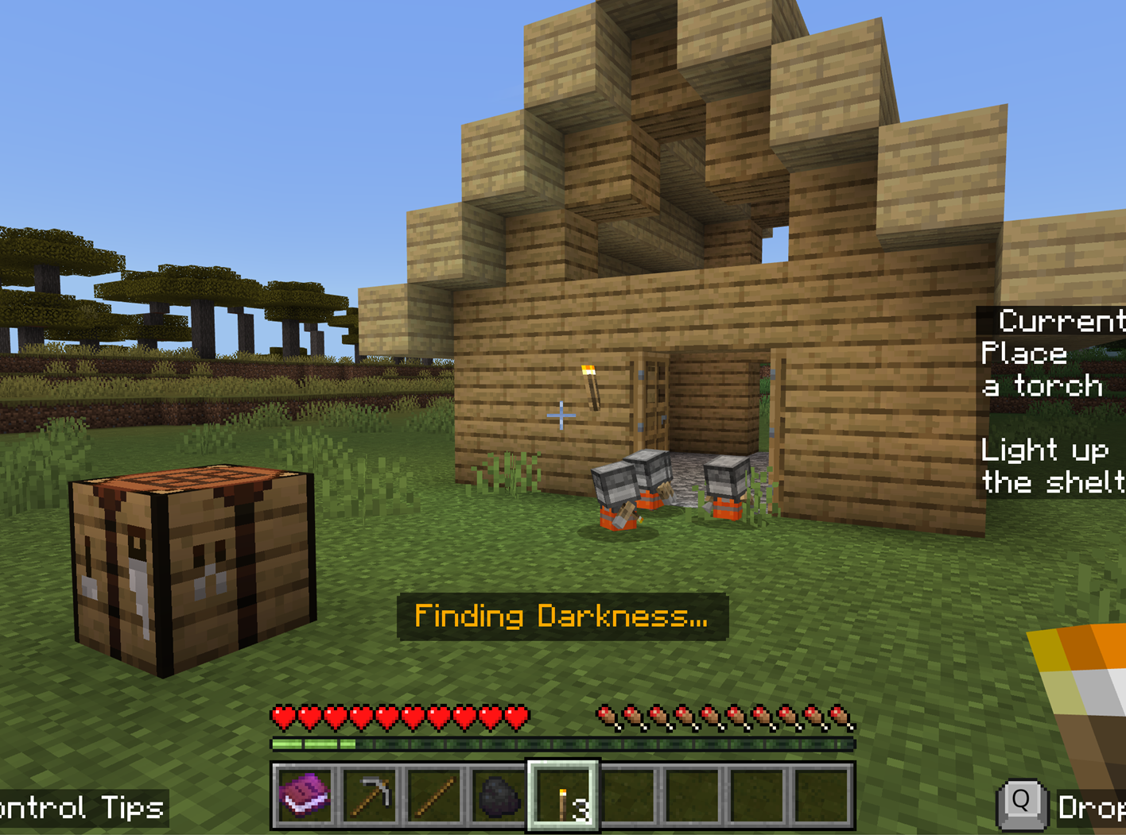
Task: Add Light
Night is drawing closer!
A torch will be useful. A torch provides light and is good at keeping mobs away.
Torches can be made from sticks and coal.

Slide 30
Action items
We need to complete the following tasks to add light (via torches):
Collect coal
Train the Agent to classify coal ore as ore (through coding)
Deploy the mini-Agents to collect a lot of coal for you
Use the crafting table to make a torch. Place them into your hotbar
Train the Agent on how to make a torch (through coding)
Place a torch on the shelter
Deploy the mini-Agents to place more torches in the shelter

Slide 31
6 – Make a bed

Slide 32
Task: Make a Bed
Night is ALMOST HERE!
We need to make a bed!
The Agent can help us…

Slide 33
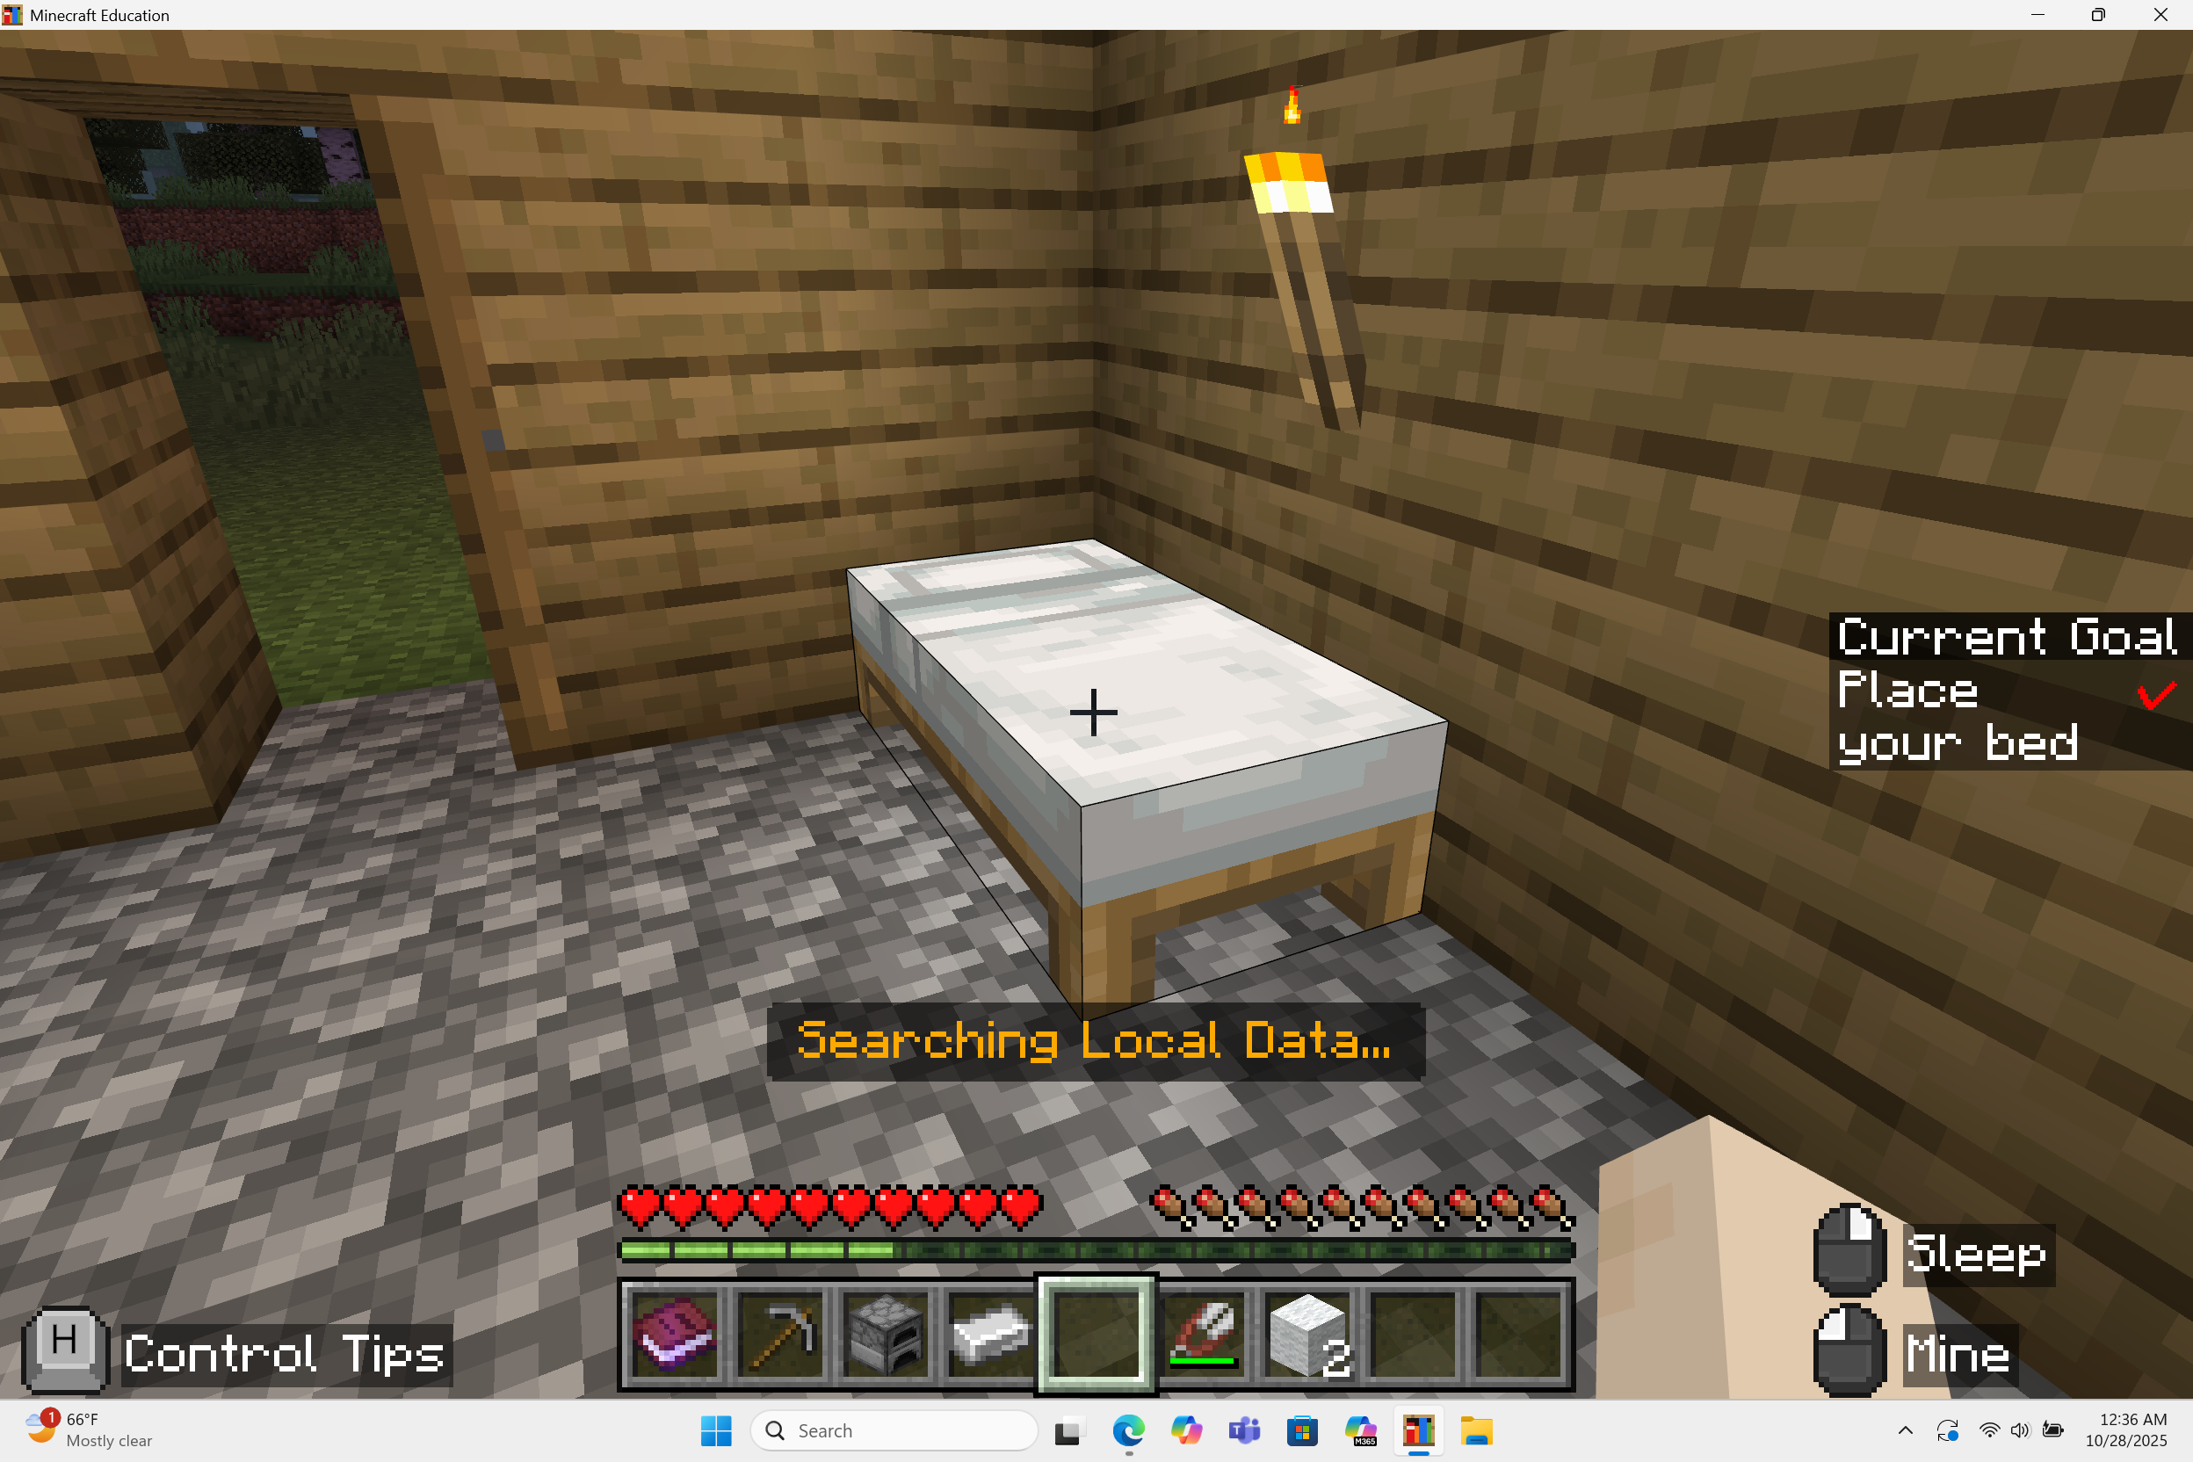
Action items
We need to complete the following tasks to make a bed.
First, you must make shears!
Collect iron
Train the Agent to classify iron ore as ore (through coding)
Deploy the mini-Agents to collect a lot of iron for you
Use the crafting table to make a furnace. Place into your hotbar
Train the Agent on how to make a furnace (through coding)
Smelt raw iron into iron ingots
Deploy the mini-Agents to smelt the rest of the iron ore
Use the crafting table to make shears. Place into your hotbar

Slide 34
Action items
We need to complete the following tasks to make a bed:
Then, you must shear a sheep and craft a bed!
Train the Agent on how to make shears (through coding)
Shear a sheep
Use the crafting table to make a bed. Place into your hotbar
Train the Agent on how to make a bed (through coding)
Place your bed inside your shelter!

Slide 35

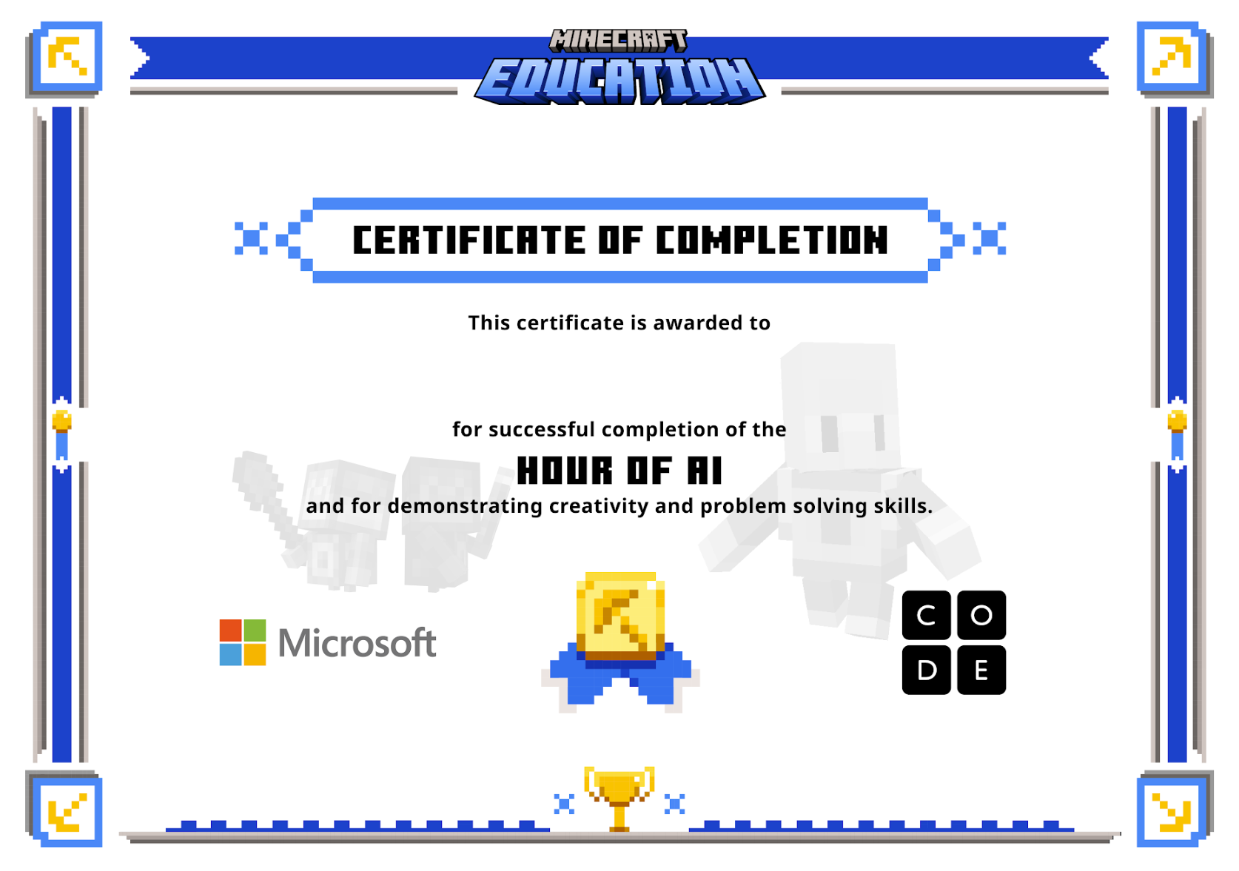
You survived the night!!
Collect your certificate.

Slide 36
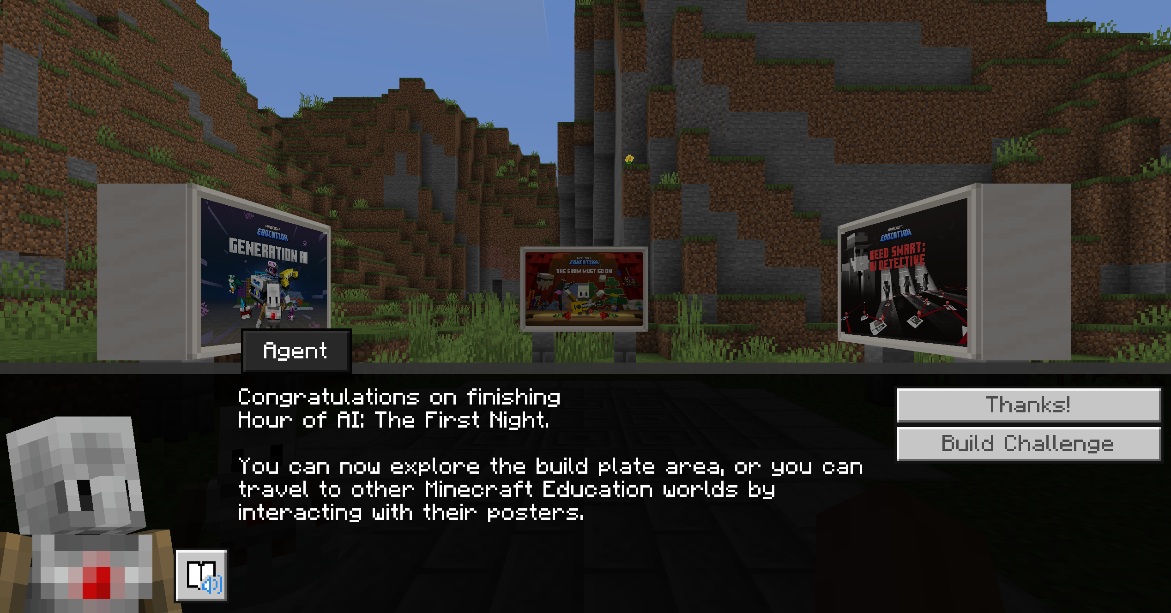
You just trained the Agent to survive the first night—nice work!

Slide 37

Reflection Questions
How do you define artificial intelligence?
Tell us about your favorite part of the game.
How did you train the Agent to help you survive the night?
Why is human verification important when using AI?

Slide 38
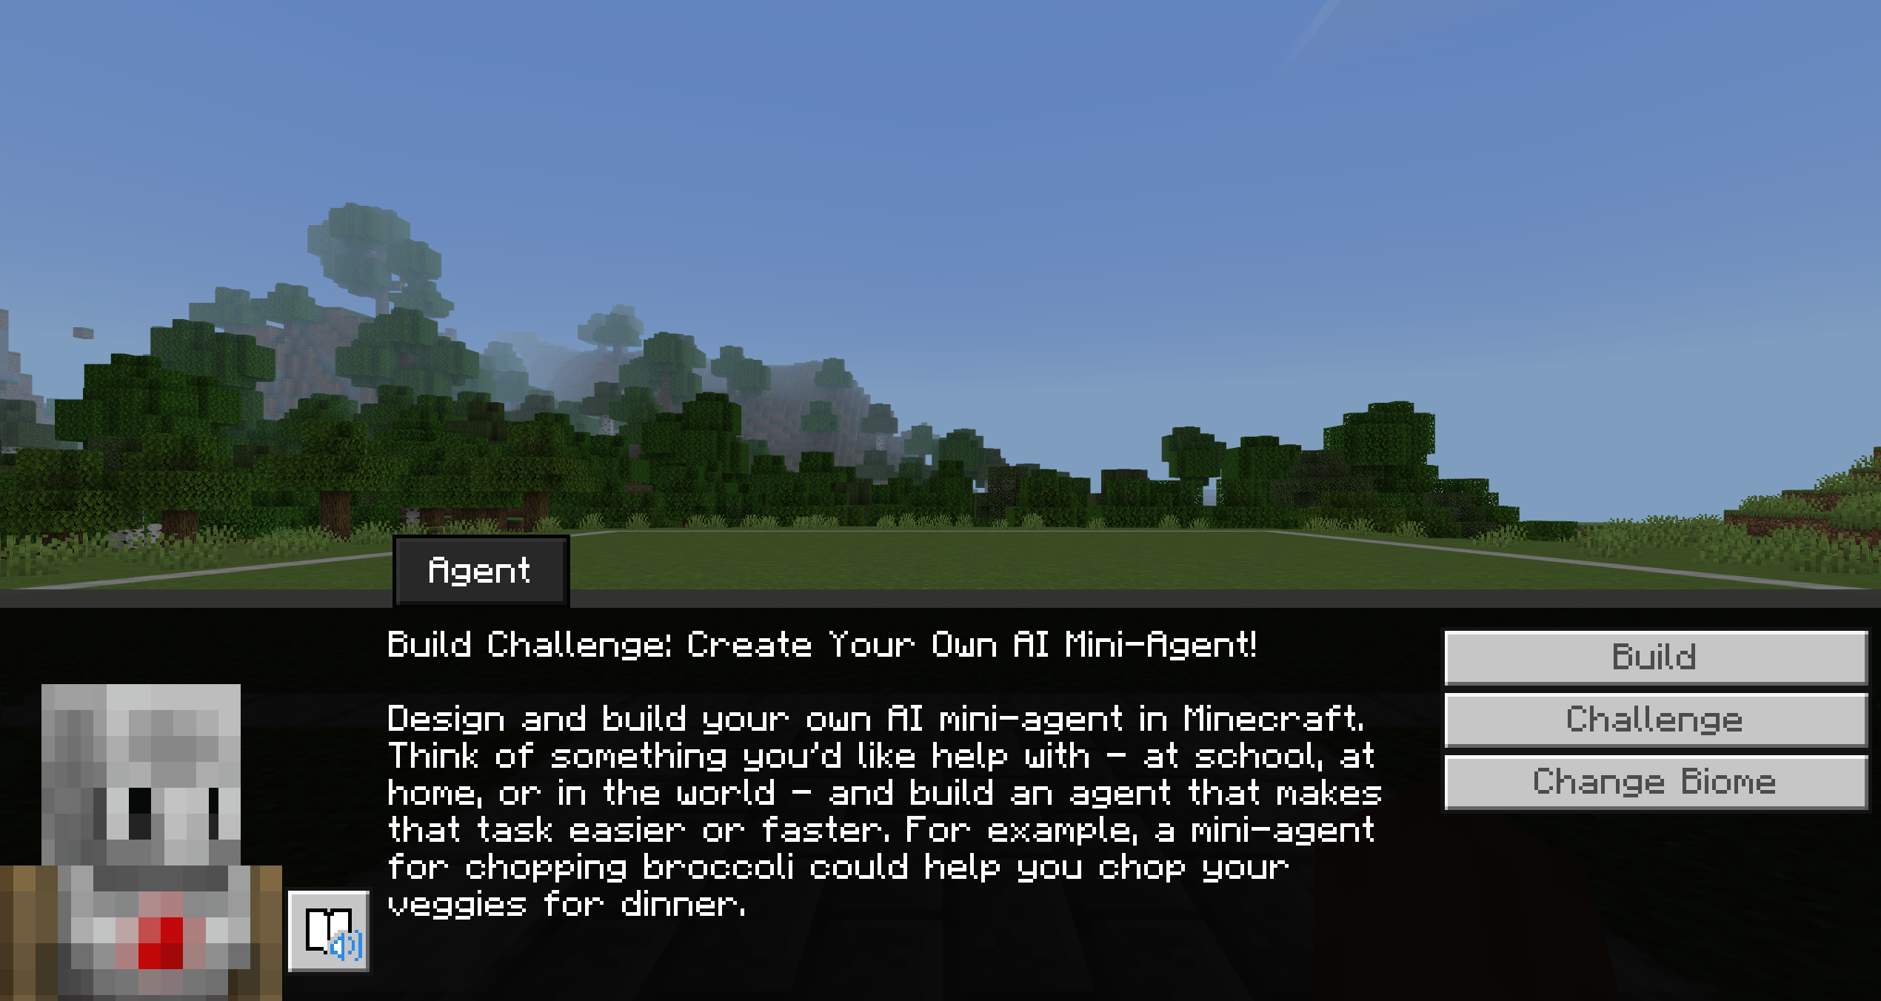
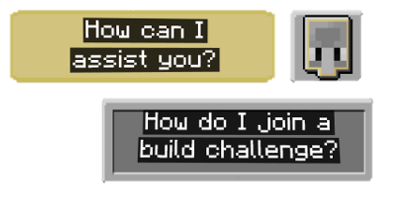
Try the AI Build challenge
Create Your Own Minecraft Agent!
Design your own AI agent to solve a problem in Minecraft, at school, or in your community.

Slide 39

5 Steps to Success
Understand the Problem
Who needs help?
Design Your Agent
Plan what it will Sense, Think, and Do.
Build in Minecraft
Build on the build plate.
Test & Improve
Try two scenarios; fix one thing and re‑test.
Share Your Solution
Show your agent and explain it.
Pick Where Your Agent Helps
In Minecraft: Make the world safer, cleaner, or easier to explore.
At School: Model a helper for the library, cafeteria line, playground safety, or lost-and-found.
In Your Community: Simulate solutions like park clean-ups, bus stop helpers, or water-saving systems.
Show Your Work (in Minecraft!)
Take screenshots of your agent in action with the Camera.
Add pictures + short captions (what it sensed, decided, and did; who it helps) in your Book & Quill.
Record a Short Video (optional) and narrate what your agent does and why it matters.
Responsible AI check: Is it fair, safe, and understandable?
Create Your Own Minecraft Agent!

Slide 40
Thank You for playing Hour of AI :
The First night

