Slide 1
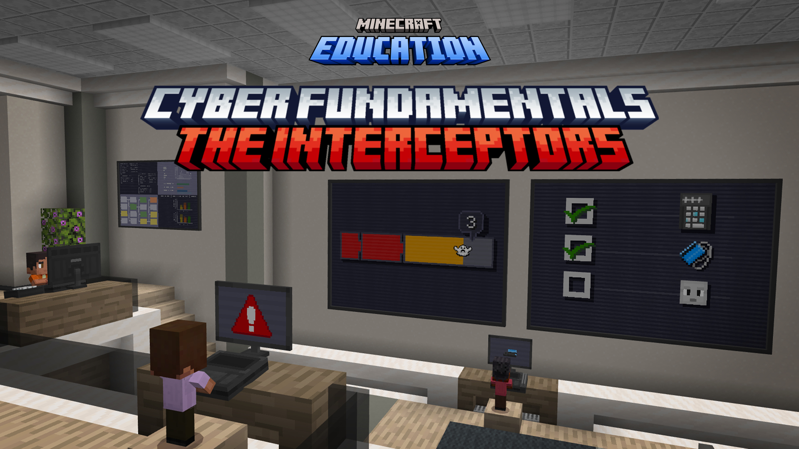

Slide 2

Lesson 1
Authentication

Slide 3
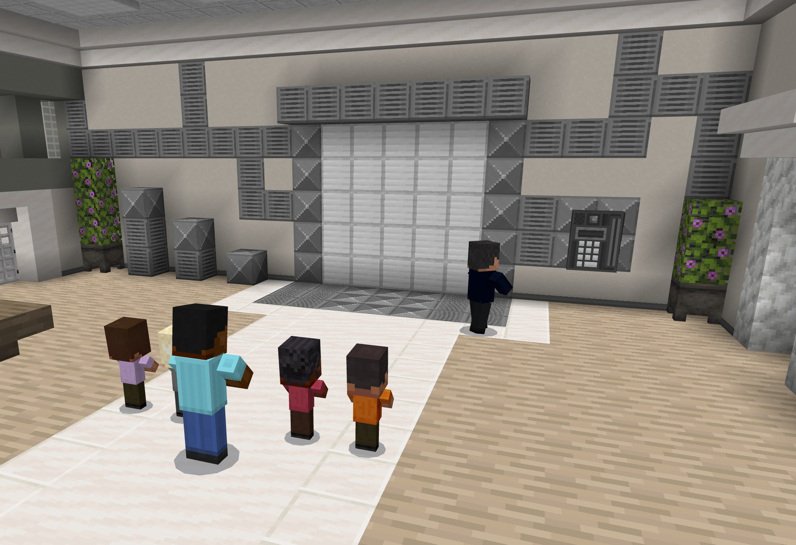
Getting started
Welcome back!
Today, you are going visit a Security Operations Center (SOC). A Cybersecurity expert will be your official guide!

Slide 4
What will we learn in this activity?
  I will define the concept of authentication.
  I will explain why authentication is important in cybersecurity.
  I will describe how multi-level authentication works.
  I will provide real examples of multi-level authentication.

Slide 5
Action items
In this lesson, you will:
Learn about multi-factor authentication
Find and utilize different types of authentication
As you are working, you should be looking for the definitions to record in your workbook:
      authentication
      multi-level authentication
      passwords
      keycards
      biometrics

Slide 6
Let’s play!
Log into Minecraft Education

Slide 7
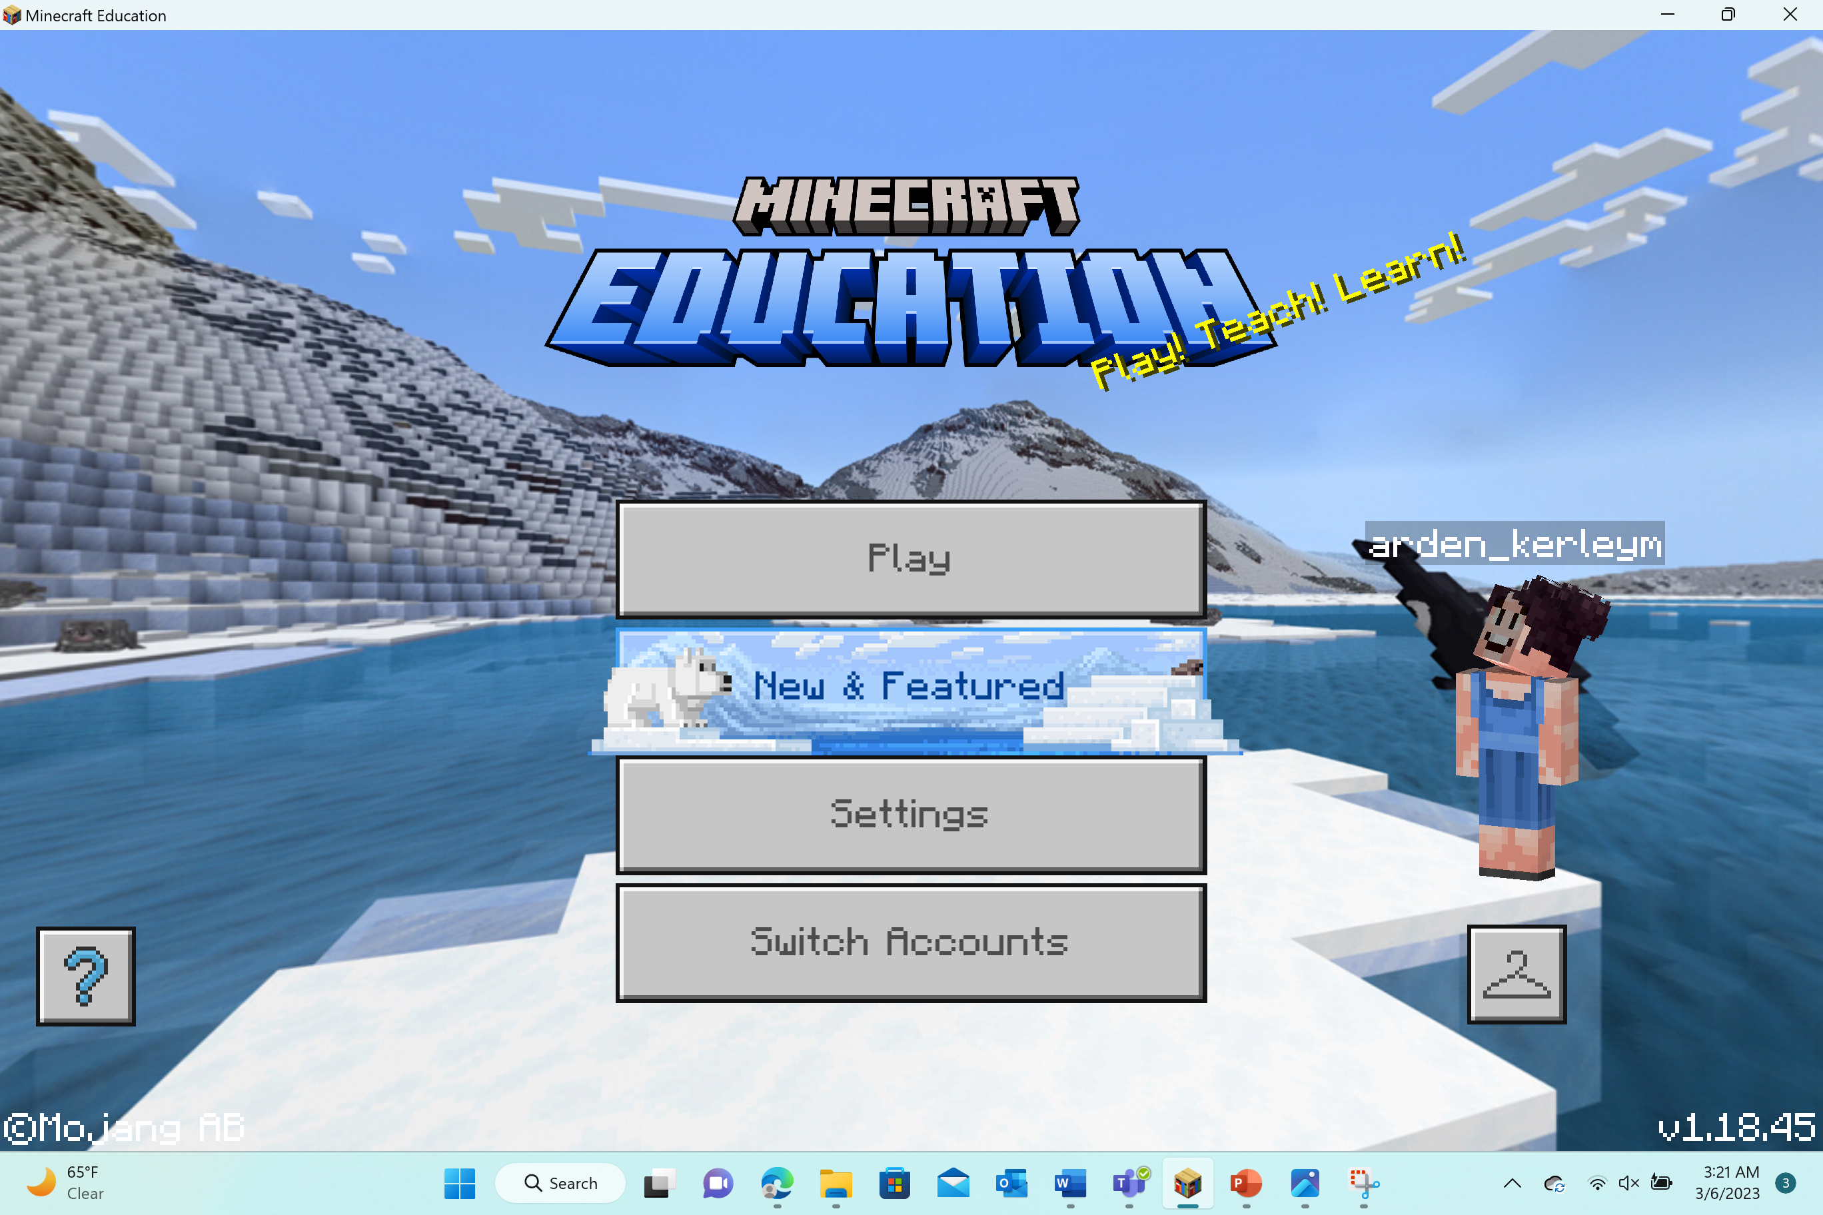
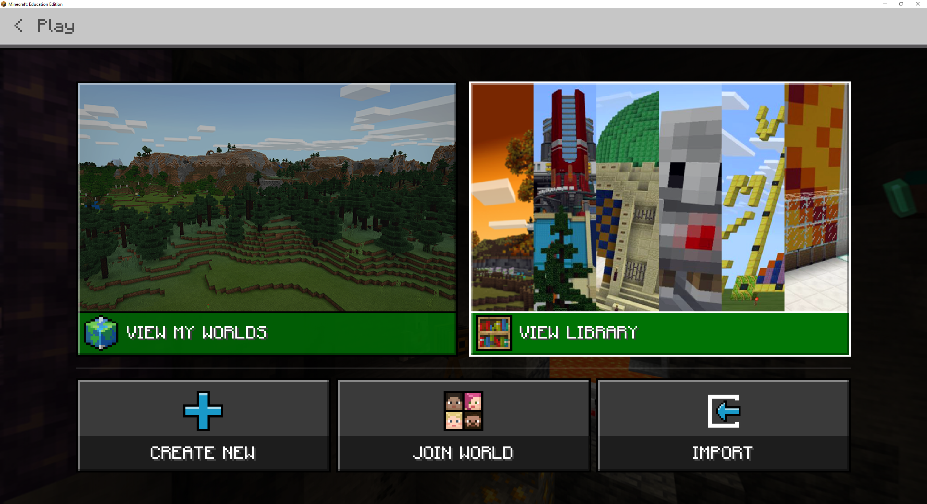
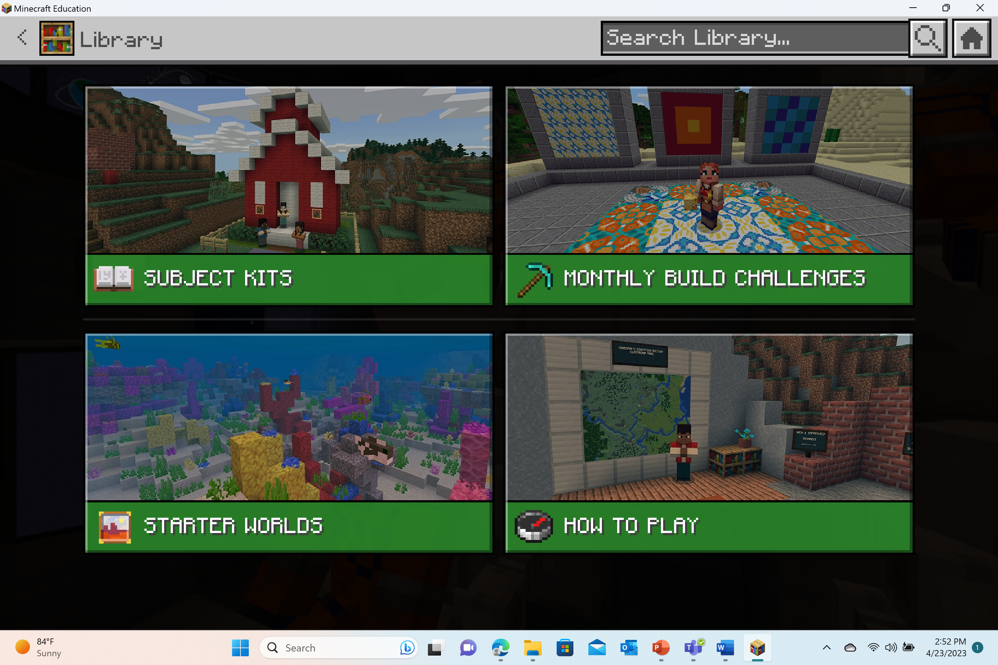



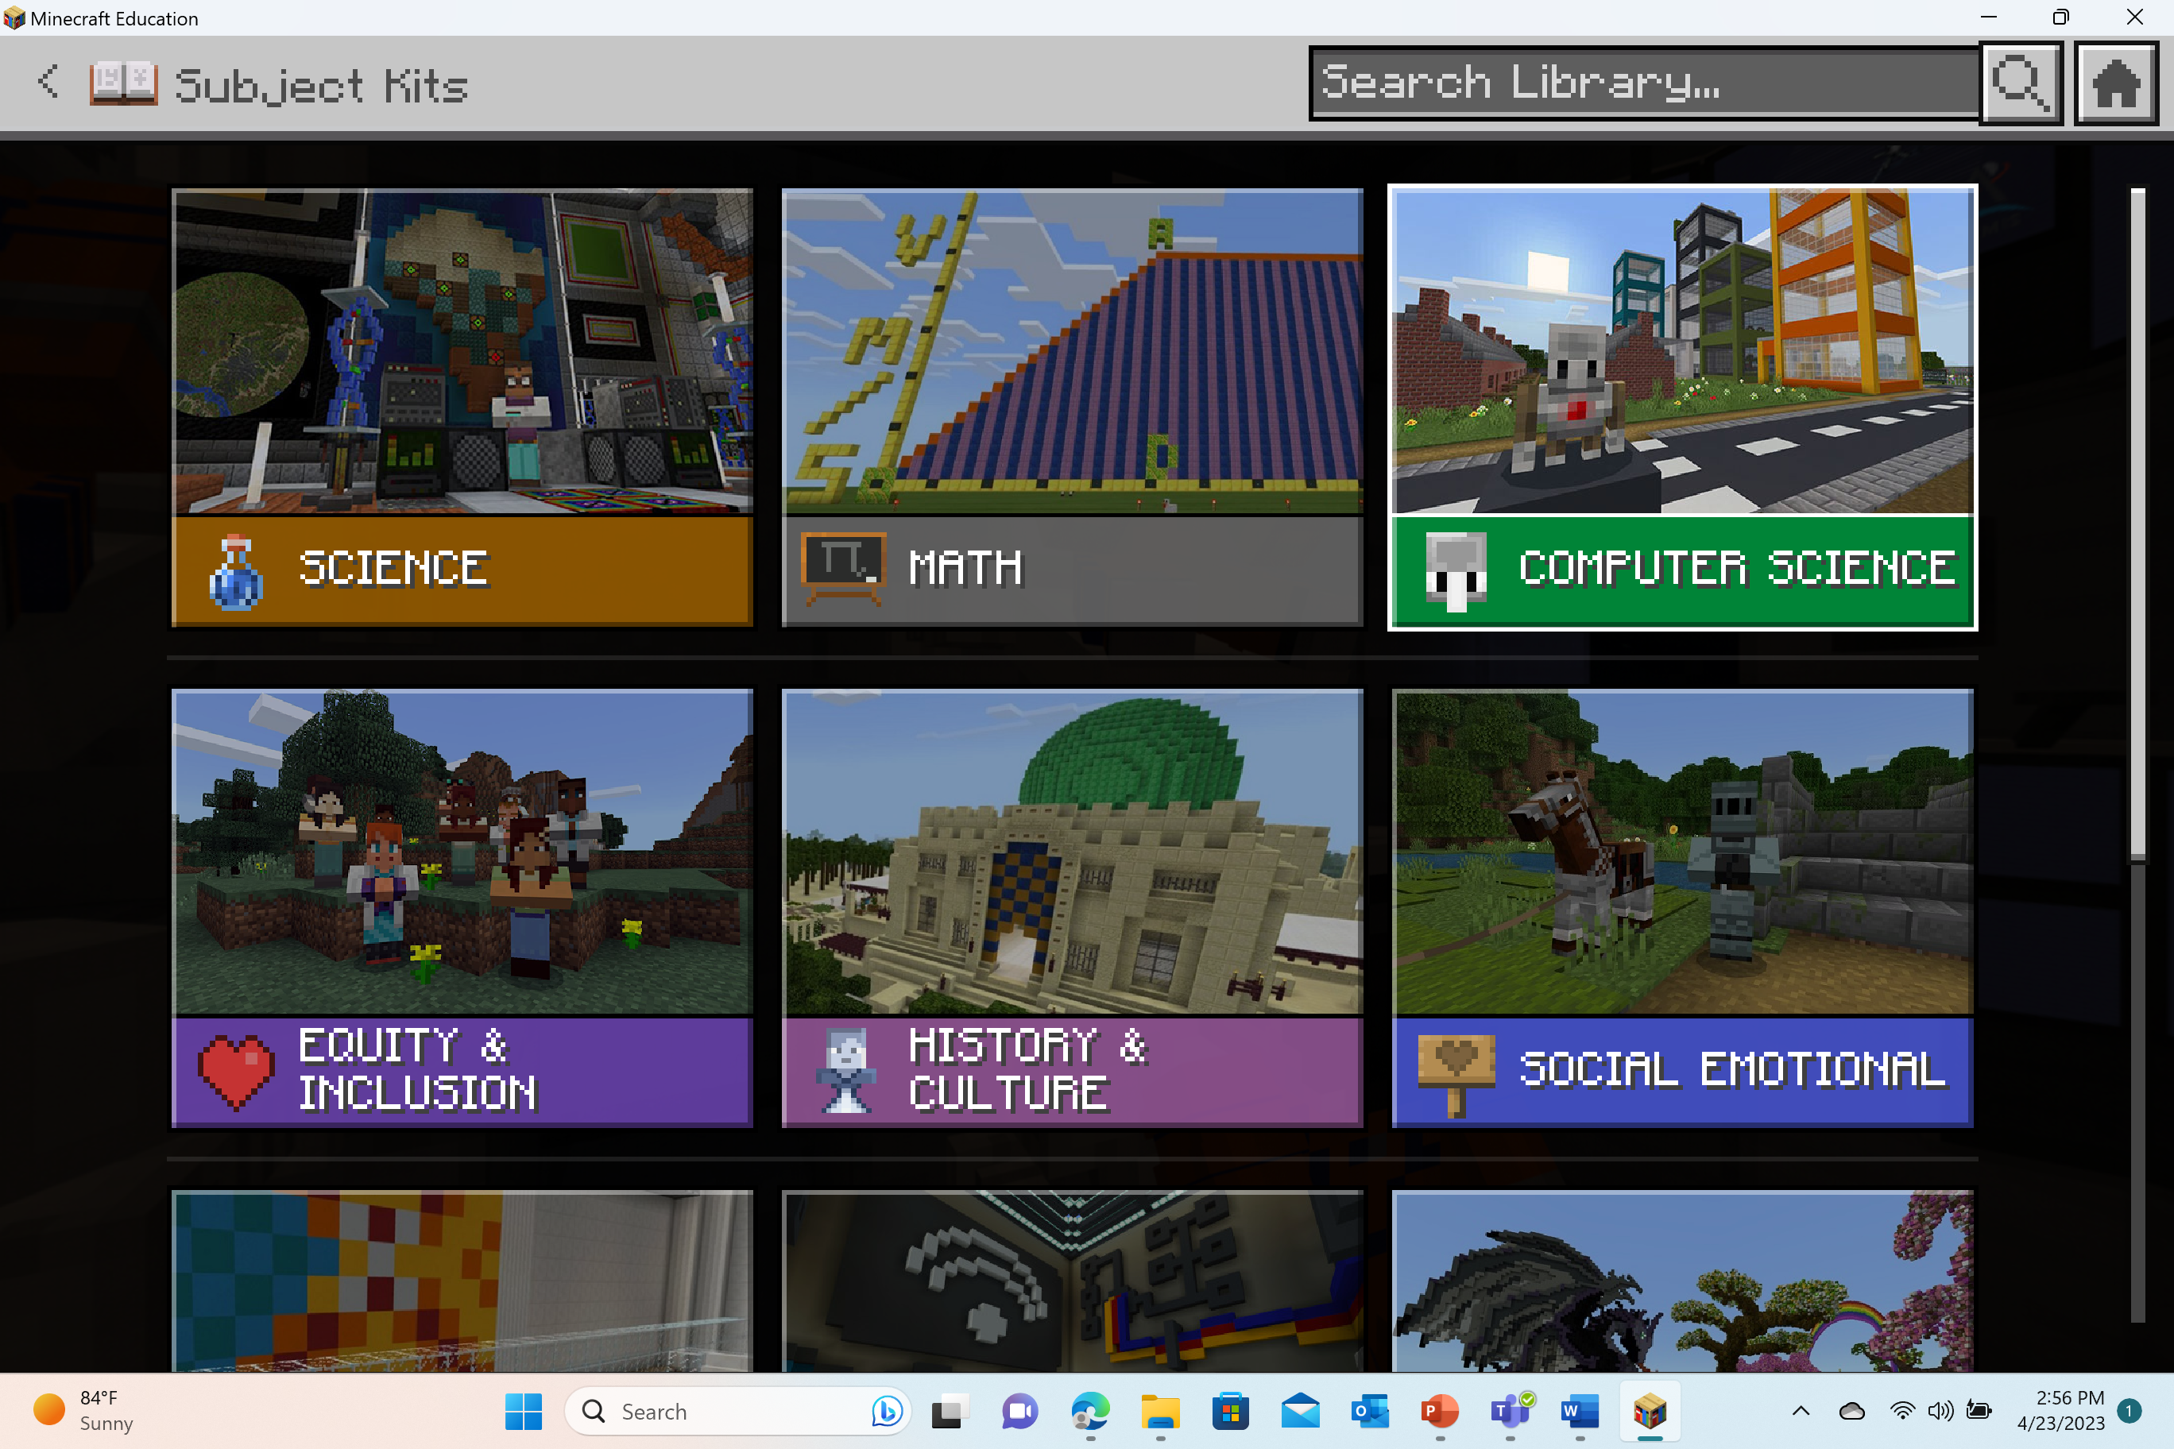
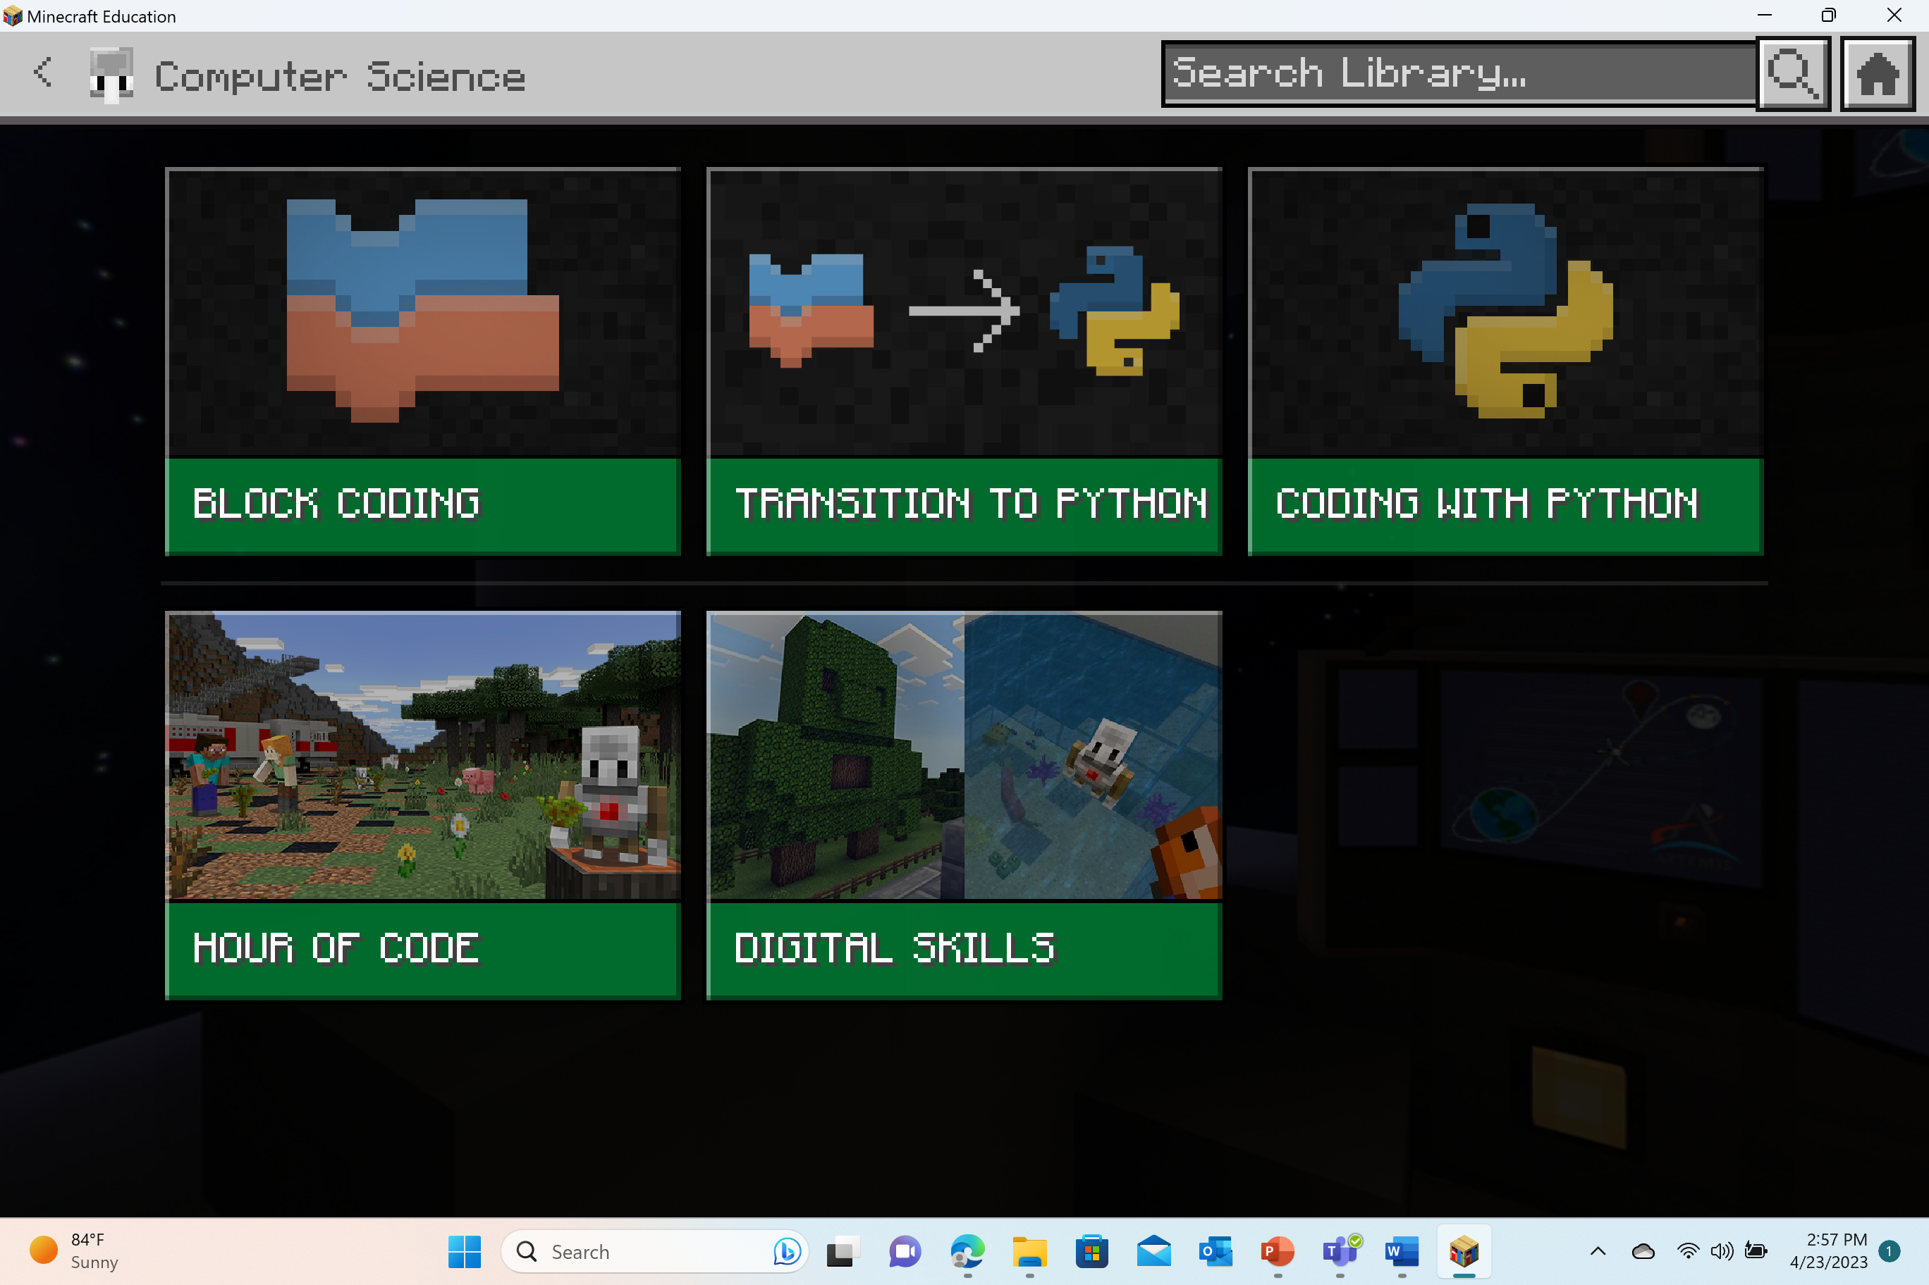
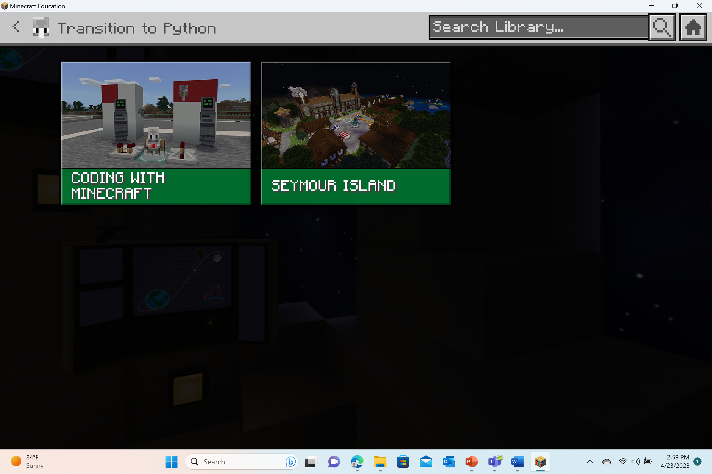
Launch the Cyber Fundamentals world
Select “Play”
Select “View Library”
Select “Subject Kits”
PLACEHOLDER
Select “Computer Science”
Select “Digital Skills”
Select “Cyber FUNdamentals”

Slide 8
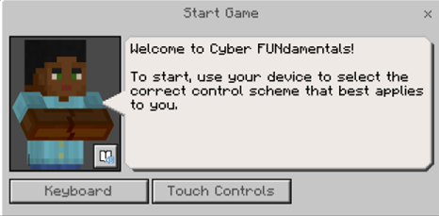
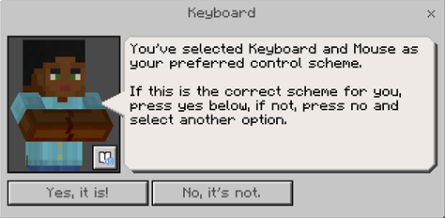
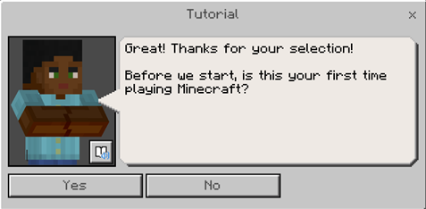
Beginning Game Play
The first dialog box will prompt you to select your control scheme: keyboard OR touch controls.
The second dialog box will have you confirm your selection with “Yes, it is!” or “No, its not.”
The third dialog box will ask if it’s your first-time playing Minecraft. If it is your first time, a follow-up question of would you like to participate in a tutorial.
Otherwise, if you answer “No”, you will move directly into game play and skip the tutorial sequence.

Slide 9
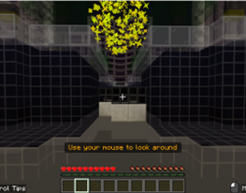
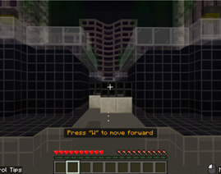
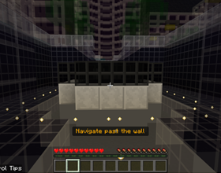
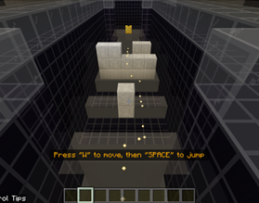
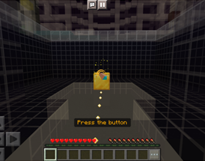
Tutorial Sequence
Look at the golden orbs
Practice moving
Navigate past the wall
Practice jumping
Press the button

Slide 10

Check for understanding
What is multi-factor authentication?
What are some examples of multi-factor authentication?
Where in your life could multi-factor authentication make things safer?

Slide 11
Lesson 2
Incident Response Team

Slide 12
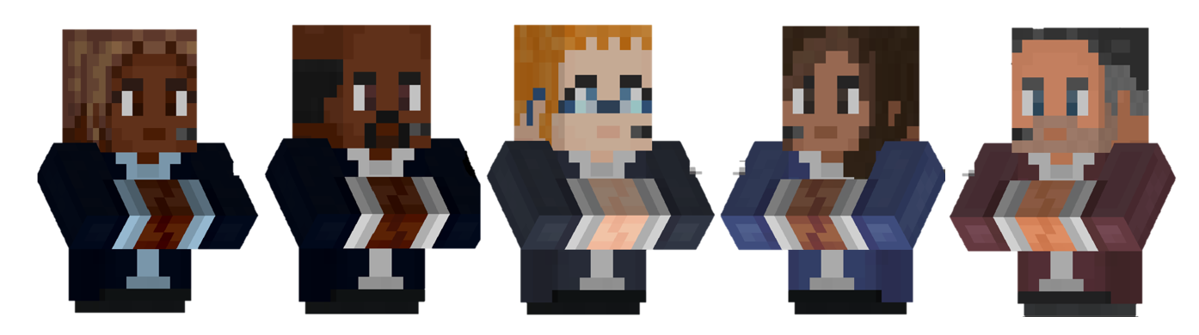
Getting started
Welcome back!
Today, you are going to need to work to assemble an Incident response team to respond to the cyber attack!

Slide 13
What careers & jobs are in cybersecurity?
2
THINK
SHARE
PAIR
1
3

Slide 14
What will we learn in this activity?
  I will articulate what is an incident response team.
  I will describe the roles and responsibilities of the incident response team members.
  I will explain how the incident response team handles a cybersecurity incident.

Slide 15
Action items
In this lesson, you will:
Learn what is an Incident Response Team, who is on this team, and how they respond when there is a cyber attack
As you are working, you should be looking for the definitions to record in your workbook:
      Incident Response Lead
      Analyst
      Forensics
      Engineer
      Communications Specialist
      Cybersecurity Legal Expert

Slide 16
Let’s play!
Log into Minecraft Education

Slide 17
Launch the Cyber Fundamentals world
Select “Play”
Select “View Library”
Select “Subject Kits”
PLACEHOLDER
Select “Computer Science”
Select “Digital Skills”
Select “Cyber FUNdamentals”

Slide 18
Beginning Game Play
The first dialog box will prompt you to select your control scheme: keyboard OR touch controls.
The second dialog box will have you confirm your selection with “Yes, it is!” or “No, its not.”
The third dialog box will ask if it’s your first-time playing Minecraft. If it is your first time, a follow-up question of would you like to participate in a tutorial.
Otherwise, if you answer “No”, you will move directly into game play and skip the tutorial sequence.

Slide 19
Tutorial Sequence
Look at the golden orbs
Practice moving
Navigate past the wall
Practice jumping
Press the button

Slide 20
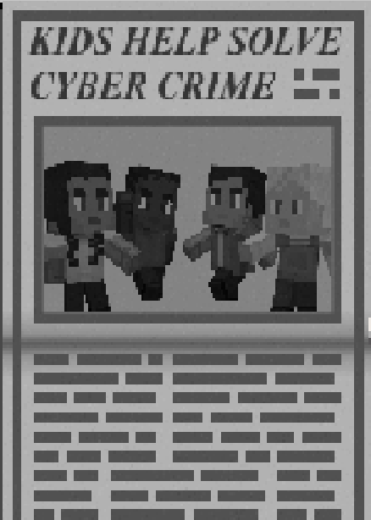
Check for understanding
What is an incident response team?
What are some of the roles of an incident response team and what do they do?
In your own words, describe what happens when a cybersecurity incident is detected.

