Slide 1
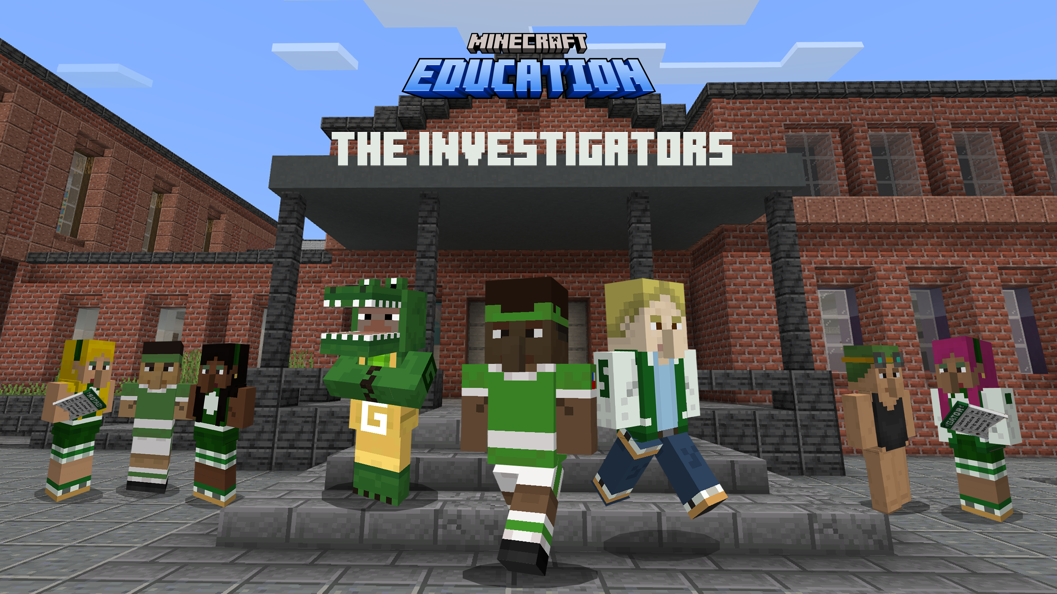

Slide 2
The Investigators provides learners with an educational experience that improves their ability to critically evaluate information they consume.
Through three scenarios, learners will learn:
Understanding why information may have been created (e.g., for entertainment, to document events, for advertising purposes etc.)
How to spot potentially untrustworthy information (e.g., false cause, cherry-picked information, personal attacks etc.)
What actions they can take when identifying information they don’t trust (e.g., pausing or stopping the sharing of misinformation, validating sources and seeking alternative viewpoints etc.)
Learning Objectives

Slide 3
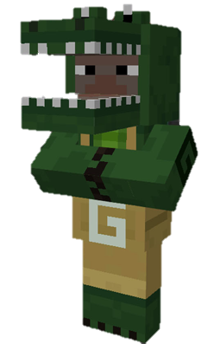
I will learn why some stories or articles are made, like for fun, to share news, or to sell things.
I will find out how to spot information that might not be true, like when only one side of a story is told or when someone is being mean to make a point.
I will know what to do when I see something I think might not be true, like waiting before I share it, checking if it's true, or looking for other sides of the story.
I will..

Slide 4
The Investigators provides learners with an educational experience that improves their ability to critically evaluate information they consume.
Through three scenarios, learners will learn:
Understanding why information may have been created (e.g., for entertainment, to document events, for advertising purposes etc.)
How to spot potentially untrustworthy information (e.g., false cause, cherry-picked information, personal attacks etc.)
What actions they can take when identifying information they don’t trust (e.g., pausing or stopping the sharing of misinformation, validating sources and seeking alternative viewpoints etc.)
Learning Objectives

Slide 5
I will learn why some stories or articles are made, like for fun, to share news, or to sell things.
I will find out how to spot information that might not be true, like when only one side of a story is told or when someone is being mean to make a point.
I will know what to do when I see something I think might not be true, like waiting before I share it, checking if it's true, or looking for other sides of the story.
I will..

Slide 6
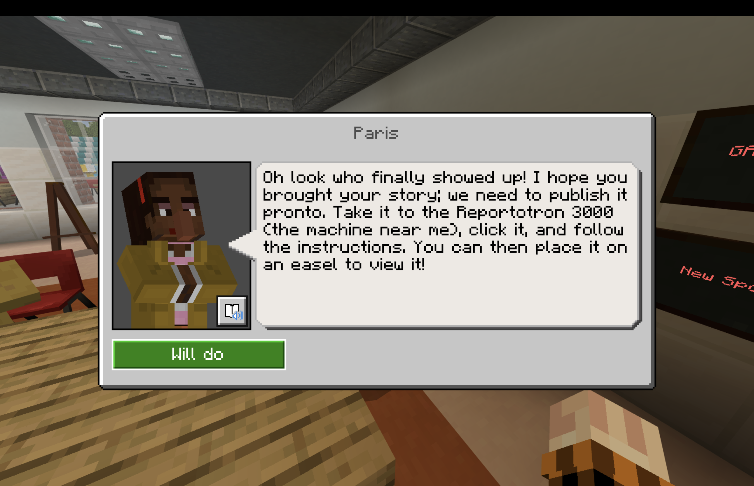
The Investigators!
The game is set in a school where the learner is a school website reporter.
There are three stories for the learner to report on:
Sustainability Score Plummets
New Sport Divides Campus
Electoral Candidate Hacked!
The stories can be played through in which ever order is preferred.
There are accompanying lesson plans and materials that educators can use for each of the three stories as well as an introductory lesson that can be used pre-game to introduce learners to key themes before they begin game play.

Slide 7
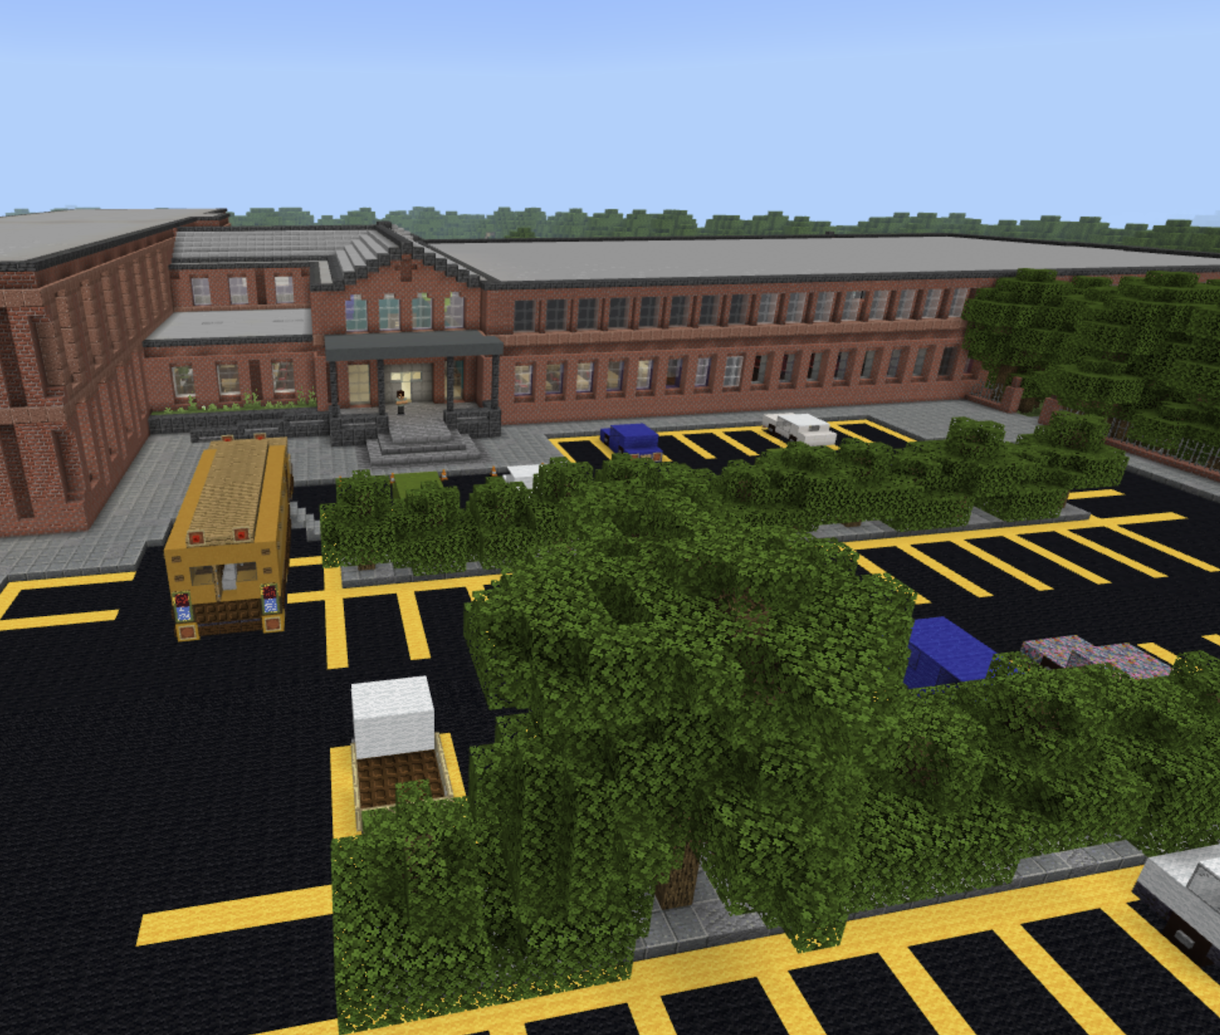

GAME PLAY
Each of the three stories will take the learner to different locations in the school.
For some of the stories the learner will visit new locations, but the majority takes place here.
There are many NPCs (non-learner characters) for the learner to interview.
The learner will be in the role of a student reporter for their school's website.
Each story is different, and it is up to the learner to break the case wide open!

Slide 8
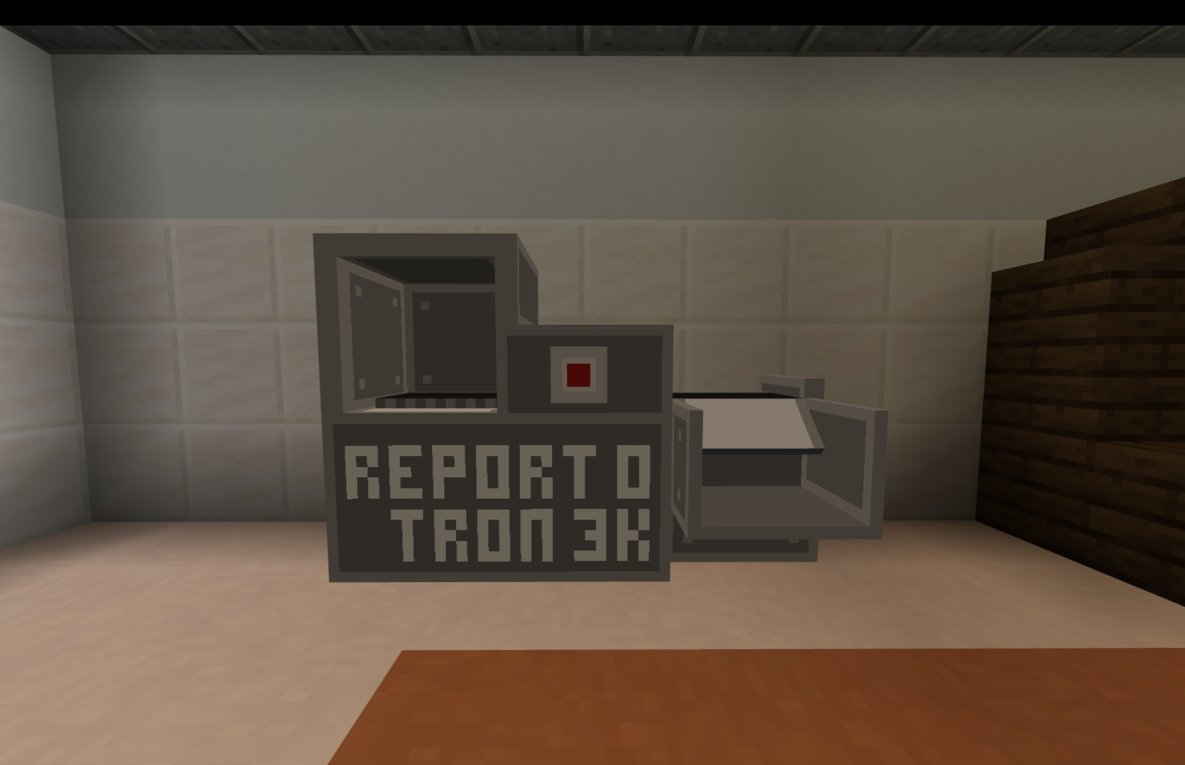


GAME PLAY
How to submit a story!
When the learner first arrives at the high school, they will be greeted by Joe who will give them a story of theirs that he proofread.
The learner will then head into the editor’s office, speak to Paris, and she will ask the learner if they are ready to hand in their article.
They can then take it to the Report-O-Tron 3000 (pictured here). This machine will give them the finished article. The learner then takes that article and places it on one of the available easels in the room to see it!
The learner will be doing this at the end of each story, so the first is just a tutorial, for practice.

Slide 9
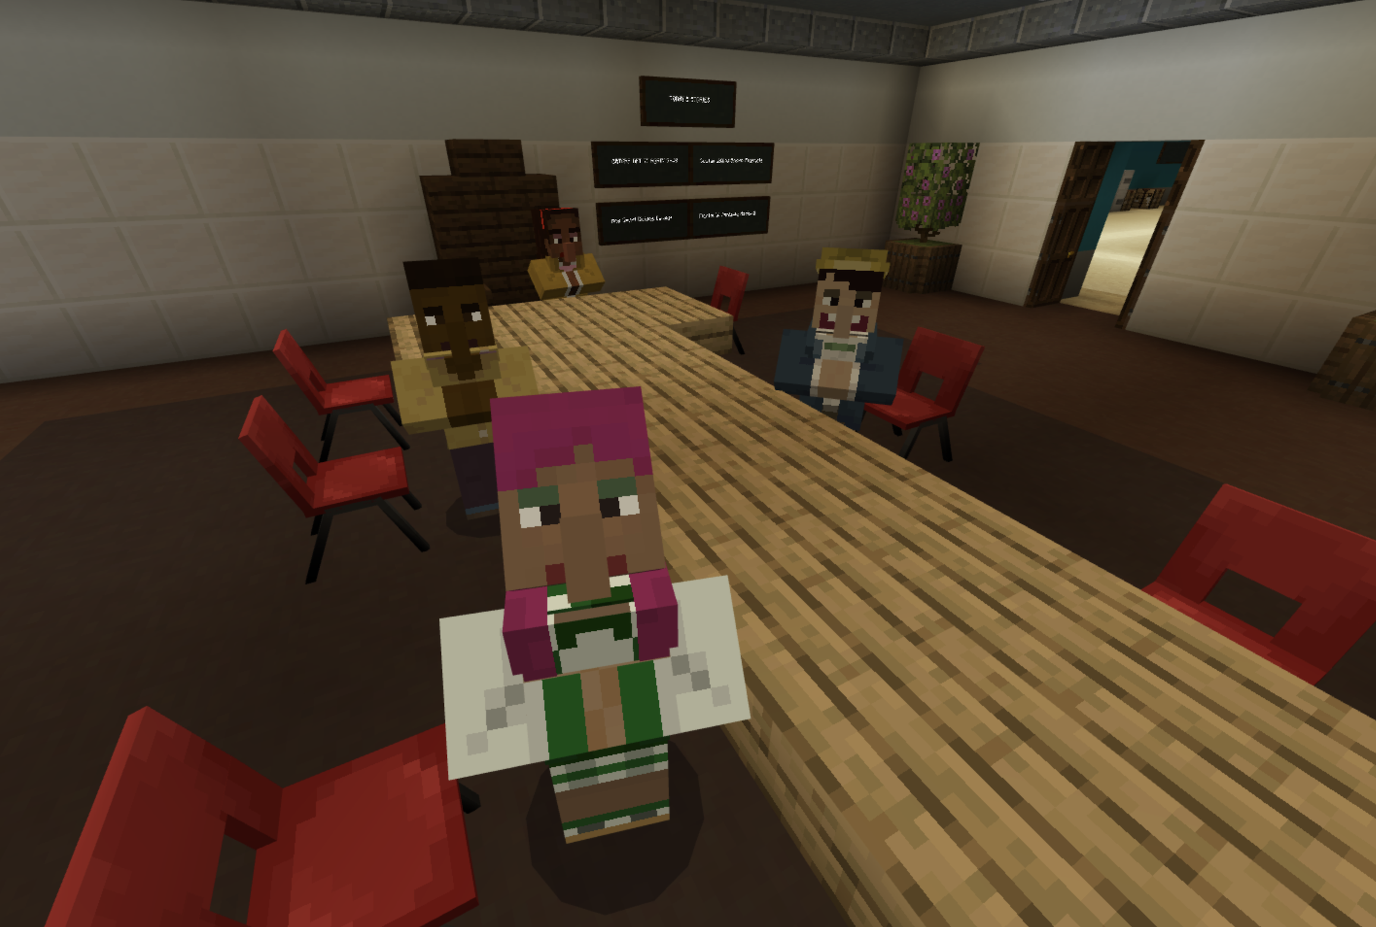
GAME PLAY
How to start each story
After submitting Joe's story, learners can start a new one.
Choose a story by selecting Sam (sustainability), Yas (sport), or Riz (hacking) in the room.
Click on the chosen story NPC or Paris for additional details.
Learners have a cell phone and a reporter's note in their inventory for guidance.
The cell phone will provide periodic updates throughout the story.

Slide 10
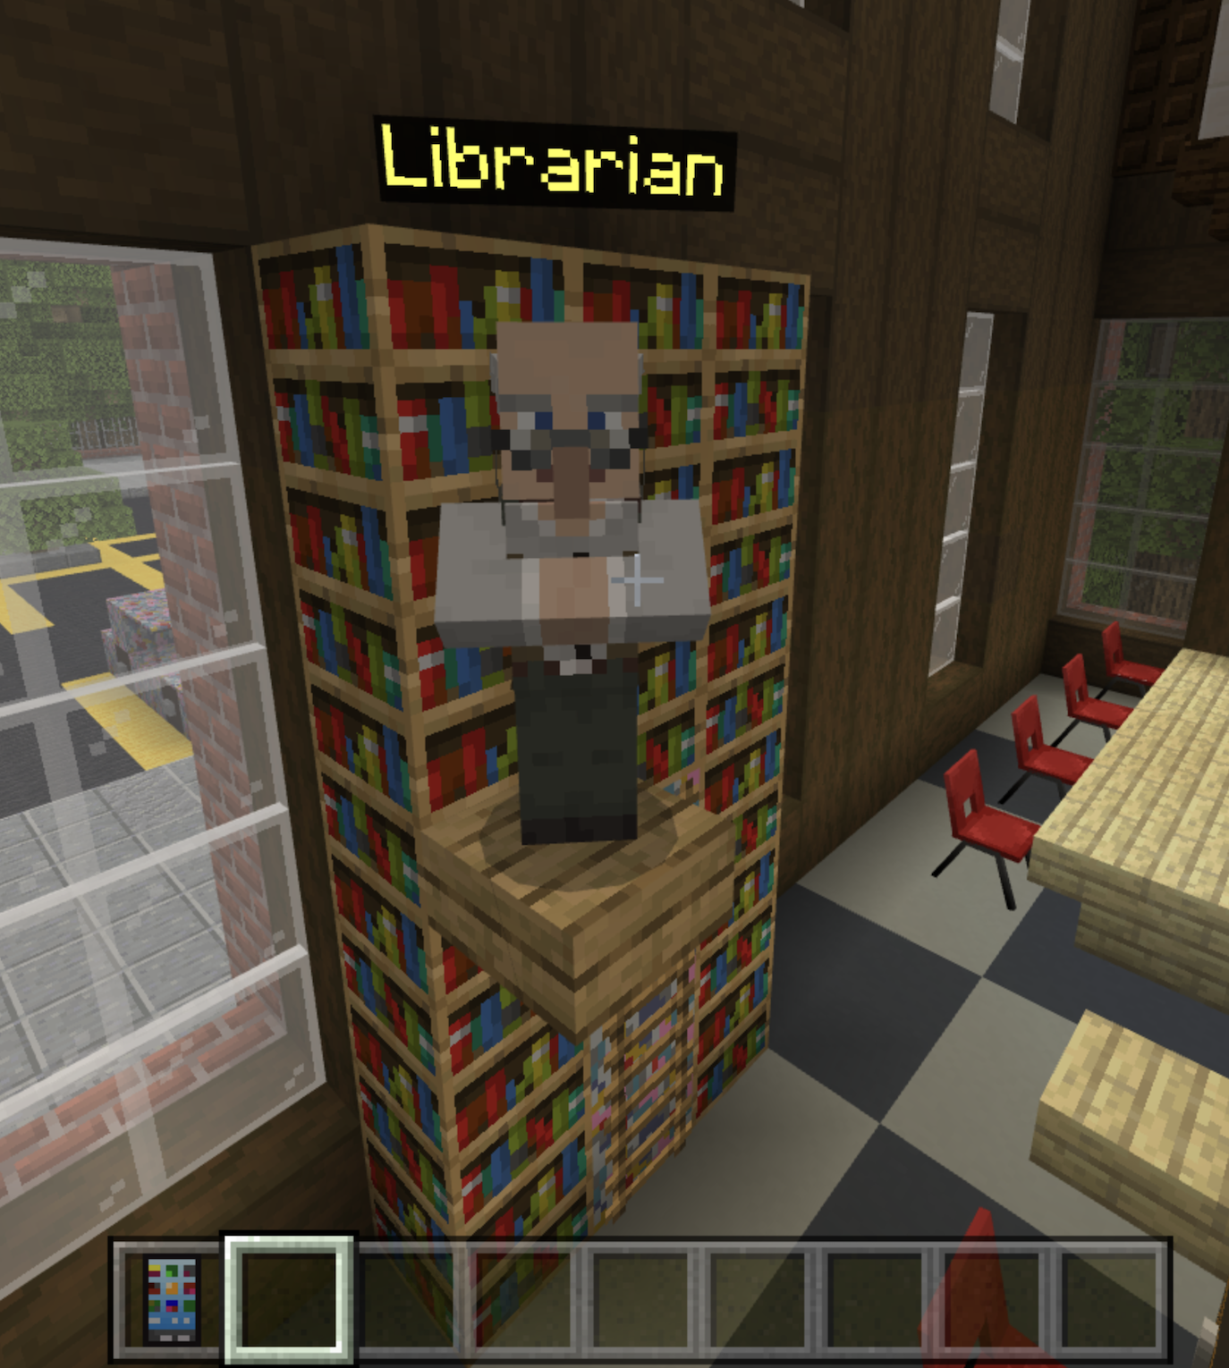
GAME PLAY
Exploring Story 1 - Sustainability
Choose Sam to begin the sustainability story and read all info from NPCs, checking the reporter's notebook often.
The story unfolds outside the editor's office, in the corridor, and classrooms. Follow Sam's instructions on who to interview next.
Pay attention to countdowns on the right, indicating the number of interviews or tasks left. If an NPC won't speak, it means someone was missed.
Throughout the story, Sam will call with directions and tasks; read everything and monitor tasks using the countdowns.
Once done, Sam instructs to publish the story. Go to the editor’s room, talk to Paris, and use the Report-O-Tron 3000 to finalize the article.

Slide 11
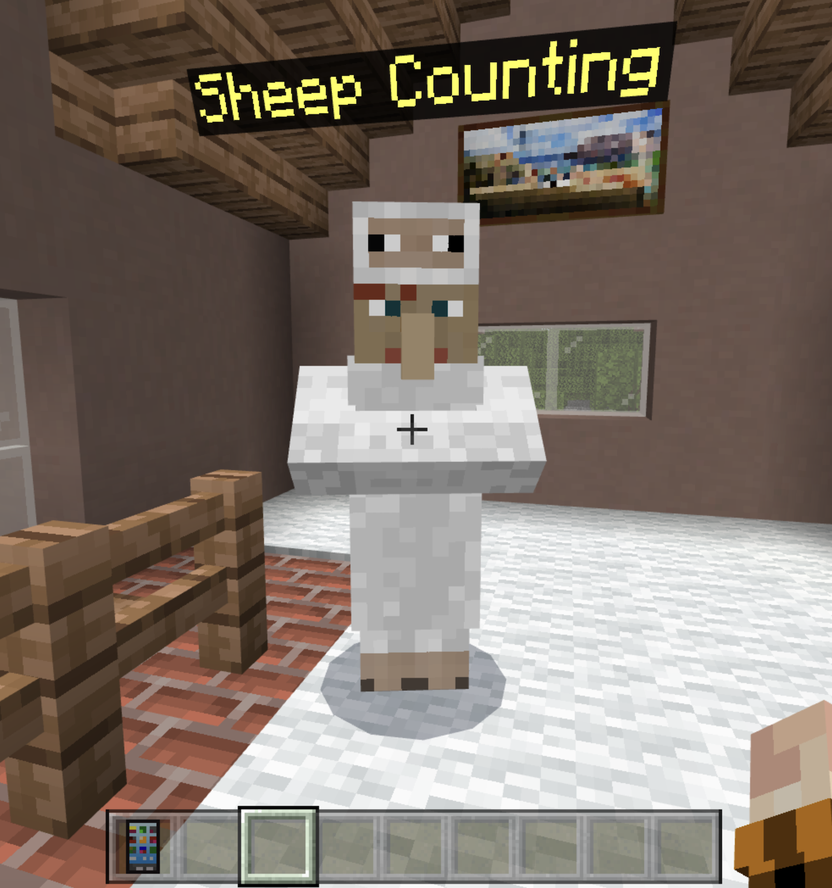
GAME PLAY
Exploring Story 2 - Sports
Choose Yas to start the sports story, reading all information from NPCs and frequently checking the reporter's notebook.
The story unfolds on the field behind the school; exit the editor's office and head left to meet the guide NPC and conduct interviews, using the countdown for guidance.
Yas will call with updates and next steps throughout the story.
After initial interviews, play each sport in sequence: Archery, Penalties, Diving, and Sheep Counting. For diving and sheep counting, locate the school buses past the stands.
Upon completion, Yas directs to publish the story. Return to the editor’s room, speak with Paris, and use the Report-O-Tron 3000 to finalize the article.

Slide 12
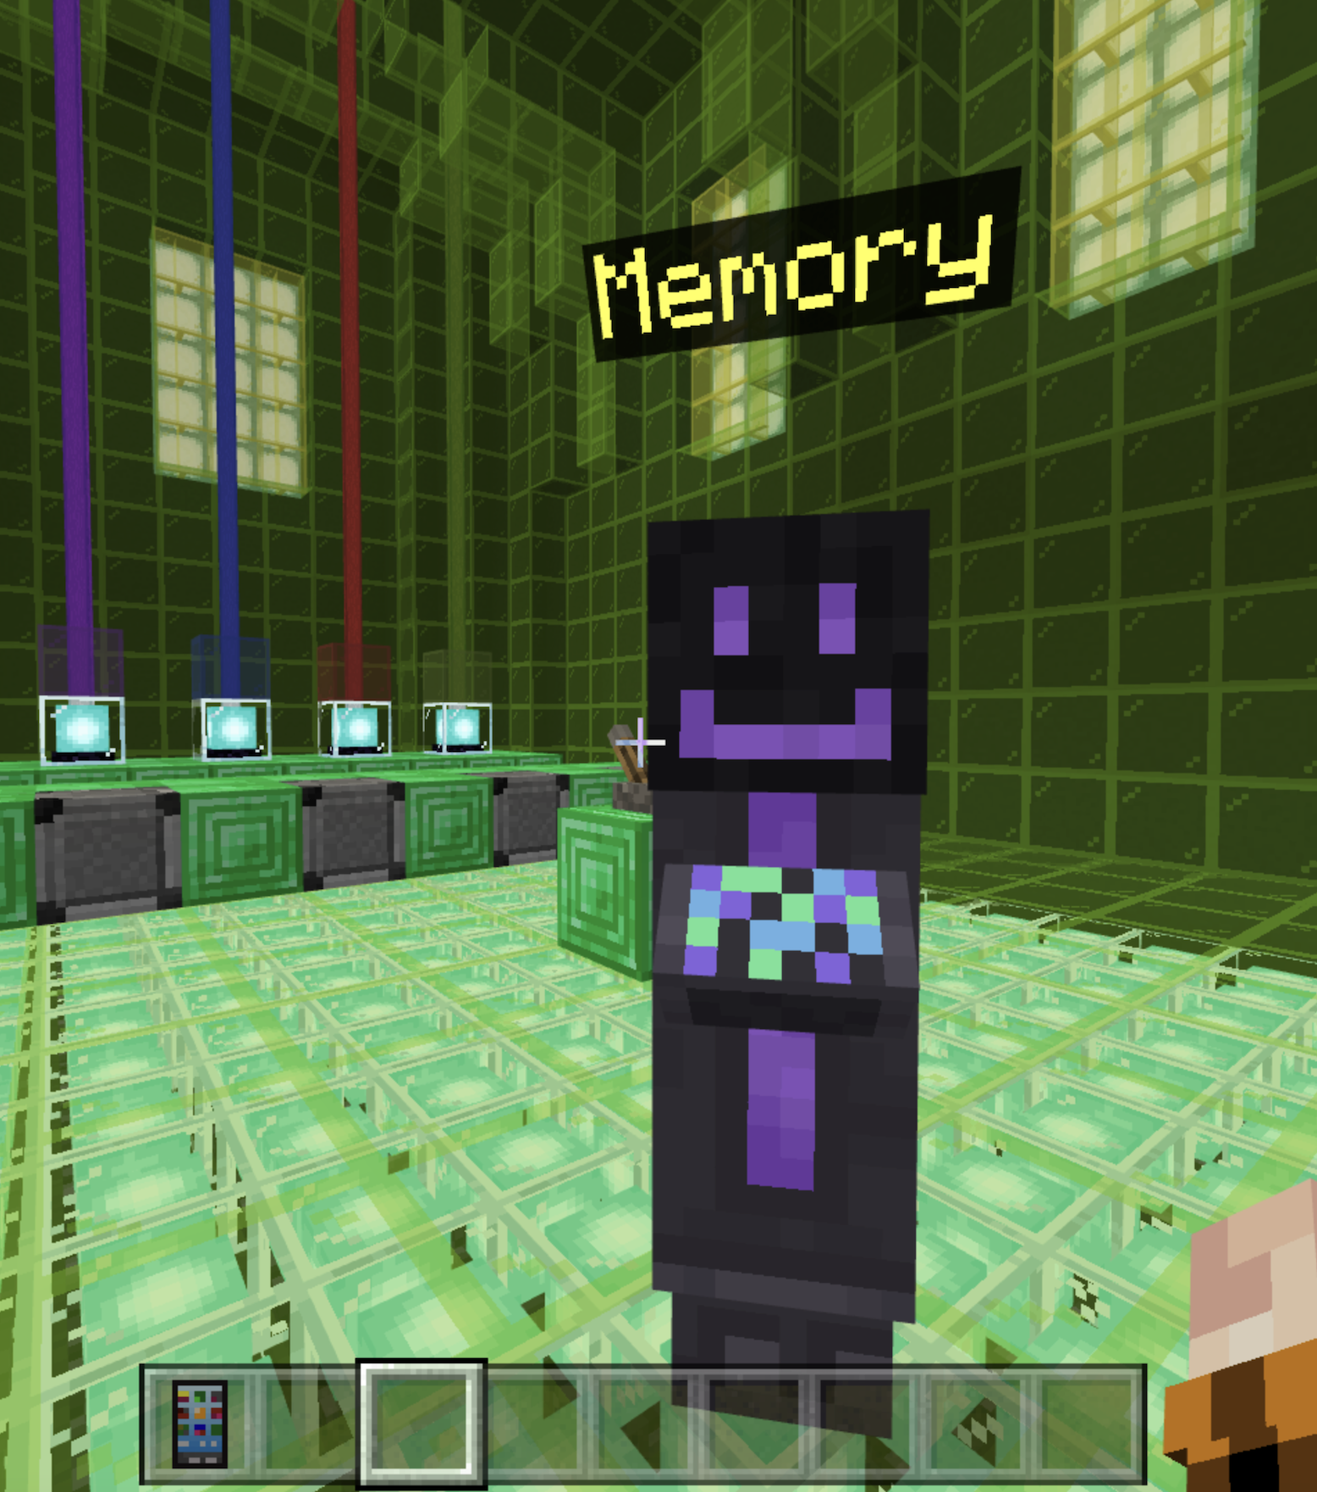
GAME PLAY
Exploring Story 3 – Election Scandal
Choose Riz to embark on the election story. Ensure all info from NPCs is read and the reporter's notebook is checked frequently.
The story setting is the corridor and classrooms left of the editor's office. Start by locating the IT Guy and proceed with interviews, using the countdown for guidance. Check accessible classrooms if someone seems missing.
Riz will provide updates and instructions via phone calls throughout the story.
Dive into various computer systems during the story, completing minigames to collect evidence and uncover the truth.
Upon story completion, Riz directs to publish the article. Return to the editor's room, confer with Paris, and use the Report-O-Tron 3000 to finalize.

Slide 13

Reflection
  What was your favorite part of The Investigators?
  What should you be thinking about when reading something online?
  Why is it important to get all the information before sharing information online?
  How can you tell the difference between fact and opinion?
  How will you respond when you find information that you cannot trust?

