Slide 1
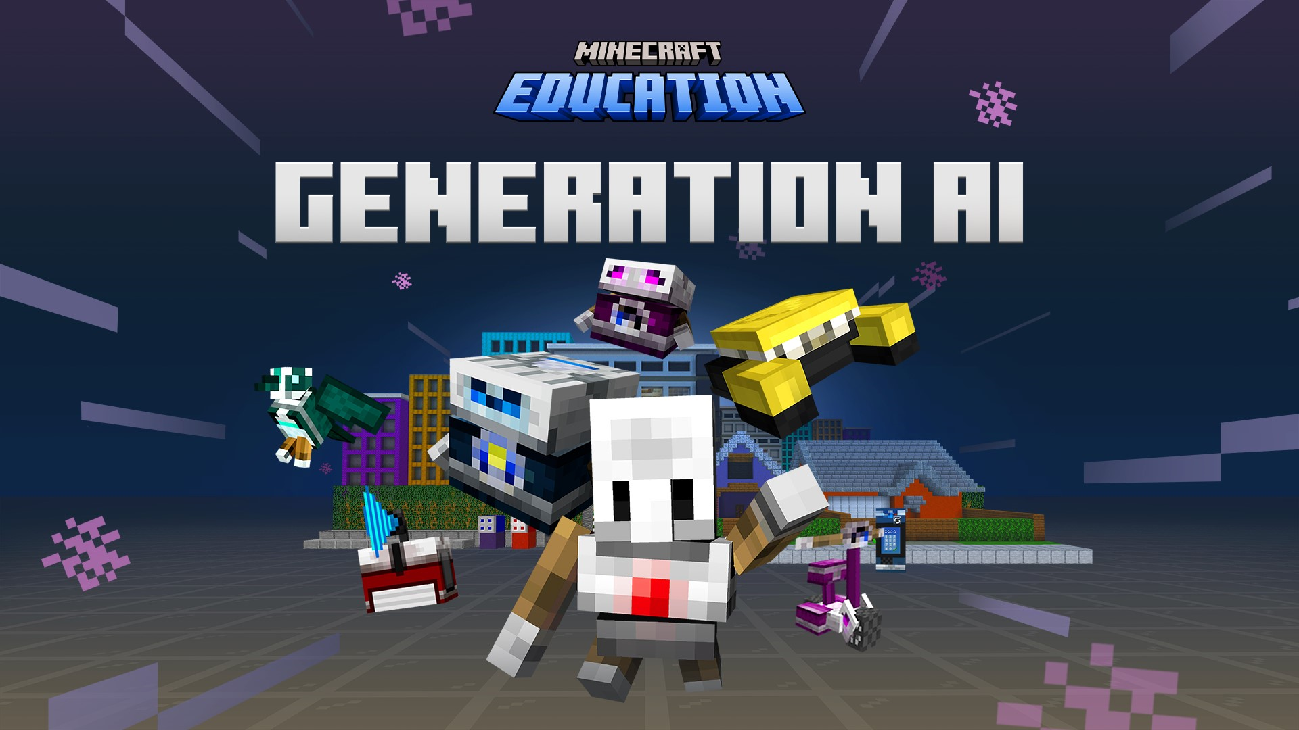

Slide 2
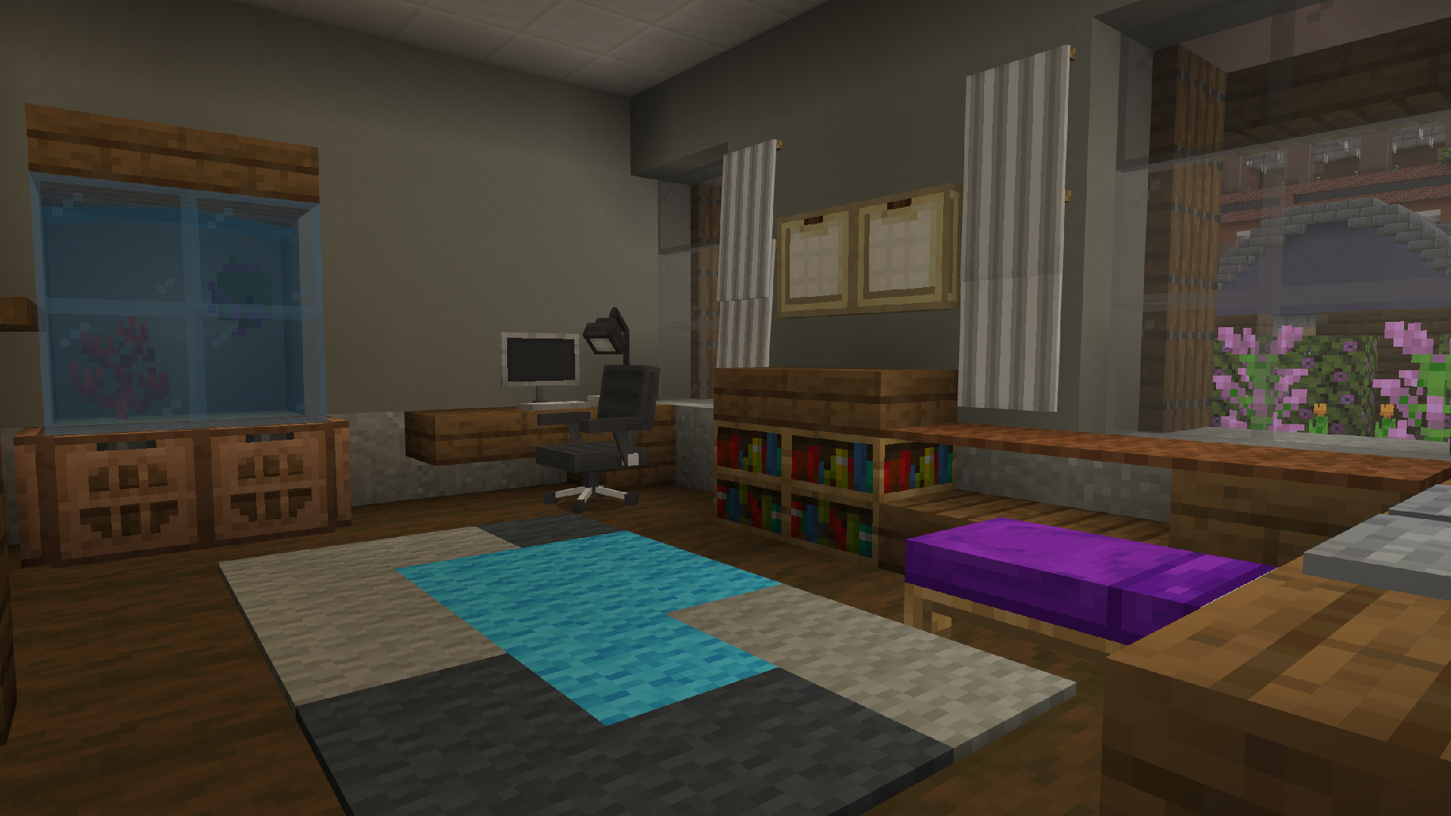

Getting started
Welcome!
Apparently, there are Artificial intelligence (AI) projects without responsible AI principles in this Minecraft world…

Slide 3

Hour of Code 2023: Generation AI Trailer

Slide 4
What is Artificial intelligence?
2
THINK
SHARE
PAIR
1
3

Slide 5


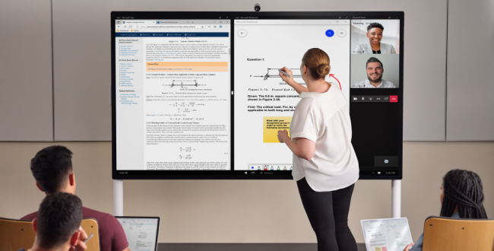
Artificial intelligence isn't magic… It's just code!
AI is like teaching a computer to think and learn! It's used in many things we see and use every day…

Slide 6
What will we learn Today?
  I will describe what artificial intelligence (AI) is and where we see it in the world around us.
  I will identify and explain the rules for using AI the right way.
  I will use coding to think like a computer and solve puzzles step by step.
  I will learn about how AI choices can impact people.
  I will apply what I have learned to understand more about careers that use AI and computer science.

Slide 7
Let’s play!
Log into Minecraft Education

Slide 8
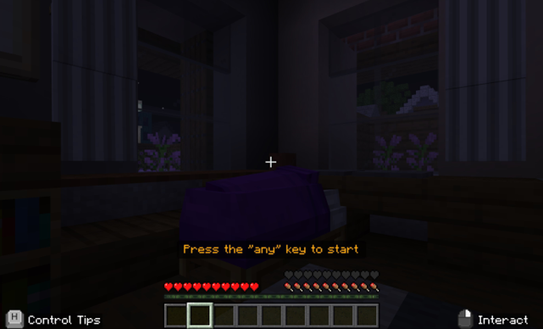
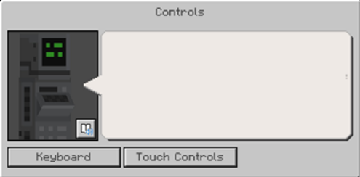
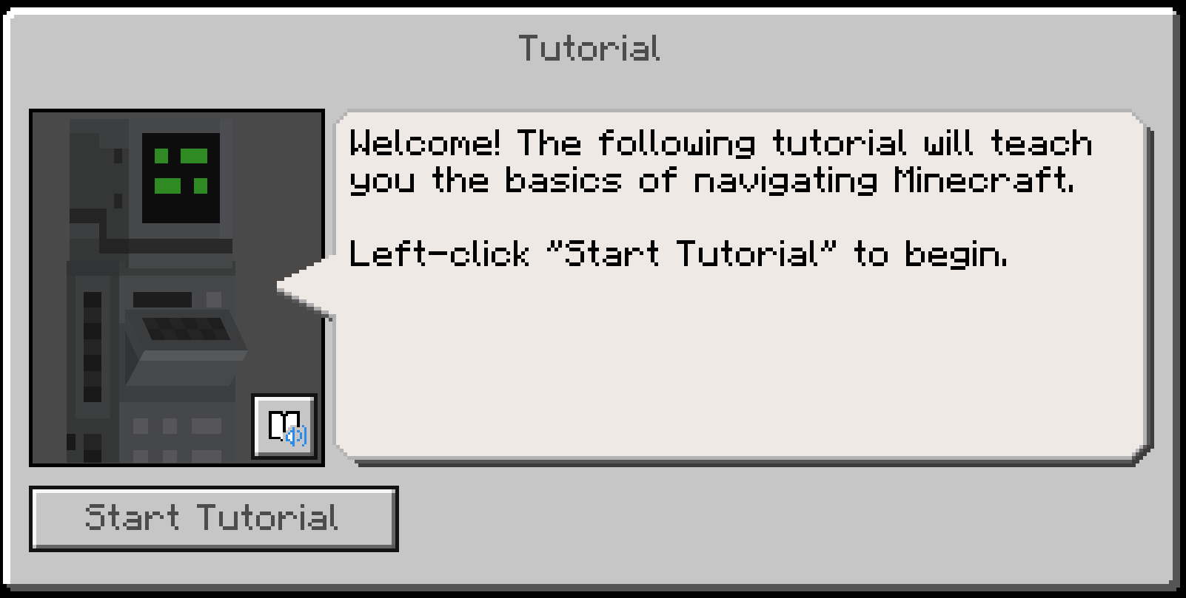
Beginning Game Play
You will spawn into a dark bedroom. You will need to press any key to start the game play.
The first dialog box will prompt you to select your control scheme: keyboard OR touch controls.
Start the tutorial.

Slide 9
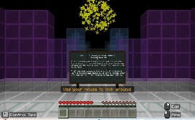
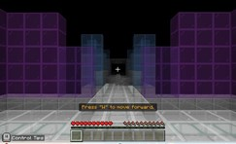
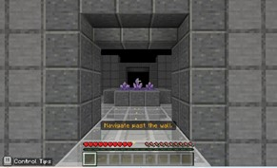
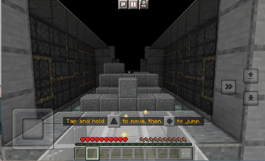
Tutorials 1-4
Look at the golden orbs
Practice moving
Navigate past the wall
Practice jumping

Slide 10
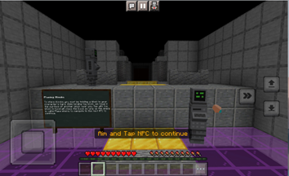
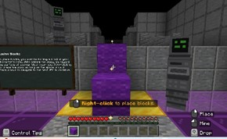
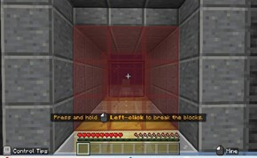
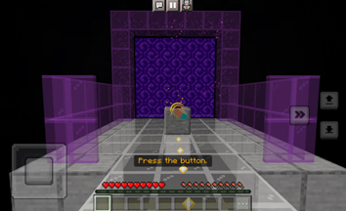
Tutorials 5-8
Interact with the NPC
Practice placing blocks
Practice breaking blocks
Press the button

Slide 11
Activity Overview
Principles of Responsible AI

Slide 12
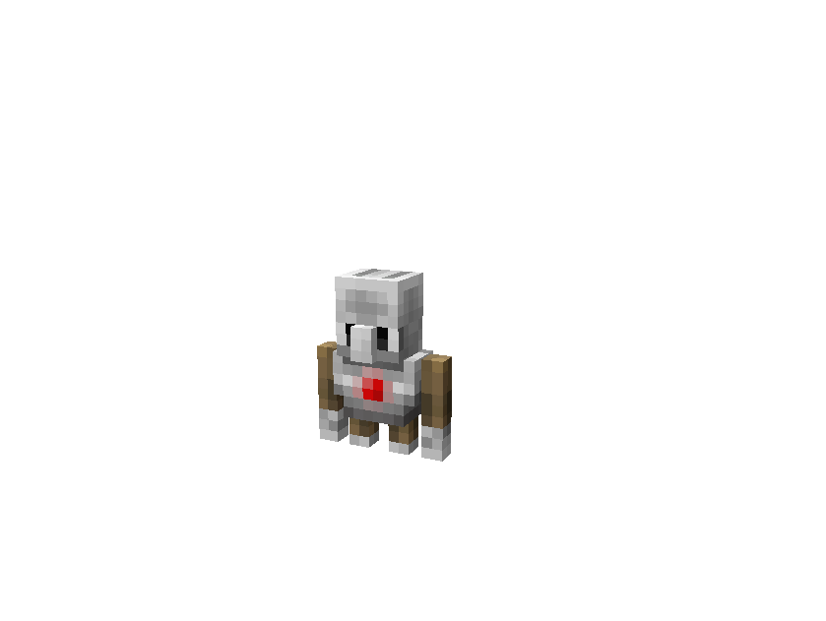
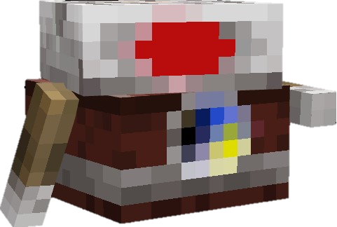
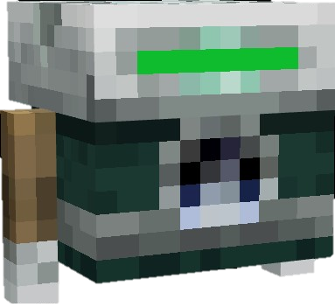
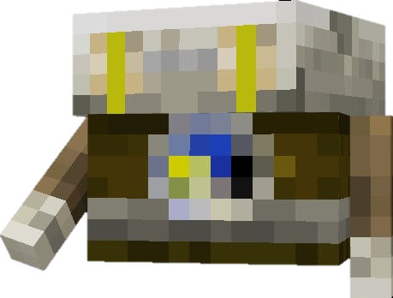
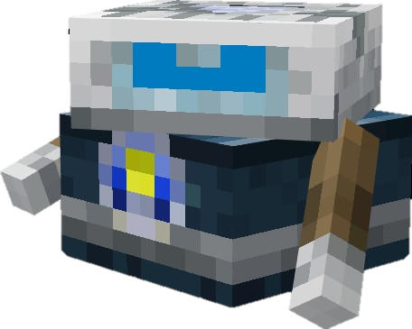
Responsible AI
In this year’s Hour of Code 2023: Generation AI, we are going to go on adventure to learn the principles of responsible AI. Our AI guides will help us learn from previous projects.

Slide 13
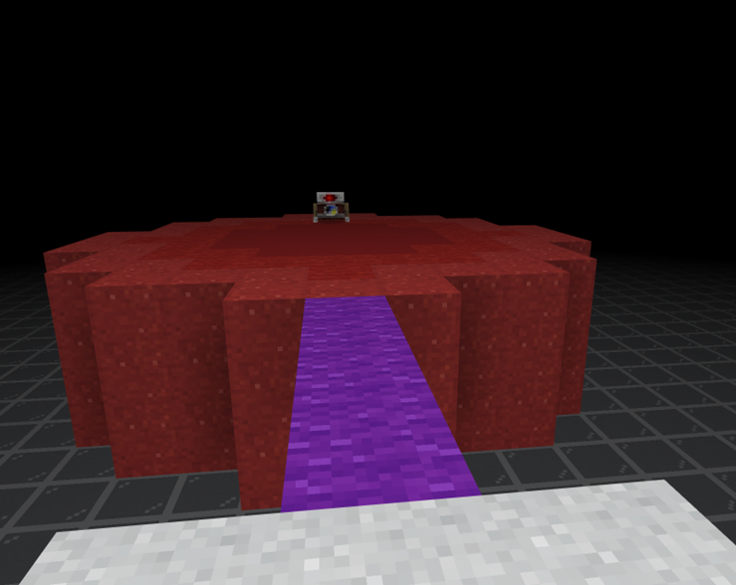
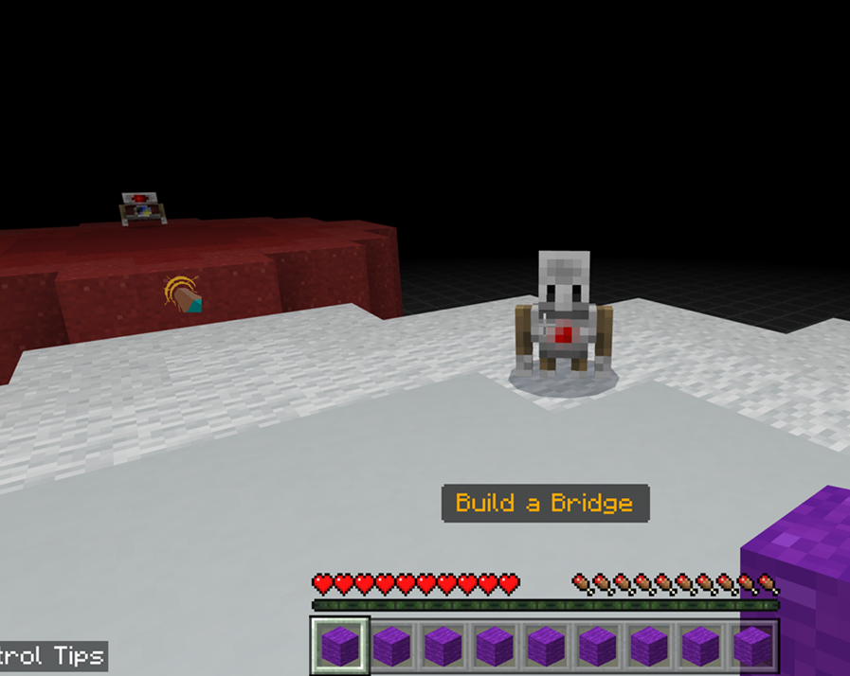
Build a Bridge - Pillar 1
To begin your journey, you will need to build a bridge to reach your reach your first AI guide. You will manually bridge a bridge using the blocks provided to you in your inventory.

Slide 14
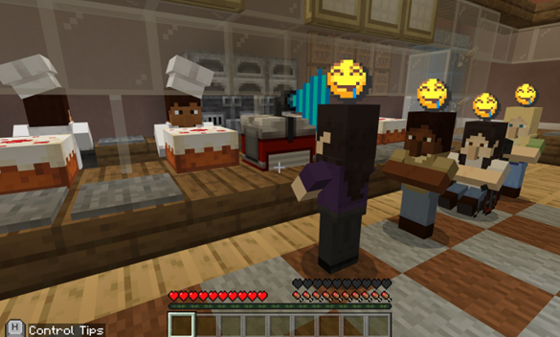
Fairness & Inclusiveness
You made an AI to automatically serve lunch to your classmates at school. The AI is programmed to scan for individuals. However, the AI only scans for individuals at a certain height. This is causing a problem; we need to change the AI to be both fair and inclusive.

Slide 15
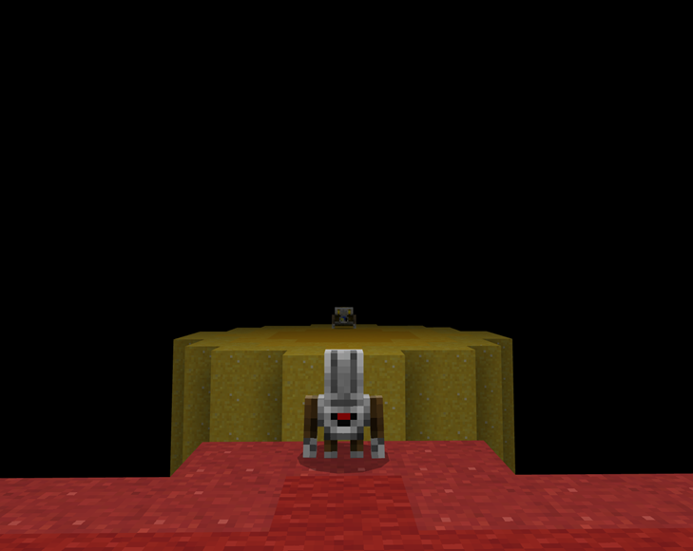
Build a Bridge with code - Pillar 2
To continue, you will build another bridge to the next pillar. However, you will use code to build your bridge this time.

Slide 16
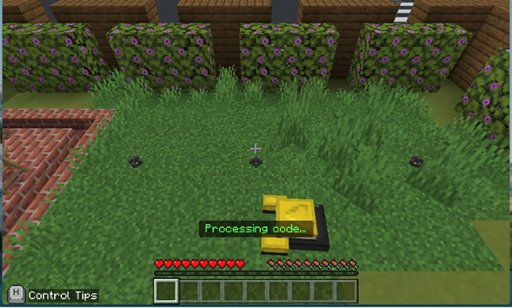
Reliability & Safety
You made an AI to automatically mow your lawn! However, the lawnmower is running over the sprinkler heads and causing damage. You will need to change the existing code to have the lawnmower check the area for sprinkler heads and avoid causing any more damage!

Slide 17
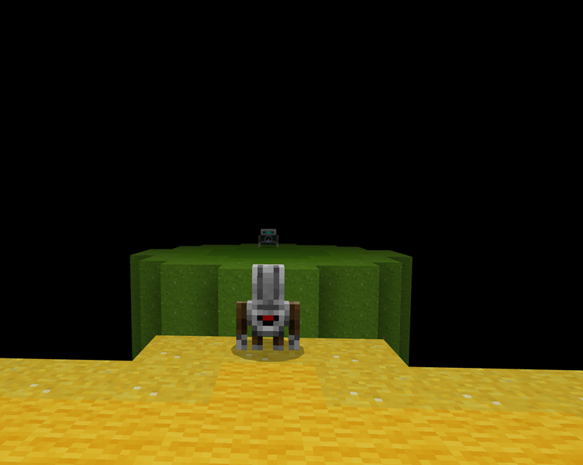
Build a Bridge with advanced code - Pillar 3
Now, you will use an advanced code to build your bridge to the next pillar.

Slide 18
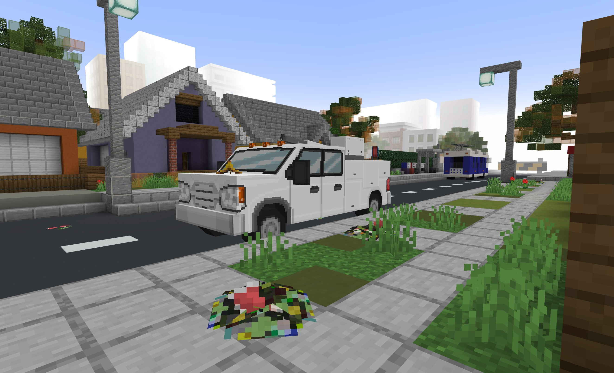
Transparency & Accountability
You made special AI birds, who collect garbage around the town and fly it over to the landfill. However, there is garbage everywhere! Something is clearly not working right… You will need to investigate the relay boxes, follow the birds to decode the secret words, and then update the code to fix the trash problem.

Slide 19
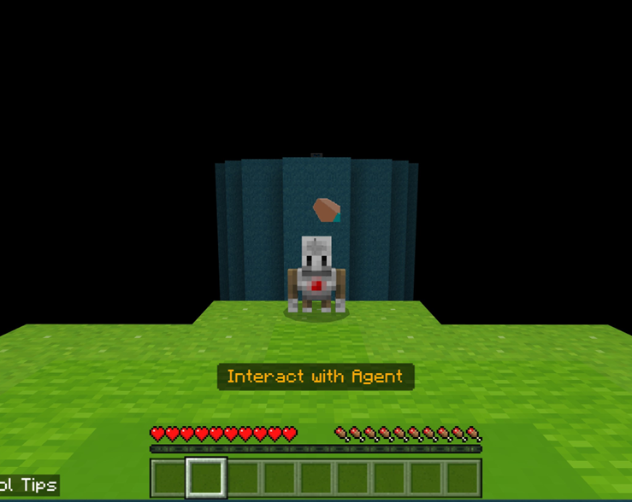
Build a Bridge with Prompts- Pillar 4
Your Agent has evolved and is rapidly gaining more abilities! You no longer need to manually enter a code to reach the next pillar. You can generate a bridge by selecting a prompt.
A prompt lets you give instructions to the AI. The AI will respond by generating information based on what you’ve asked. It’s a new way for you to communicate with the AI!

Slide 20
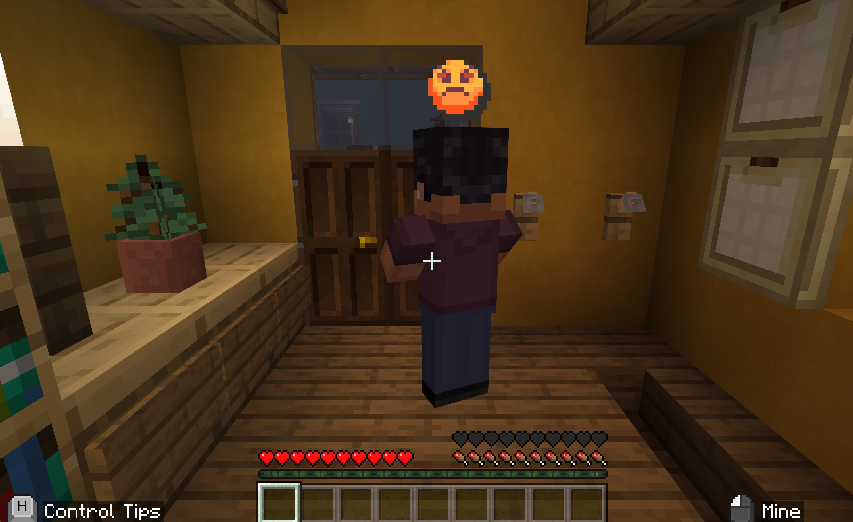
Privacy & Security
You made the most secure smart locks on the market, known as AI Tech Locks. Unfortunately, a customer is not very happy with their smart lock. Every time they sit down for dinner, salespeople show up at their door. How do they always know when they home?!

Slide 21
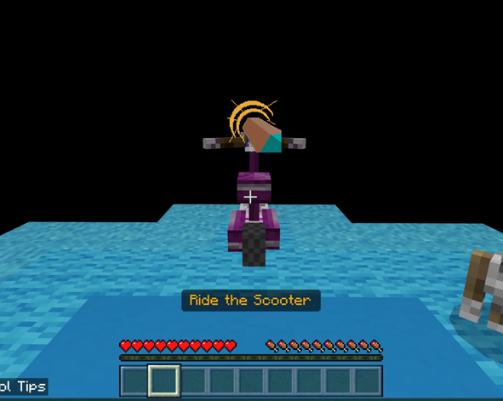
Onto the last pillar…
You have done it! You have learned the principles of Responsible AI:
Fairness and Inclusiveness
Reliability and Safety
Transparency and Accountability
Privacy and Security
Now, let’s ride the scooter over to the last pillar!

Slide 22
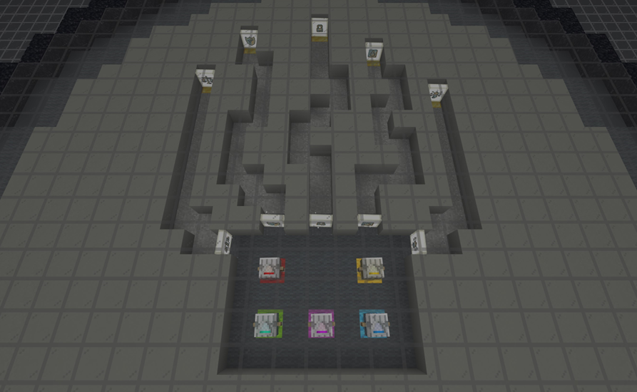
Train the responsible AI
Let’s take all of your new knowledge about responsible AI and train the others to be responsible AI! You will need to consider the principles of responsible AI and match the AI to the correct statements.!

Slide 23
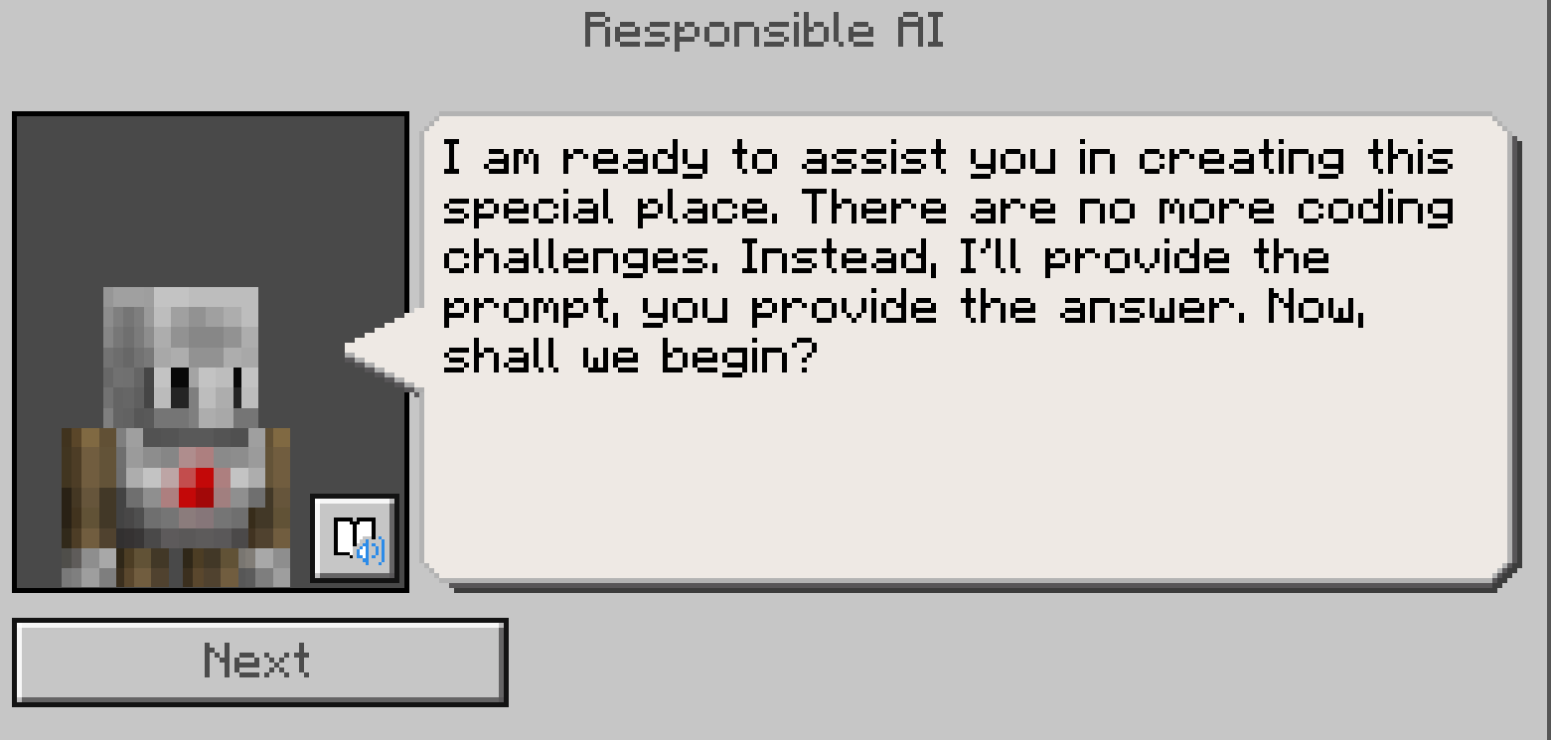
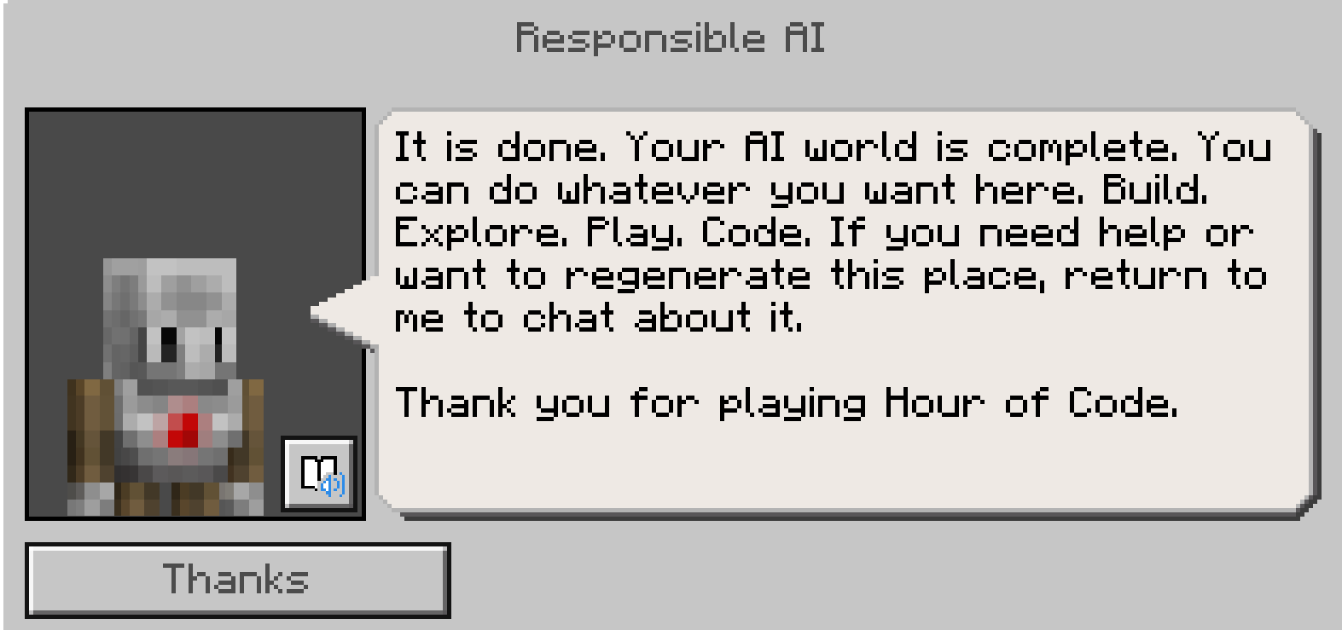
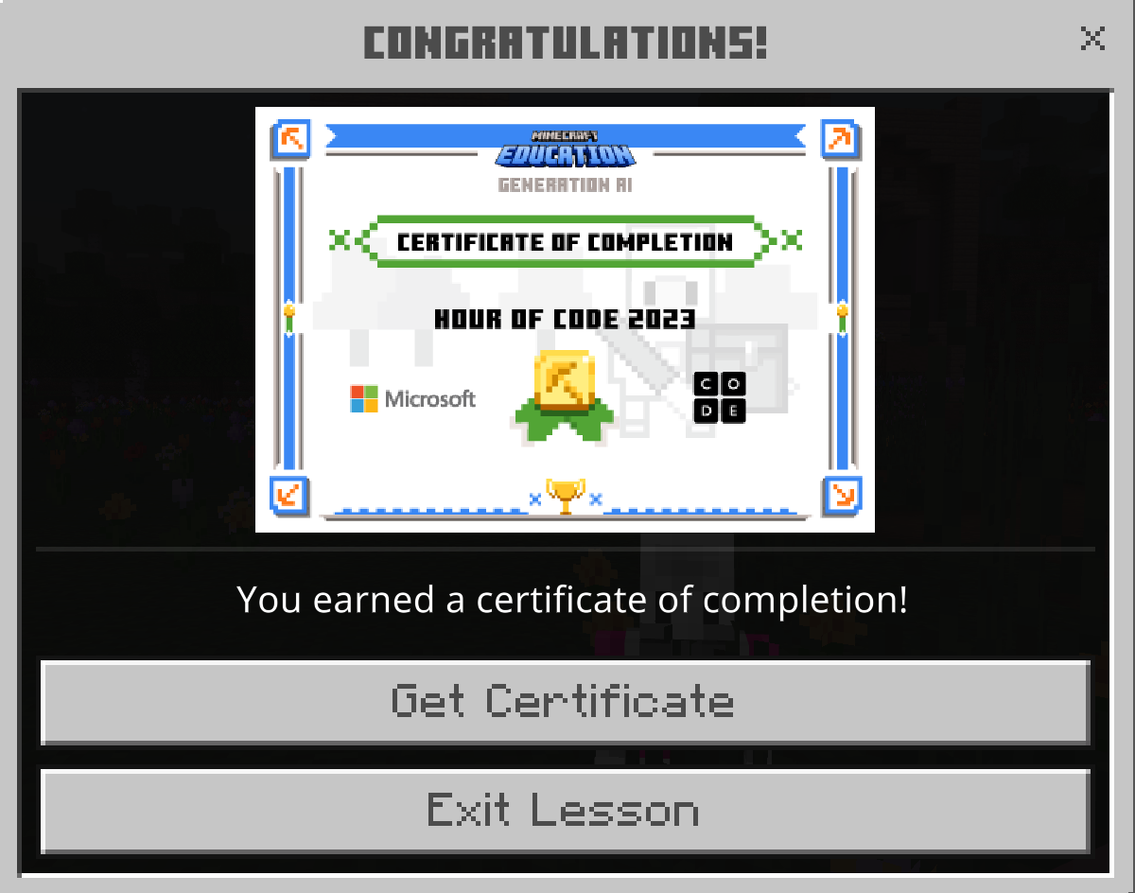
Welcome to generation ai
You’ve created your Responsible AI!
Using prompts, generate the maps of your choosing.
Thank you for playing the Hour of Code!
Design your map with prompts.
Generate your map.
Get your certificate.

Slide 24
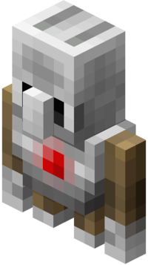
Reflection Questions
How do you define artificial intelligence (AI)?
Name one principle of responsible AI. Explain this principle.
How is artificial intelligence used in our everyday lives?
What do you think is the most important thing to understand about AI?
What are some of the ethical and societal impacts of AI?
How will AI impact jobs? What kind of jobs may be created because of AI? How can AI make certain jobs easier or more efficient?

Slide 25
Thank you for playing hour of code:
Generation AI

