Slide 1
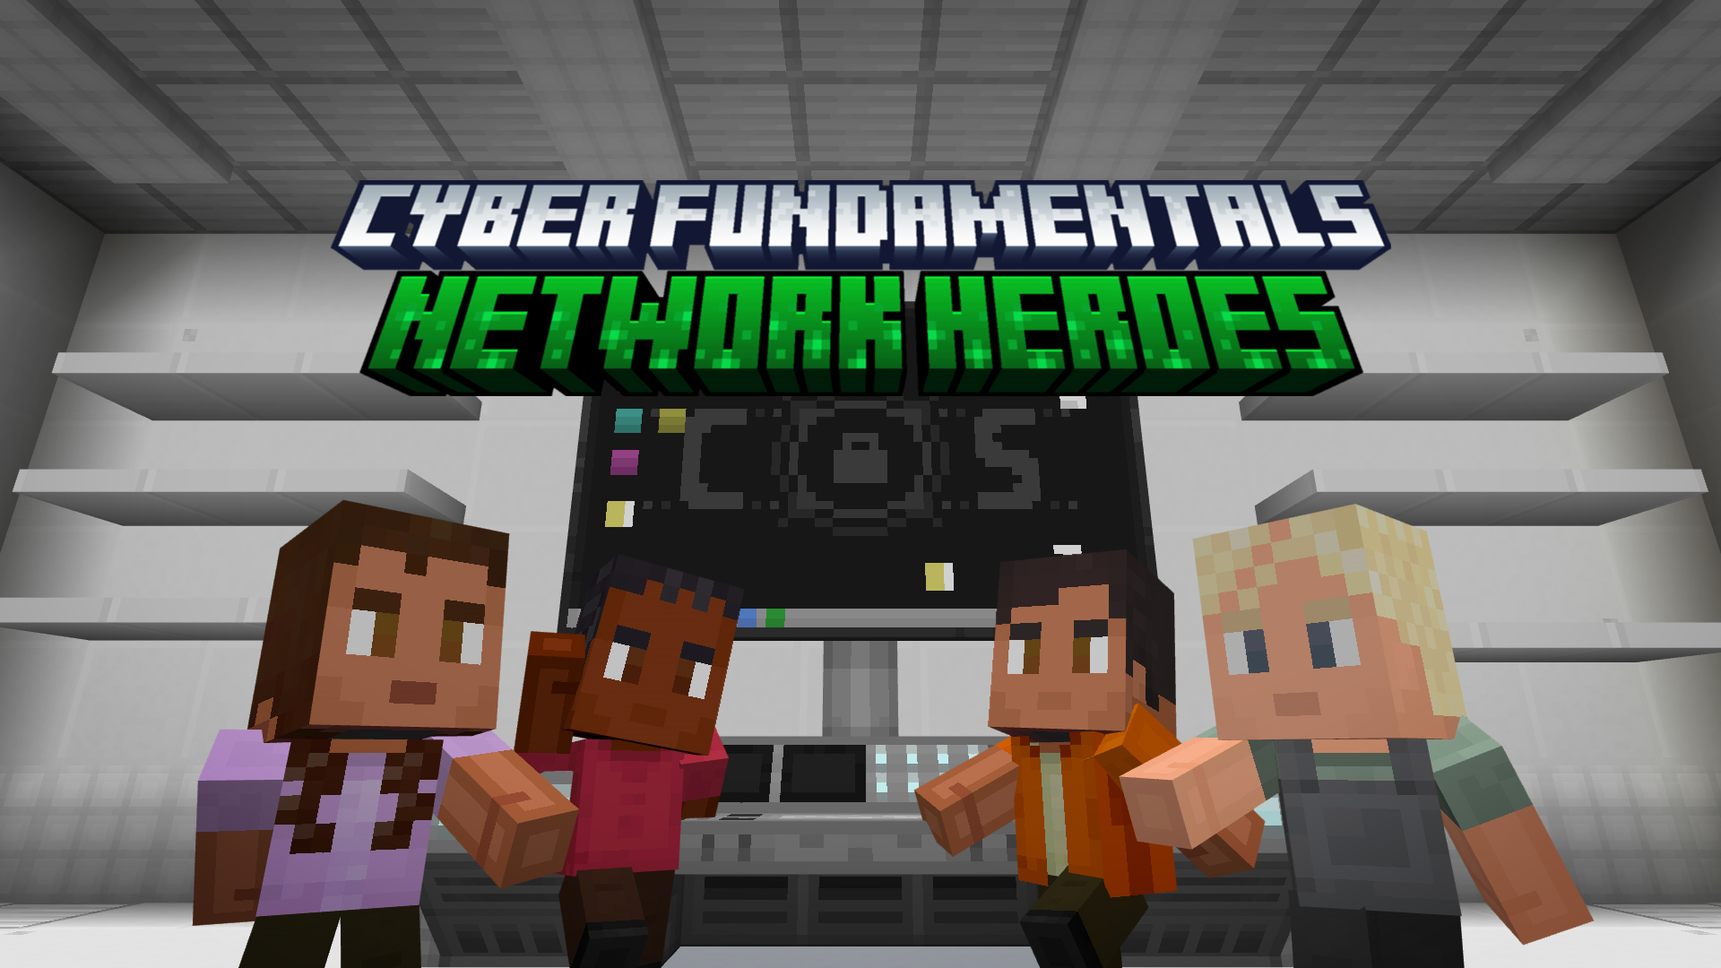


Slide 2
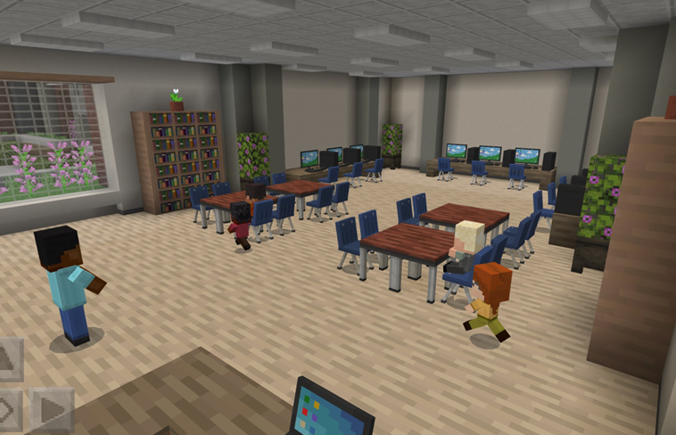

Getting started
Welcome cybersecurity specialists!
Your help is greatly needed! There are some villains who are trying to commit cybersecurity attacks against the school!

Slide 3
What is cybersecurity?
2
THINK
SHARE
PAIR
1
3

Slide 4
Let’s play!
Log into Minecraft Education

Slide 5
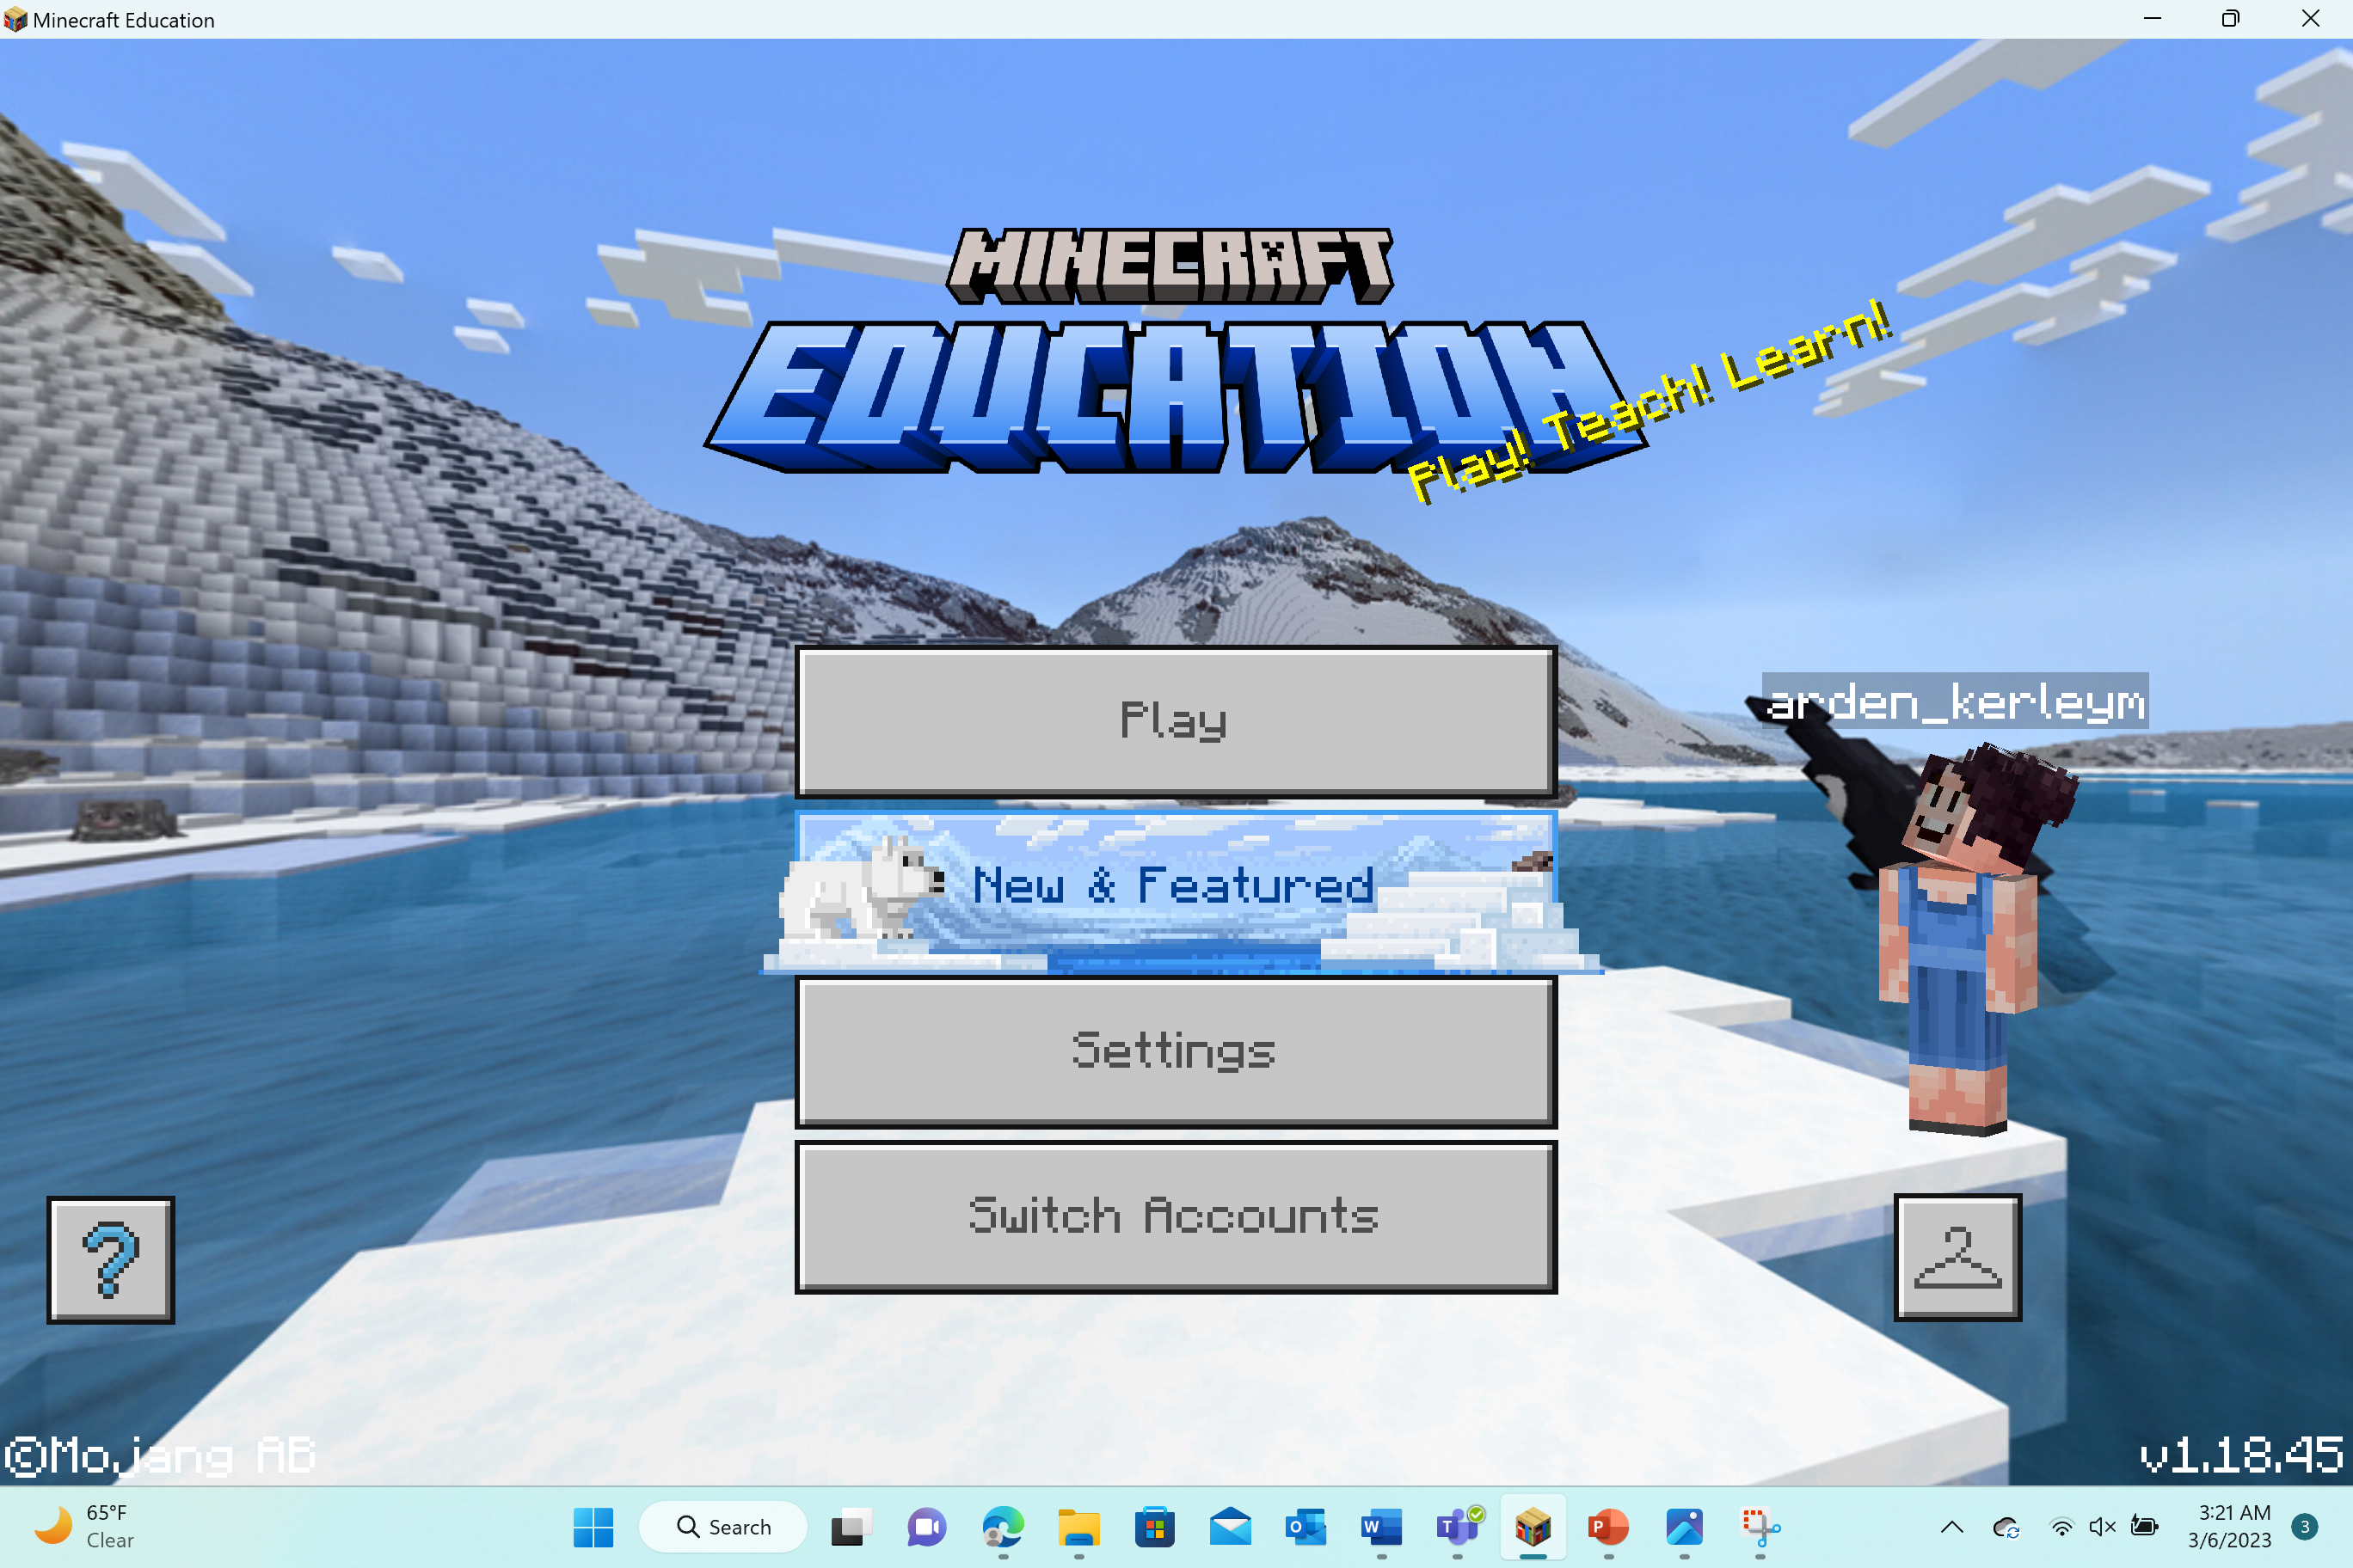
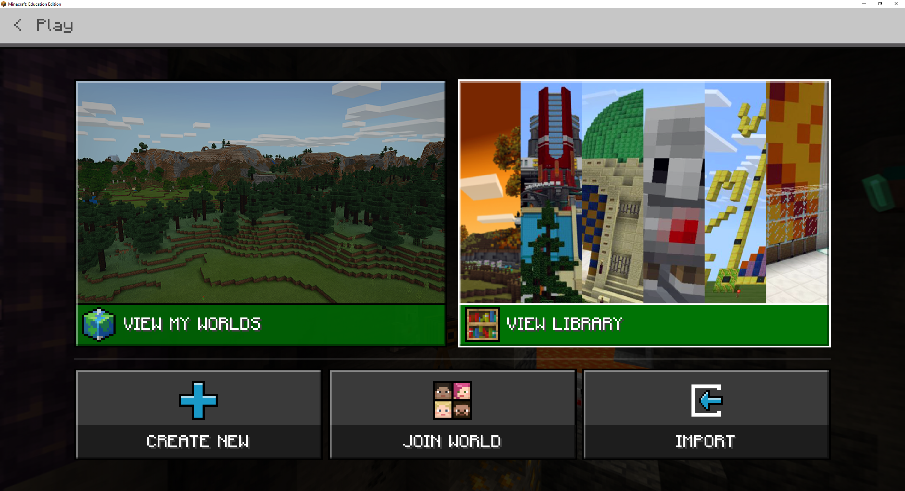
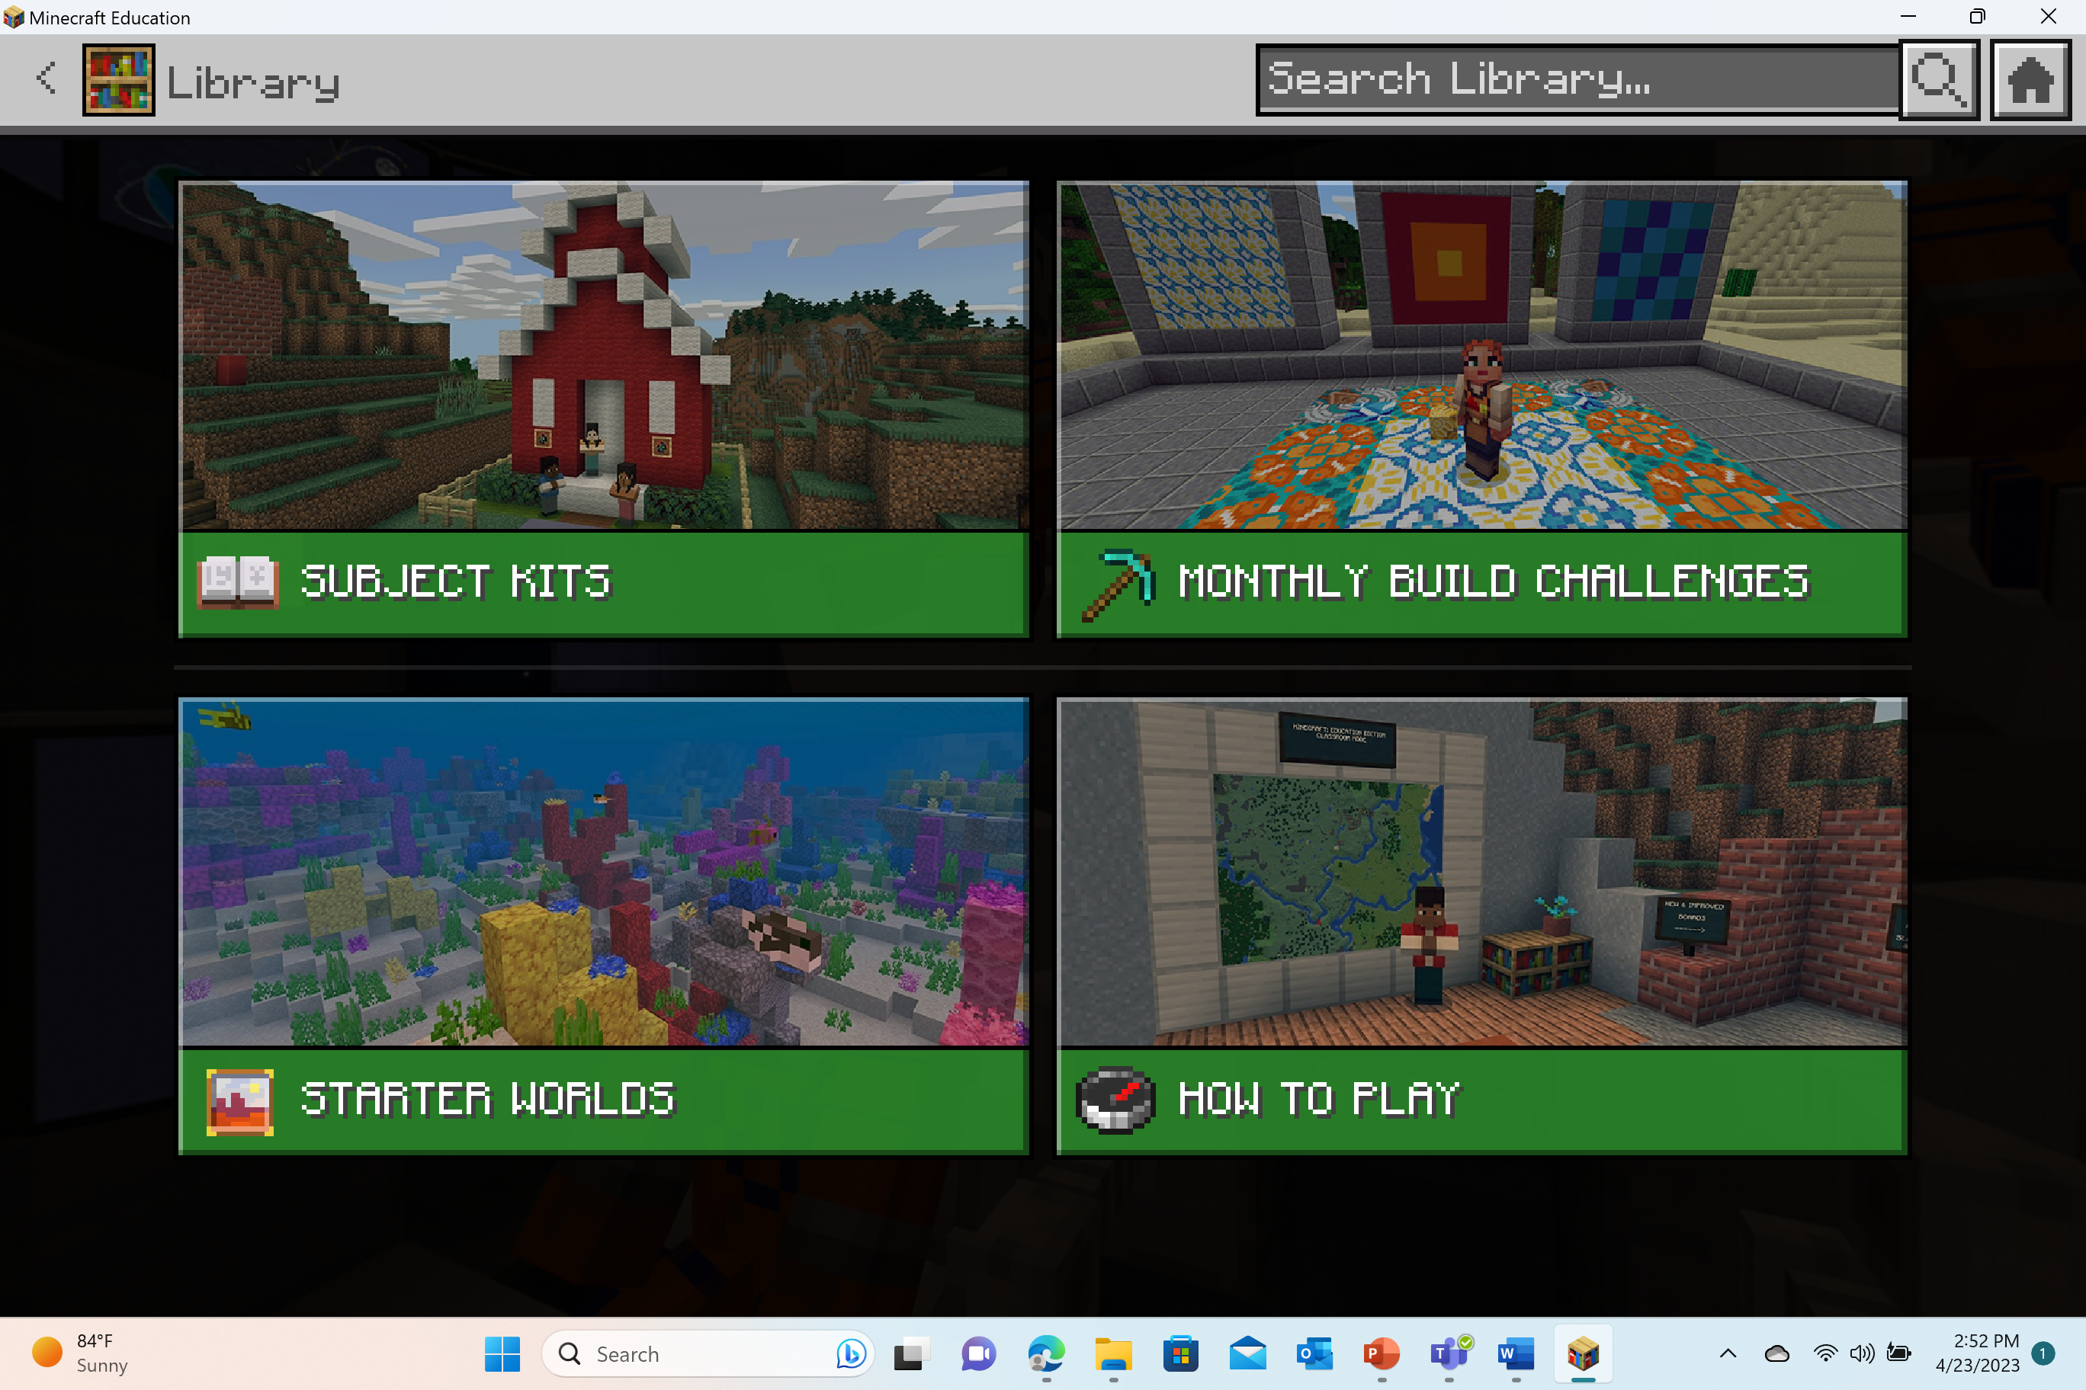



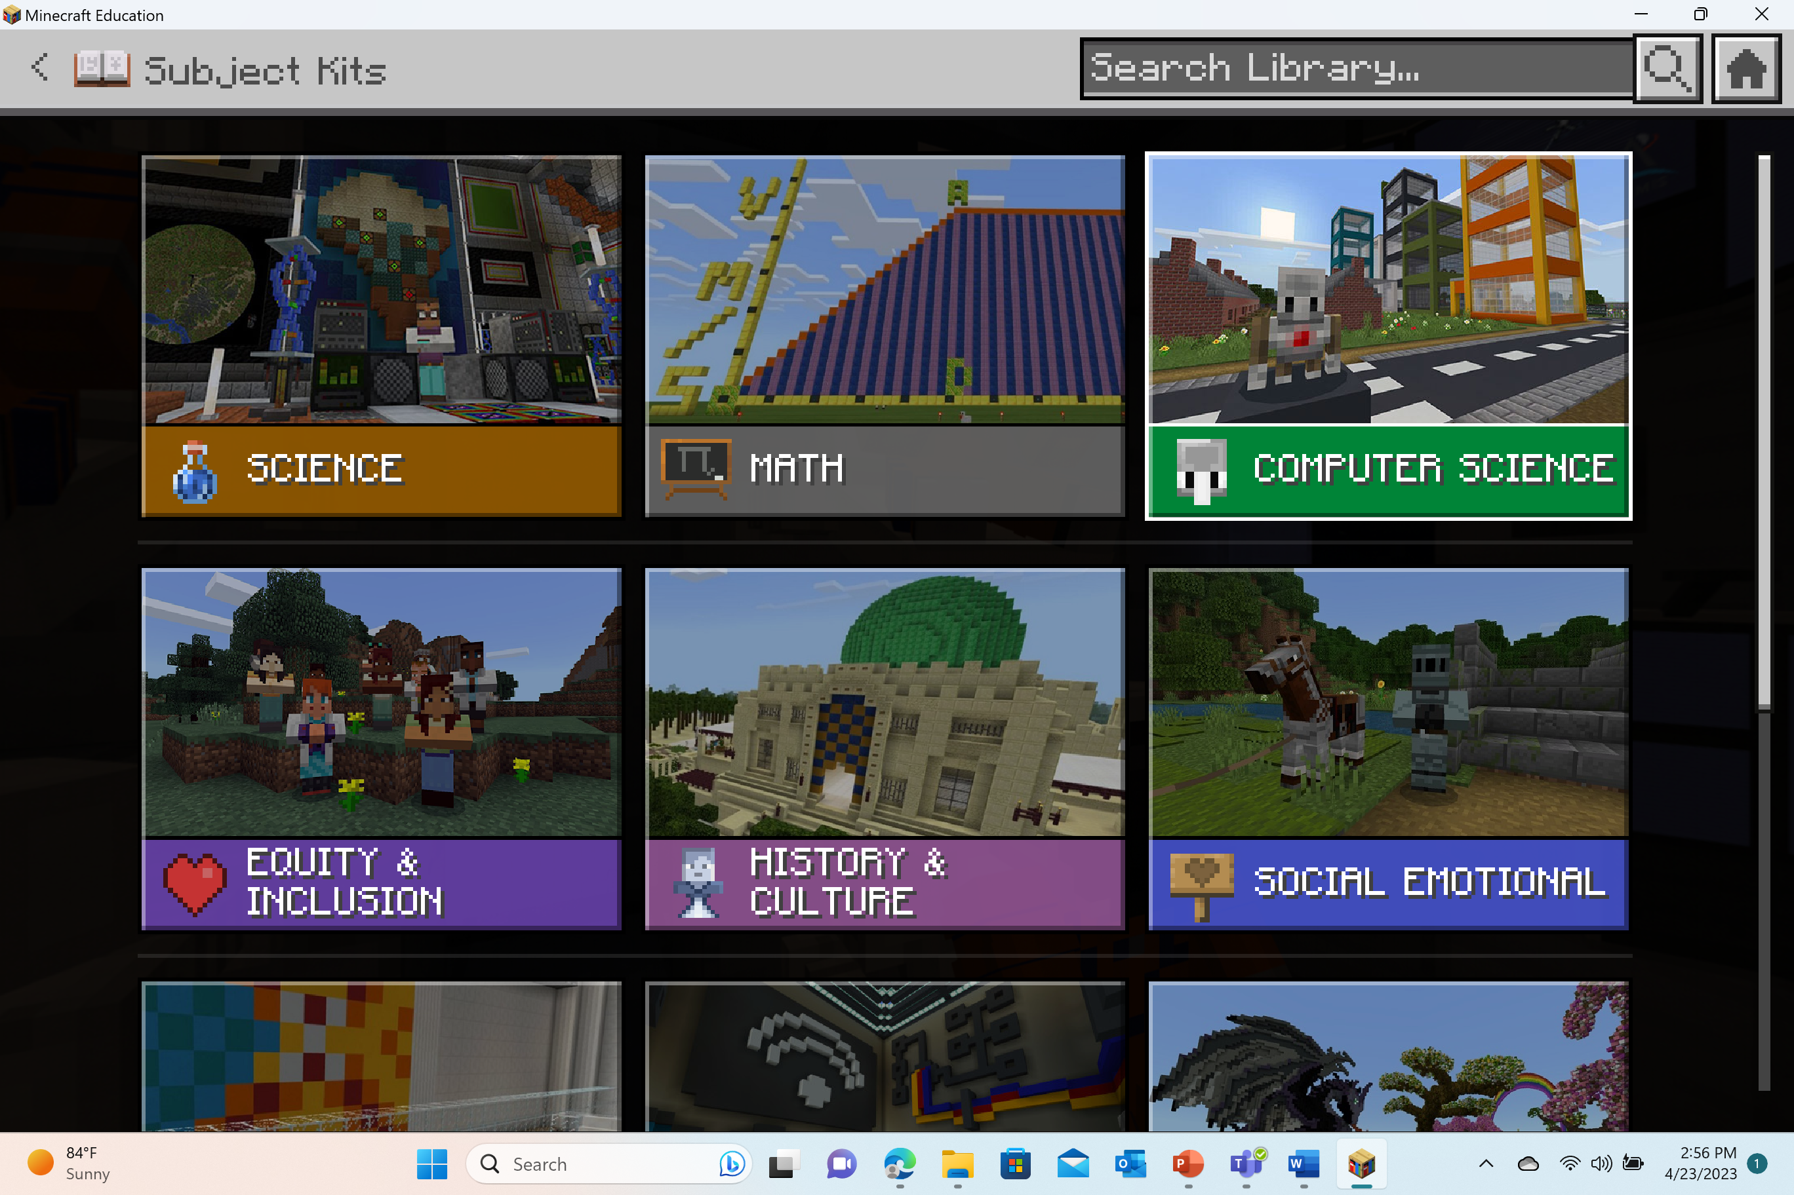
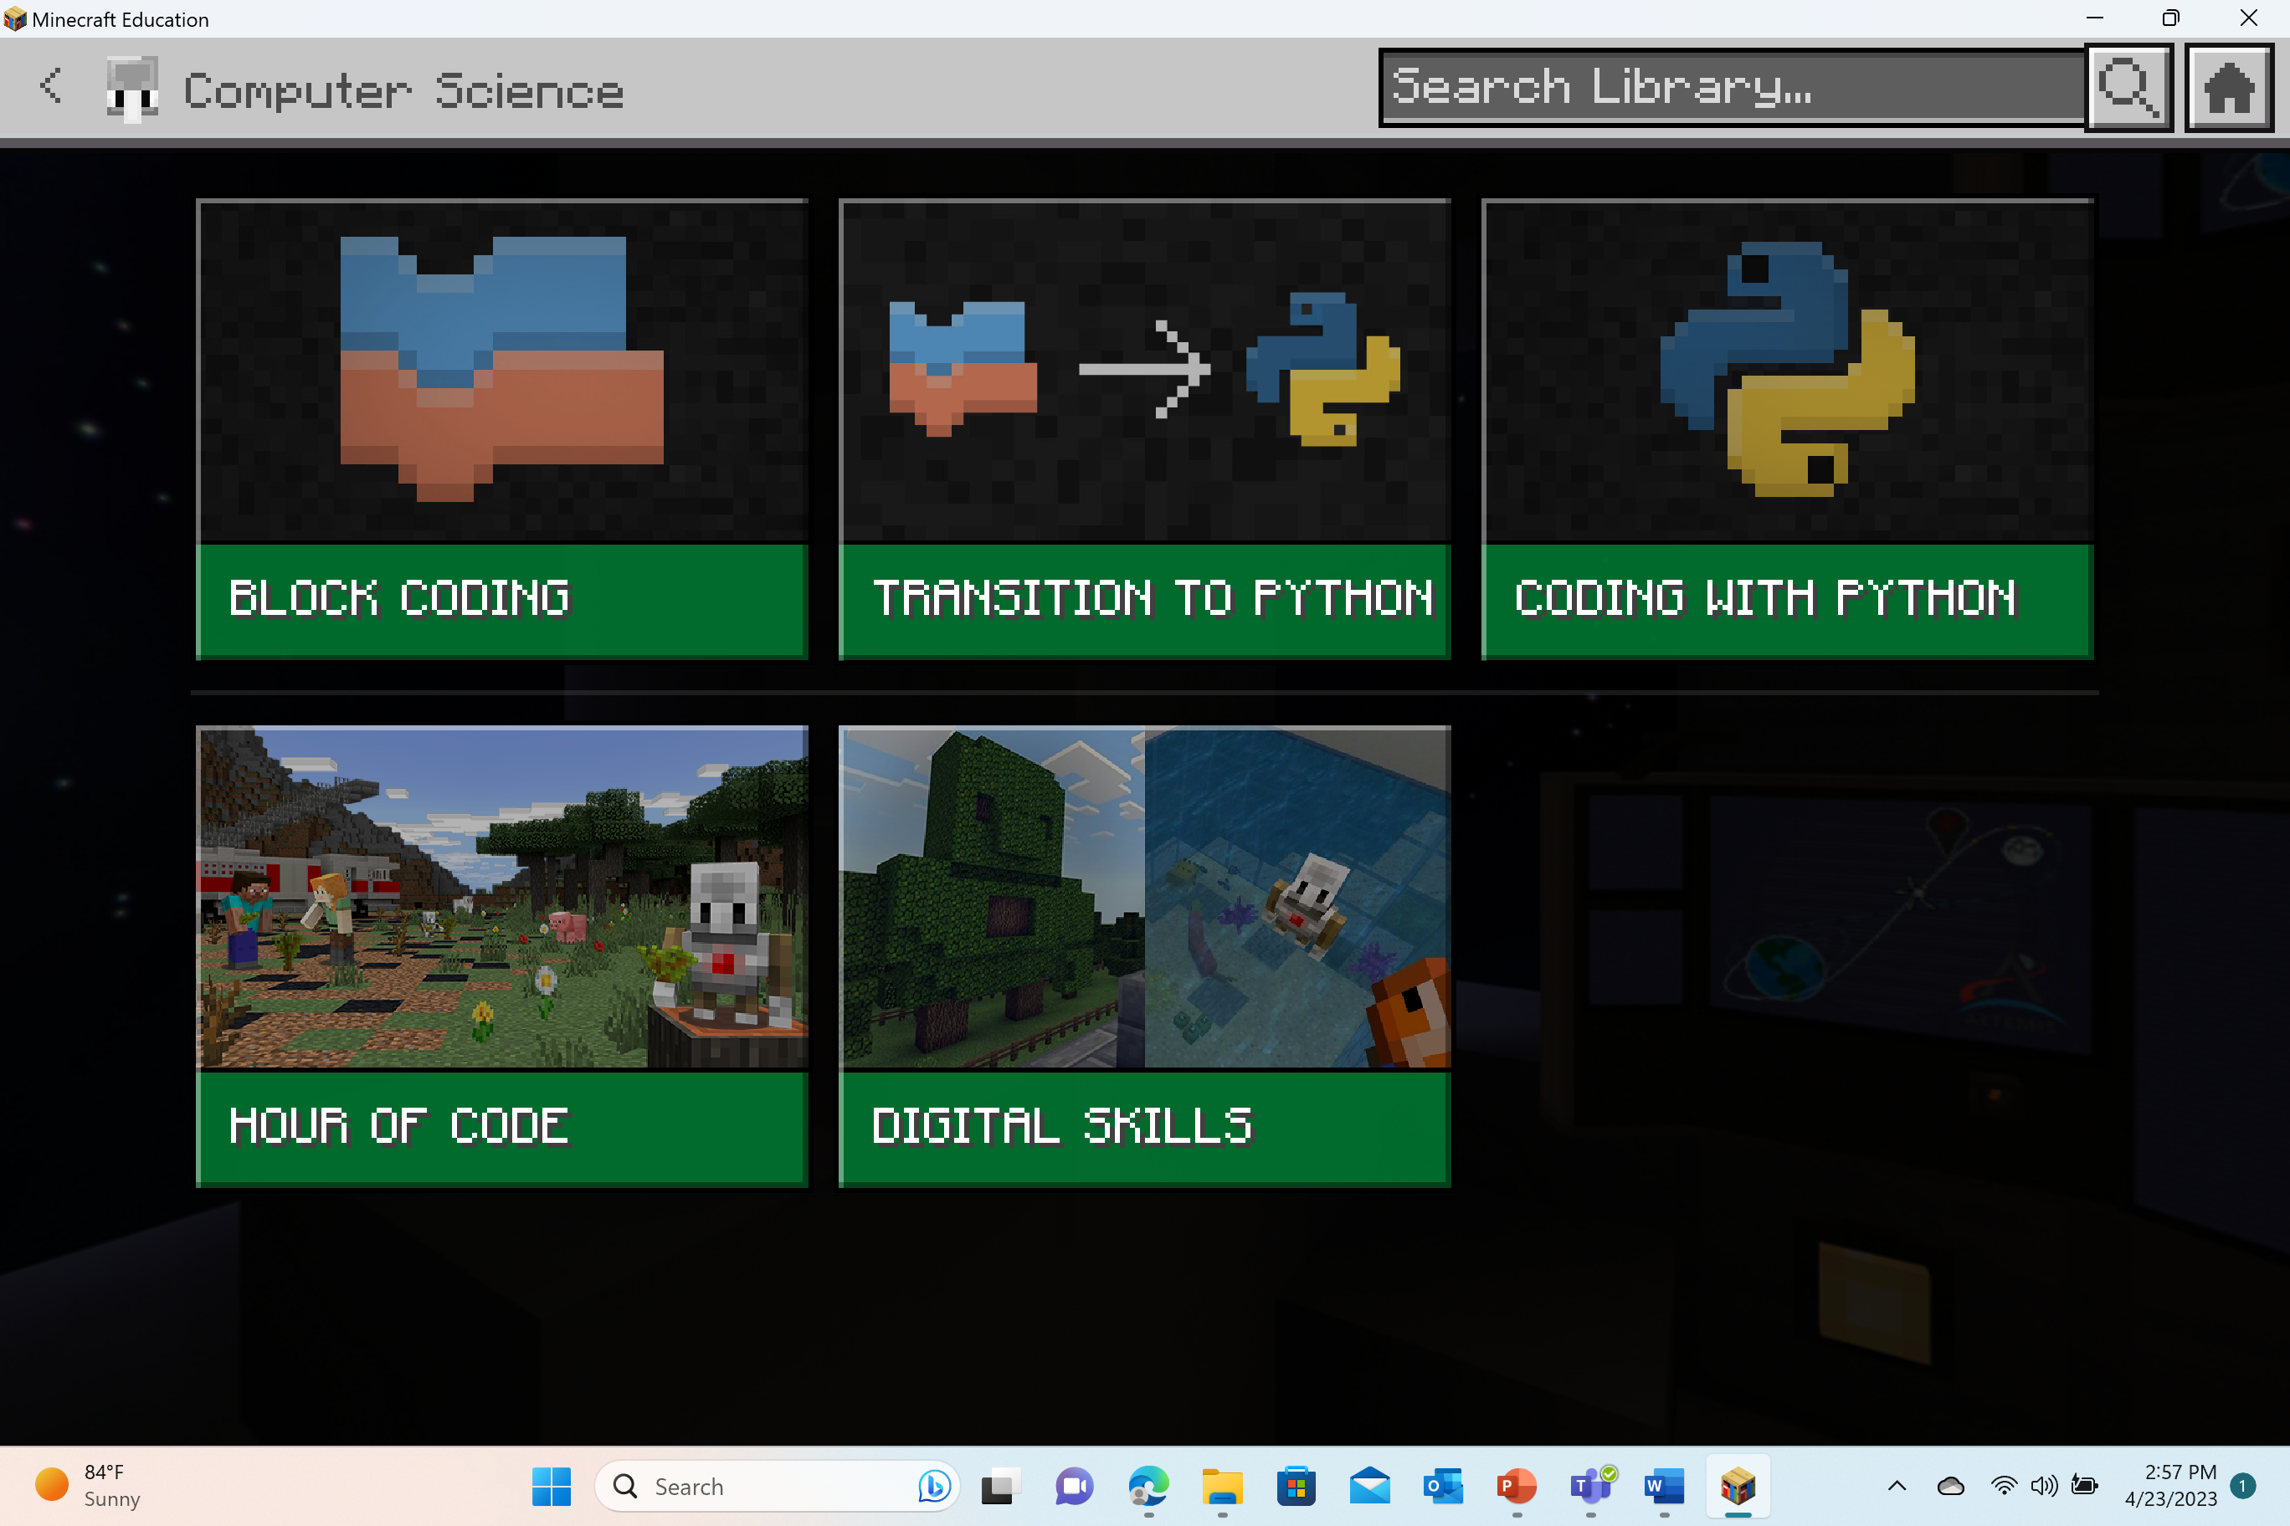
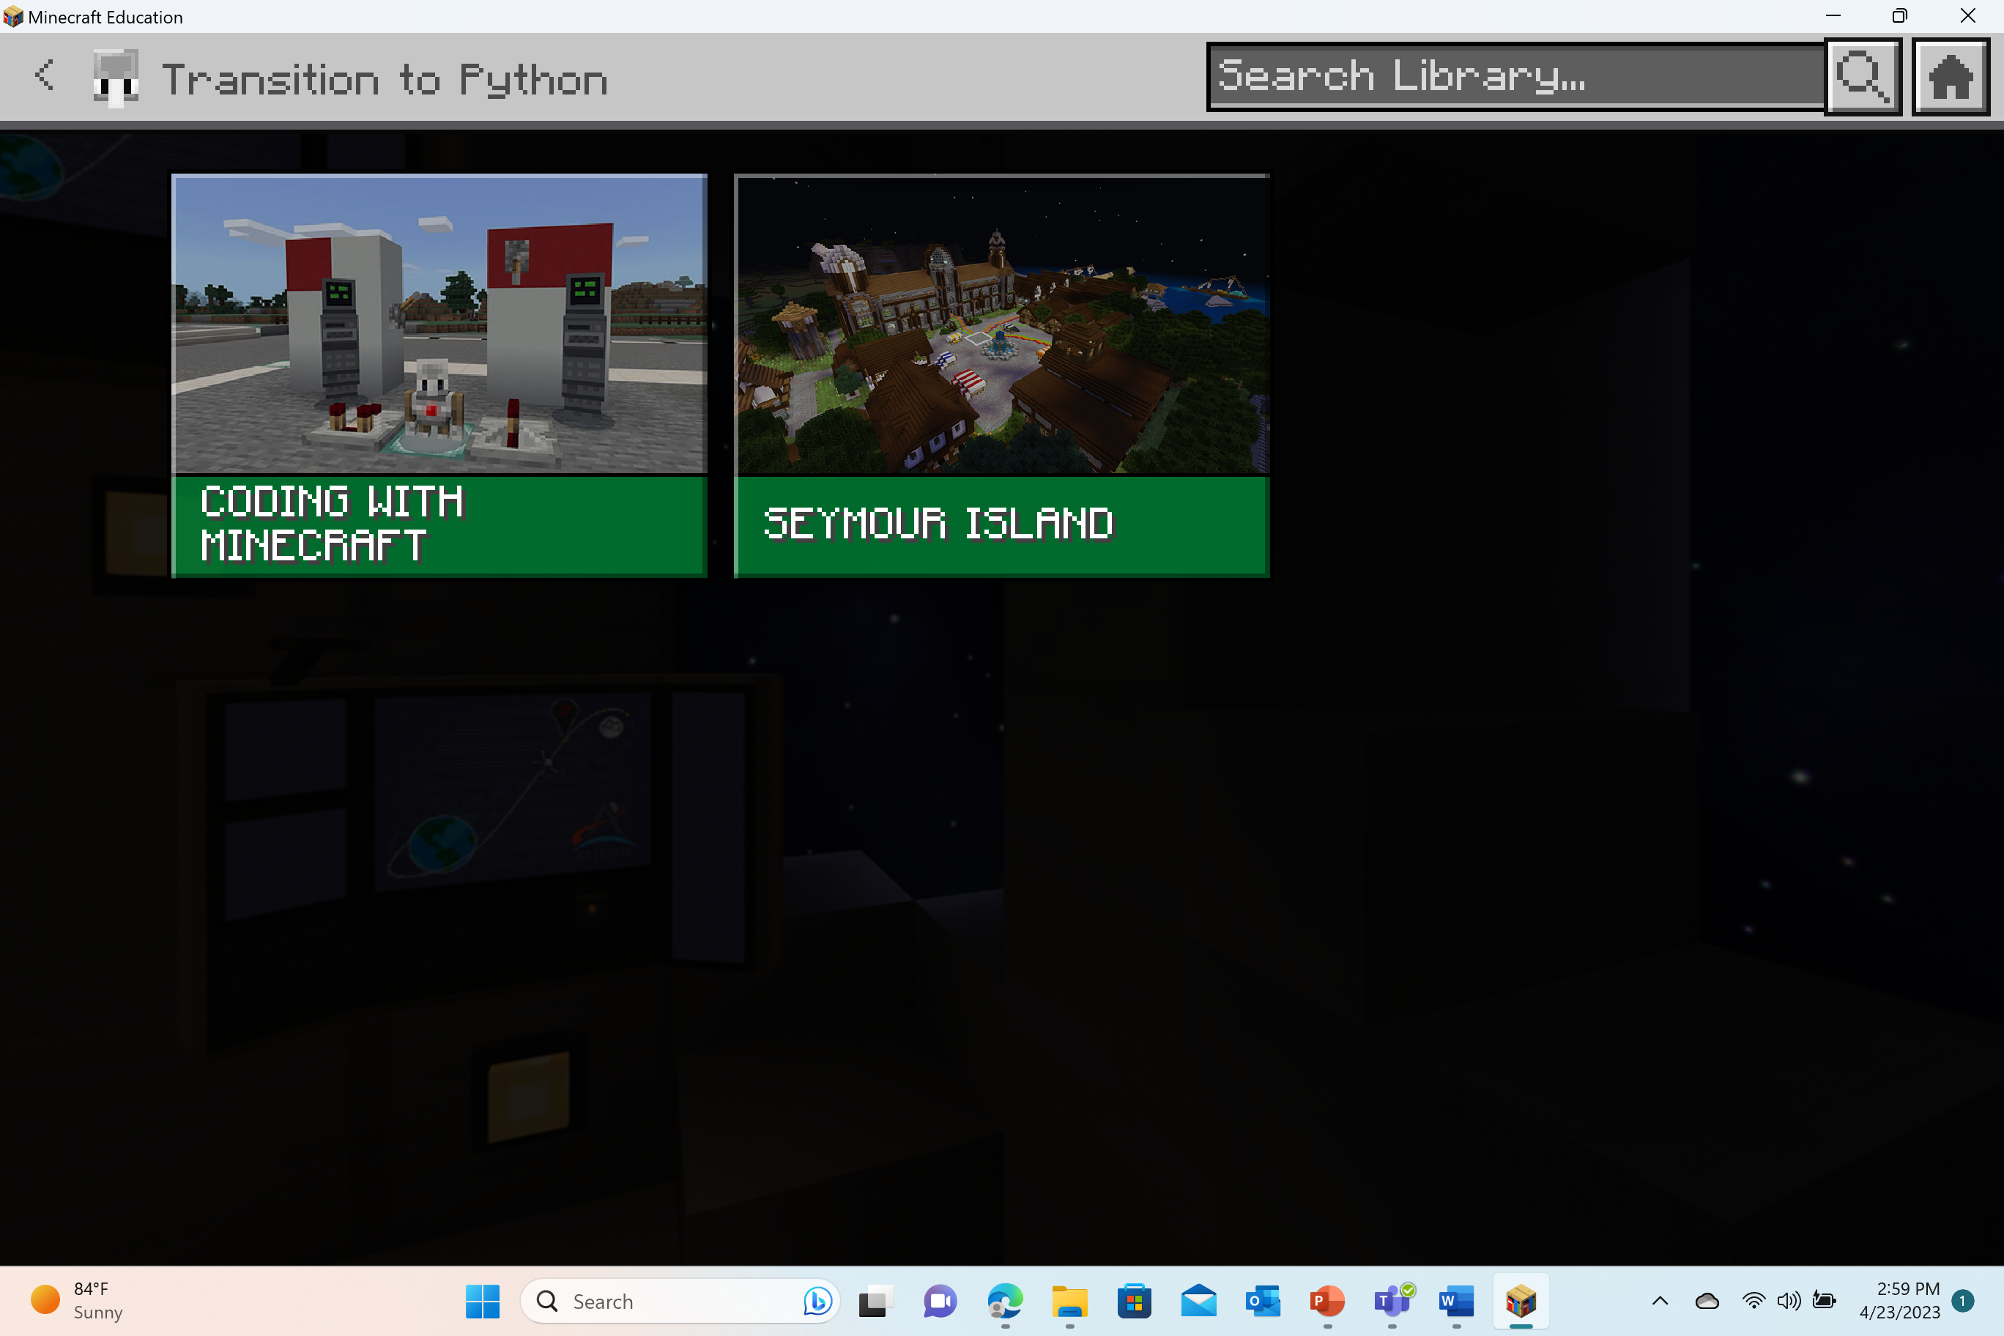
Launch the Cyber Fundamentals world
Select “Play”
Select “View Library”
Select “Subject Kits”
Select “Computer Science”
Select “Digital Skills”
Select “Cyber FUNdamentals”

Slide 6
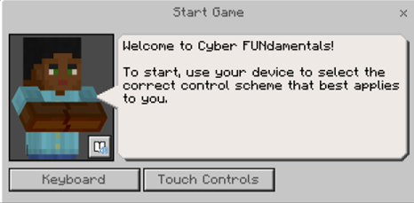
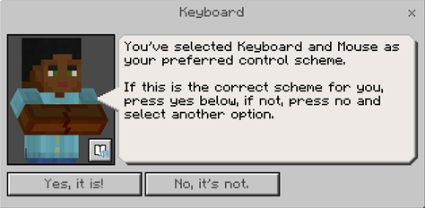
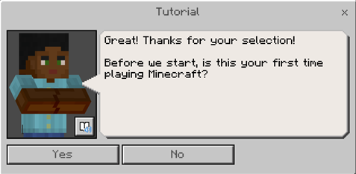
Beginning Game Play
The first dialog box will prompt you to select your control scheme: keyboard OR touch controls.
The second dialog box will have you confirm your selection with “Yes, it is!” or “No, its not.”
The third dialog box will ask if it’s your first-time playing Minecraft. If it is your first time, a follow-up question of would you like to participate in a tutorial.
Otherwise, if you answer “No”, you will move directly into game play and skip the tutorial sequence.

Slide 7
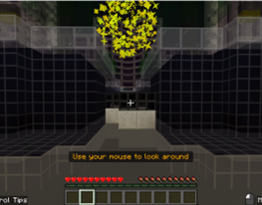
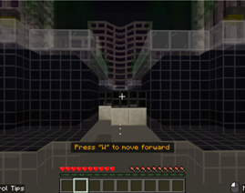
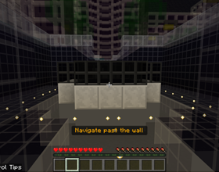
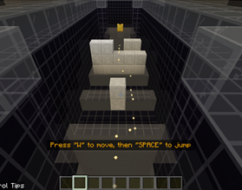
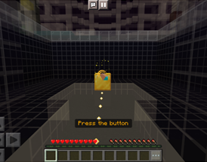
Tutorial Sequence
Look at the golden orbs
Practice moving
Navigate past the wall
Practice jumping
Press the button

Slide 8
Lesson 1
Network Components

Slide 9
What will we learn in this activity?
  I will articulate the components of a network.
  I will explain the difference between a local-area network (LAN) and wide-area network (WAN).
  I will describe the process of encryption.
  I will explain how information travels through a network.

Slide 10
Action items
In this lesson, you will:
Set up a network in Minecraft
Find and encrypt computers
As you are working, you should be looking for the definitions to record in your workbook:
      network
      network components (computer, ethernet cable, router)
      protocols
      packets
      local area network (LAN)
      wide area network (WAN)

Slide 11

Check for understanding
What components make up a local-area network (LAN)?
How are a local area-network (LAN) and wide-area network (WAN) different from one another?
Draw and label a diagram of how information travels through a network.

Slide 12
Lesson 2
Password Protection

Slide 13
What will we learn in this activity?
  I will articulate what makes a complex password.
  I will describe a password based on its entropy.
  I will explain how layered strategies can protect networks.

Slide 14
Action items
In this lesson, you will:
Create (3) types of passwords
As you are working, you should be looking for the definitions to record in your workbook:
      brute-force
      password
      entropy
      firewall
      two-factor authentication (2FA)
      layered strategies

Slide 15
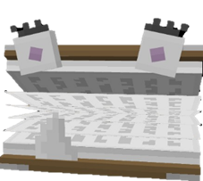
Check for understanding
How can you create a complex password?
Why are complex passwords important in cybersecurity?
Name one other way to keep a network safe.

Slide 16
Lesson 3
Malware

Slide 17
What will we learn in this activity?
  I will articulate what is malware.
  I will describe how a phishing scam works.
  I will explain how I can protect myself from malware.

Slide 18
Action items
In this lesson, you will:
Quarantine the malware in Online Shopping
Speak up to help in Villager Social
Fight in the Boss Battle
As you are working, you should be looking for the definitions to record in your workbook:
      malware (malicious software)
      quarantine
      phishing
      pop-up ads
      delivery vectors/attack vectors

Slide 19
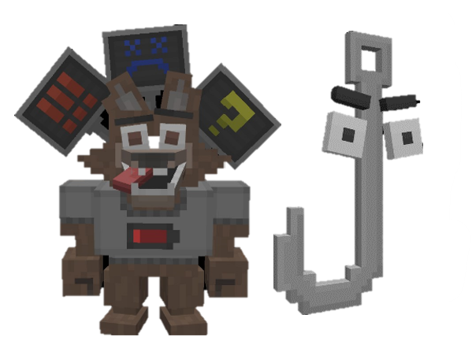
Check for understanding
What is malware?
How do phishing scams work?
How can you protect yourself from malware?

