Slide 1
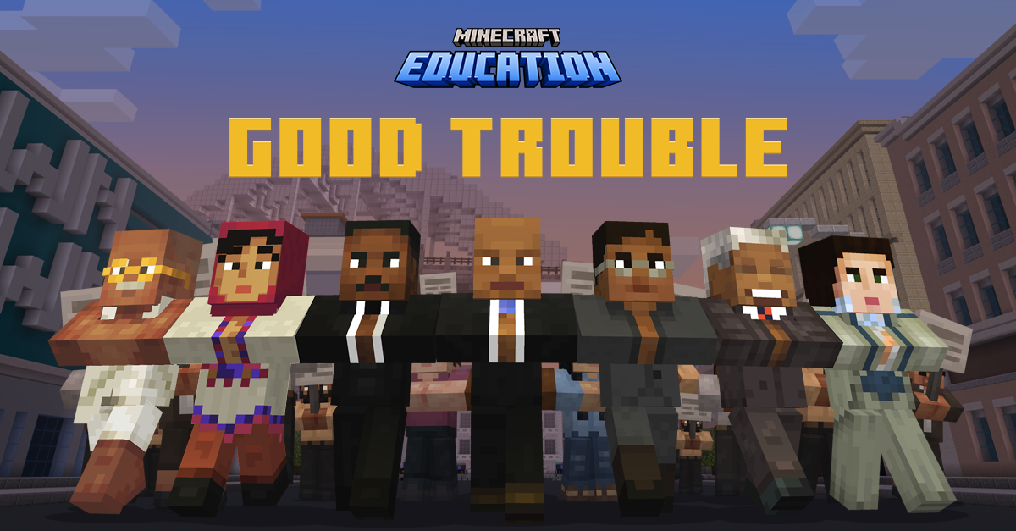

Slide 2

Welcome to this month’s fika!
Lessons in Good Trouble uses historical events and leadership principles to help players understand how civic action, moral courage, and “good trouble” have shaped society—and how similar principles can guide their own actions today.
Let’s take a closer look…
© Microsoft. All Rights Reserved.
Notes:
Let’s get started, class!
The world of AI is rapidly evolving and changing – it seems like every day it’s being added to the platforms and apps we use in our daily lives. Given how easily AI can create content, it’s important for us to understand the role we play in making sure that AI is used positively, and responsibly.
Today, we will be exploring a Minecraft world that will present various challenges. It will be up to you to decide which path you feel is right, and thinking about how your choices impact yourself, and others.
Are you ready?! Let’s go!

Slide 3
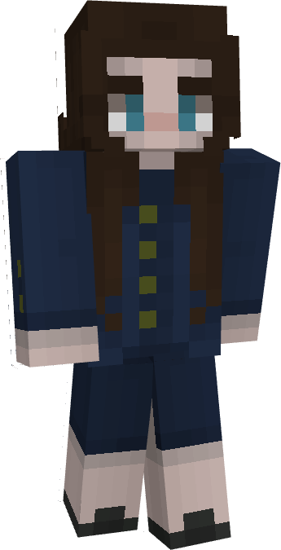
What will we learn?
Throughout Lessons In Good Trouble, we will experience "good trouble" to build skills in:
Civics and Citizenship – Use the Selma to Montgomery marches and John Lewis’s life as a lens to explore civic action and the broader global movements that shape societies.
Leadership & Efficacy – Recognize how individual and collective leadership can drive social or political change—“good trouble” as active citizenship.
Global Connections – See how various social justice movements around the parallel and intersect with each other.
© Microsoft. All Rights Reserved.

Slide 4
Essential question?
How have civil rights and social justice movements around the world influenced positive changes in society or in a community?
  U.S. Civil Rights Movement
  Equal Education for Girls
  India's independence
  Anti-Apartheid
  Women’s suffrage
© Microsoft. All Rights Reserved.
Notes:
Why have civil rights and social justice movements occurred?
What was/is the context in which these movements have occurred?
What conditions were present that served as a catalyst for the movement?

Slide 5
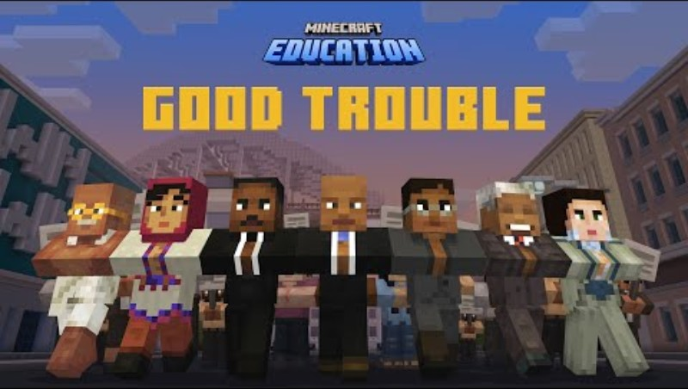

Lessons in good trouble
© Microsoft. All Rights Reserved.

Slide 6
What do you think when you hear ‘trouble’?
2
THINK
SHARE
PAIR
1
3
© Microsoft. All Rights Reserved.
Notes:
Let’s start with a couple of questions, to get our minds thinking about how we interact with AI.
Discussion Prompt: What are some ways you can think of where AI is used in your daily life?
You can prompt a discussion by providing some examples of AI models (i.e. voice assistants available through phones and smart home devices, self-driving cars, language translation, chatbots, such as customer service bots, etc.)

Slide 7
What do you think when you hear ‘good trouble’?
2
THINK
SHARE
PAIR
1
3
© Microsoft. All Rights Reserved.
Notes:
Discussion Prompt: Based on previously discussed examples, how do you feel AI can be helpful and/or unhelpful?
To help prompt discussion, you can provide some examples:
Possible Helpful Points:
Convenience and efficiency (AI can automate repetitive tasks)
Education (AI-powered tools can help create personalized learning experiences)
Possible Unhelpful Points:
AI can only help based on how it’s trained, so something like a customer service chatbot is sometimes limited, compared to what a human customer service worker can help with.
AI can sometimes provide inaccurate responses, misleading those who are trying to gather information.

Slide 8
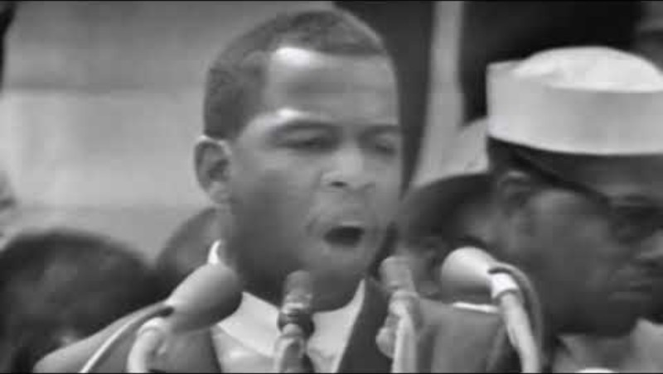
John lewis
© Microsoft. All Rights Reserved.

Slide 9
Let’s play!
Log into Minecraft Education
© Microsoft. All Rights Reserved.

Slide 10
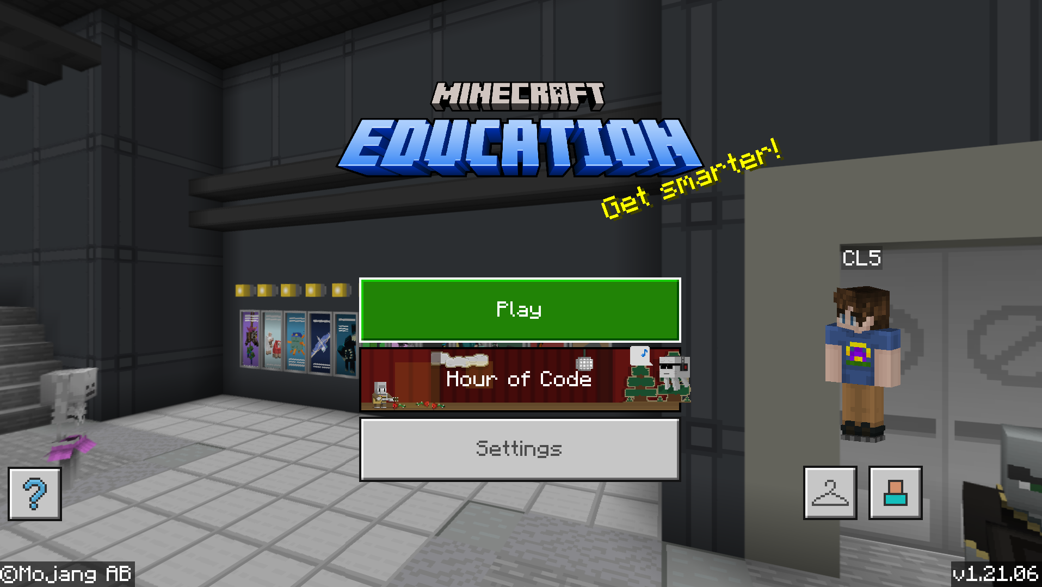
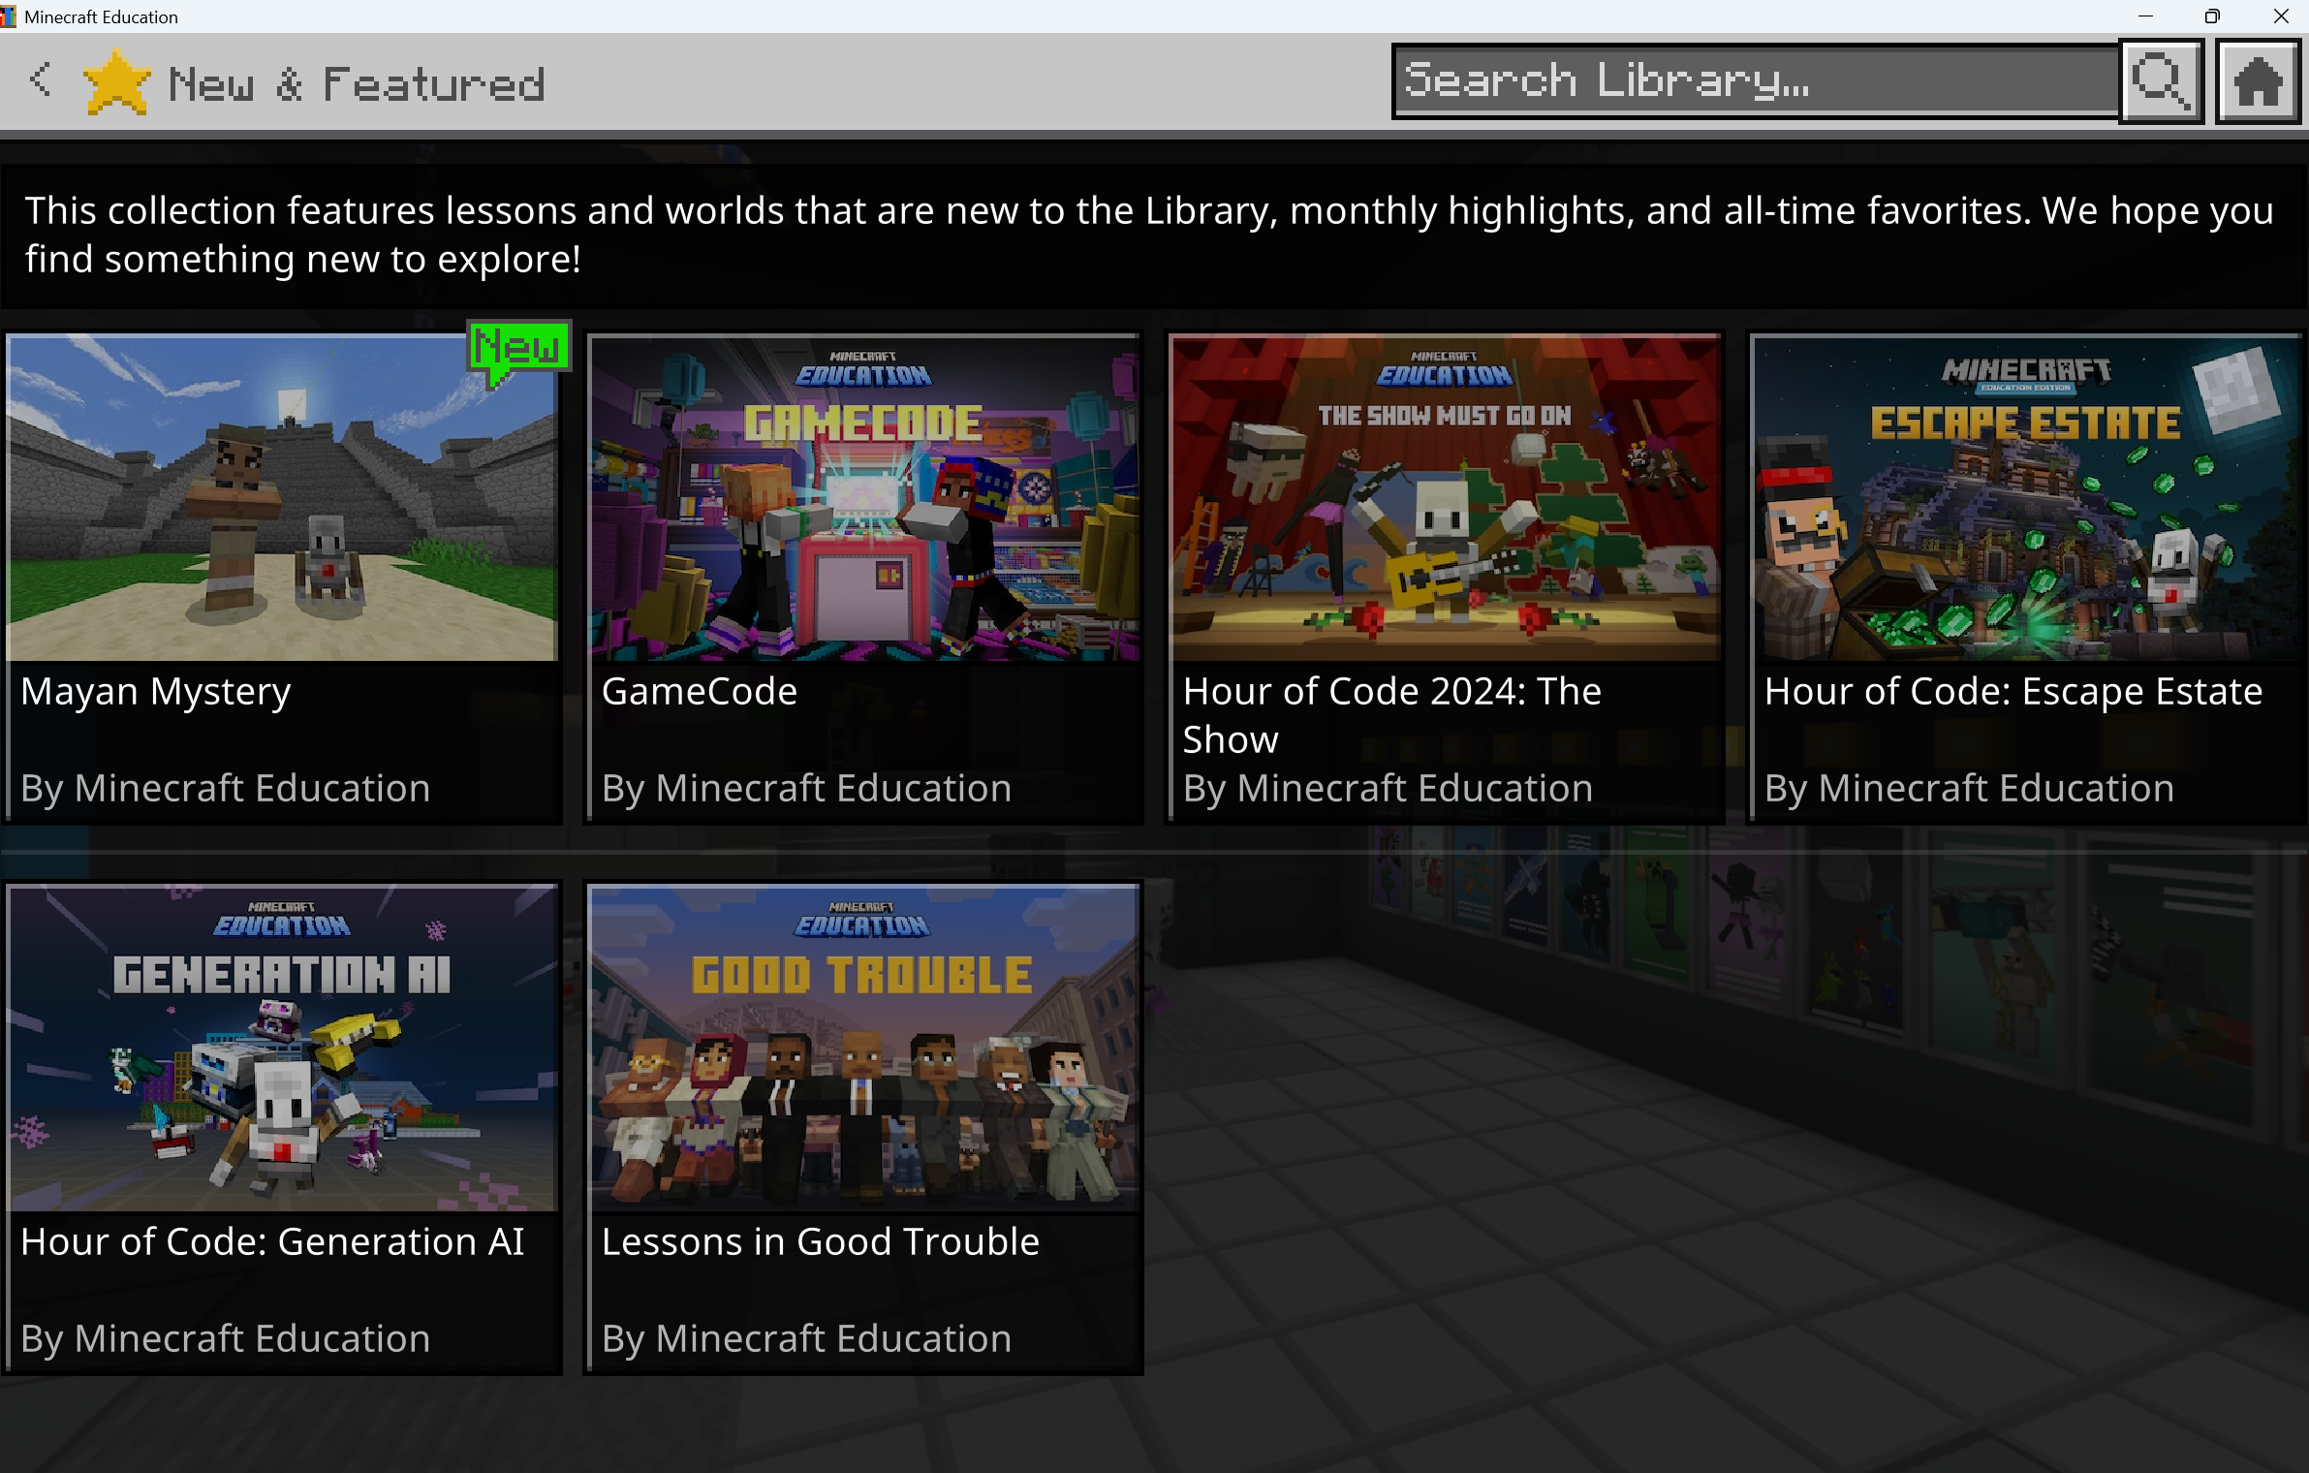
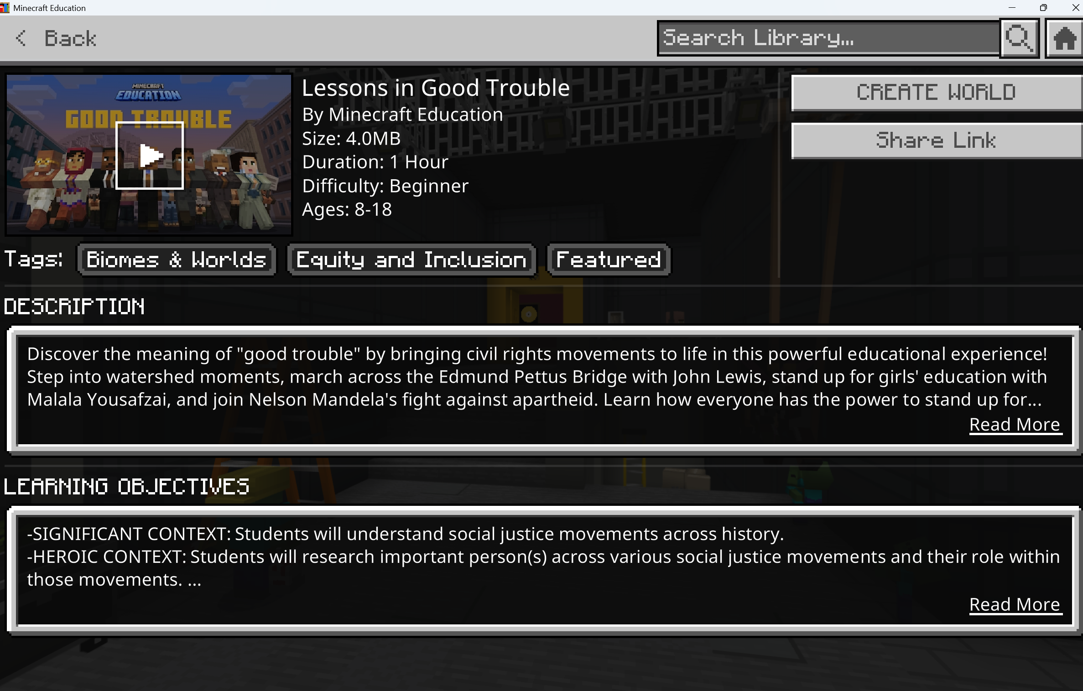



Launch the Lessons in Good trouble
Select “Hour of Code”
Select “Lessons in Good Trouble”
Select “Create World”
© Microsoft. All Rights Reserved.
Notes:
You can find the world by following these steps:

Slide 11
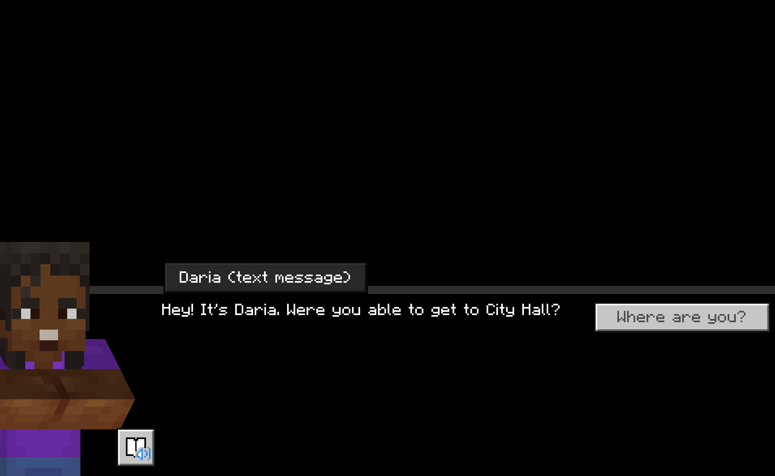
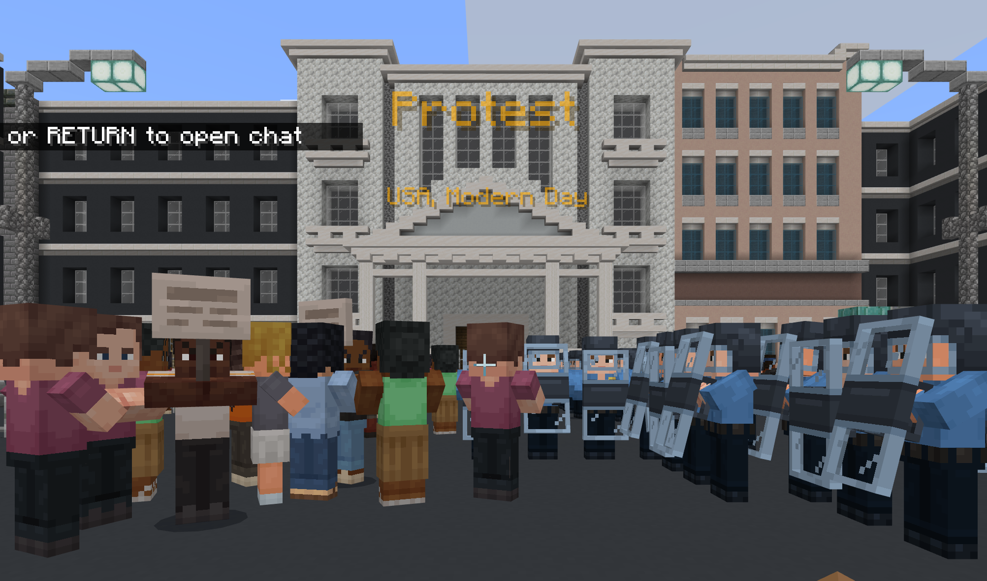
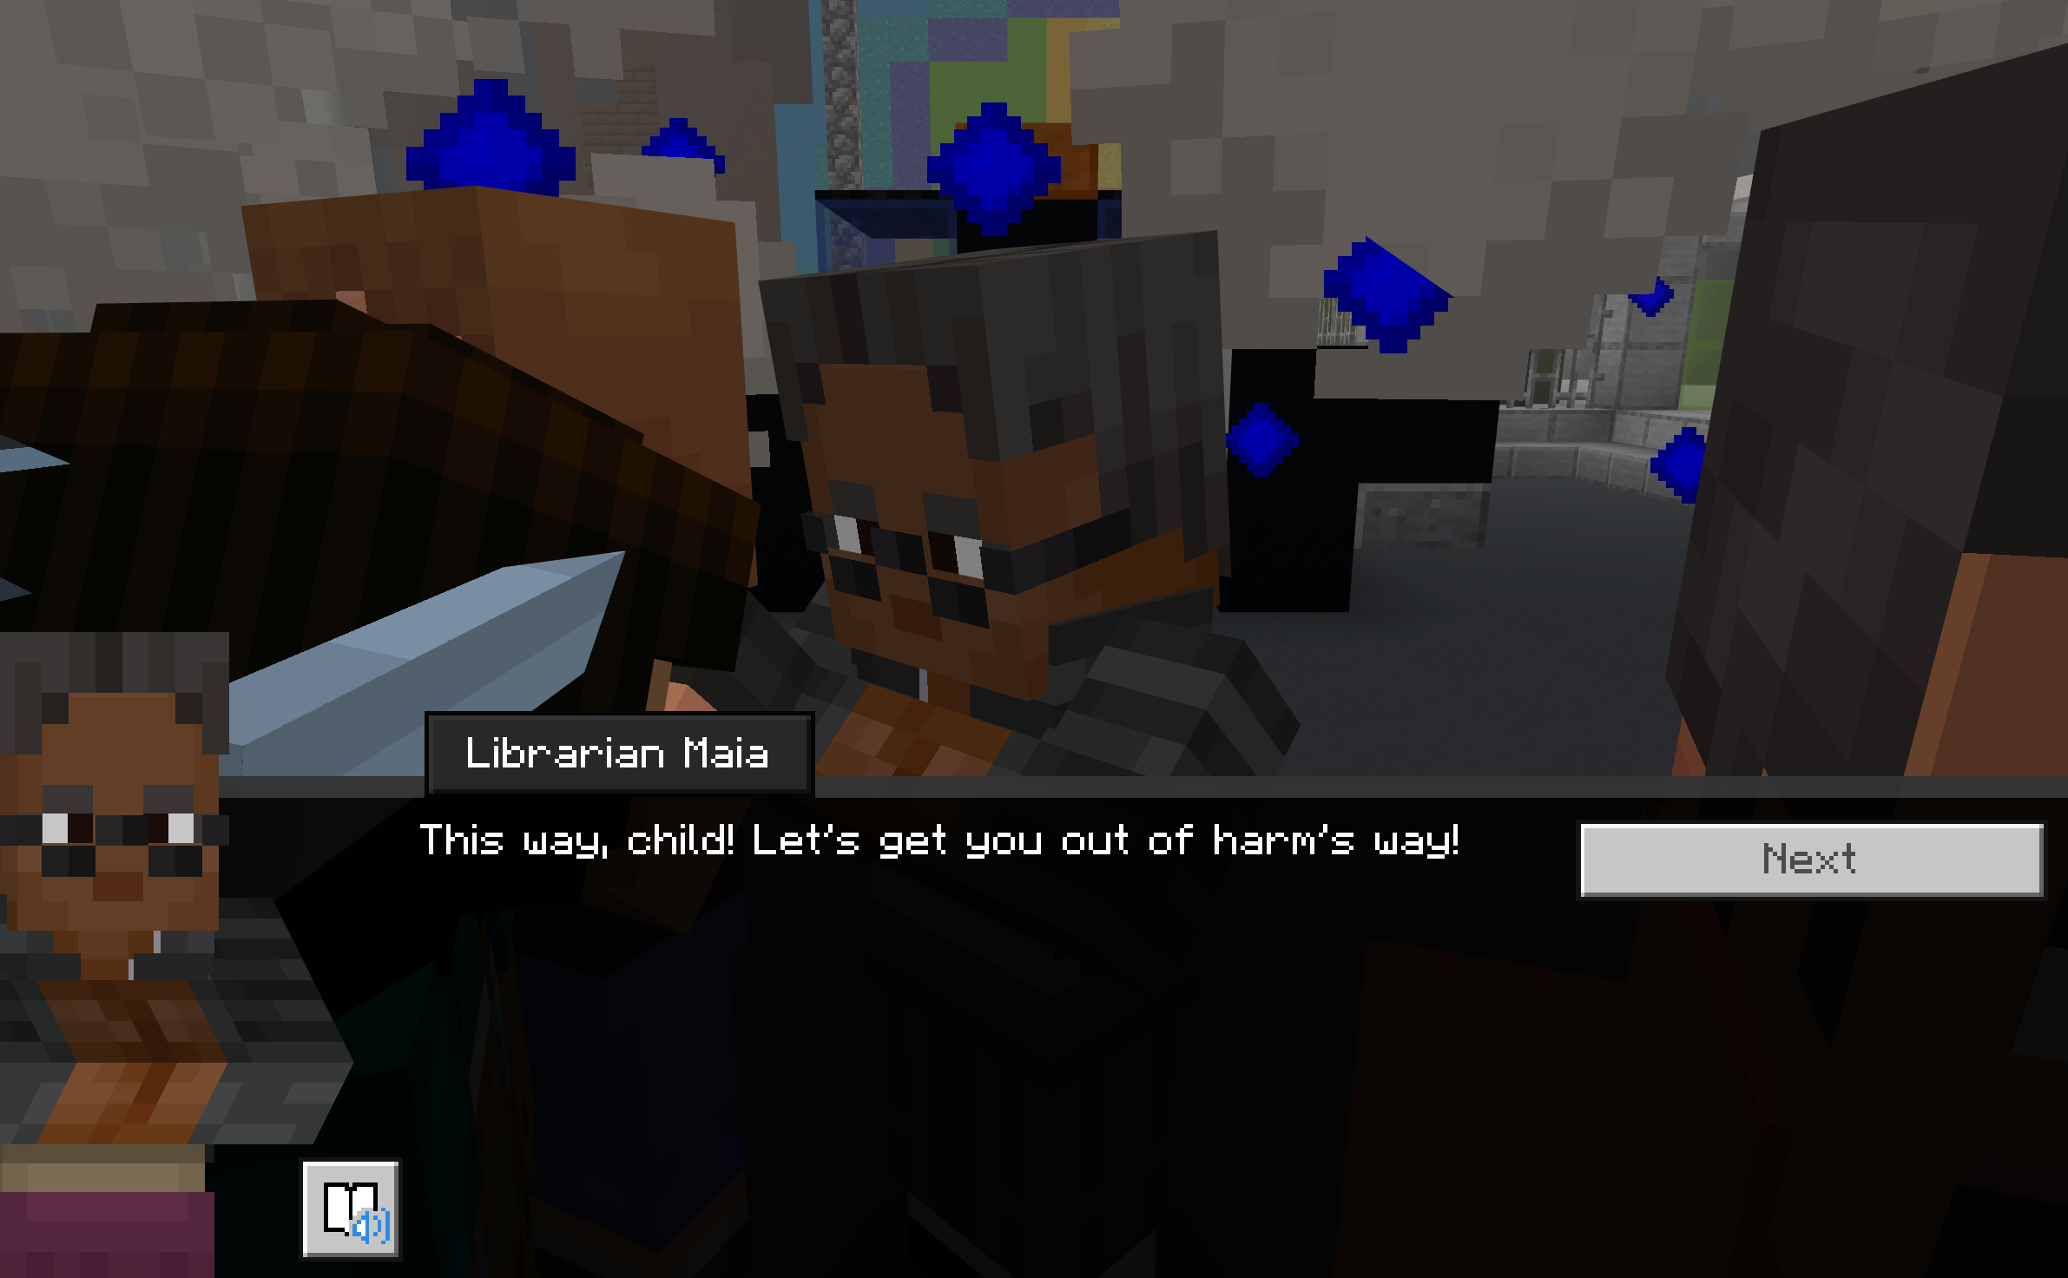
Beginning Game Play
The opening scene in Good Trouble connects you with Daria, your partner for a book report.
Next, you will walk through a short tutorial in a protest scene.
Maia will help you escape.
© Microsoft. All Rights Reserved.

Slide 12
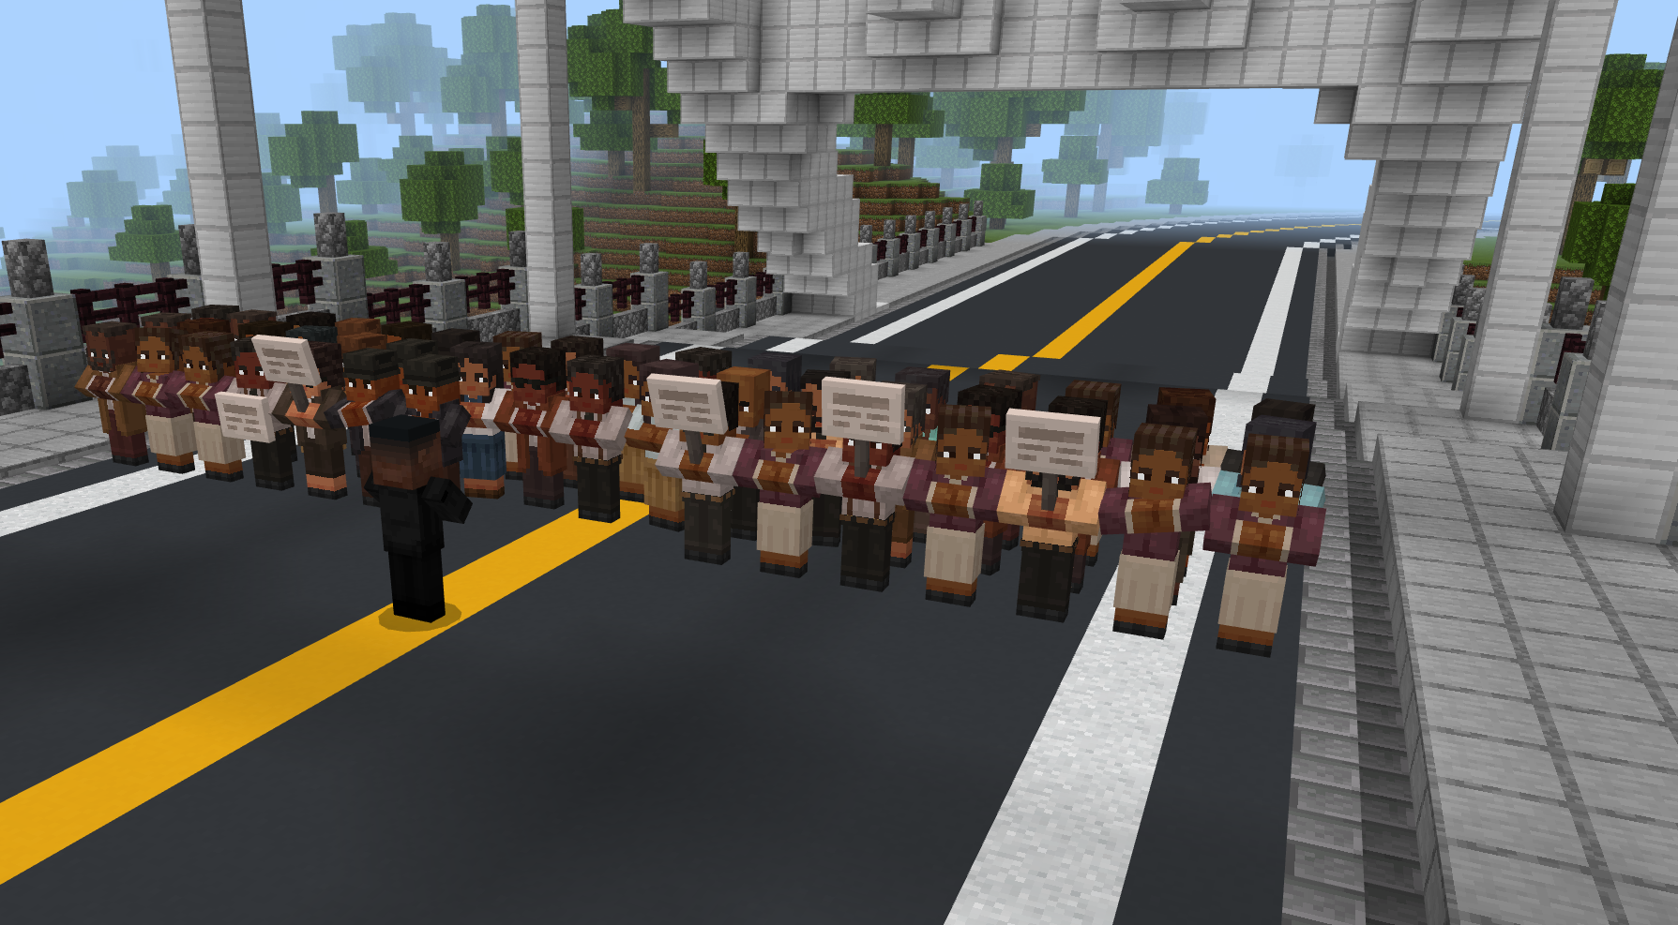
Bloody sunday
Let’s start our journey with Bloody Sunday and John Lewis
Starting with Bloody Sunday, you will interact with John Lewis and the Edmund Pettus Bridge three times throughout the game.
Explore other stories to learn more about other movements and how John Lewis inspired them.
© Microsoft. All Rights Reserved.

Slide 13
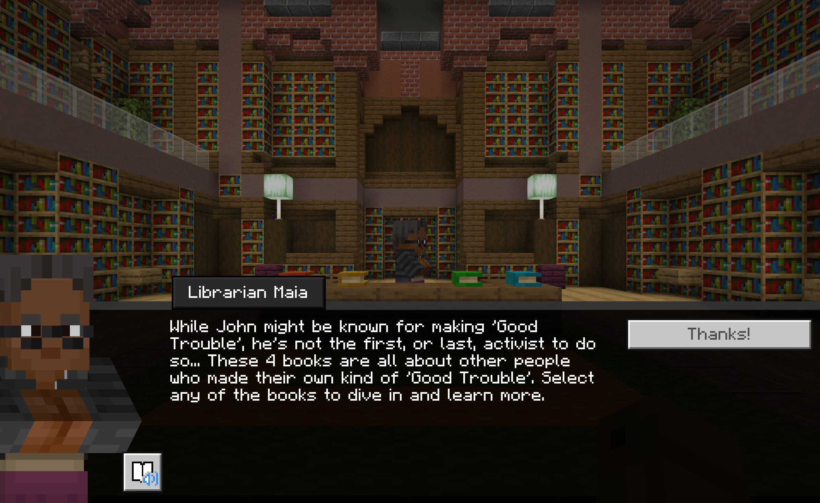
Explore Other Stories
Select one of the books on Maia’s desk to explore the stories of other global social justice movements and the leaders who inspired them.
© Microsoft. All Rights Reserved.

Slide 14
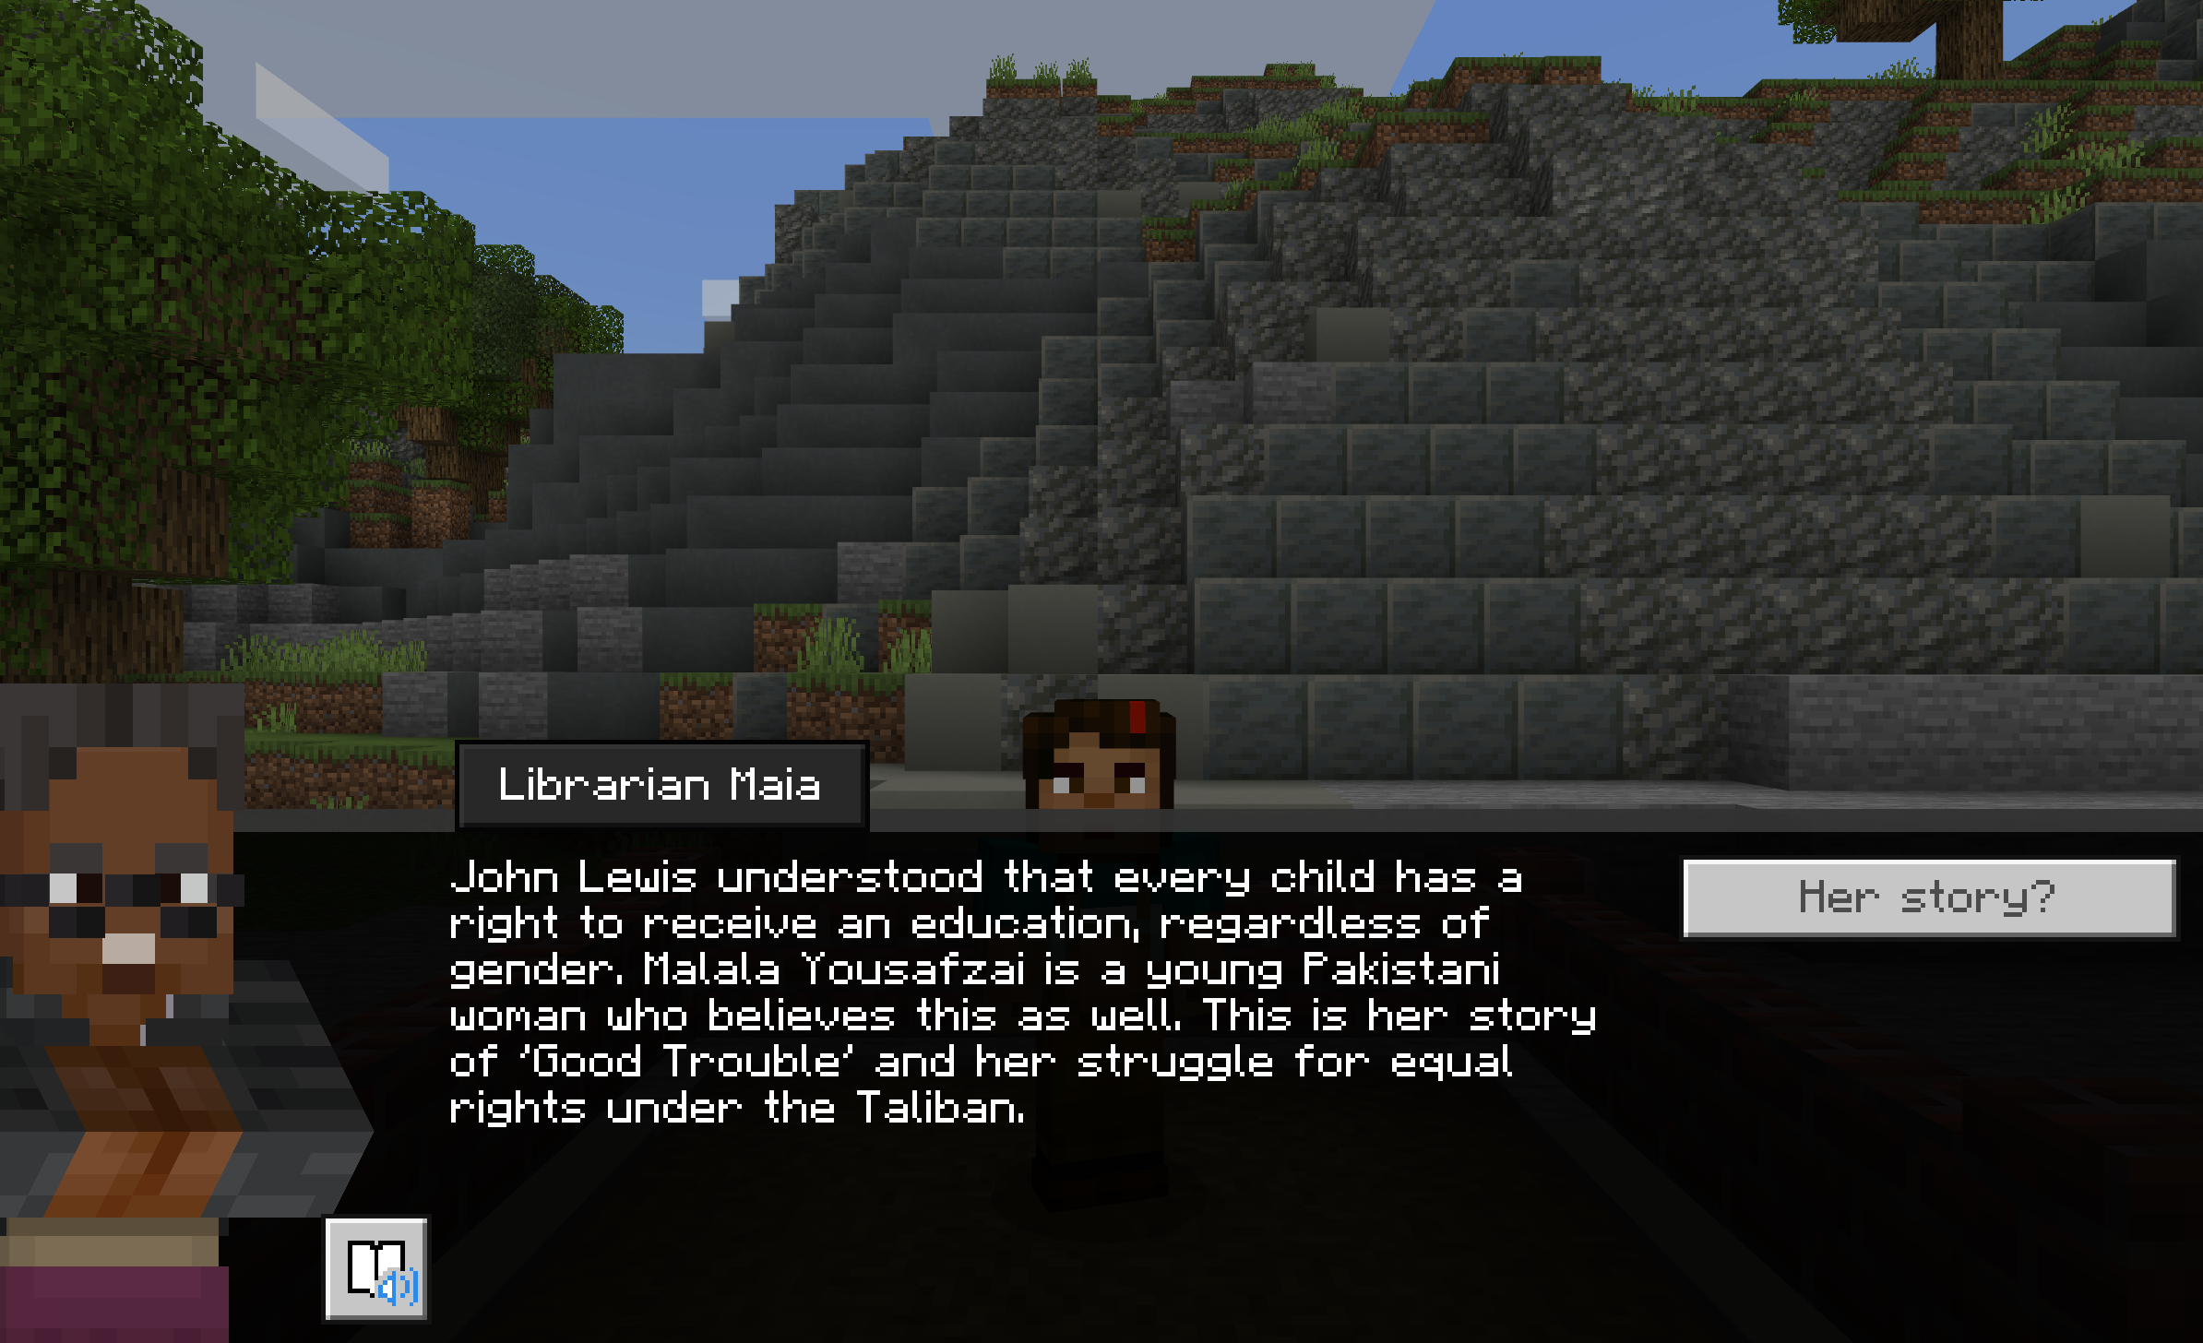
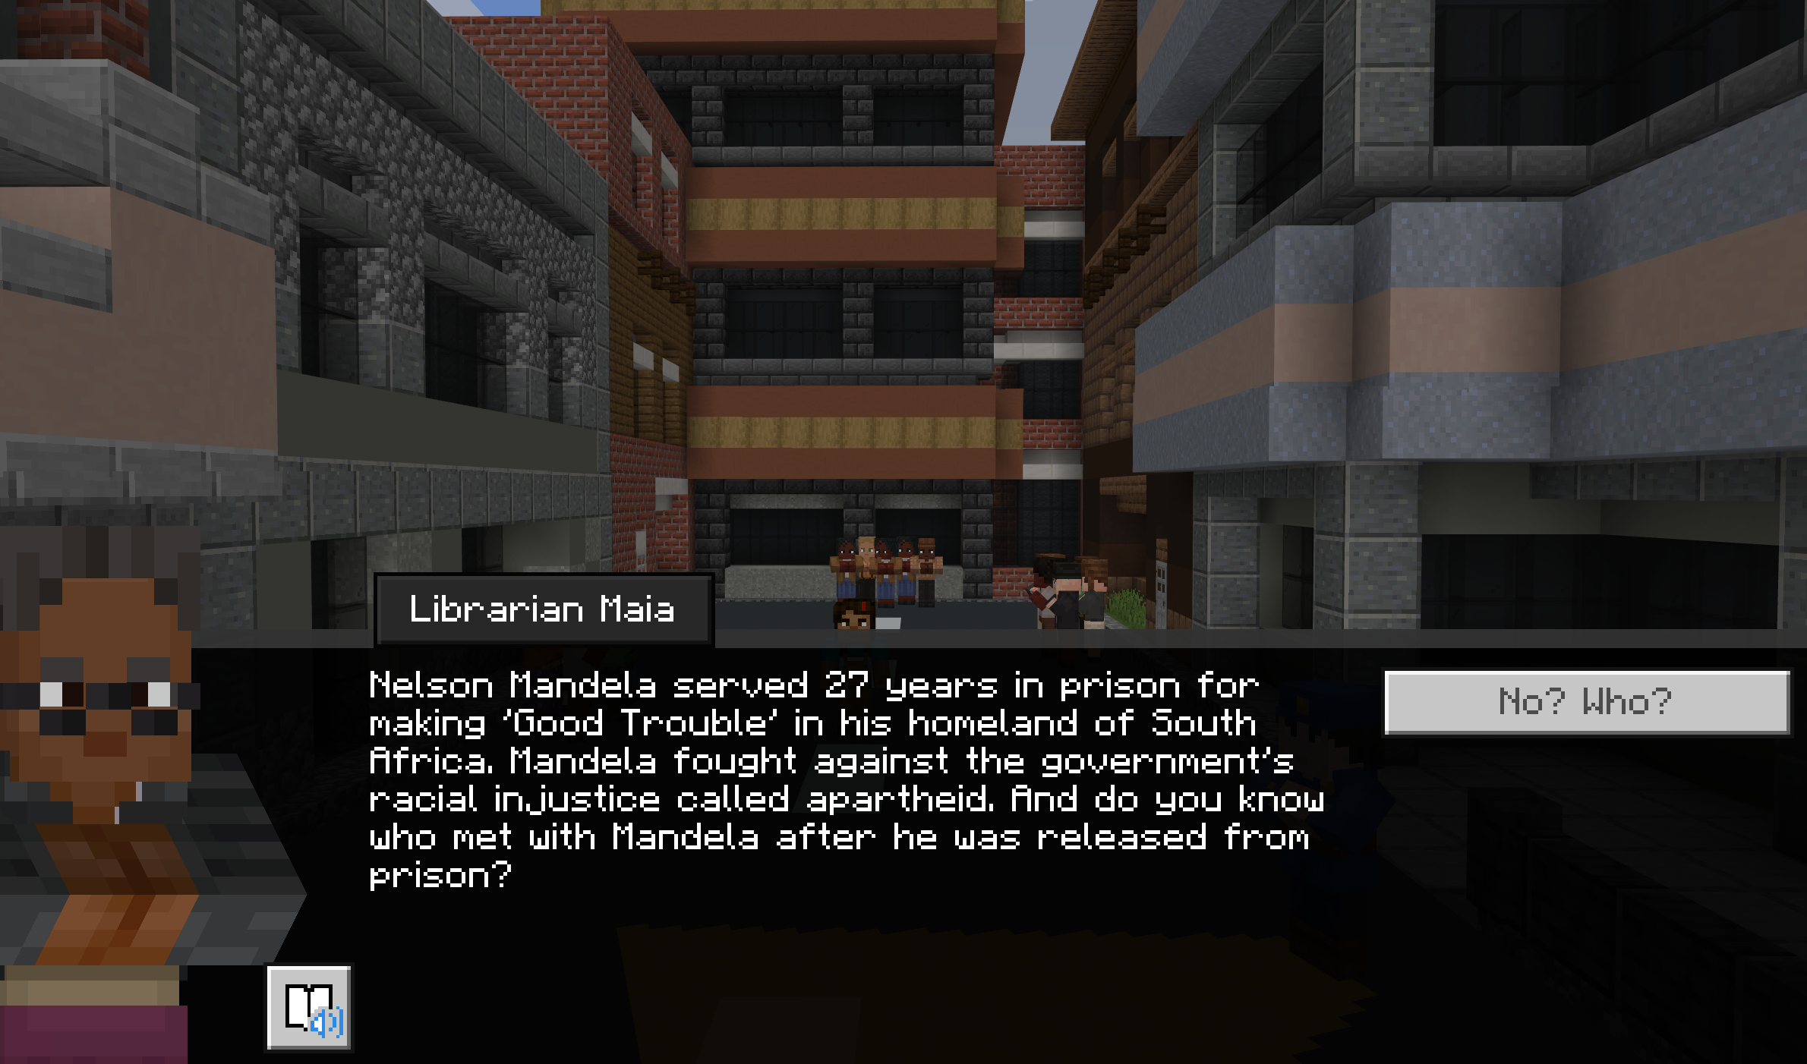
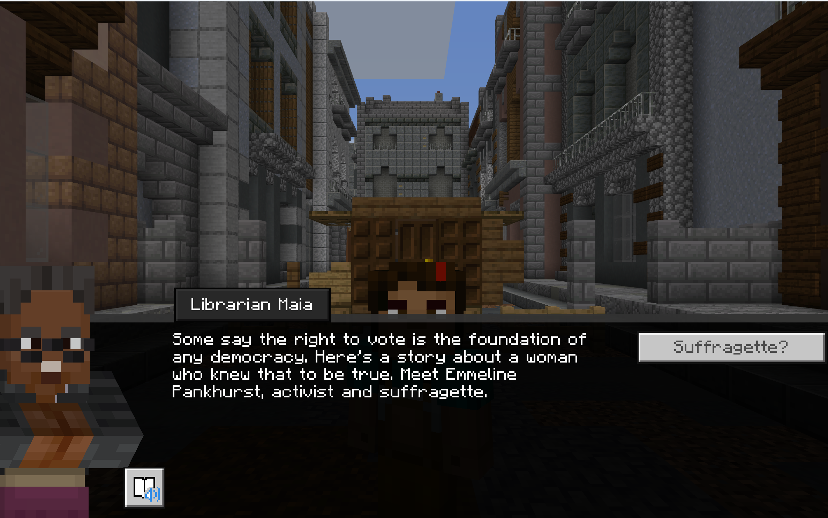
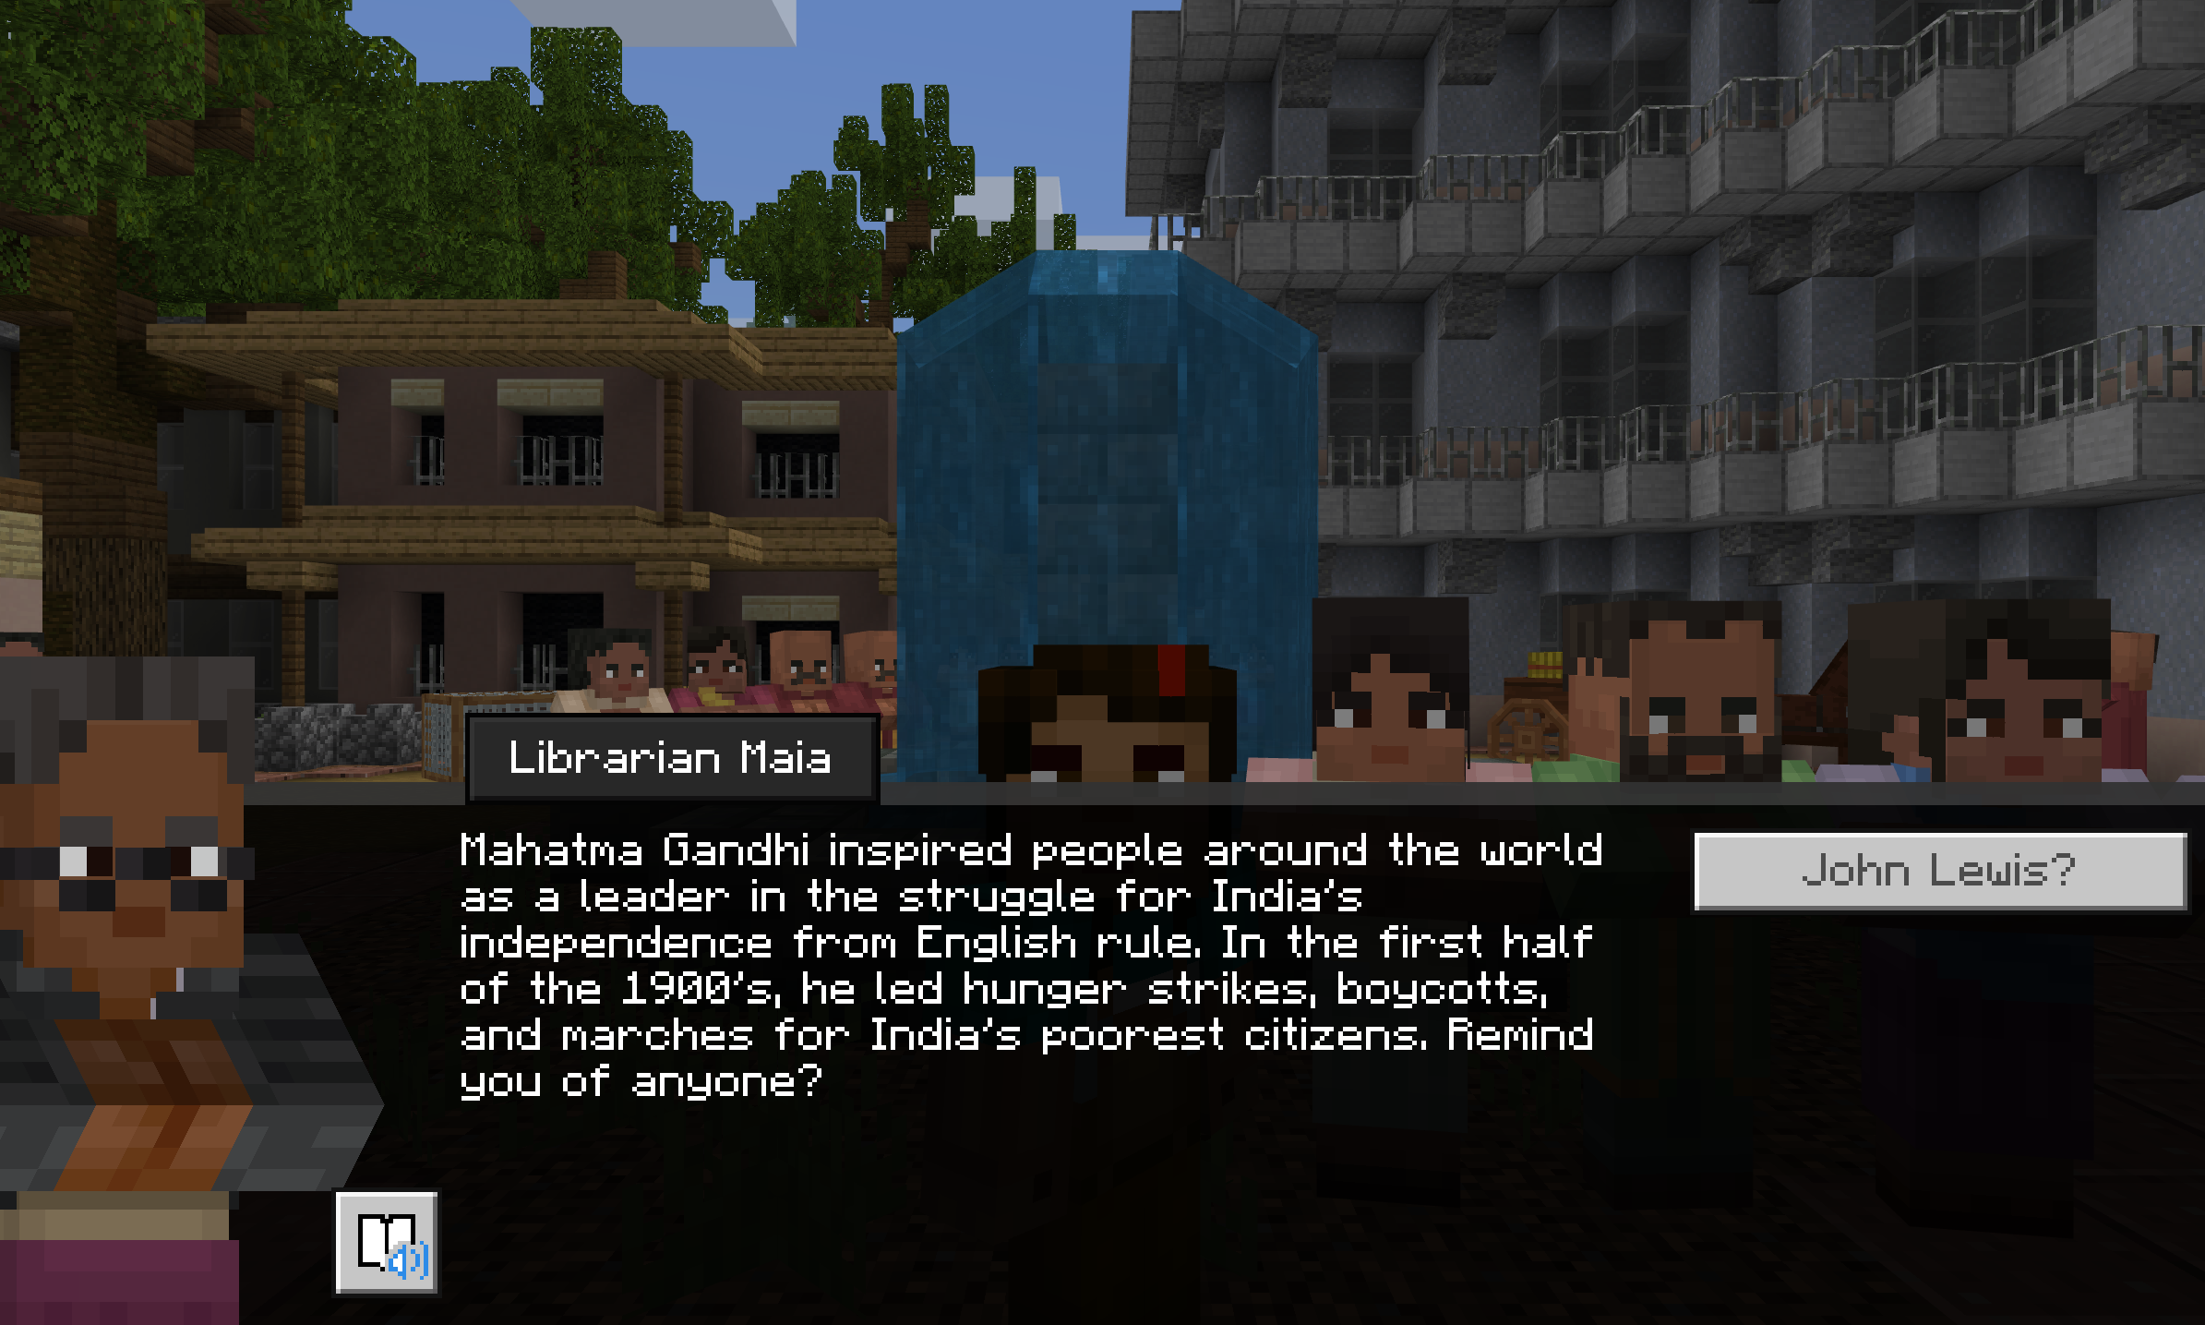
Stories of Good Trouble
Malala and Equal Education for Girls
Nelson Mandela and Anti-Apartheid
E Pankhurst and Women’s Suffrage
Gandhi and Independence for India
© Microsoft. All Rights Reserved.

Slide 15
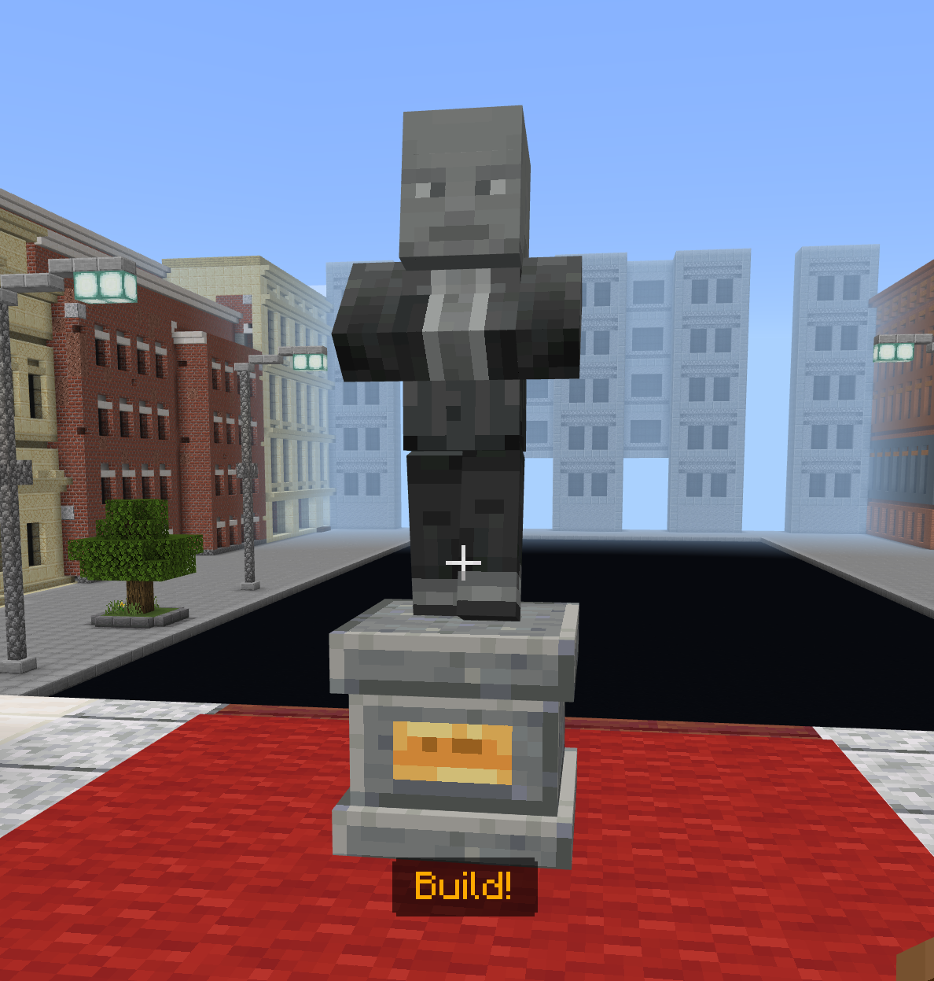
How will you build a better world?
“In my life, I have done all I can to demonstrate that the way of peace, the way of love, the way of non-violence is the most excellent way. Now, it’s your turn to let freedom ring.” – John Lewis
© Microsoft. All Rights Reserved.

