Slide 1
Round to the nearest 10’s

Slide 2
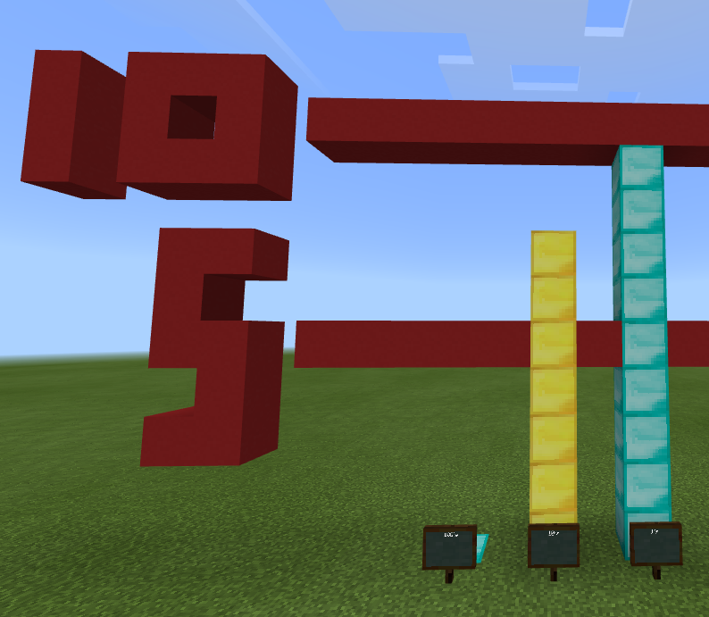
What number is this and how much is it about?
Round it to the nearest 10’s
100’s
10’s
1’s

Slide 3
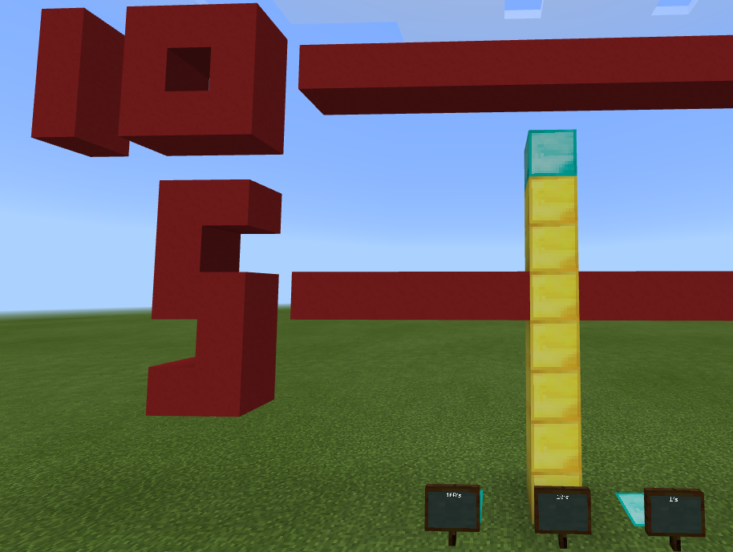
It was 79 and that’s about
80.
Why do you think there are red lines going through the numbers?
100’s
10’s
1’s

Slide 4
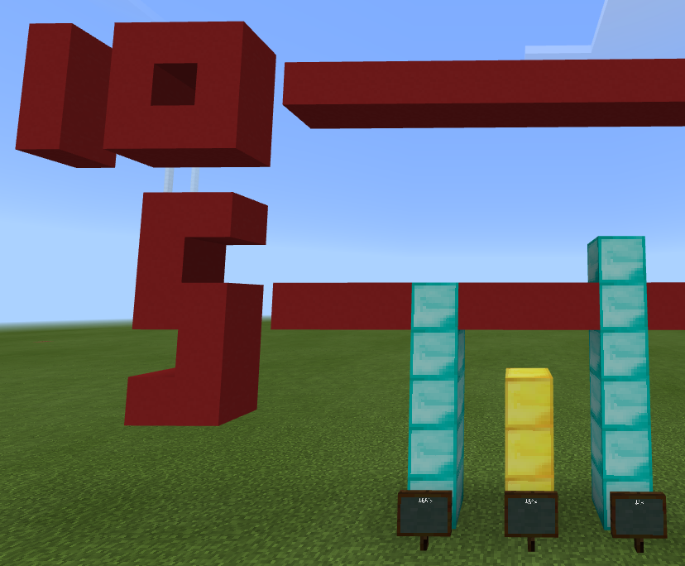
What number is this and how much is it about?
Round it to the nearest 10’s
100’s
10’s
1’s

Slide 5
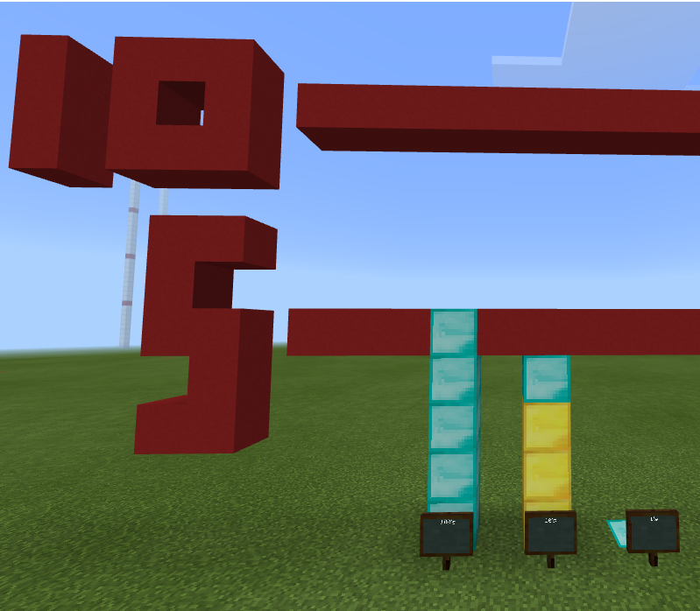
It was 536 and that’s about 540
Why do you think the tens column is gold?
100’s
10’s
1’s

Slide 6
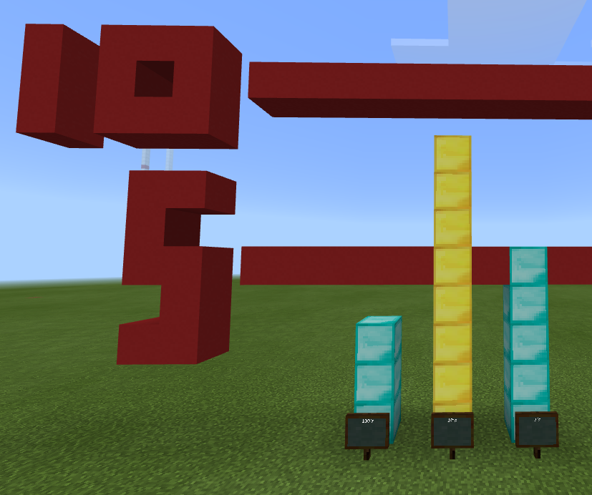
What number is this and how much is it about?
Round it to the nearest 10’s
Is the 100’s column important when you round to the nearest 10?
100’s
10’s
1’s

Slide 7
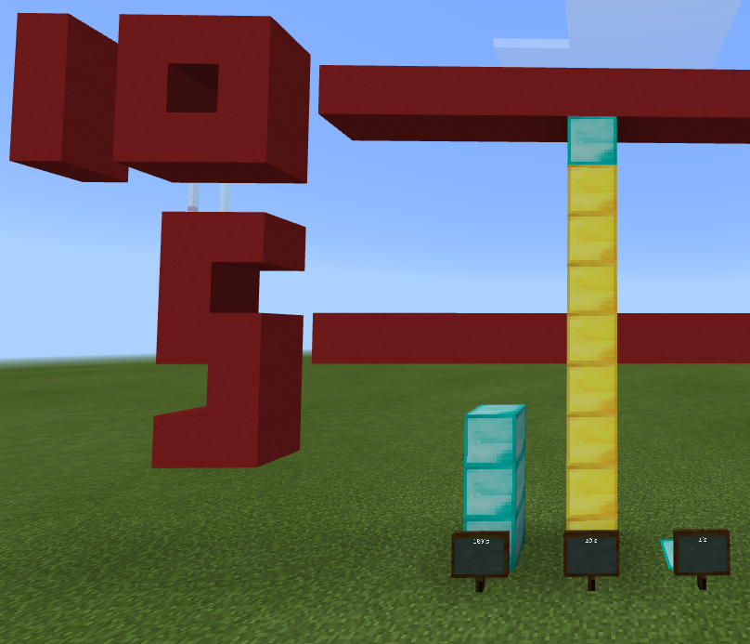
It was 385 and that’s about 390
Why is the 5 line so important?
Is the 100’s column important when you round to the nearest 10?
100’s
10’s
1’s

Slide 8
Round to the nearest 100s

Slide 9
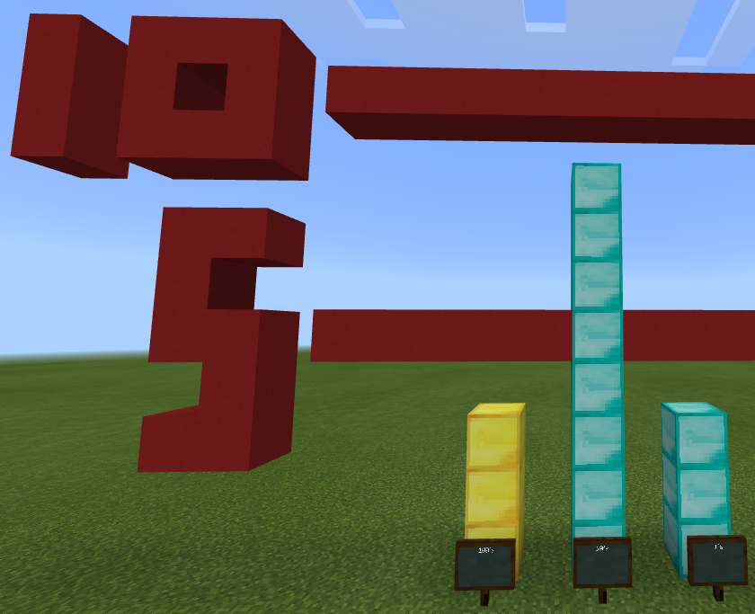
What number is this and how much is it about?
Round it to the nearest 100’s
100’s
10’s
1’s

Slide 10
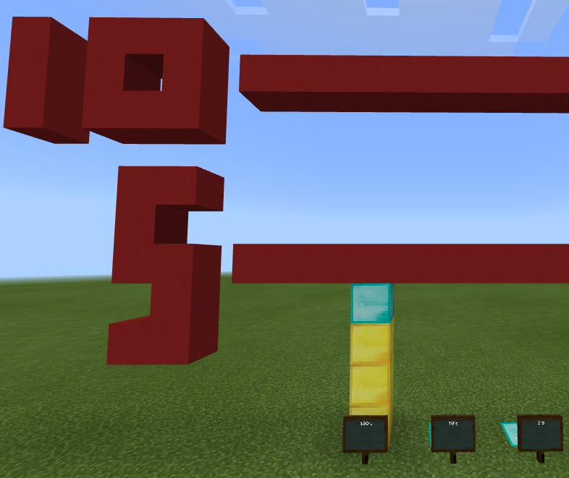
It was 383 and that’s about 400
Why is there a diamond block in the 100’s column?
100’s
10’s
1’s

Slide 11
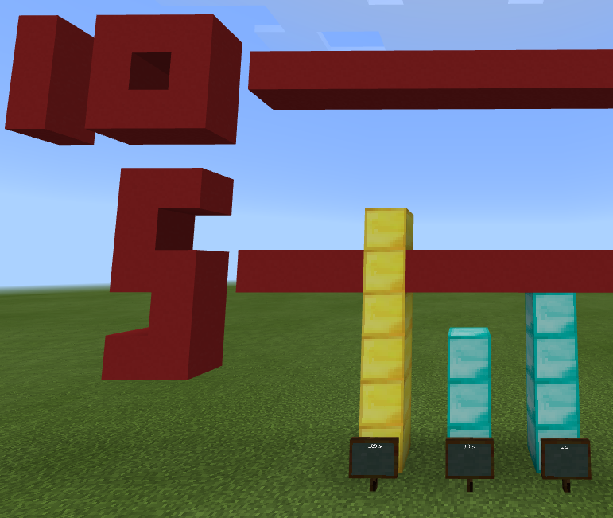
What number is this and how much is it about?
Round it to the nearest 100’s
100’s
10’s
1’s

Slide 12
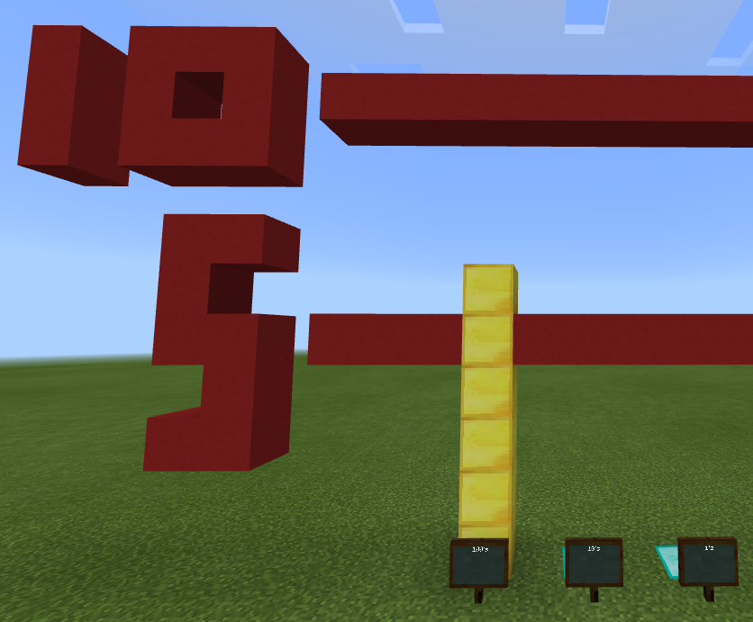
It was 624 and that’s about 600
Why is there no diamond block in the 100’s column?
100’s
10’s
1’s

Slide 13
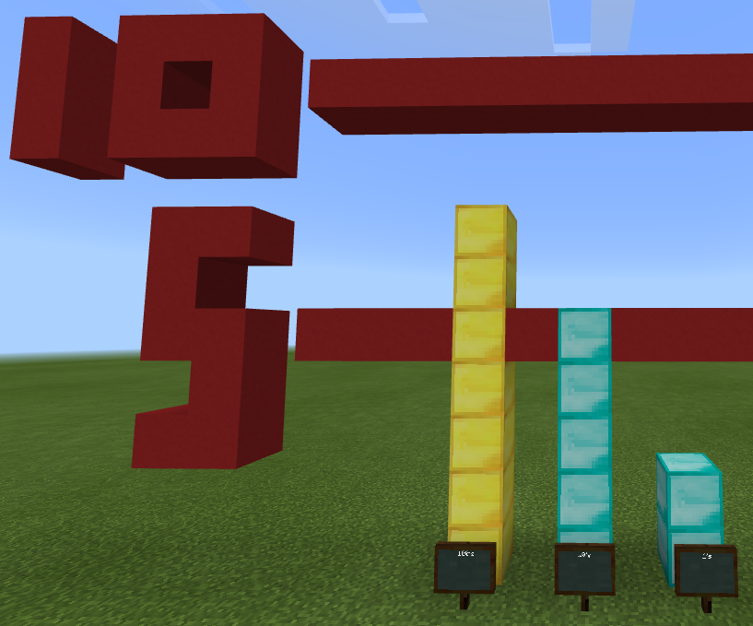
What number is this and how much is it about?
Round it to the nearest 100’s
100’s
10’s
1’s

Slide 14
It was 752 and that’s about 800
Why is the 10’s column important when we round to the nearest 100’s?
100’s
10’s
1’s

Slide 15
Why and when should we round numbers?

Slide 16
When do we not want to round numbers?

Slide 17
The Big Idea
Rounding numbers make them easier to work with.

