Slide 1
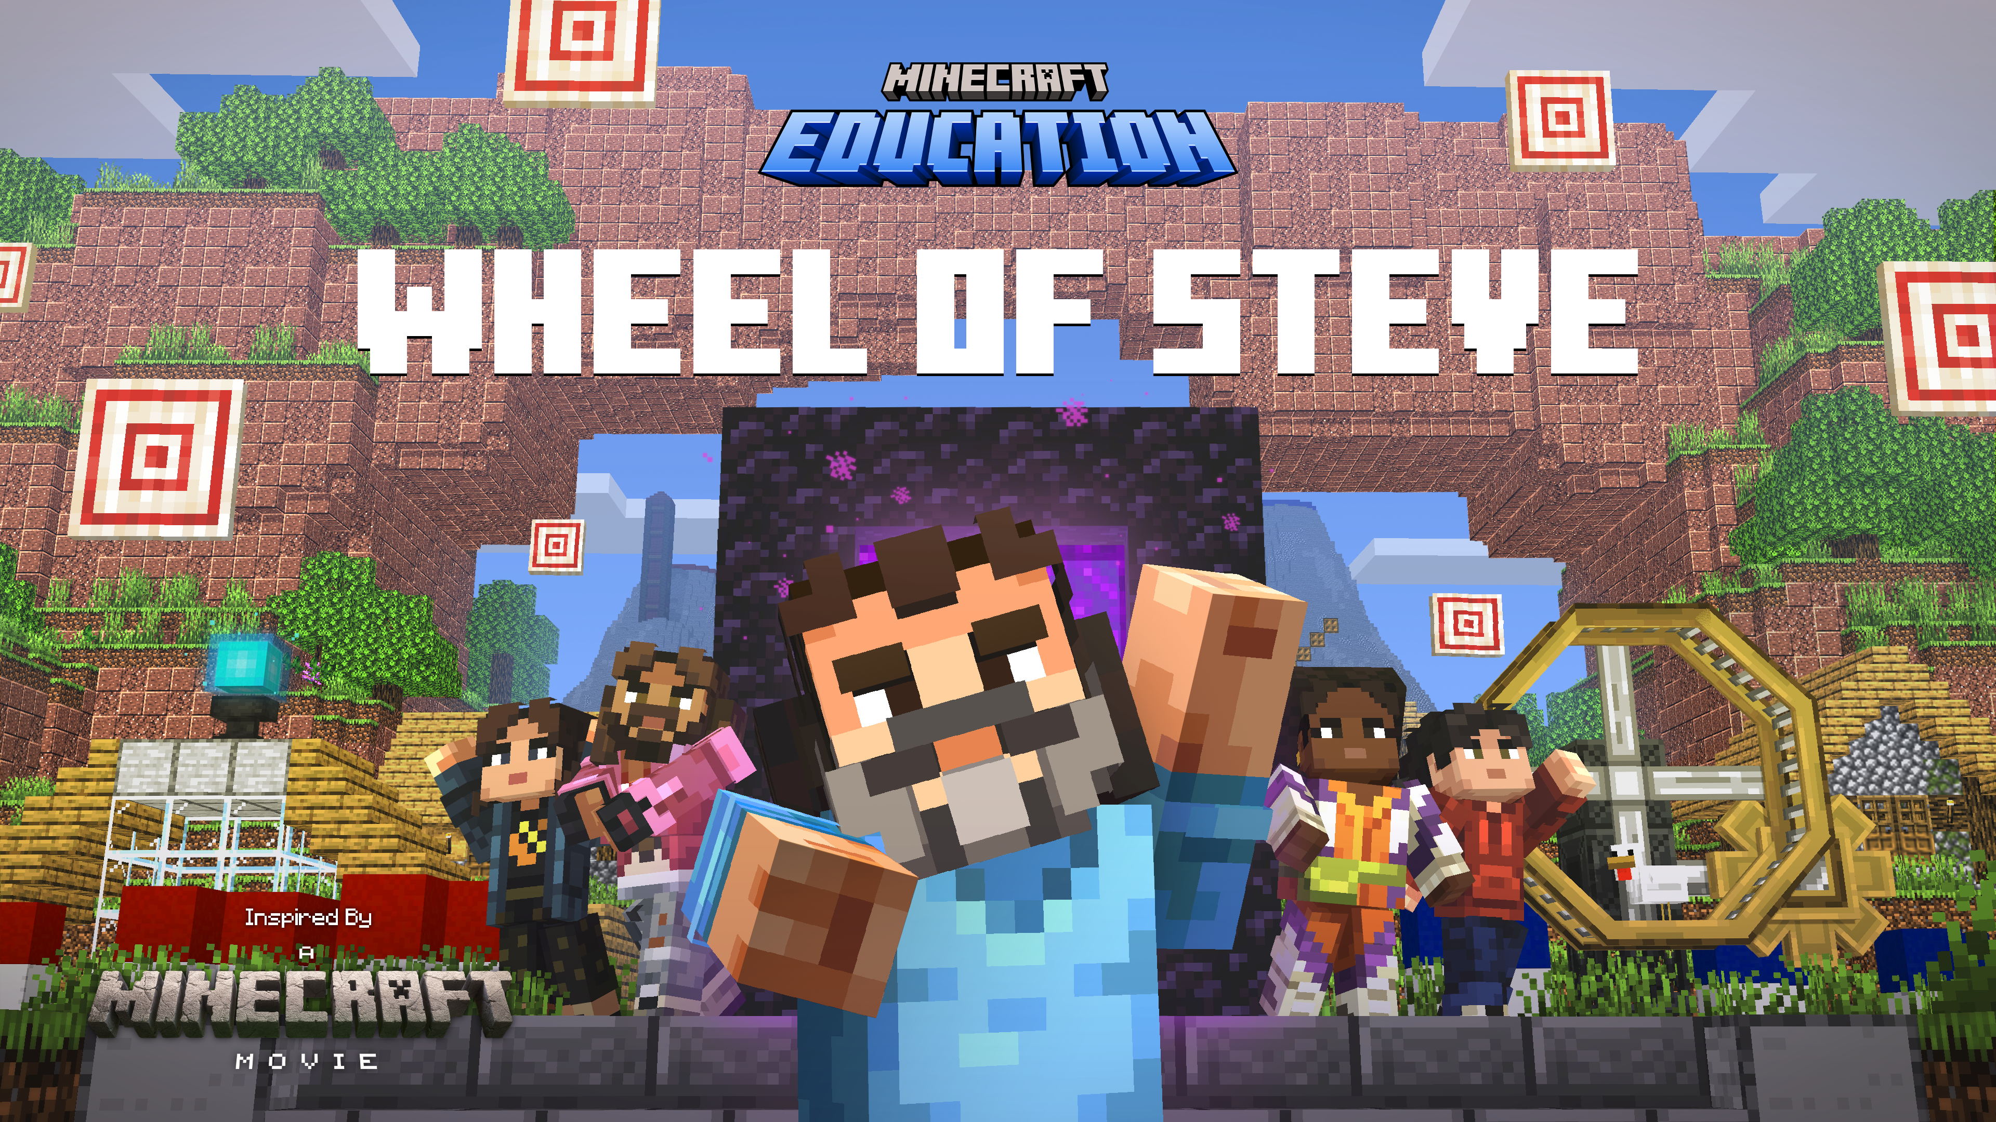
Inspired by the Artemis Missions

Slide 2
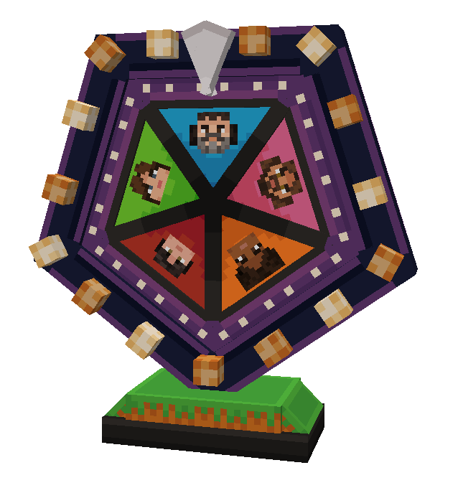

Getting started
Welcome players!
Today, you will play through a series of Minecraft mini-games that will give you the chance to practice some important skills.
Let’s spin the Wheel of Steve!
© Microsoft. All Rights Reserved.
Notes:
Let’s get started, class!
The world of AI is rapidly evolving and changing – it seems like every day it’s being added to the platforms and apps we use in our daily lives. Given how easily AI can create content, it’s important for us to understand the role we play in making sure that AI is used positively, and responsibly.
Today, we will be exploring a Minecraft world that will present various challenges. It will be up to you to decide which path you feel is right, and thinking about how your choices impact yourself, and others.
Are you ready?! Let’s go!

Slide 3
What skills are important for working in a team?
2
THINK
SHARE
PAIR
1
3
© Microsoft. All Rights Reserved.
Notes:
Let’s start with a couple of questions, to get our minds thinking about how we interact with AI.
Discussion Prompt: What are some ways you can think of where AI is used in your daily life?
You can prompt a discussion by providing some examples of AI models (i.e. voice assistants available through phones and smart home devices, self-driving cars, language translation, chatbots, such as customer service bots, etc.)

Slide 4
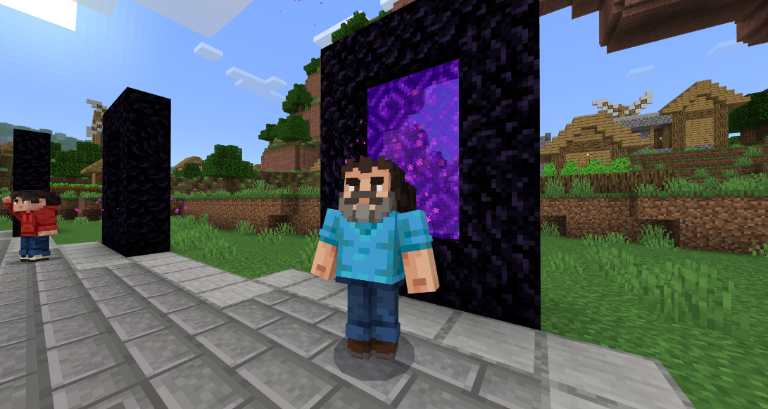
21st Century skills
Each of the five mini-games in Wheel of Steve is designed to help you practice one of these skills:
Creativity
Critical Thinking
Communication
Community
Collaboration
© Microsoft. All Rights Reserved.

Slide 5
21st Century skills
Wheel of Steve
Creativity
Connection
Critical thinking
Collaboration
Communication
What do these words mean?
What are some ways you can think of where you use these skills in school and in your daily life?
How might you use these skills during games you play as a team, either in real life sports or in video games?
© Microsoft. All Rights Reserved.
Notes:
The 21st century skills of Creativity, Critical Thinking, Communication, Connection, and Collaboration are essential for student success as they equip students with the ability to navigate and thrive in an increasingly complex and interconnected world.
Creativity fosters innovation and problem-solving, allowing students to think outside the box and develop unique solutions.
Critical Thinking enables them to analyze information critically and make informed decisions.
Communication is crucial for expressing ideas clearly and working with others.
Community helps students build meaningful relationships and networks, enhancing their social and emotional intelligence.
Collaboration teaches them to work effectively in teams, leveraging diverse perspectives to achieve common goals.
Together, these skills prepare students to adapt to changing environments, excel in their careers, and contribute positively to society.

Slide 6
Let’s play!
For each pair of teams, choose a “host” player to load the world.
Teams’ members join the host’s world.
Choose teams of up to four players
1
2
3
© Microsoft. All Rights Reserved.
Notes:
Let’s start with a couple of questions, to get our minds thinking about how we interact with AI.
Discussion Prompt: What are some ways you can think of where AI is used in your daily life?
You can prompt a discussion by providing some examples of AI models (i.e. voice assistants available through phones and smart home devices, self-driving cars, language translation, chatbots, such as customer service bots, etc.)

Slide 7
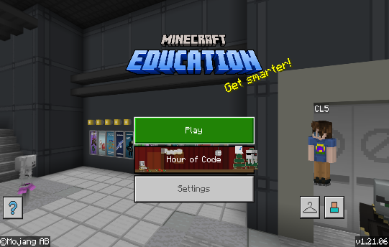
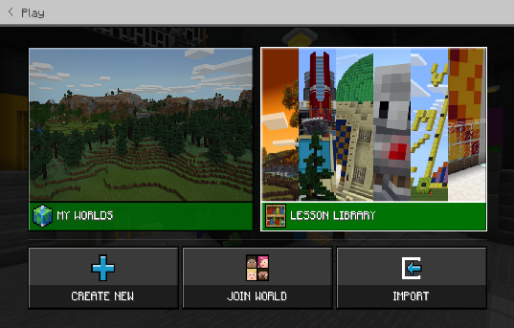
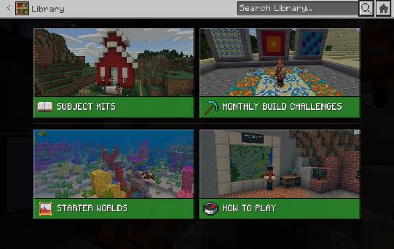



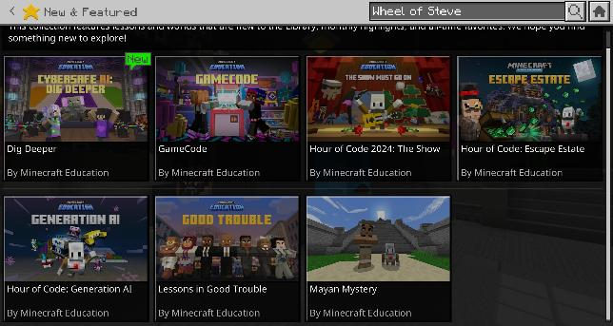
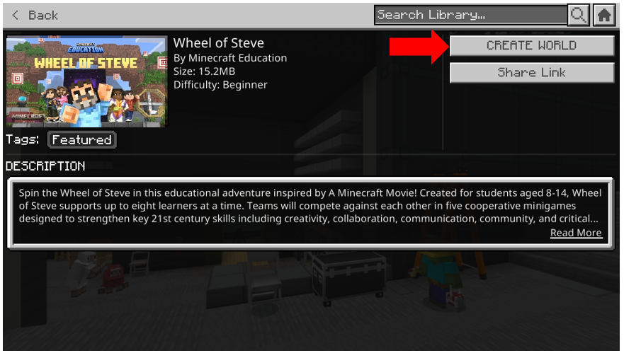
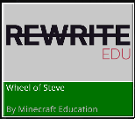

Hosts launch the world
Select “Play”
Select “Lesson Library”
Search Wheel of Steve
Select “Wheel of Steve”
Select “Create World”
© Microsoft. All Rights Reserved.
Notes:
You can find the world by following these steps:
Click “Play” from the main menu.
Select “Lesson Library”.
Select “Subject Kits”.
Select “Computer Science”.
Select “Cyber”.
Select “CyberSafe”.
From here you should see CyberSafe AI: Dig Deeper.
Select “Create World”.

Slide 8
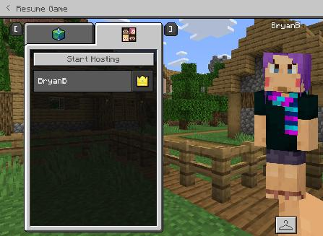
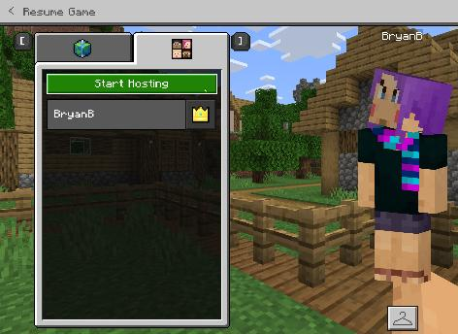
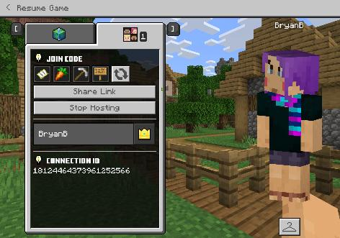
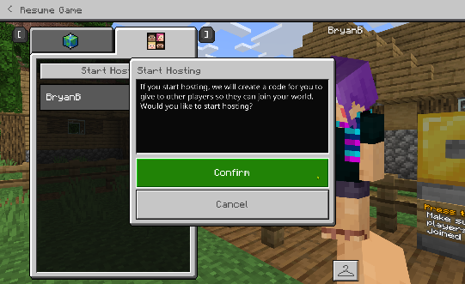
Hosts Begins hosting
1
2
Pause game, select Friends tab
Select “Start Hosting”
3
4
Provide the join code to other players who will be joining your world
Select Confirm
© Microsoft. All Rights Reserved.
Notes:
You can find the world by following these steps:
Click “Play” from the main menu.
Select “Lesson Library”.
Select “Subject Kits”.
Select “Computer Science”.
Select “Cyber”.
Select “CyberSafe”.
From here you should see CyberSafe AI: Dig Deeper.
Select “Create World”.

Slide 9
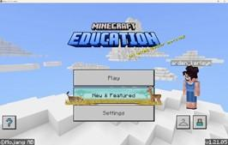
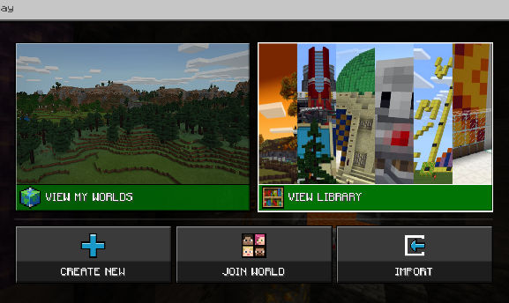
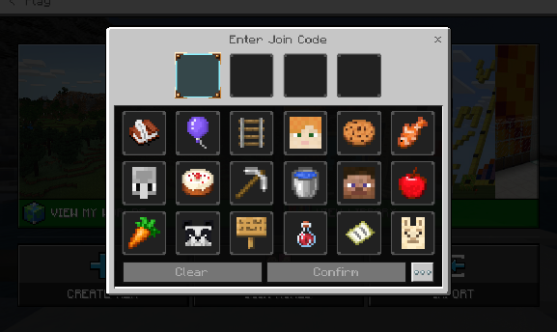
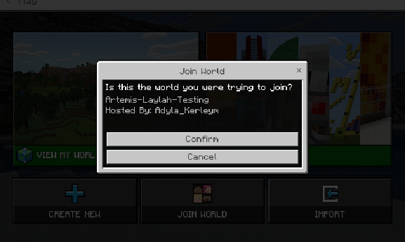
Team members join host world
1
2
3
4
© Microsoft. All Rights Reserved.

Slide 10
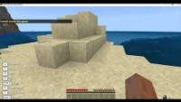
Hosting and joining a world

Slide 11
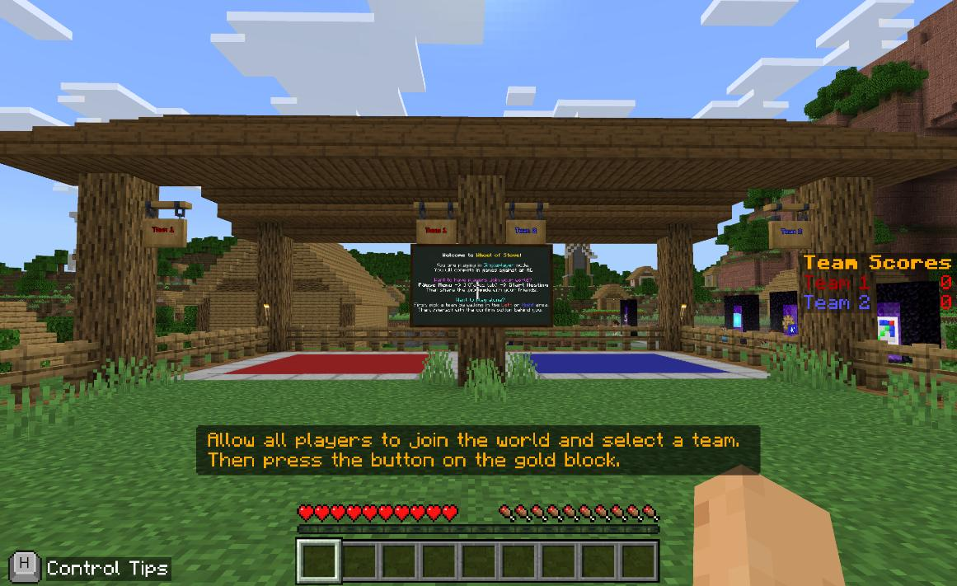
Team selection
Step on the Red or Blue mat to join a team.
© Microsoft. All Rights Reserved.

Slide 12
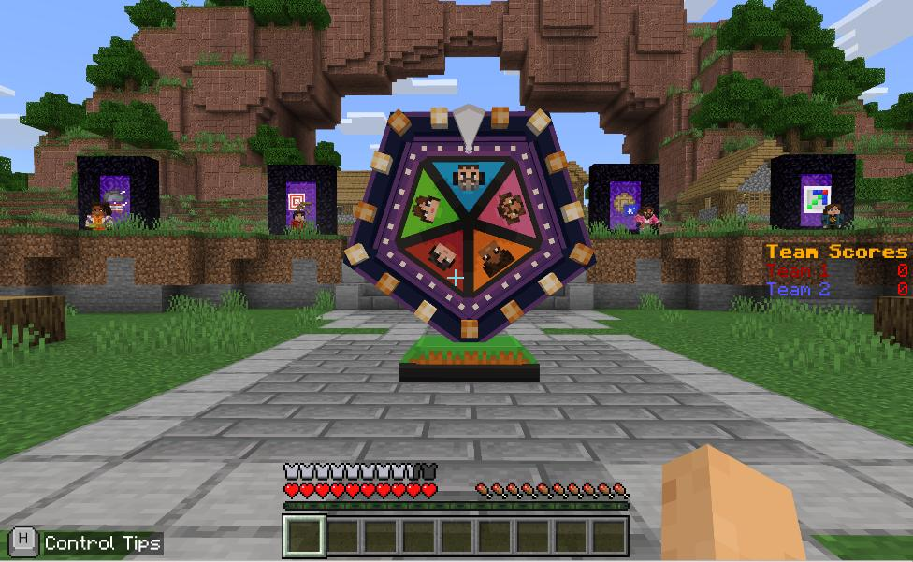
game selection
Spin the Wheel of Steve!
Host spins the wheel. The first team to win 3 random mini-games is the winner.
Practice the mini-games!
The host can speak with any character to begin playing a specific mini-game to practice.
© Microsoft. All Rights Reserved.

Slide 13
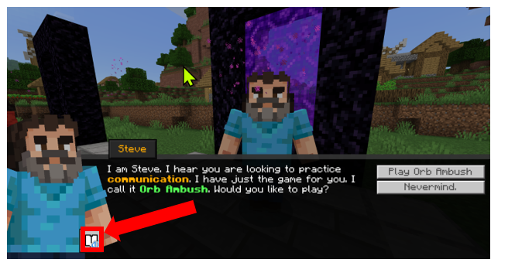
Immersive Reader
Immersive Reader, part of Minecraft Education, reads signs and NPC dialog! It is incredibly helpful! It’s great for extra help for reading, including translating the text and reading it aloud.
How to use Immersive Reader in Minecraft: Education Edition https://aka.ms/ImmersiveReaderYT
© Microsoft. All Rights Reserved.

Slide 14
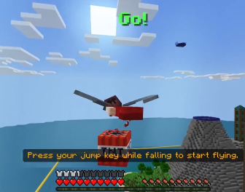
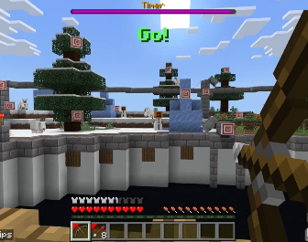
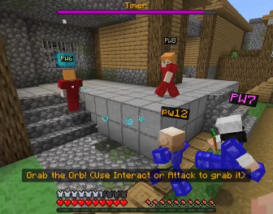
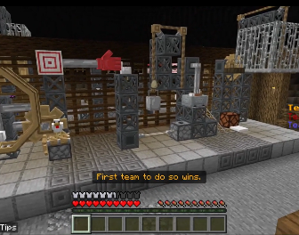
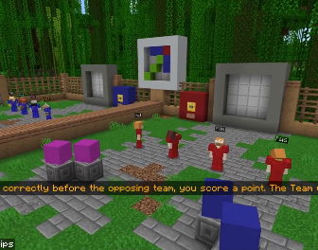
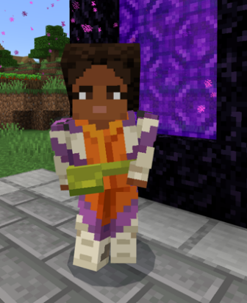
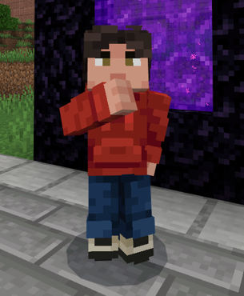
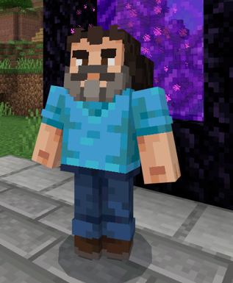
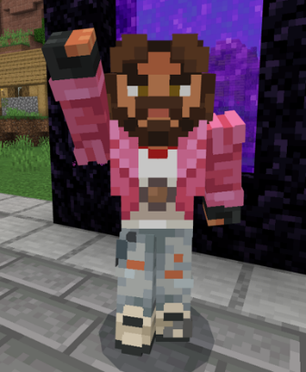
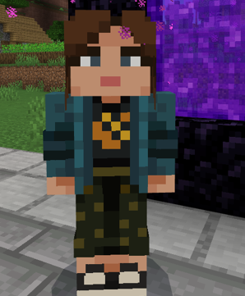
Games
Elytra Rumble
Nock it Off
Orb Ambush
Contraption Craft Off
Grid Wars
© Microsoft. All Rights Reserved.

Slide 15
Good luck and have fun!

Slide 16

Reflection
What were some creative solutions you came up with during the activity?
What challenges did you face, and how did you overcome them? What strategies did you use to analyze and solve problems?
How did you communicate your ideas to your teammates? What methods worked best for effective communication?
How did you build relationships and connect with your teammates? What actions did you take to ensure everyone felt included?
How did you contribute to the team's success? What role did you play, and how did you support your teammates?
© Microsoft. All Rights Reserved. Inspired by A Minecraft Movie

