Slide 1
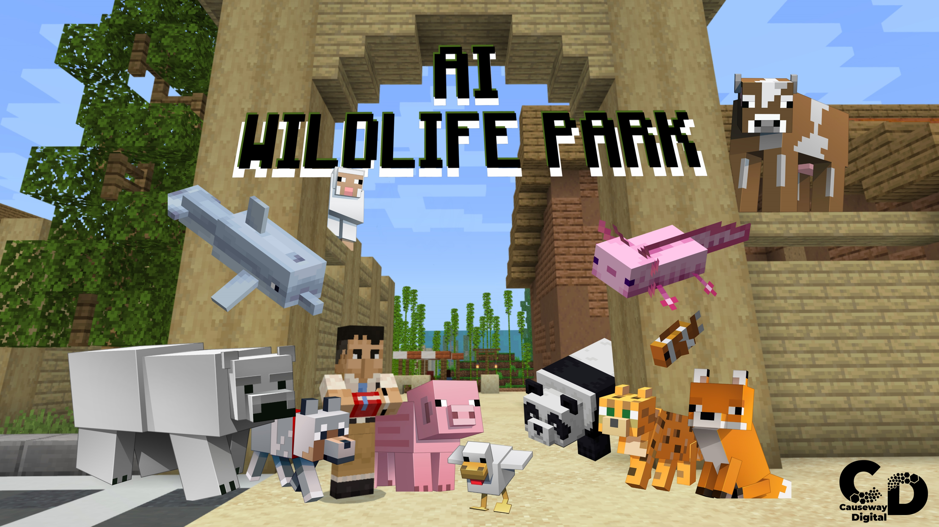




Slide 2
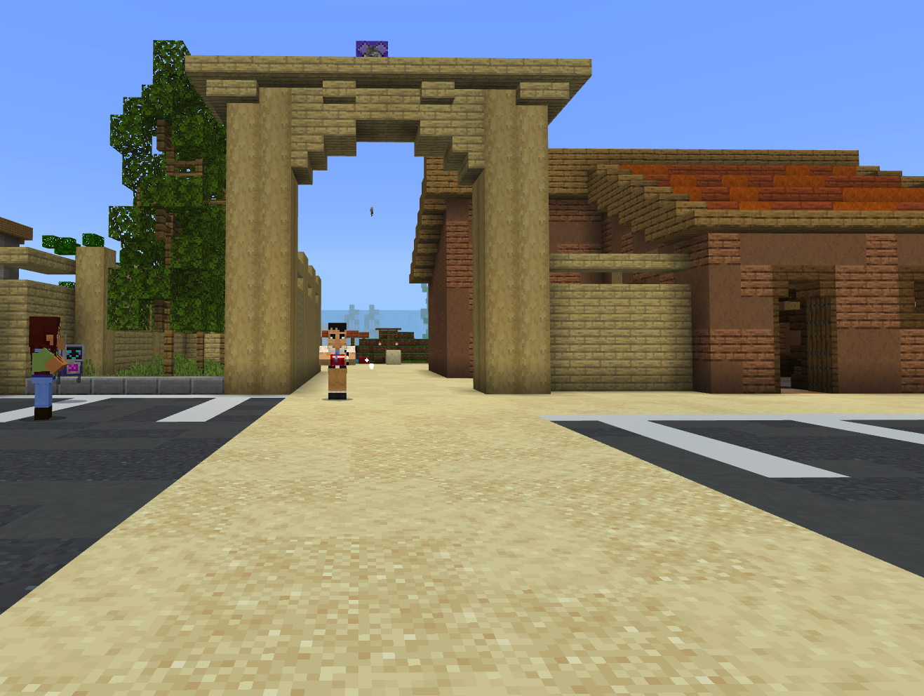
Overview
We are going to explore the AI Wildlife Park to help them with feeding the animals.
While exploring the AI Wildlife Park we will learn:
  The very basics of Artificial Intelligence.
  How to train an AI and how this impacts the AI decisions.
  How the AI decisions can be controlled.
  What CAPTCHAs are and how they are used.

Slide 3
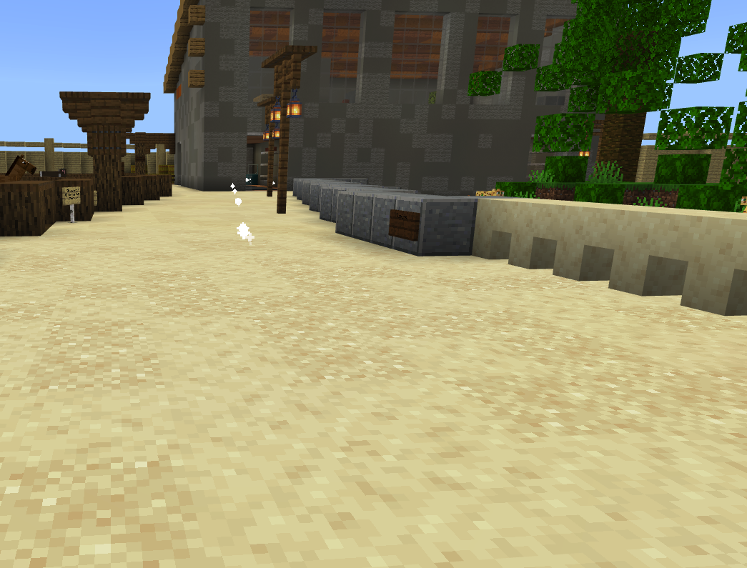
Introduction
Follow the particles on the ground and speak to the head ranger.
Notes:
Say: Your pseudocode should look similar to this. Between this and the Python code we gave you on the previous slide you will be starting to understand what we mean by Python code being easy to read.
Do: Advance to the next slide

Slide 4
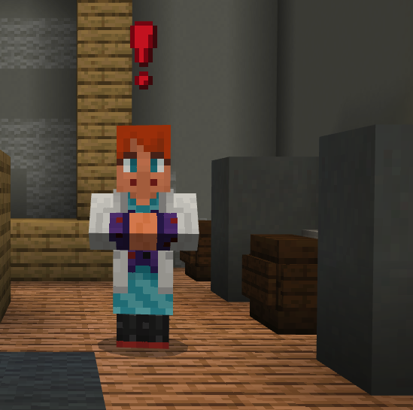
Activity 1 – AI TESTING
Talk to the Technician to test the AI System
Notes:
Say: Accessing Python tutorials is slightly different as to how we have accessed previous content. These can be opened within any world by pressing “C” on your keyboard to access the coding environment.
Do: Walkthrough how to open the Python tutorials within Minecraft: Education Edition get the participants to follow along
Do: Advance to the next slide.

Slide 5
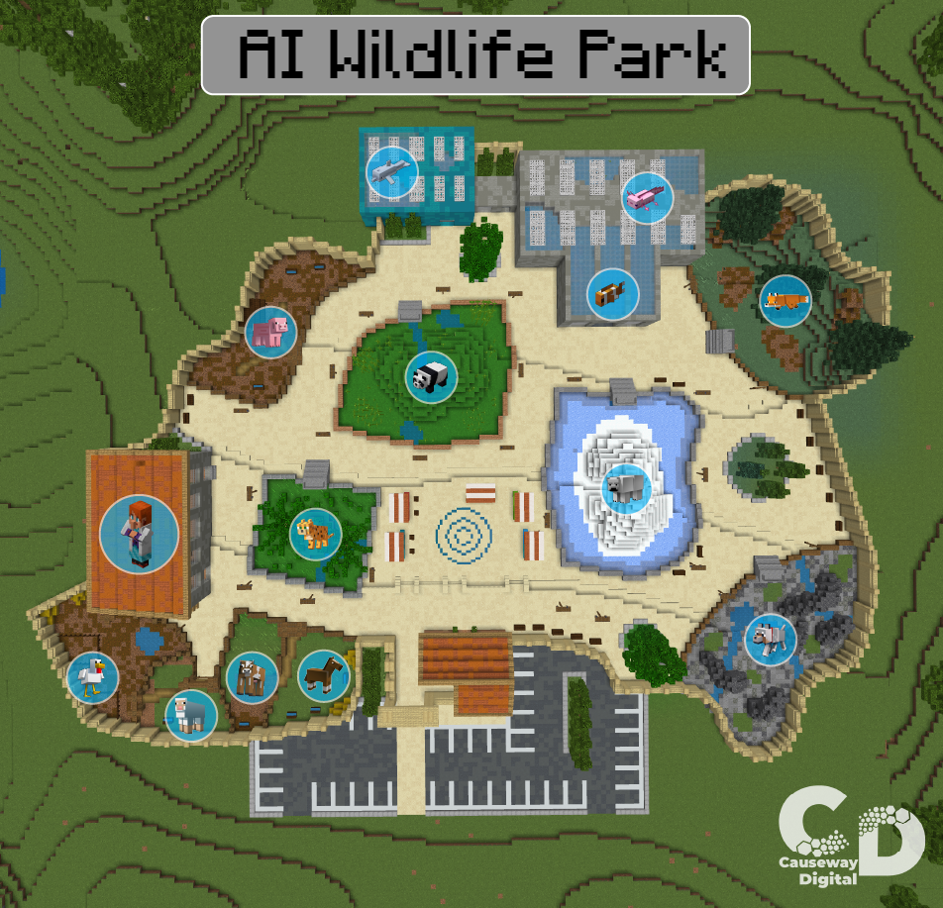
Activity 2 – MAP
Explore the Wildlife Park and photograph all the animals needed.
Notes:
Say: Accessing Python tutorials is slightly different as to how we have accessed previous content. These can be opened within any world by pressing “C” on your keyboard to access the coding environment.
Do: Walkthrough how to open the Python tutorials within Minecraft: Education Edition get the participants to follow along
Do: Advance to the next slide.

Slide 6
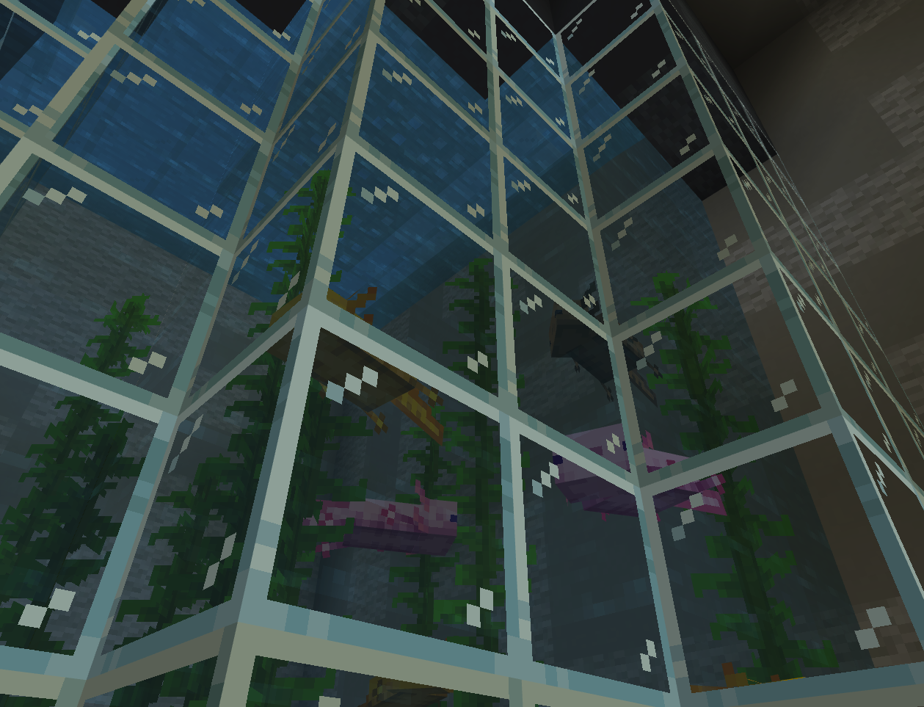
Activity 2 – Photographing the Animals
Axolotl
Go and take a photo of the Axolotl and note what food they eat.
Not sure what an Axolotl eats? Look around for hints!
Notes:
Say: Accessing Python tutorials is slightly different as to how we have accessed previous content. These can be opened within any world by pressing “C” on your keyboard to access the coding environment.
Do: Walkthrough how to open the Python tutorials within Minecraft: Education Edition get the participants to follow along
Do: Advance to the next slide.

Slide 7
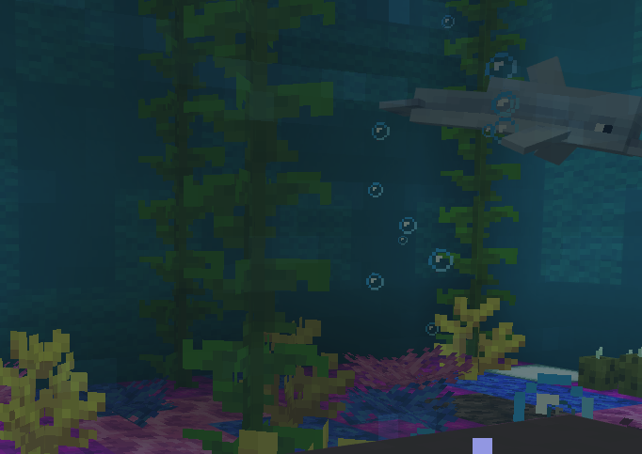
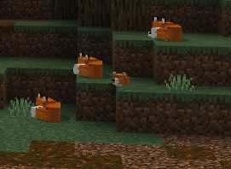
Activity 2 – Photographing the Animals
Dolphin
Fox
Photograph the Dolphins and take note of what they eat
Photograph the Foxes and take note of what they eat
Notes:
Say: Accessing Python tutorials is slightly different as to how we have accessed previous content. These can be opened within any world by pressing “C” on your keyboard to access the coding environment.
Do: Walkthrough how to open the Python tutorials within Minecraft: Education Edition get the participants to follow along
Do: Advance to the next slide.

Slide 8
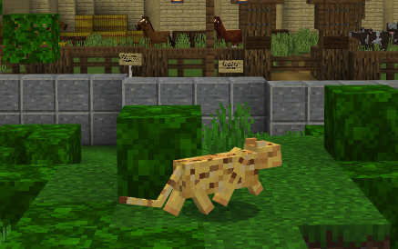
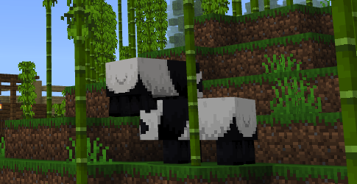
Activity 2 – Photographing the Animals
Ocelot
Panda
Photograph the Ocelot and take note of what they eat
Photograph the pandas and take note of what they eat
Notes:
Say: Accessing Python tutorials is slightly different as to how we have accessed previous content. These can be opened within any world by pressing “C” on your keyboard to access the coding environment.
Do: Walkthrough how to open the Python tutorials within Minecraft: Education Edition get the participants to follow along
Do: Advance to the next slide.

Slide 9
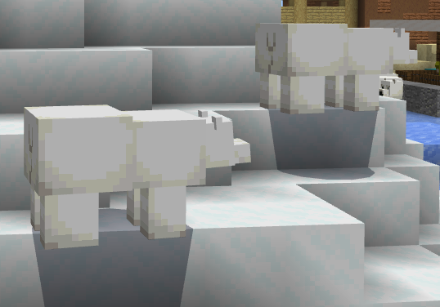
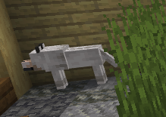
Activity 2 – Photographing the Animals
Wolf
Polar Bear
Photograph the wolves and take note of what they eat
Photograph the polar bears and take note of what they eat
Notes:
Say: Accessing Python tutorials is slightly different as to how we have accessed previous content. These can be opened within any world by pressing “C” on your keyboard to access the coding environment.
Do: Walkthrough how to open the Python tutorials within Minecraft: Education Edition get the participants to follow along
Do: Advance to the next slide.

Slide 10
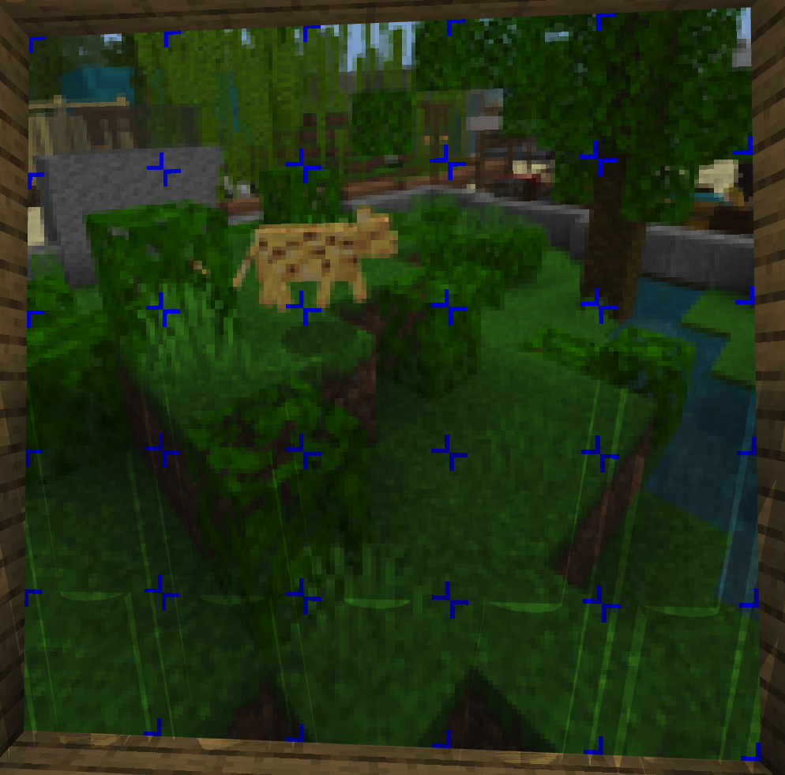
Activity 3 – Talk to the head ranger
The photographs you have taken will be shown on the big screen and you need to click all the squares where there is an animal.
Talk to the technician every time you complete an image.
Notes:
Say: Let’s take a look at the flower trail tutorial. This will take us through how to use the on player travelled event and placing flowers behind us as we move.
1st thing we are going to use here is the on player travelled event. There are a number of events that we can tap into within Minecraft: Education Edition. An event is triggered when something happens within the world. Any code added into the event handler is run when the event triggers. So here we are going to create code to do something when the player moves.
Next, we are going to add a world.set() command to our on player move event. The world set command takes in the parameter's location and block. Again, we are going to use coordinates relative to our position within the world.set command using the Tilda (~) signs for our X, Y and Z coordinates. The block is going to be the type of flower we are going to leave behind us.
The last part of this tutorial is to get the flowers to spawn 1 or 2 blocks around you rather than all 3 flowers spawning at once. You do this by adding a 1 or 2 after the Tilda (~) sign within your coordinates.
Do: Give the participants time to complete this tutorial.
Do: Advance to the next slide.

Slide 11
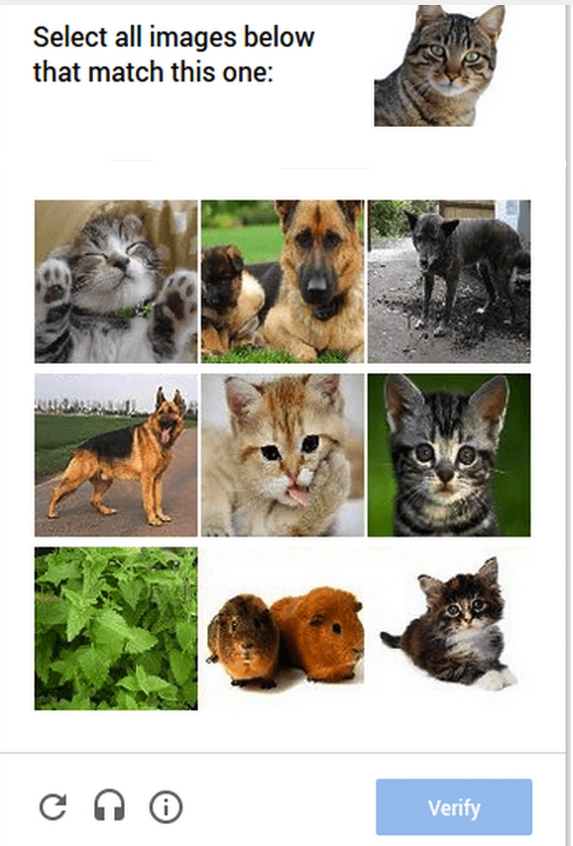
Active Knowledge - CAPTCHAs
What is CAPTCHA?
CAPTCHA (Completely Automated Public Turing test to tell Computers and Humans Apart).
Tools used to tell the difference between real users and automated users e.g. bots.
Notes:
Say: To support you using Python 101 within the classroom there is an Educator Guide per tutorial, Scope and Sequence of Python 101 and an Introduction to using Azure Notebooks. Each Educator guide contains an overview and learning objectives for the task.
Do: Open Lesson 1 Educator Guide while you are talking about it.
Say: The Scope and Sequence Document gives an overview of the learning standards and Computer Science concepts that will be taught through each lesson within Python 101
Do: Open the Scope and Sequence document while talking about it
Say: The Introduction to Azure Notebooks slide deck takes you through how to create a Minecraft world and using Azure Notebooks within that world.
Do: Open the Introduction to Azure Notebooks slide deck while talking about it.
Do: Advance to the next slide

Slide 12
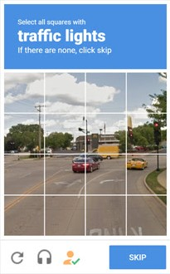
Active Knowledge - CAPTCHAs
What are CAPTCHAs used for?
  CAPTCHAs are used by websites that want to restrict bot usage.
  E.g. preventing false comments.
  By providing challenges which are easy for humans to figure out but difficult for computers.
  For example image-based that provide a grid of images and the user has to click specific areas of the screen within a given time.
Notes:
Say: To support you using Python 101 within the classroom there is an Educator Guide per tutorial, Scope and Sequence of Python 101 and an Introduction to using Azure Notebooks. Each Educator guide contains an overview and learning objectives for the task.
Do: Open Lesson 1 Educator Guide while you are talking about it.
Say: The Scope and Sequence Document gives an overview of the learning standards and Computer Science concepts that will be taught through each lesson within Python 101
Do: Open the Scope and Sequence document while talking about it
Say: The Introduction to Azure Notebooks slide deck takes you through how to create a Minecraft world and using Azure Notebooks within that world.
Do: Open the Introduction to Azure Notebooks slide deck while talking about it.
Do: Advance to the next slide

Slide 13
Active Knowledge - CAPTCHAs
Example
image-based CAPTCHA that provide a grid of images and the user has to click specific areas of the screen.
This is similar to what we have just done within the Minecraft world.
Notes:
Say: To support you using Python 101 within the classroom there is an Educator Guide per tutorial, Scope and Sequence of Python 101 and an Introduction to using Azure Notebooks. Each Educator guide contains an overview and learning objectives for the task.
Do: Open Lesson 1 Educator Guide while you are talking about it.
Say: The Scope and Sequence Document gives an overview of the learning standards and Computer Science concepts that will be taught through each lesson within Python 101
Do: Open the Scope and Sequence document while talking about it
Say: The Introduction to Azure Notebooks slide deck takes you through how to create a Minecraft world and using Azure Notebooks within that world.
Do: Open the Introduction to Azure Notebooks slide deck while talking about it.
Do: Advance to the next slide

Slide 14
Knowledge check
Why were we taking photographs of the animals and taking note of what they ate?
So the rangers know what to feed the animals
To train the AI what to feed the animals
To create a database of the animals and what they like to eat
To train the AI what food the animals do not like
What does AI mean?
Amazing Internet
As Intelligence
Artificial Internet
Artificial Intelligence
What does the “T” in CAPTCHA stand for?
Turing
Turner
Terry
Tea
What do CAPTCHAs try to stop?
Buttons
Bubbles
Bots
Humans
Notes:
Say: To support you using Python 101 within the classroom there is an Educator Guide per tutorial, Scope and Sequence of Python 101 and an Introduction to using Azure Notebooks. Each Educator guide contains an overview and learning objectives for the task.
Do: Open Lesson 1 Educator Guide while you are talking about it.
Say: The Scope and Sequence Document gives an overview of the learning standards and Computer Science concepts that will be taught through each lesson within Python 101
Do: Open the Scope and Sequence document while talking about it
Say: The Introduction to Azure Notebooks slide deck takes you through how to create a Minecraft world and using Azure Notebooks within that world.
Do: Open the Introduction to Azure Notebooks slide deck while talking about it.
Do: Advance to the next slide

Slide 15
Knowledge check - Answers
Why were we taking photographs of the animals and taking note of what they ate?
So the rangers know what to feed the animals
To train the AI what to feed the animals
To create a database of the animals and what they like to eat
To train the AI what food the animals do not like
What does AI mean?
Amazing Internet
As Intelligence
Artificial Internet
Artificial Intelligence
What does the “T” in CAPTCHA stand for?
Turing
Turner
Terry
Tea
What do CAPTCHAs try to stop?
Buttons
Bubbles
Bots
Humans
Notes:
Say: To support you using Python 101 within the classroom there is an Educator Guide per tutorial, Scope and Sequence of Python 101 and an Introduction to using Azure Notebooks. Each Educator guide contains an overview and learning objectives for the task.
Do: Open Lesson 1 Educator Guide while you are talking about it.
Say: The Scope and Sequence Document gives an overview of the learning standards and Computer Science concepts that will be taught through each lesson within Python 101
Do: Open the Scope and Sequence document while talking about it
Say: The Introduction to Azure Notebooks slide deck takes you through how to create a Minecraft world and using Azure Notebooks within that world.
Do: Open the Introduction to Azure Notebooks slide deck while talking about it.
Do: Advance to the next slide

Slide 16
Reflection
What have you learned about AI?
What did you enjoy most about the world?
What is a CAPTCHA?
Do AIs think the same way as a human?
Notes:
Say: Here are some questions to consider and answer within your workbooks.
[give time to answer]
Say: Any questions or thoughts on the Python Islands materials?
IF Virtual
Comment within the chat box or unmute yourselves
[Give time for Answers]
Do: Advance to the next slide.

