Slide 1





Teachers Notes
Questions to Discuss
Video to watch
Activities to complete
Instructions
If you would like to edit these slides, please make a copy for personal use.
Please refer to the EDU guide when facilitating this lesson.
@2025 Microsoft

Slide 2
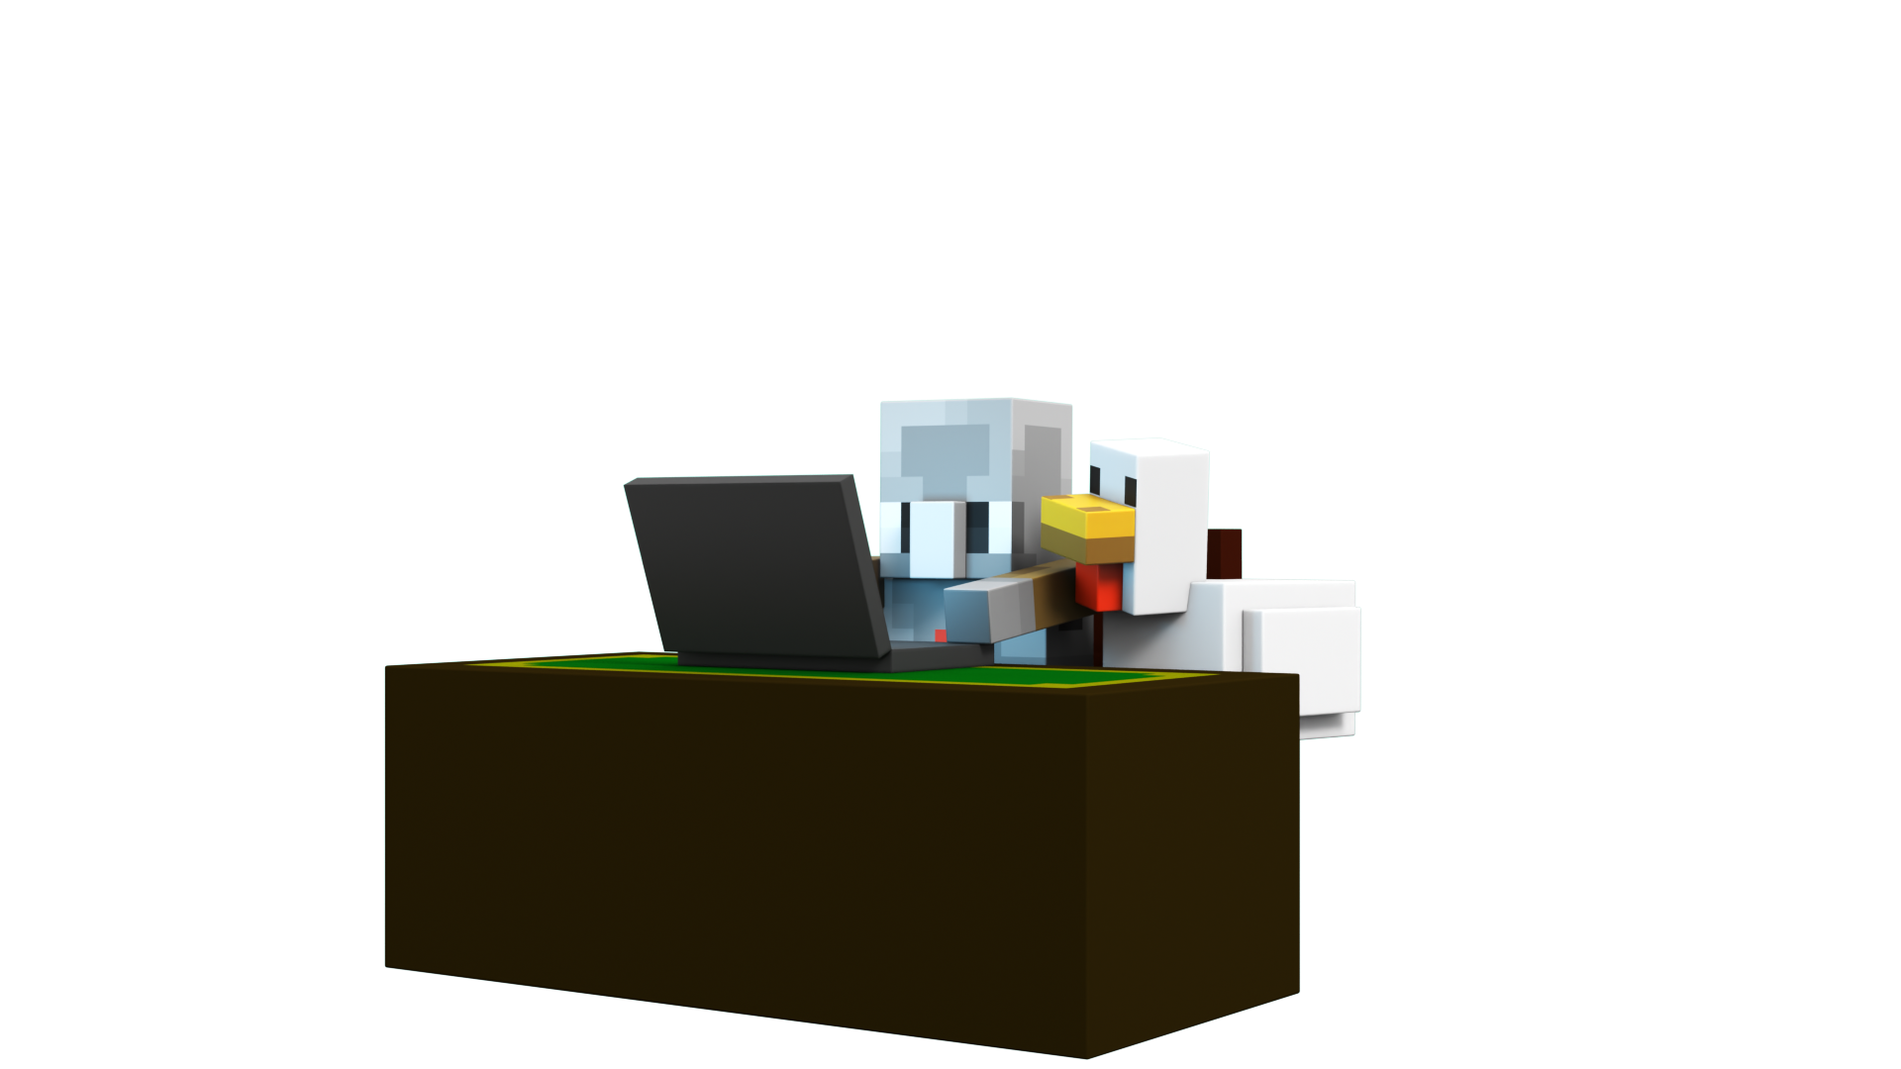

AI Adventurers: Using AI Thoughtfully
@2025 Microsoft

Slide 3

What will we learn today?
Utilize appropriate skepticism when I encounter AI-generated images and information
Use visual and/audio clues to help identify AI-generated content
Recognize how AI can be a useful tool for generating ideas and providing information
Explain why it is important to cross-check AI-provided information with trusted, reliable sources
Understand what makes a source more or less reliable
Reflect on how AI can assist with creativity ​
@2025 Microsoft

Slide 4
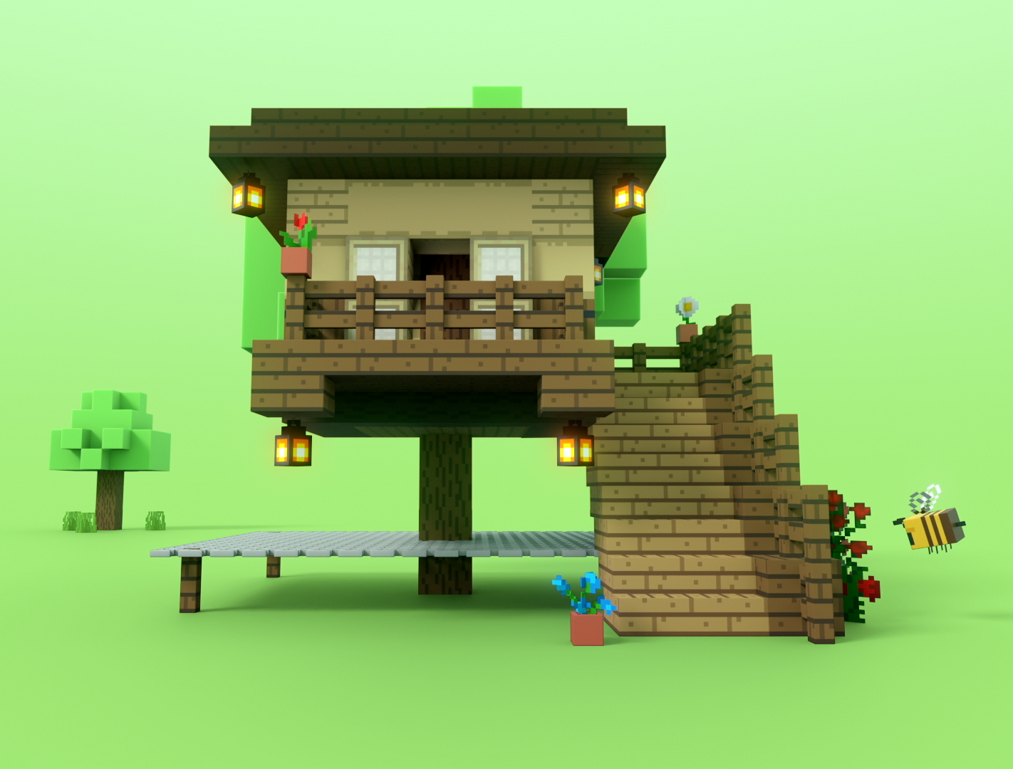

Do Now
Turn and Talk
Have you ever heard the expression "too good to be true?" What do you think that means?
@2025 Microsoft
Notes:
pre video questions

Slide 5

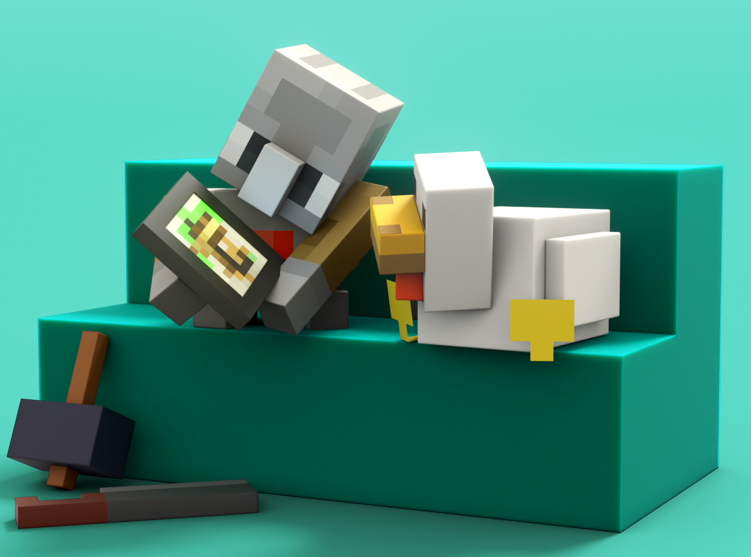
@2025 Microsoft

Slide 6



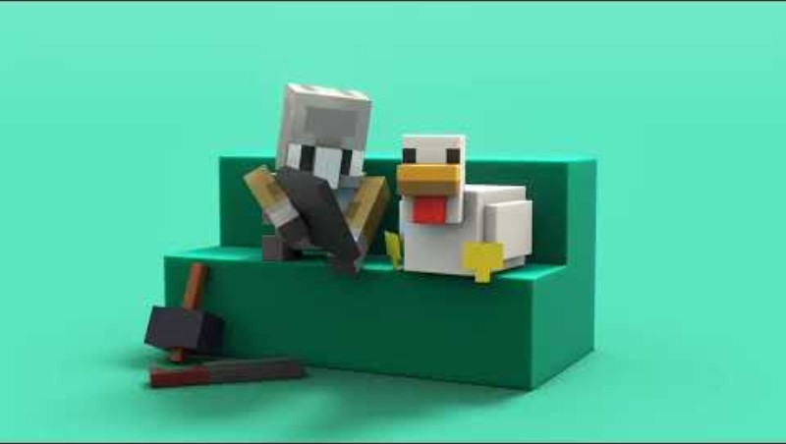
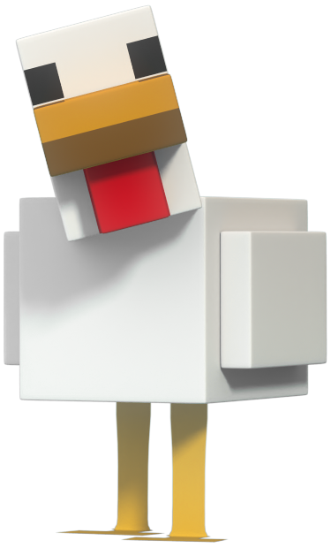
Hey, Chicken! How can I use AI thoughtfully?
@2025 Microsoft

Slide 7
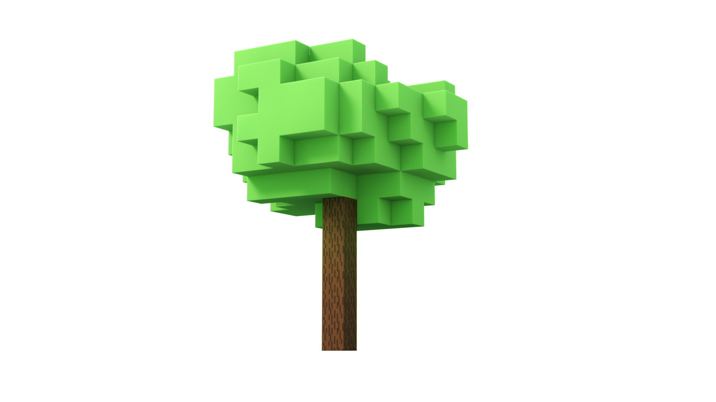

Vocabulary
Look at the words, do you know their meanings?
Artificial intelligence (AI)
AI-generated images
AI results
Cross check
Reliable sources
@2025 Microsoft
Notes:
pre video

Slide 8

Let’s discuss
THINK | PAIR | SHARE
What is artificial intelligence? | Work with your assigned partner. | Take 30 seconds to share with your partner your response to the question, “What is artificial intelligence?” Then, allow your partner to share their response(s).
@2025 Microsoft

Slide 9
Vocabulary
What are AI-generated images?
Pictures that are made by AI that are always real
Pictures that are made by AI that are never real
Pictures that are made by AI that may not be real
Pictures that are made by AI that are always fake
@2025 Microsoft
Notes:
pre video

Slide 10
Vocabulary
What are AI results?
The answers or information that AI gives you
A comprehensive research report
Official accurate documentation
A presentation deck of facts
@2025 Microsoft
Notes:
pre video

Slide 11
Vocabulary
What does it mean to cross check?
Looking at only one website
Double-checking information by looking at other trusted places
Asking AI the same question more than once
Using two different types of AI to check information
@2025 Microsoft
Notes:
pre video

Slide 12
Vocabulary
What are reliable sources?
A source that provides popular and widely shared information
A source that provides accurate and biased information
Someone or something you can trust to give the right information
Someone online who provides information without citing evidence
@2025 Microsoft
Notes:
pre video

Slide 13
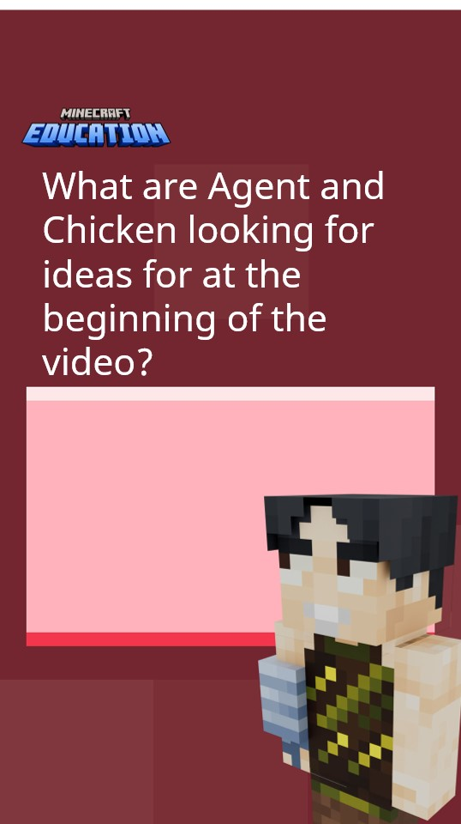
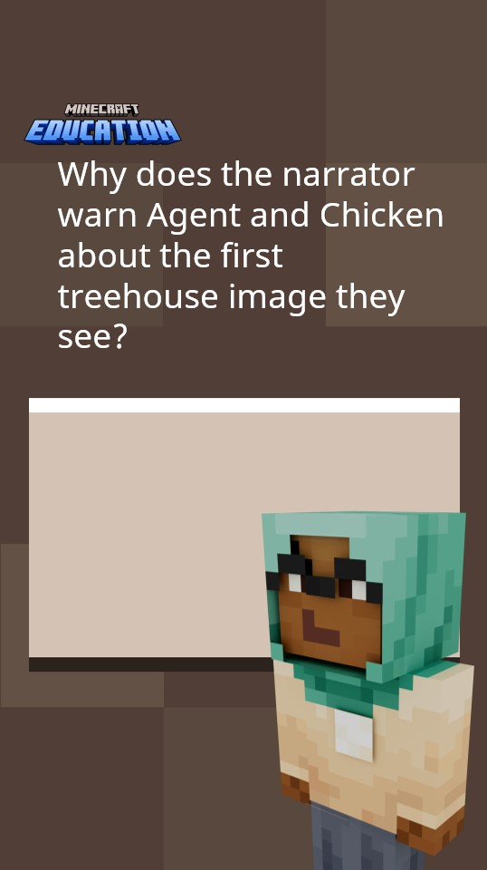
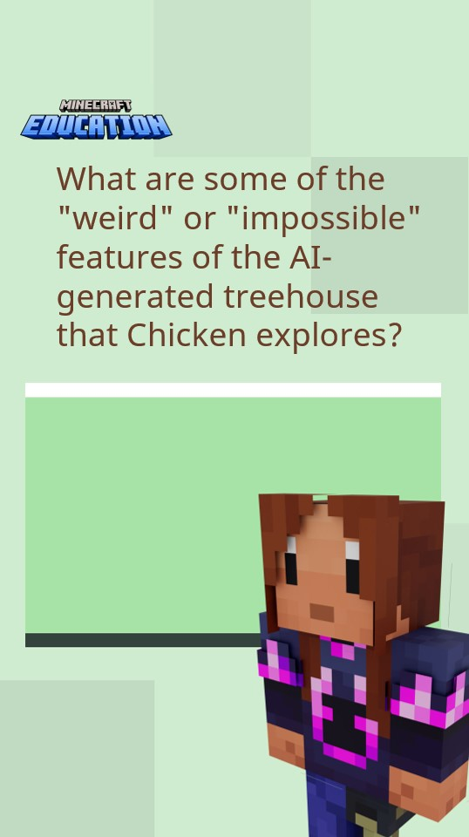
Big Question: Why should I be careful when encountering information online?
@2025 Microsoft
Notes:
The AI model is pre-programmed for map use and does not have the programming of a chatbot

Slide 14
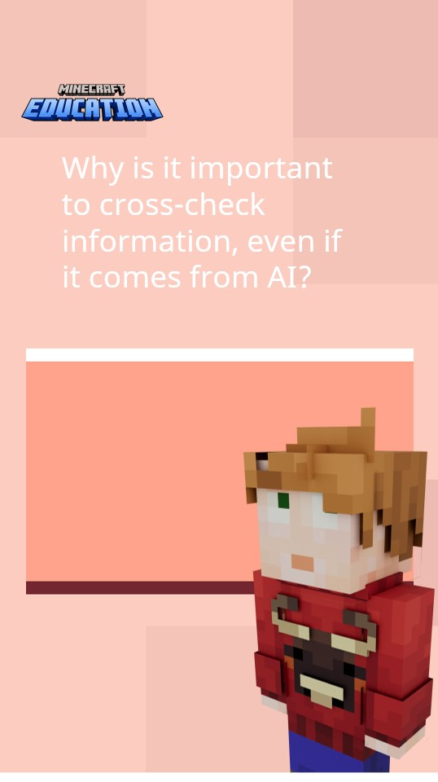
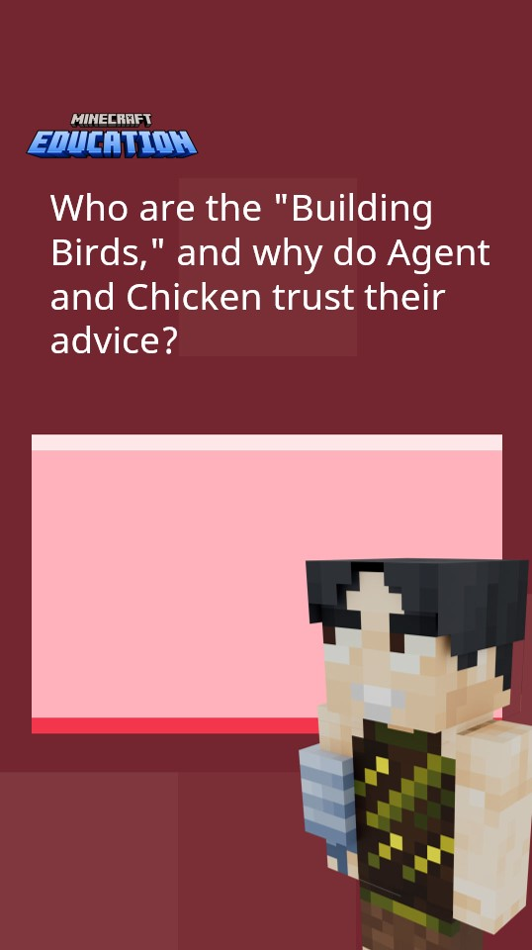
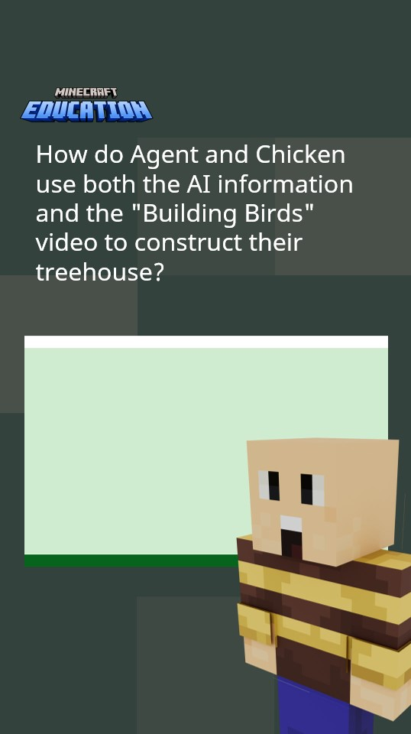
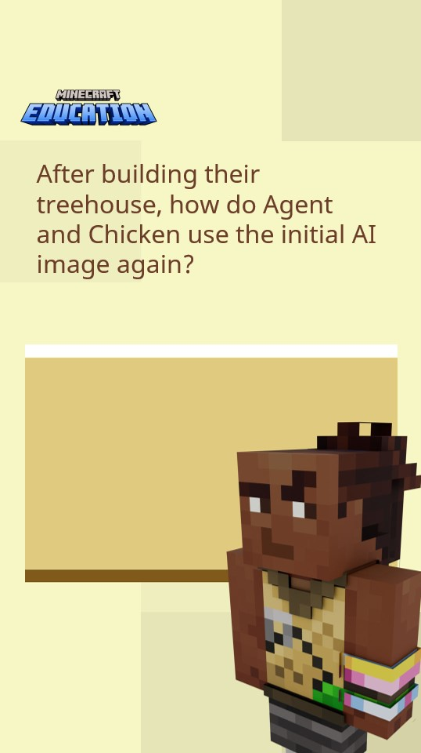
v
Big Question: How can I make sure I am using AI thoughtfully?
How does AI help Agent and Chicken after they are disappointed by the fake image?
@2025 Microsoft

Slide 15
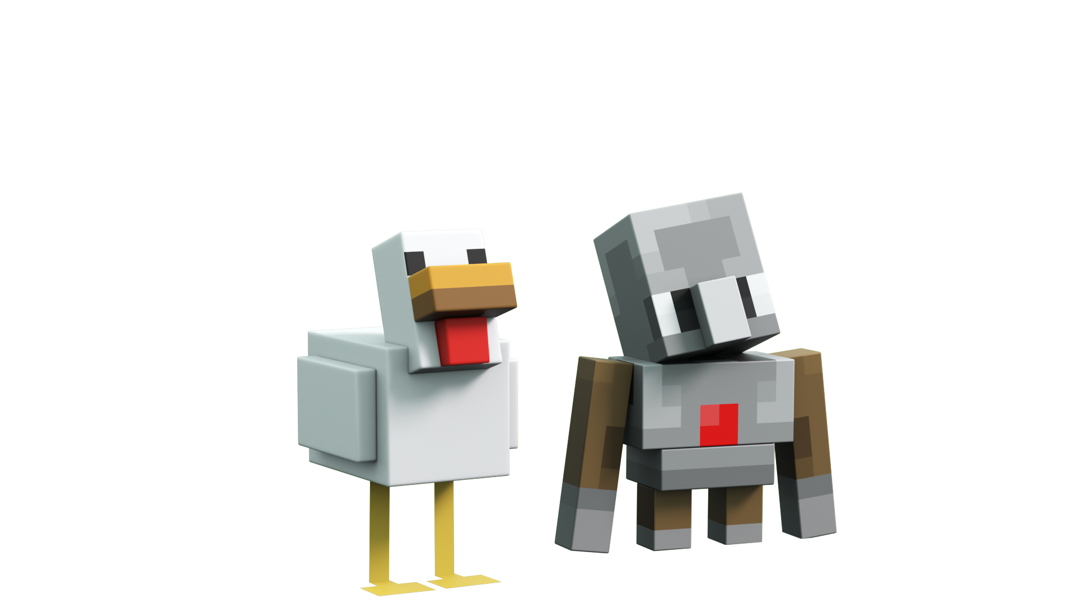

@2025 Microsoft

Slide 16

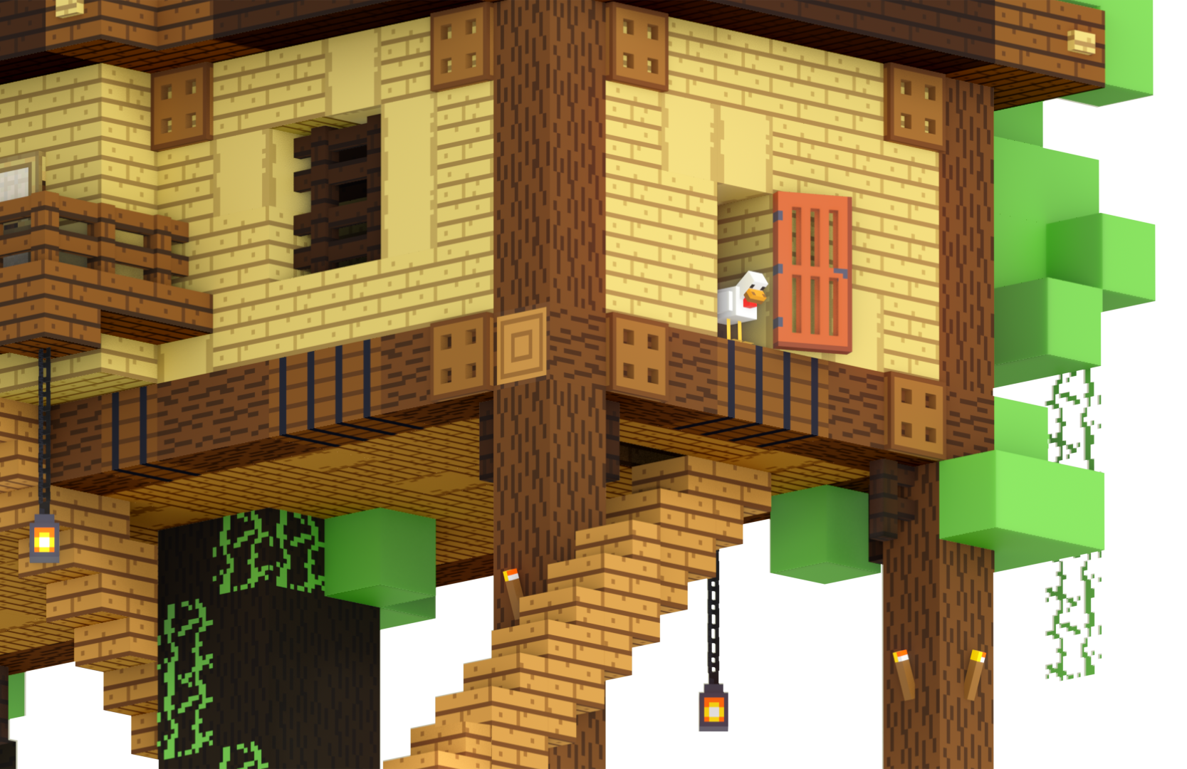

Visual Clues Help Identify Fake Images
In the video, Chicken and the Agent were able to determine that the treehouse would be unsafe because of the strange features. Can you recall what they saw that made them question the treehouse?
REMEMBER
Sometimes, the only way you can tell something is AI-generated is by looking at it…
Pay attention when something seems too good to be true!
@2025 Microsoft

Slide 17
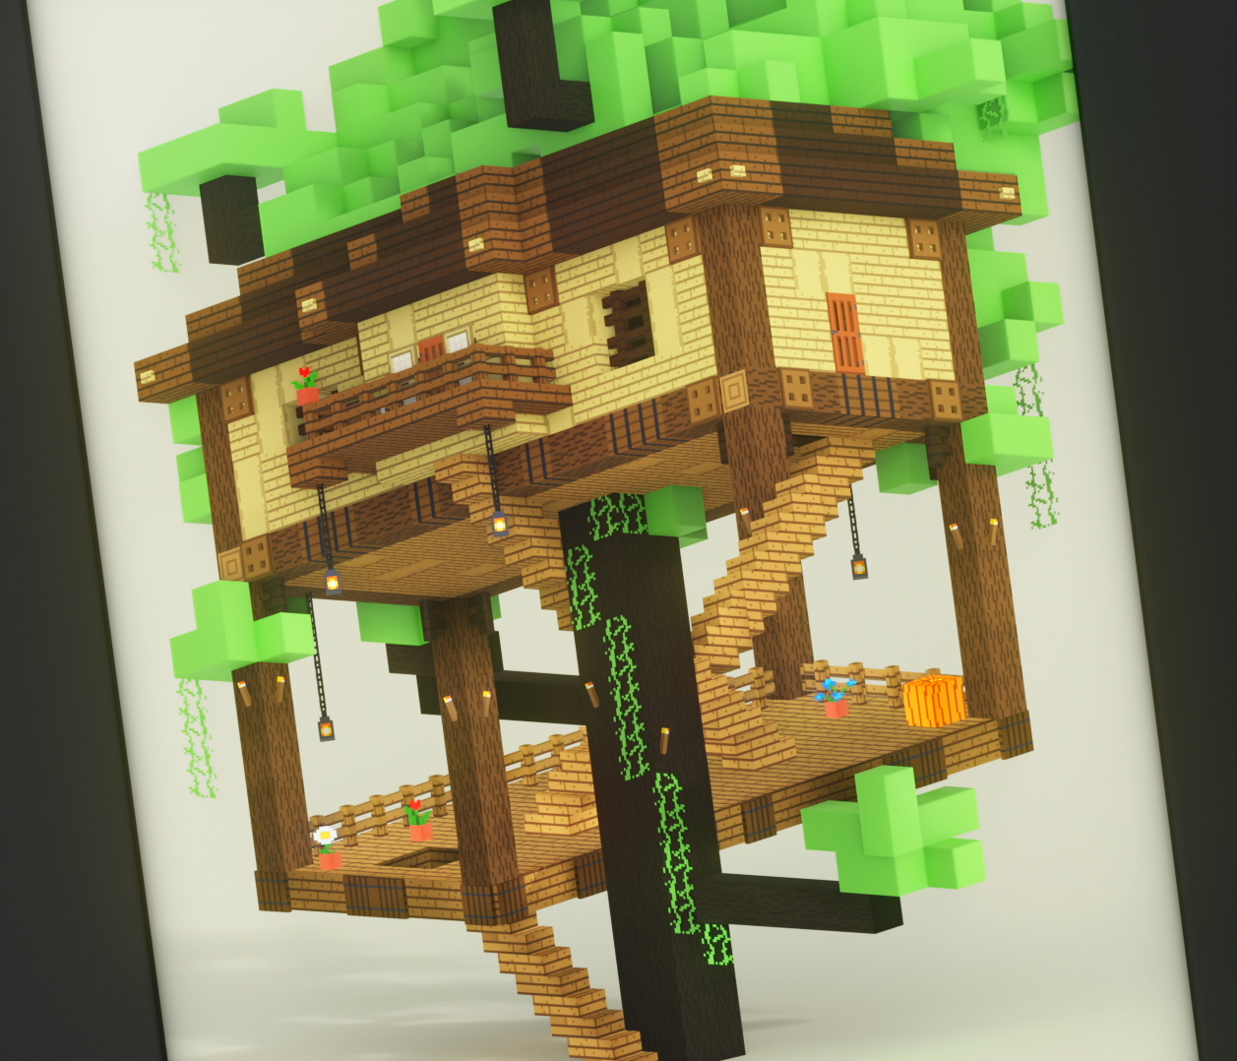
Cross-checking Information
In the video, Chicken and the Agent
are trying to build a treehouse.
Their​ first online search results provided an AI-generated example that would be impossible to build. ​
Then, they ask AI how to build a safe treehouse, but they didn't just trust what the AI told them.
They verified the AI-generated ideas using trusted, real-world sources. ​
What source helped them build a safer treehouse, and why did it seem trustworthy?
@2025 Microsoft
@2025 Microsoft

Slide 18

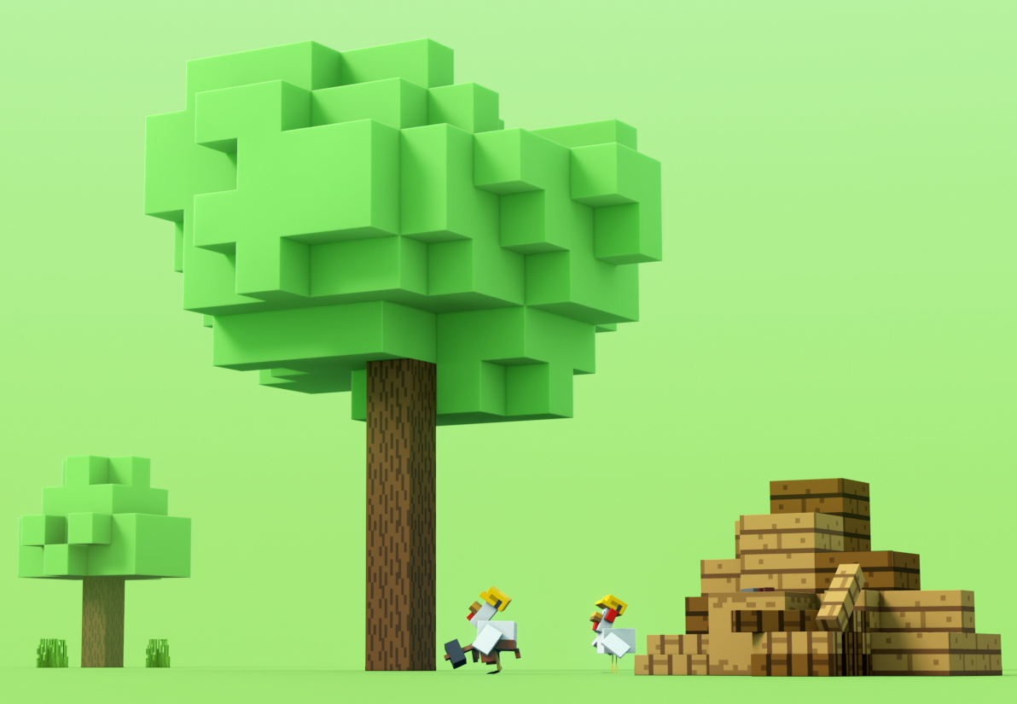
AI is a Tool
What is AI good for?
Providing inspiration
Finding useful information
Using to assist in research
All the above
None of the above
@2025 Microsoft

Slide 19
AI is a Tool
What should you be careful about when using AI?
It always gives the best answers.
It never makes mistakes.
It can sound confident, even when it’s wrong.
All of the above
None of the above
@2025 Microsoft

Slide 20
AI is a Tool
Which of these is a smart way to use AI?
Use it to get ideas, then cross-check the facts.
Copy everything it says without thinking.
Let it do all your homework
All of the above
None of the above
@2025 Microsoft

Slide 21
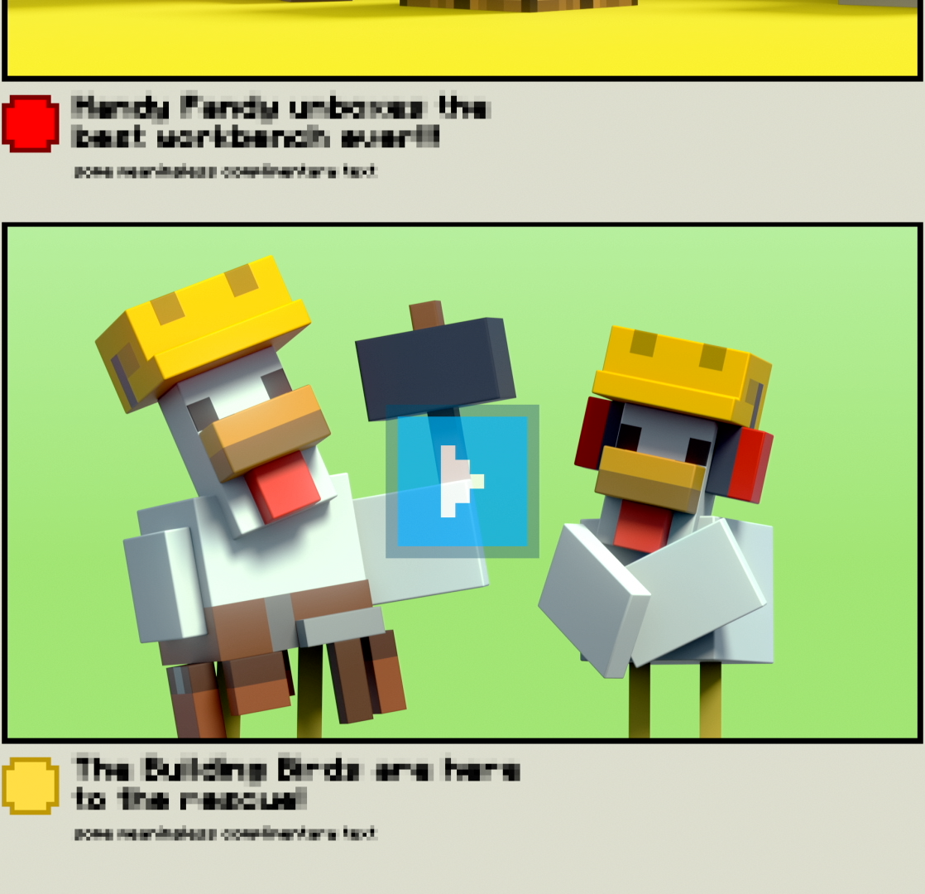

Using AI Thoughtfully
What have we learned so far about using AI thoughtfully?
Be careful! Sometimes pictures or videos that look real might be AI-generated…
When you ask AI a question, cross check the information with reliable sources.
Think critically – AI is a great creative companion, but we still need to think critically when we use it!
@2025 Microsoft

Slide 22

Glossary
Artificial Intelligence (AI): A smart computer program that can answer questions or give ideas.
AI-Generated Images: Pictures made by AI that may not be real.
AI Results: The answers or information that AI gives you.
AI Search: When you ask AI a question to get ideas or answers.
@2025 Microsoft
Notes:
pre video

Slide 23
Glossary
Cross-Check: Double-checking information with a different reliable source.
Reliable Source: Someone or something you can trust to give the right information.
Verification: Making sure information is true.
@2025 Microsoft
Notes:
pre video

Slide 24

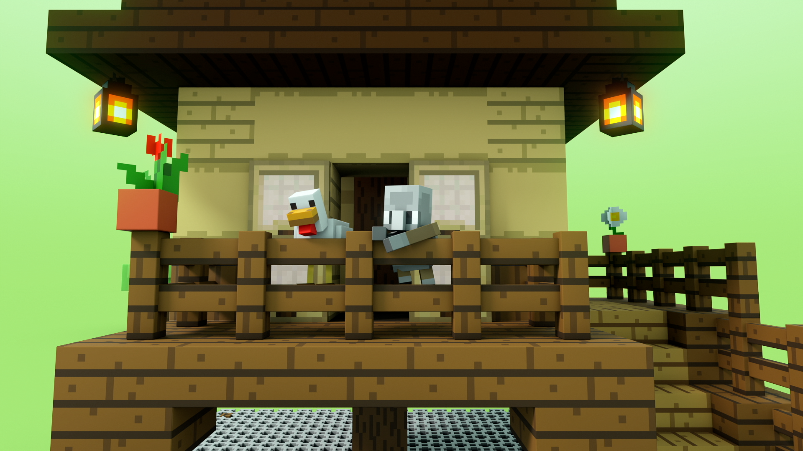
to deepen your knowledge of artificial intelligence
@2025 Microsoft

Slide 25

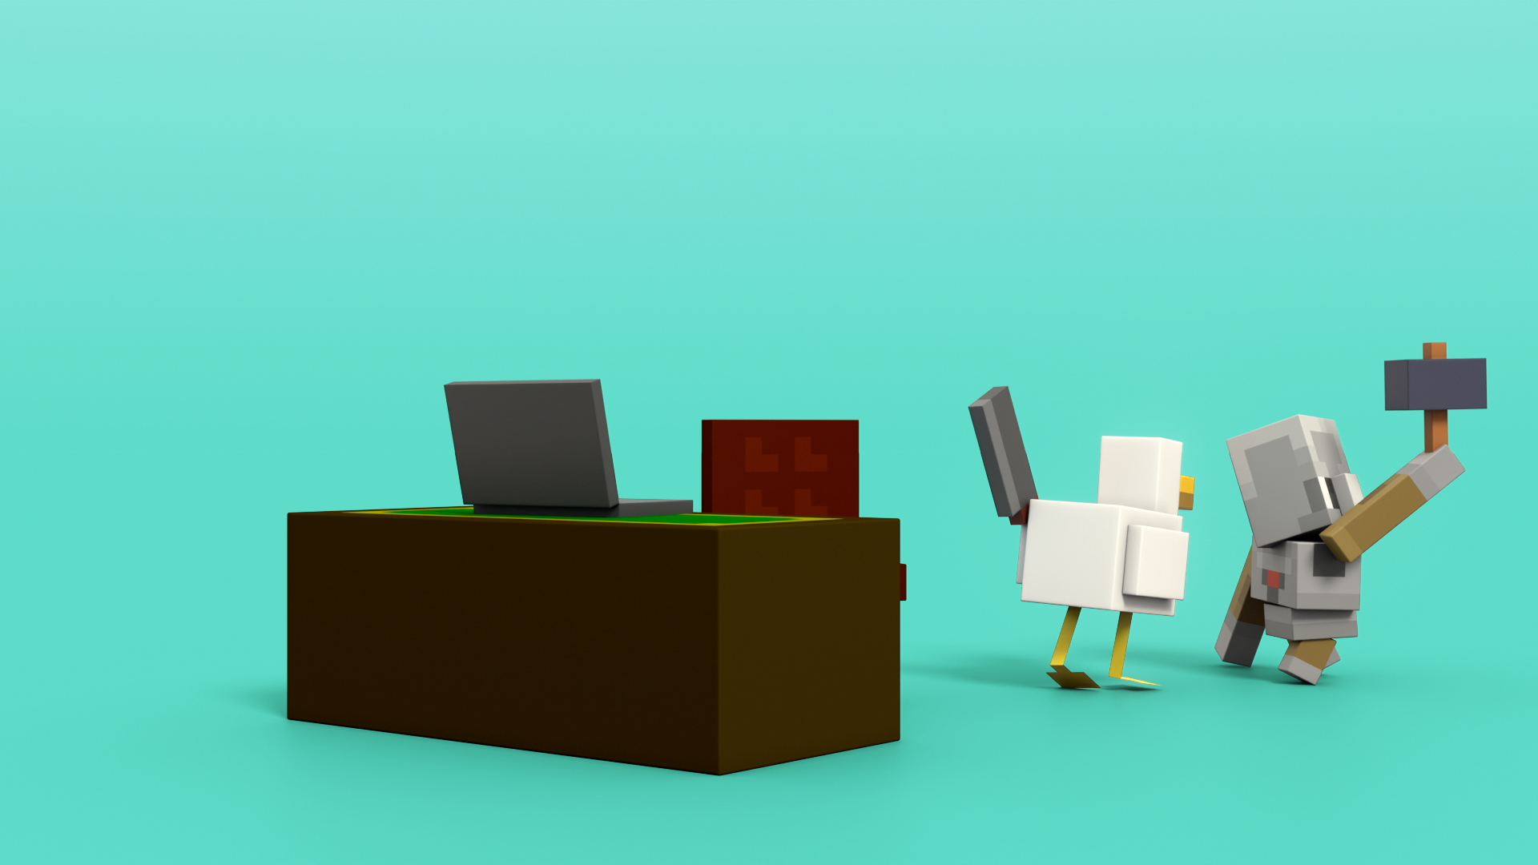
Activity 1: Reliable Source Scavenger Hunt
In this activity, we will become "information detectives" on a Reliable Source Scavenger Hunt. Our mission is to identify different types of reliable sources we can use to learn about a specific topic.
@2025 Microsoft

Slide 26
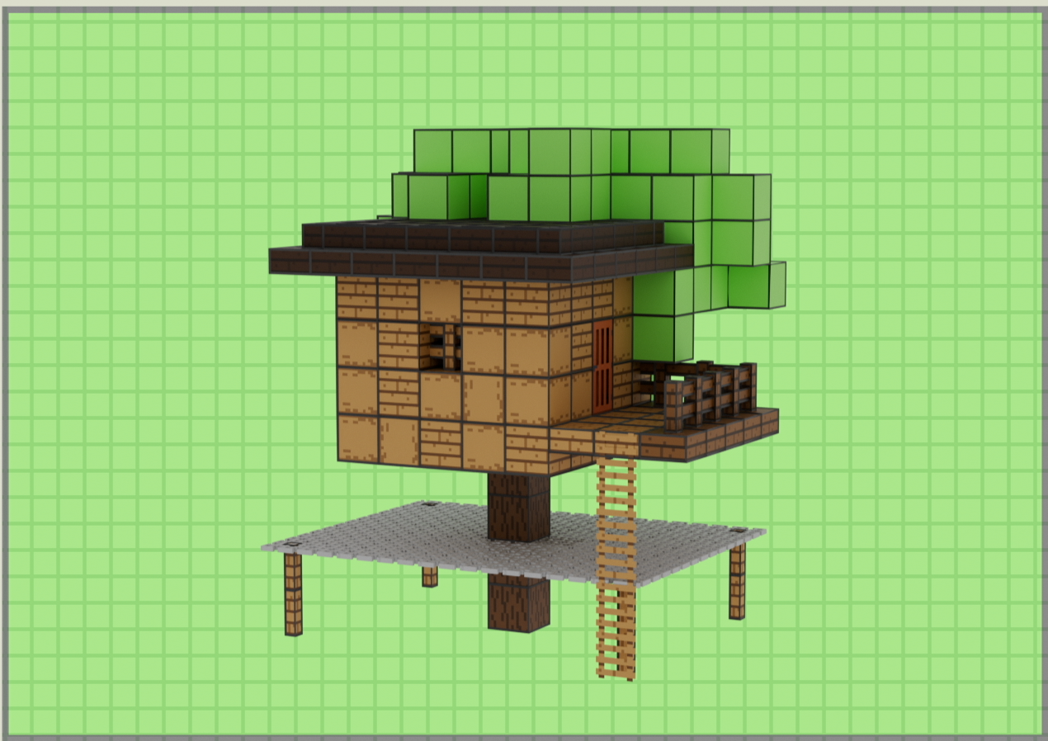
Activity 1: Reliable Source Scavenger Hunt
What does reliable mean when it comes to finding sources on the internet or in real life?
If we wanted to look for ways to take care of a class pet goldfish, who would have trustworthy advice about this, and how could we find out what they have to say?
People: Who?
Books: What types?
Websites: How do we know they're reliable?
Videos: How do we know they are accurate?
Local News: Who can we trust?
@2025 Microsoft

Slide 27
Activity 1: Reliable Source Scavenger Hunt
People: a trusted family member, a teacher
Books: nonfiction books from the library
Websites:
  Is it published by a known organization?
  Is there an author listed?
  Do they have credentials or experience in the topic?
  When was it written or last updated?
  Does the site include sources or links to data?
  Is it mentioned on another site (i.e., can you cross-check this source)?
Videos: educational videos only.
Local News: is it a known source? Does it give evidence?
@2025 Microsoft

Slide 28

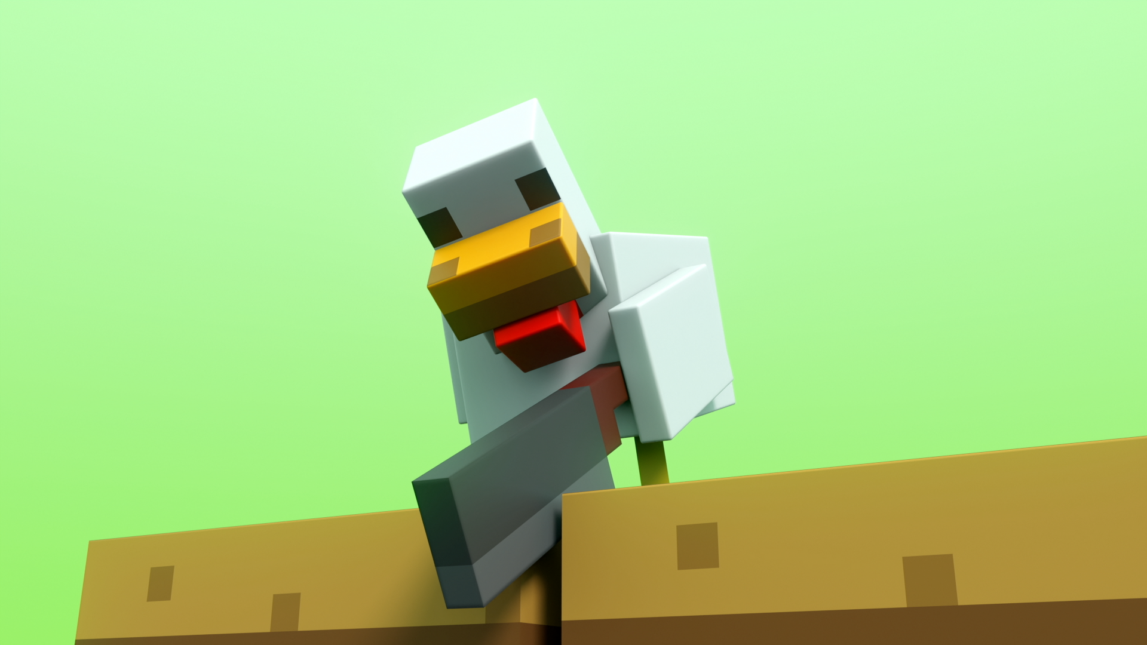
Activity 2: Image Detectives
Remember the first treehouse Agent and Chicken saw on the tablet? What did the narrator say about it?
AI can make very real-looking images, but they might not be true. So how do we know what to trust? In this activity, we’re not just guessing with our eyes — we’re learning how to double-check and read sideways, like real fact-checkers do!
REMEMBER: Although we can look for visual cues, this is NOT a perfect approach…
AI is powerful and helpful, but not always right.
You can’t always tell if something is real just by looking.
AI is getting better and better!
Let's practice!
@2025 Microsoft

Slide 29
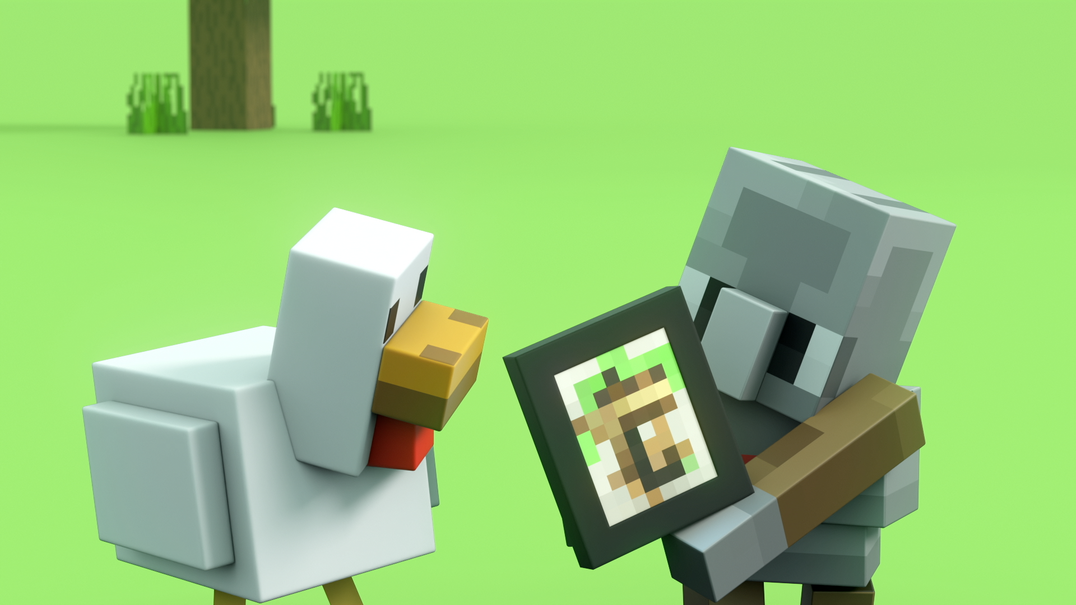
Questions to Consider
What do I notice first about this image?
Can I figure out who made this image, or where it came from?
  Is it from a real source I know and trust?
Can I find this image or story somewhere else on a trusted site?
  What happens if I look it up on a different website?
Does this image make me feel really surprised, upset, or excited? Why?
  Sometimes AI is used to grab your attention — emotions can be a clue!
Would I be confident sharing this image with someone else as “true”? Why or why not?
🧠 Look closely…
but think critically too!​
@2025 Microsoft

Slide 30
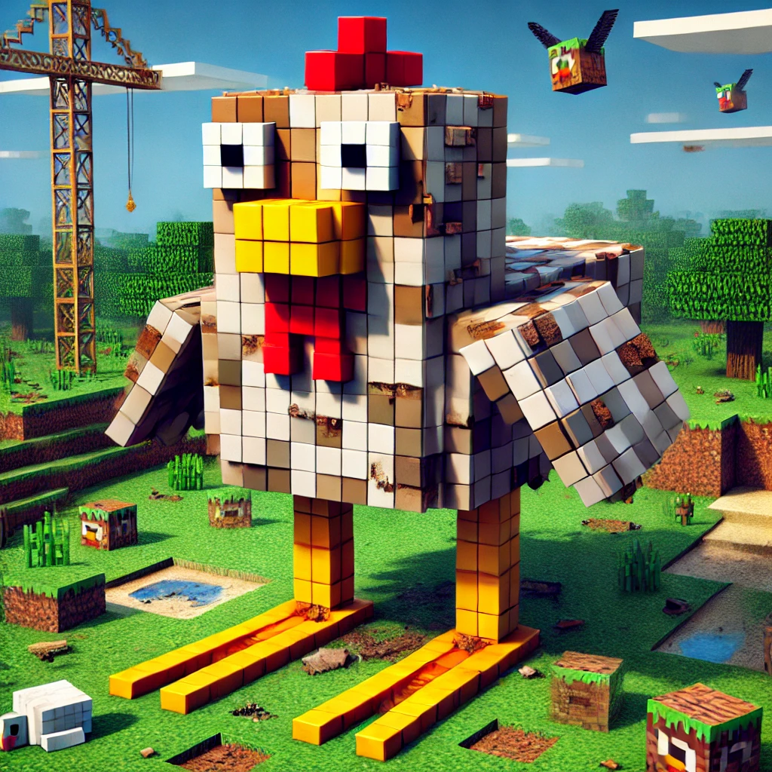
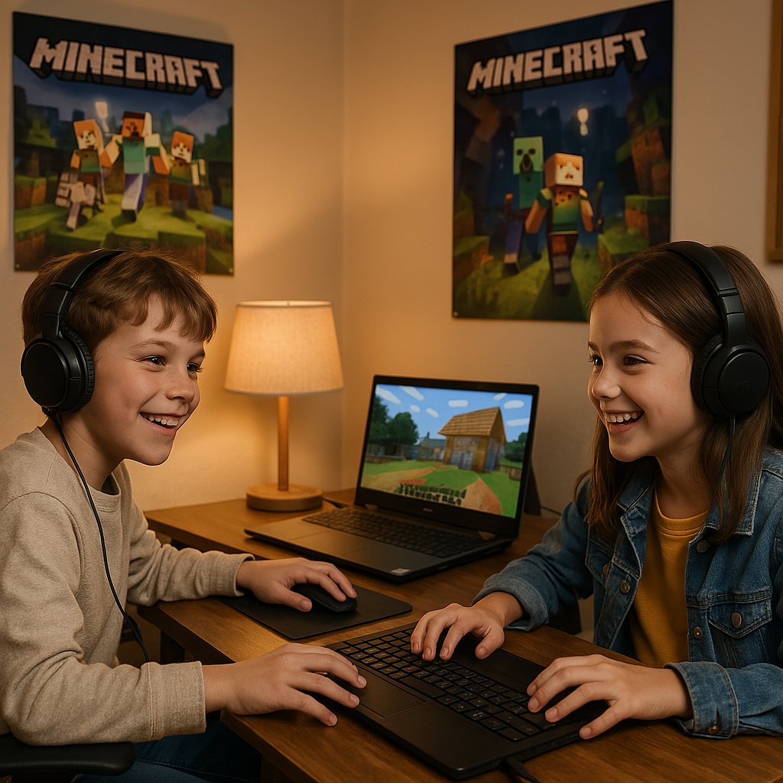

Activity 2: Image Detectives
❓ "Let’s vote —
Use the cluse to analyze which image is real and which is AI generated?
Some of these images seem so real,
we must always check the source!"
@2025 Microsoft
Notes:
Reveal the truth — including the “trick” AI image
Then show how we can use reverse image search or check the source/creator of the image to find out

Slide 31
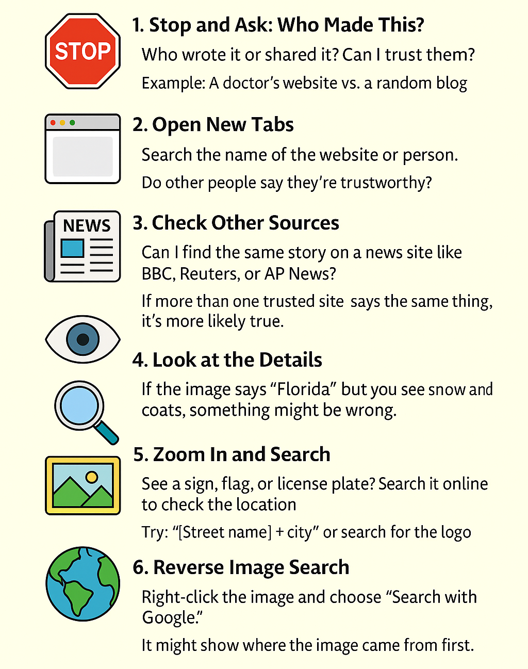
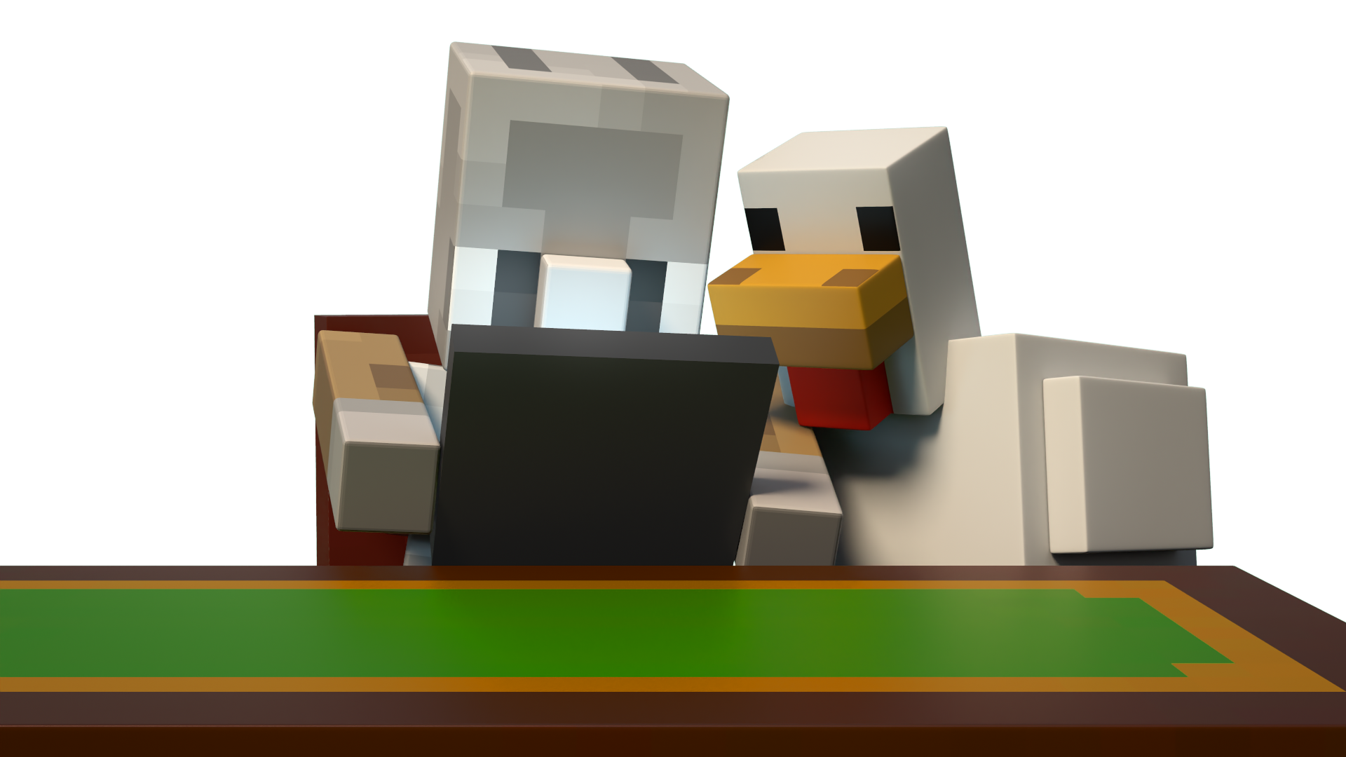
Activity 2: Image Detectives
Think like a fact checker! Fact-checkers don’t just look at one image or website — they do lateral reading and reverse image search.
Don't just look once—check the facts like a pro!
@2025 Microsoft

Slide 32
Activity 3: When is AI a good creative helper?
Let’s reflect on how AI can assist with creativity!
Think about the following scenarios:
Would using AI in this task be helpful? Why or why not?
Ideas for decorating your locker at school | Writing a birthday card for a family member | Answering your math homework
@2025 Microsoft

Slide 33

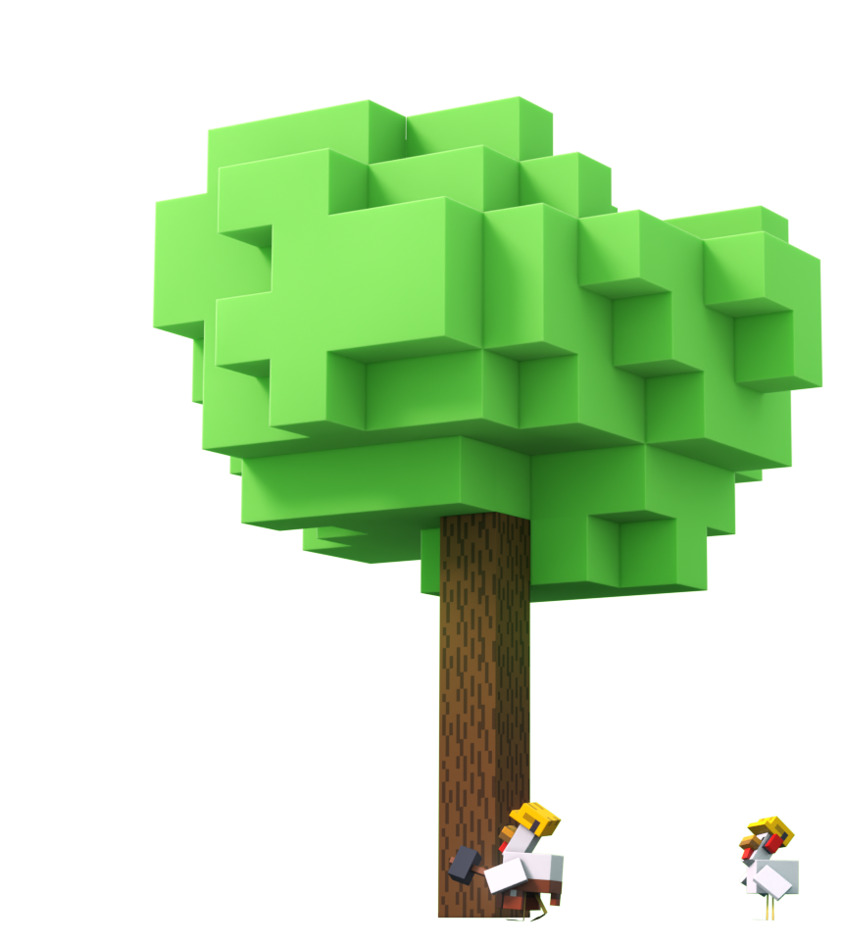

Extend Your Learning
Elem
In Fantastic Fairgrounds, you get to be the problem-solver, just like Agent and Chicken!
With help from your AI assistant, you’ll explore different parts of the fairgrounds to fix problems, solve puzzles, and make smart choices. You’ll learn how to tell if something made by AI is real or fake, how to use AI to improve things (like a light show), and how to make sure AI is used in fair and responsible ways.
@2025 Microsoft

