Slide 1





Teachers Notes
Questions to Discuss
Video to watch
Activities to complete
Instructions
If you would like to edit these slides, please make a copy for personal use.
Please refer to the lesson plan and discussion guide when facilitating this lesson.

Slide 2




Slide 3


Let’s Review-Fill in the Blank
Artificial intelligence is a branch of computer science that ____________________________________________________.
“Classical AI” refers to ____________________________________________________.
Some examples of classical AI include_______________________________________________________________________________________________.
insert image

Slide 4

What will we learn today?
I will learn what Generative AI is and is not
I will identify the difference between predictive AI and generative AI
I will learn about chatbots
I will identify ways that generative AI help us with tasks
I will identify how to use AI responsibly

Slide 5


f
What is generative AI?
Turn and Talk
What do you think of when you hear the word generative?
Notes:
pre video questions

Slide 6

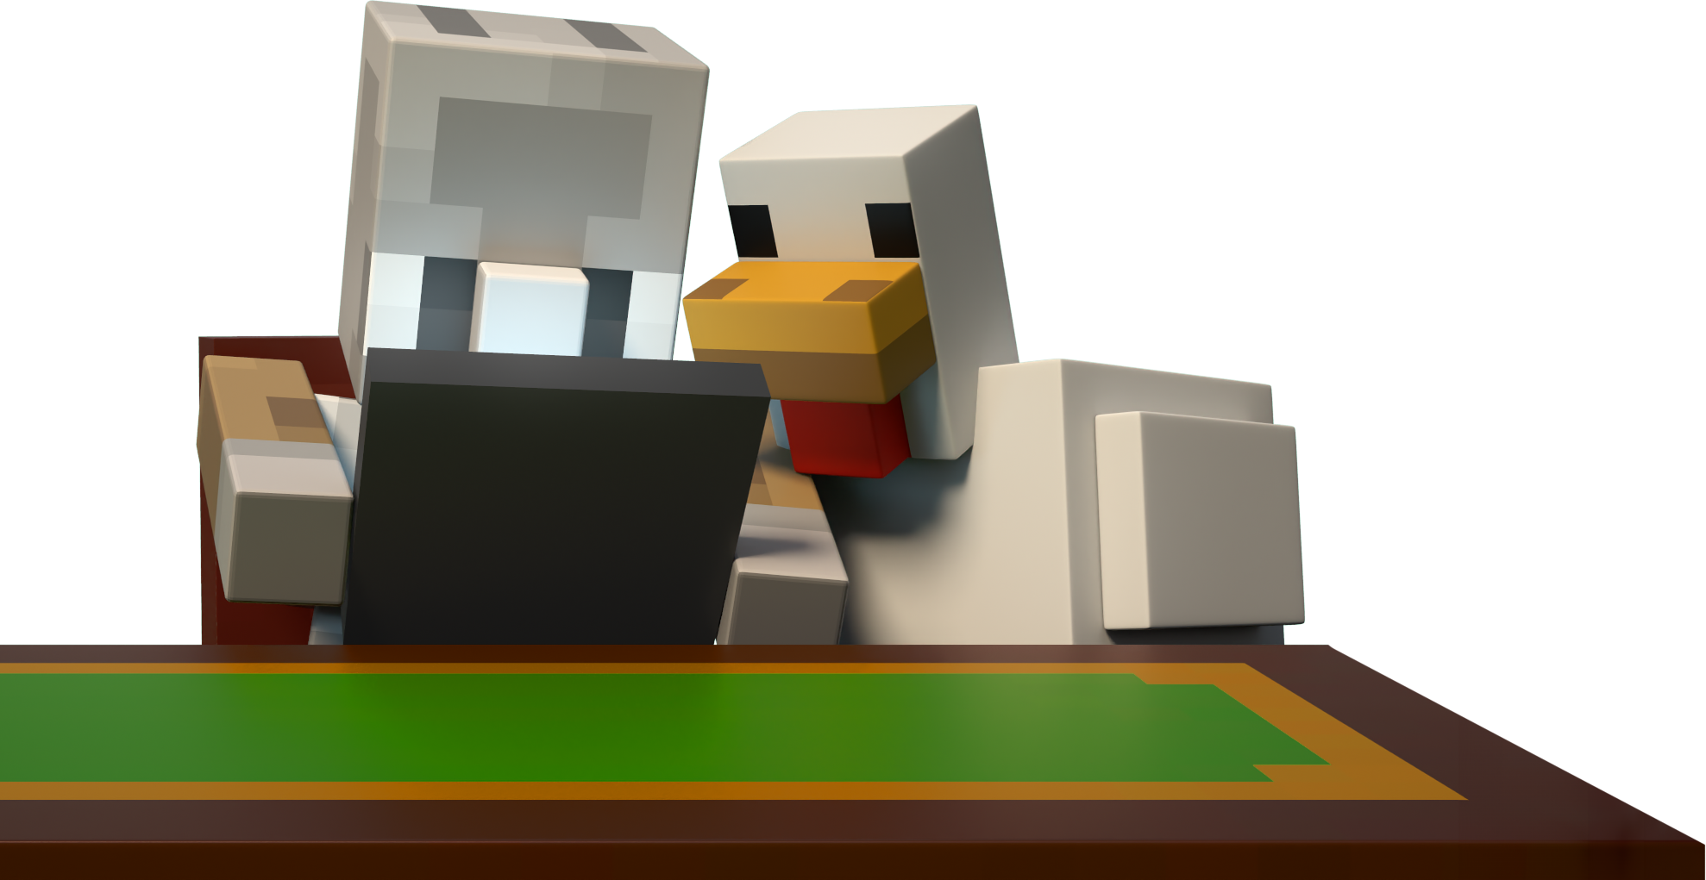

Slide 7

Preview the Vocabulary
Look at the word, do you know the meaning?
automate
prompt
algorithm
Generative Artificial Intelligence (AI)
chatbot
Notes:
pre video

Slide 8



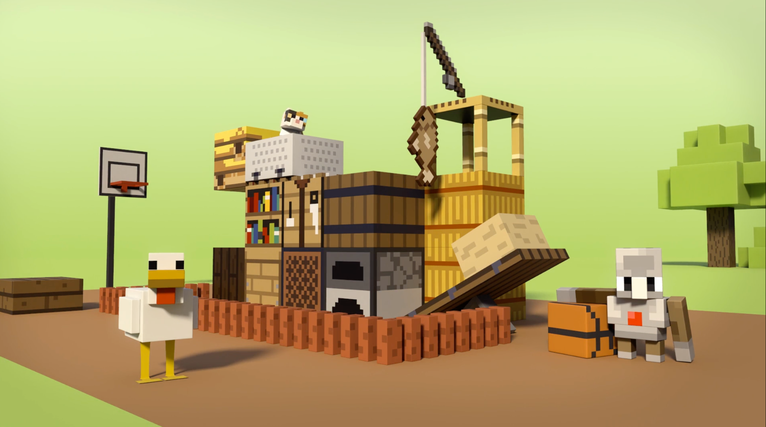

Hey, Chicken! What is Generative AI?

Slide 9
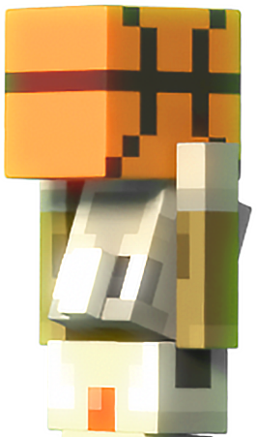

v
Big Question: How are AI and
Generative AI different?
What was Chicken watching at the start of the video?
What type of AI is used in the car’s GPS or mapping system?
Why wouldn’t this type of AI be preferred for help with making a “trick shot?”
Notes:
During video discussion (0.00-0.48)

Slide 10
v
Big Question: What is
generative AI?
Have you heard the term chatbot before? Have you used a chatbot?
Why wasn’t it enough that the chatbot helped Chicken get the basketball in the basket?
Why does generative AI only do what you tell it to do?
Notes:
During video discussion (0.48-1:45)

Slide 11


v
Big Question: What is
generative AI?
What does the speaker mean when they say “review what the AI tells you and make it your own?”
Why must the instructions to generative AI be detailed and specific?”
Notes:
During video discussion (0.48-1:45)

Slide 12

v
Big Question: How do we use
Generative AI responsibly?
Did the chatbot give Chicken correct instructions for making a trick shot? Why or why not?
What did Chicken have to do to complete the trick shot?
What lesson can we learn from Chicken’s interaction with the chatbot for his trick shot creation?
Notes:
During video discussion (1:45-2:30)

Slide 13

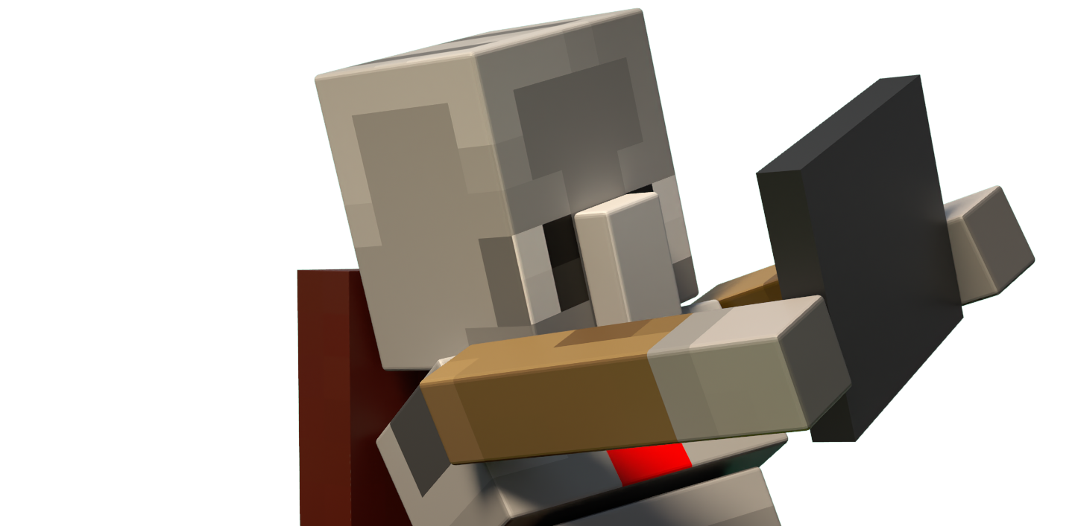

Slide 14



Specific Instructions and Algorithms
What do you think of the instructions that Chicken gave the chatbot?
In the video, Chicken struggled to give the chatbot precise instructions. Remember, AI operates based on the instructions it receives, as it doesn't have human understanding.
An algorithm is a set of steps or rules to follow in order to solve a problem or accomplish a specific task.
Let’s look at this prompt together, do you think it’s specific enough for the chatbot? What can we do to make it more specific?
“Give me instructions to get a basketball through a hoop.”

Slide 15

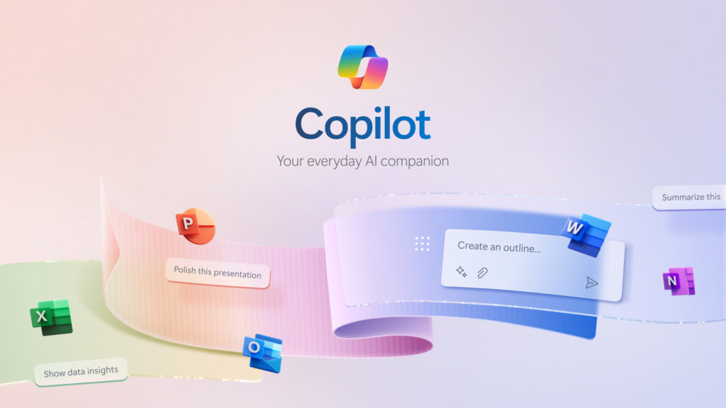
Generative Artificial Intelligence
Generative AI is a powerful category of AI that includes models that generate text, images, videos, or music.
Copilot for Microsoft is a chatbot. This chatbot allows you to search for specific information, generate text, and create images based on prompts you write.
Have you or your family used this chatbot or another chatbot?

Slide 16

Generative AI
Based on what you have learned so far, what differences and similarities do you see between generative AI and predictive AI?
Generative AI
Generative AI is most effective for generating new information like content, images, identifying patterns in data, and producing text.
Predictive AI
Predictive AI is useful for analyzing patterns to make forecasts and predictions, aiding in decision-making processes.
What else can we add to these lists?

Slide 17

Review the Lesson Big Ideas
Conversations Automated through Chatbots
Human conversations can be automated using computer algorithms or a series of instructions, allowing a machine to participate in human-like interactions and conversations.
A chatbot is a type of generative AI that can create new content, such as images, text, or music, based on patterns and data it has been trained on.
  A chatbot is a program that is designed to converse with human beings.
  A prompt is a set of instructions given to an AI tool to help it focus on a specific topic, task, or purpose.
  Automate means to have a machine or device carry out a task

Slide 18
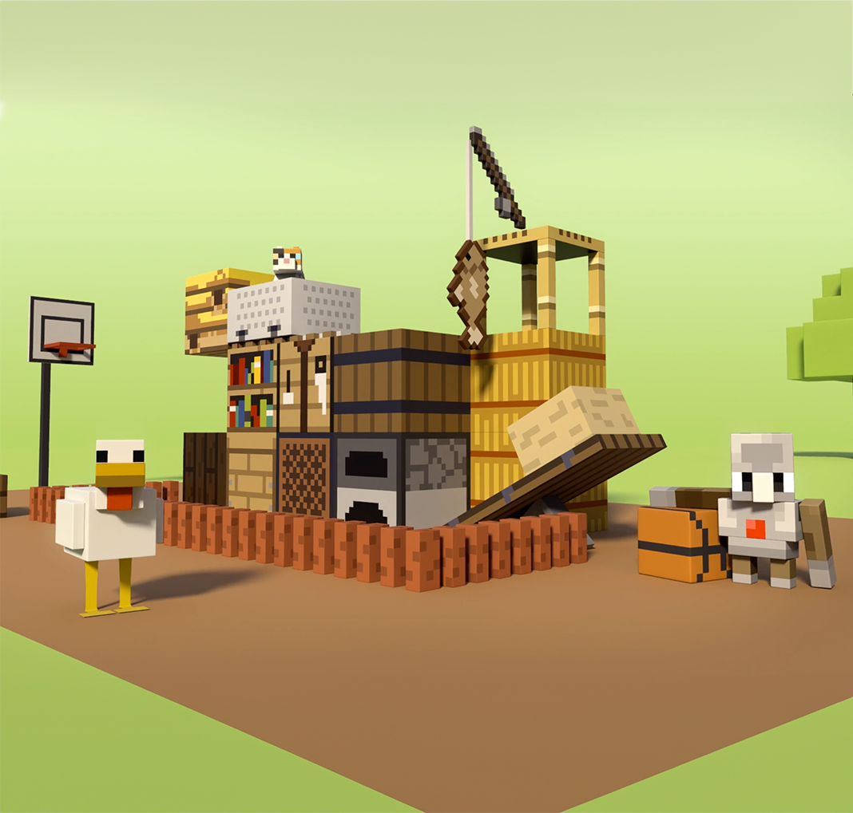

Using Generative AI Responsibly
What have we learned so far about using AI responsibly?
“Make it your own”

Slide 19
Review Today’s Lesson Vocabulary
Generative artificial intelligence (AI)
prompt
Chatbot
A prompt is a set of instructions given to an AI tool to help it focus on a specific topic, task, or purpose.
A chatbot is a type of generative AI that can create new content, such as images, text, or music, based on patterns and data it has been trained on.
is a powerful category of AI that includes models that generate text, images, videos, or music.
Notes:
pre video

Slide 20
Review Today’s Lesson Vocabulary
automate
algorithm
to have a machine or device carry out a task.
An algorithm is a set of steps or rules to follow in order to solve a problem or accomplish a specific task.
Notes:
pre video

Slide 21

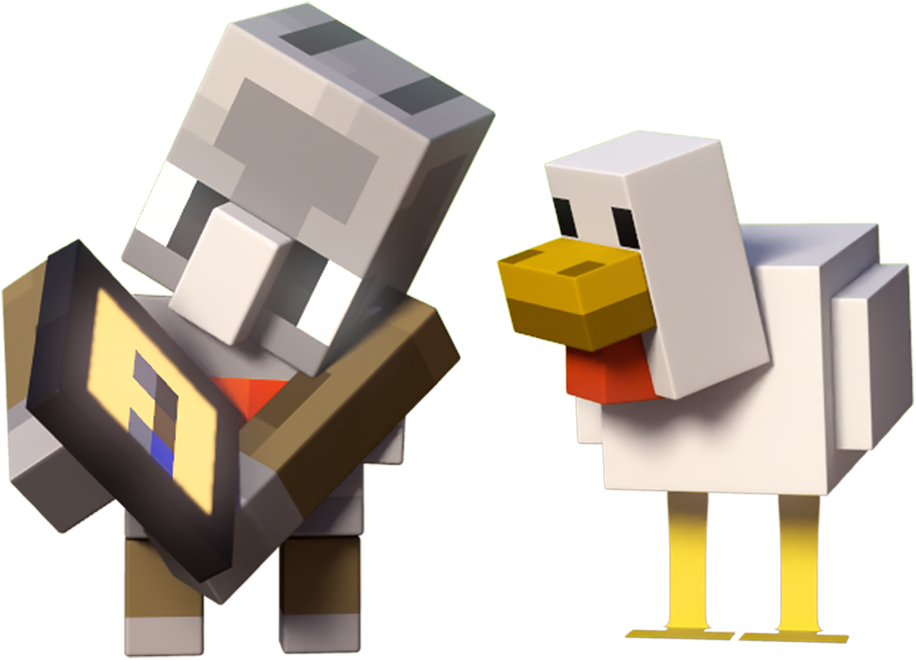
to deepen your knowledge of artificial intelligence

Slide 22

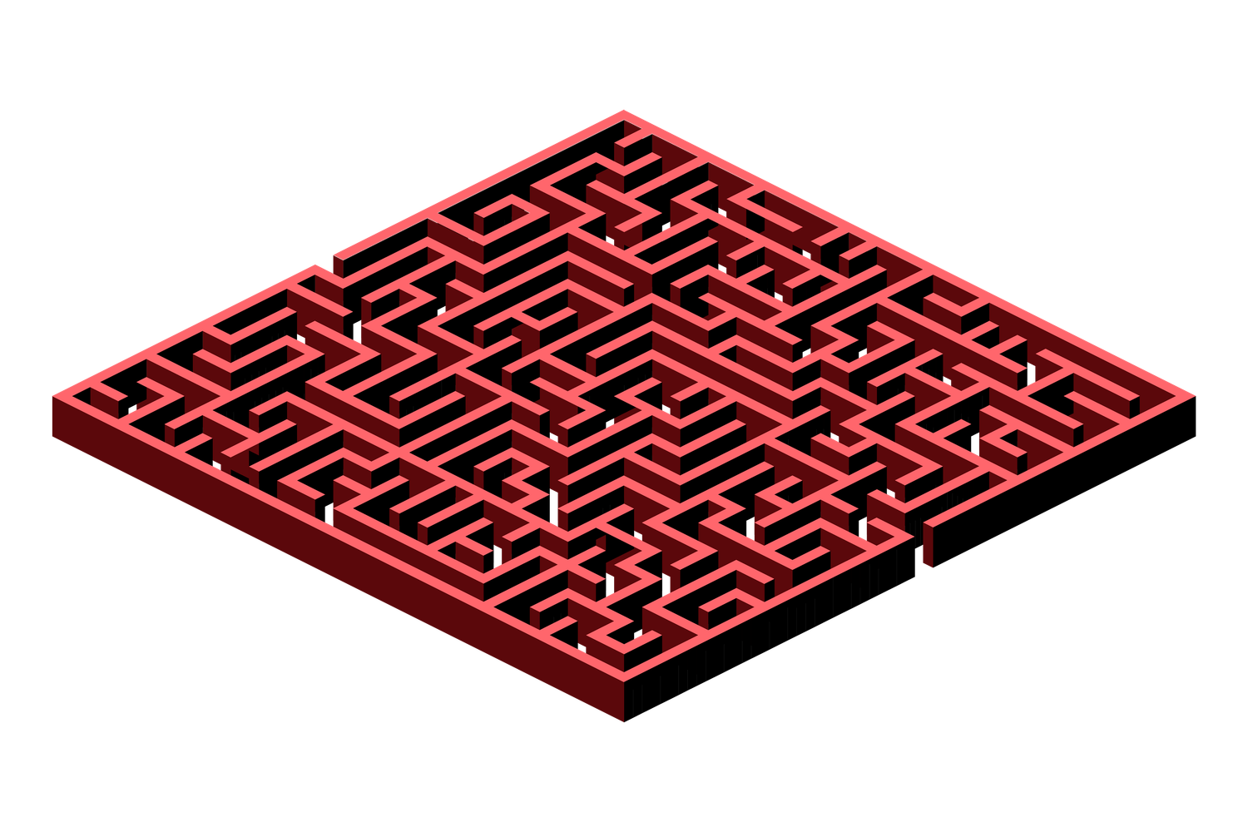
Activity 1: Giving Instructions
and Algorithm Creation
In this activity we are going to practice writing algorithms. We are going to create a simple algorithm that guides a character through a series of tasks, that will remind us the importance of giving clear and specific instructions.

Slide 23
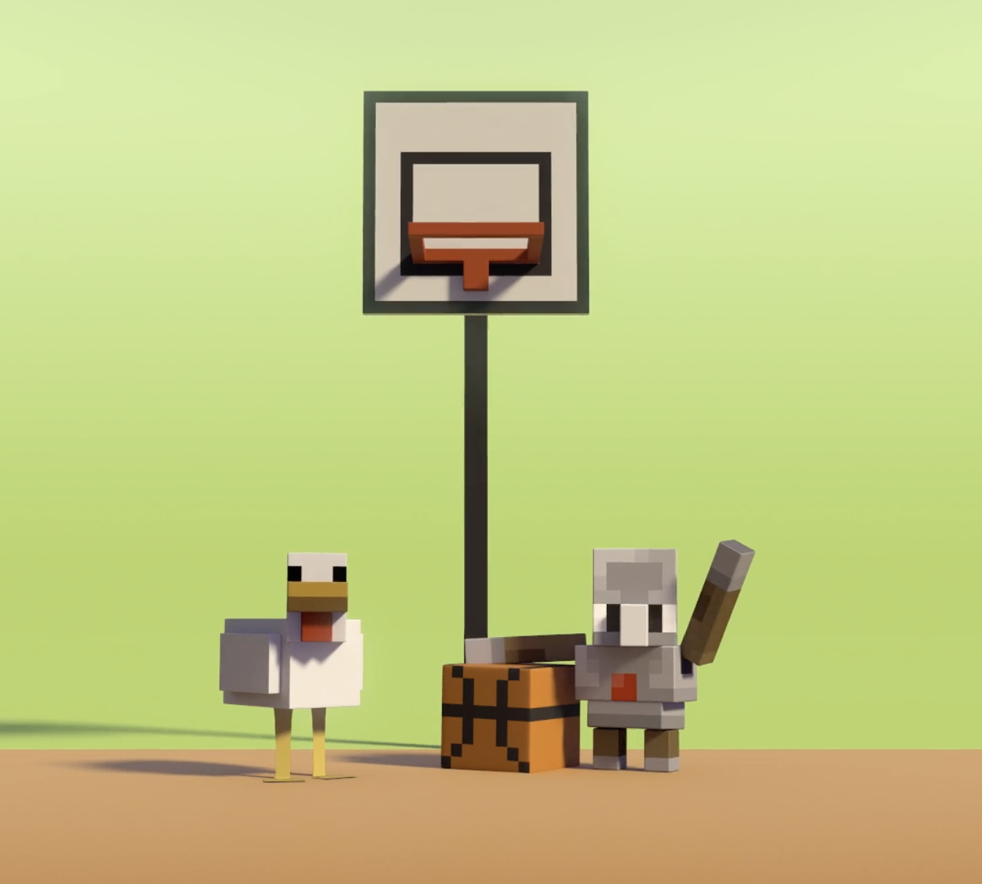

Activity 2: The Principles of
Responsible AI
In this activity we are going to discuss 6 principles for being responsible with AI.
A principle is a rule or set of rules for good behavior.

Slide 24
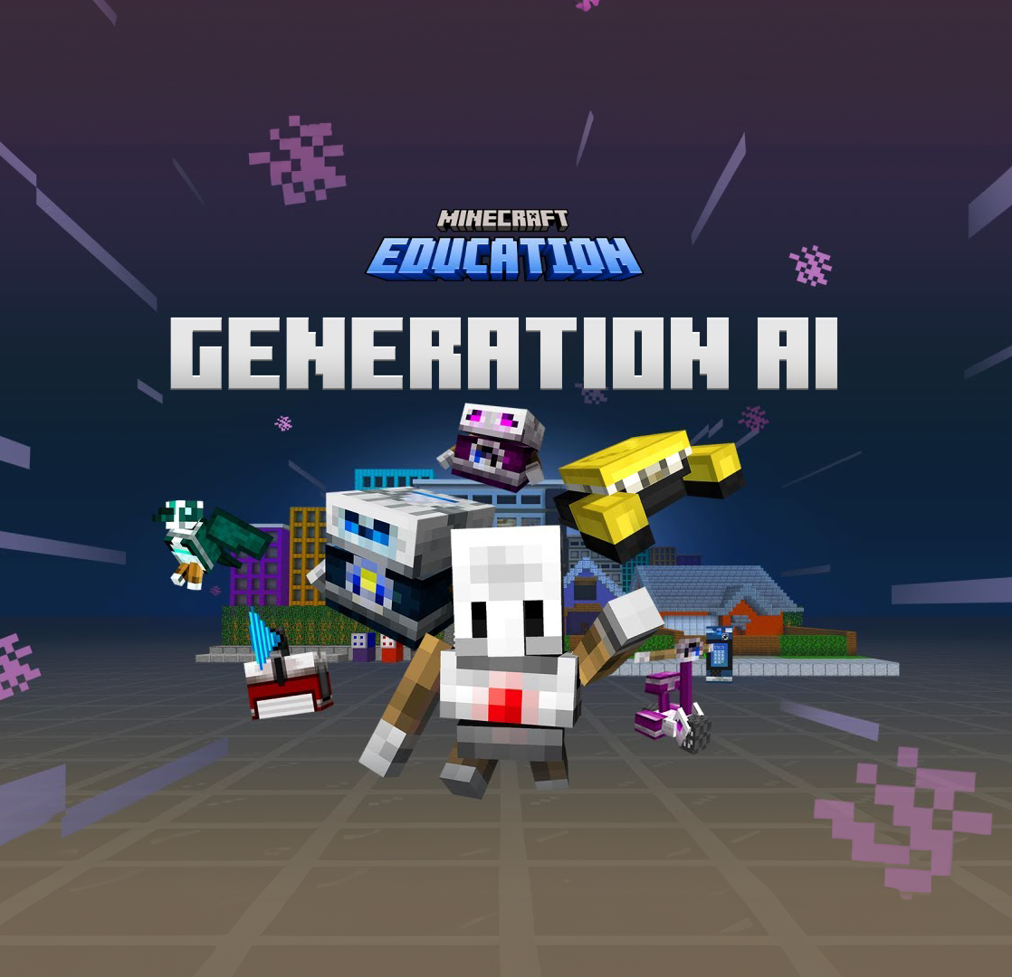
Activity 3: Generation AI
Hour of code: Generation AI
In this Minecraft Education activity, students will further their understanding of artificial intelligence and how it is shaping our world. Students will also begin to recognize the 6 principles that guide AI development and use.
(This activity can be utilized throughout all video lessons)

Slide 25

Further Learning
Elem
Elementary:
Code.org’s How AI Works Video Series
Grades 6 and up:
Making a Flower Maze in Minecraft!
https://education.minecraft.net/en-us/lessons/sequencing
(these activities require prior coding in Minecraft lessons)

