Slide 1





Teachers Notes
Questions to Discuss
Video to watch
Activities to complete
Instructions
If you would like to edit these slides, please make a copy for personal use.
Please refer to the lesson plan and discussion guide when facilitating this lesson.

Slide 2





Slide 3

Let’s Review
In the last lesson, we learned that artificial intelligence is a branch of Computer Science that focuses on using information (data) to program machines so that they can perform tasks that typically require a human.
The most common form of artificial intelligence we use in our everyday lives in called predictive artificial intelligence.
An “AI model” is created when a programmer provides a lot of different types of information (data) to the computer program. This is called machine learning.
Notes:
Alternatively, you can review any activities the students completed after video 1.

Slide 4

What will we learn today?
I will identify AI tools around me now!
I will identify AI tools that have been in use
I will recognize how AI is changing the world
I will begin to explore how AI can be used to address global issues.

Slide 5
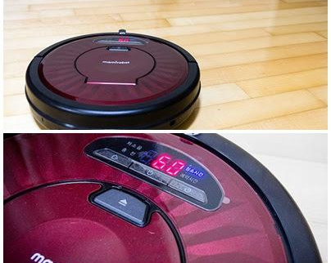
Warm Up
Do you recognize the device in the photos?
Do you think this device uses AI? Why or why not?
Does this device help us solve a problem?

Slide 6


Slide 7
Preview the Vocabulary
Look at the word, do you know the meaning?
Algorithmic Bias
Facial Recognition Technology
classical AI
Notes:
pre video

Slide 8



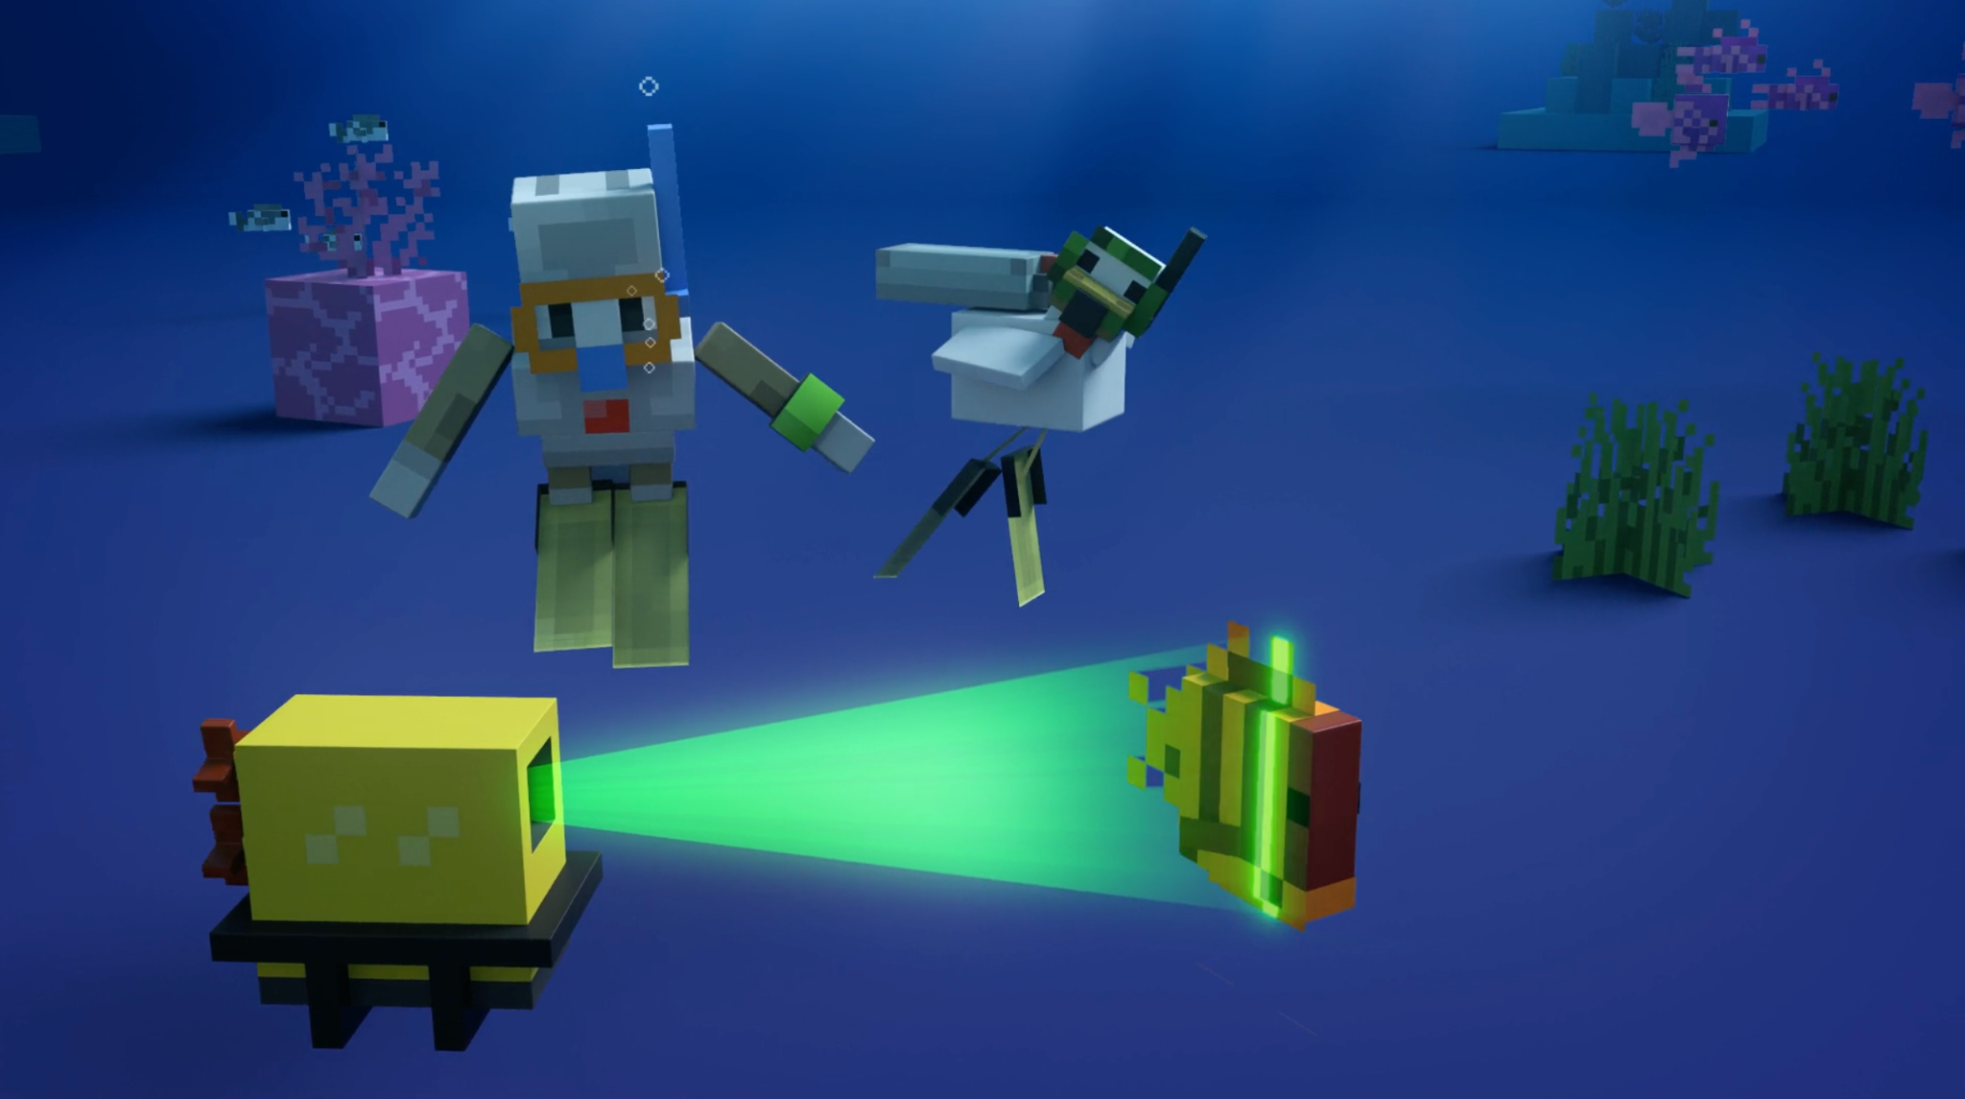

Hey, Chicken! -

Slide 9
v
Big Question: What AI is Old?
What AI is new?
Do you use facial recognition? If yes, with what device?
When you are using facial recognition, what do you think is happening?
Have you heard of people being able to create their own chatbot?
What kind of AI do you think is used by a self-driving taxi?
  Do you think a self-driving car is a good idea? Why or why not?
Notes:
During video discussion (0:00-0.54)

Slide 10
v
Big Question: How can AI help us
learn more about our world?
Do you think using AI to learn more about our oceans is a good use of AI? Why or why not?
Chicken was able to understand the dolphin in the video, how was this helpful for the dolphin?
Notes:
During video discussion (0:54-end)

Slide 11

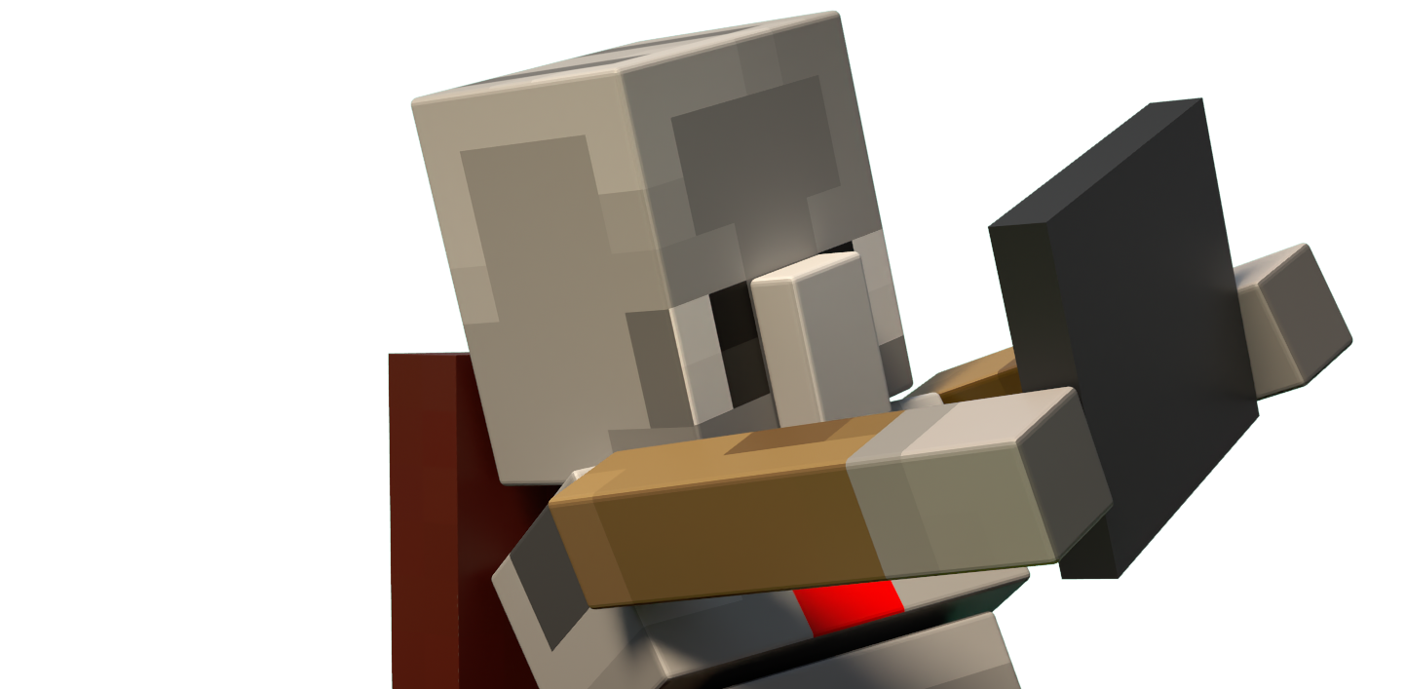

Slide 12



AI: Old and New
Before Chicken’s video, had you heard about or seen a robot vacuum?
Robot vacuums use a form of AI known as Classical AI. Classical AI is like a programmed robot following a strict set of human-made rules.
This type of AI is not new and has been in our everyday lives for quite some time. It is able to solve problems but this type of AI does not learn from data like newer AI.

Slide 13
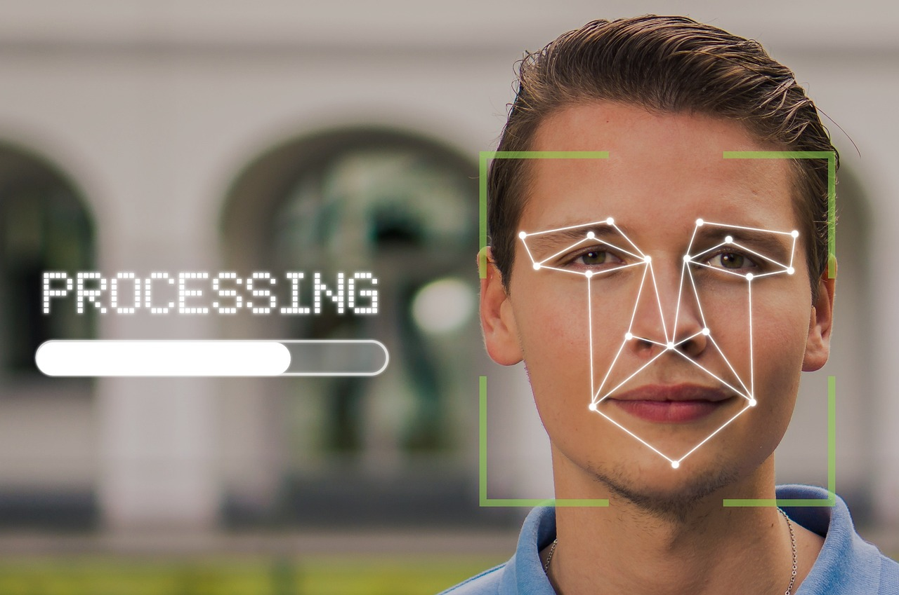
Facial Recognition
Facial recognition technology is used for the identification of humans in images and video.
Face recognition is a form of artificial intelligence (AI) that copies a human’s ability to recognize human faces. Just like when a human recognizes a face, facial recognition software captures facial features and creates a pattern of facial features which it uses to identify or group a face.
Do you think facial recognition software is a good use of AI? Why or why not?
Notes:
SOURCE: https://azure.microsoft.com/en-us/resources/cloud-computing-dictionary/what-is-face-recognition

Slide 14


How does facial recognition work?
One approach to face recognition, is looking at an image of a face and analyzing the shapes of its features, such as the eye spacing. Then, an algorithm is then used to assess if the shapes in the images are closely enough connected to the images in the data to suggest a match.
Facial recognition is used for many things, like unlocking your tablet with your face or helping airports make sure the right person gets on the plane. It is important to know that sometimes this technology can make mistakes, especially if people have similar features or if the lighting isn’t good.

Slide 15

Facial Recognition and
Algorithmic Bias
All facial measurements and shapes are not the same. This affects the data being put supplied to the algorithm
Algorithmic bias is the lack of fairness in the outputs generated by an algorithm. Or repeated errors that provide privilege to one group of users over another.
Have you or a family member ever encountered an issue with facial recognition technology?
Notes:
SOURCE: https://azure.microsoft.com/en-us/resources/cloud-computing-dictionary/what-is-face-recognition

Slide 16

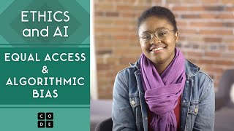
Deeper Dive into AI and Bias
Watch this video for more information and a deeper discussion on algorithmic bias.

Slide 17

Review Today’s Lesson Vocabulary
Algorithmic Bias
Classical AI
Facial Recognition Technology
is the lack of fairness in the outputs generated by an algorithm. Or repeated errors that provide privilege to one group of users over another.
This type of AI is not new and has been in our everyday lives for some time. It can solve problems but this type of AI does not learn from data like newer AI.
Face recognition is a form of artificial intelligence (AI) that copies a human’s ability to recognize human faces.

Slide 18

Putting it All Together
Artificial Intelligence is a branch of Computer Science that …refers to programs or machines that simulate tasks that typically require human intelligence.
Machine Learning happens when a programmer provides a lot of different types of information to an AI model. Since computers are not humans, this is how it “learns.”

Slide 19

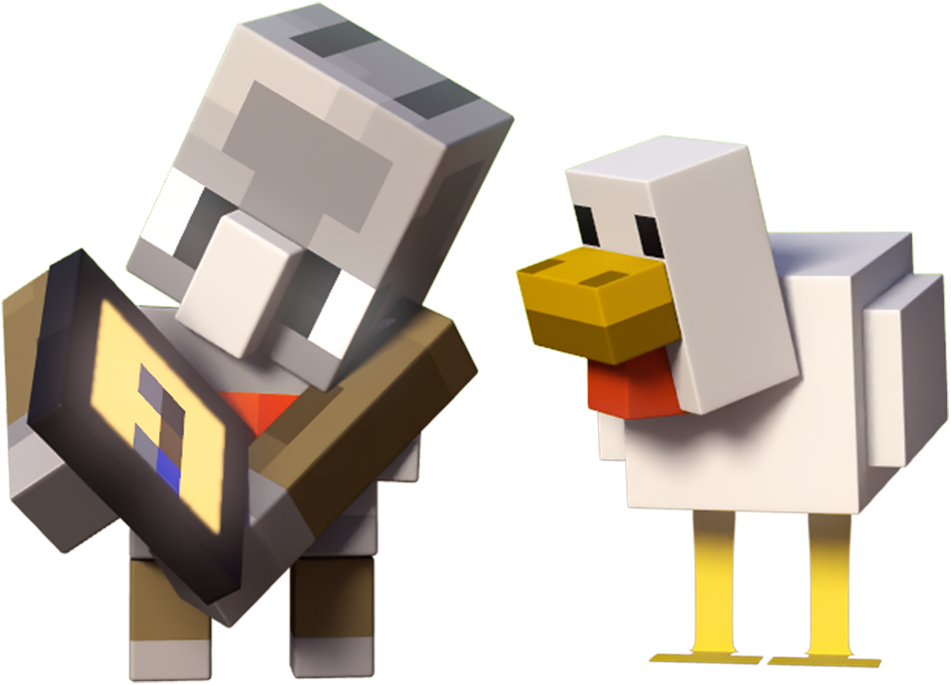
to deepen your knowledge of artificial intelligence

Slide 20

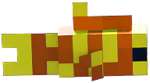
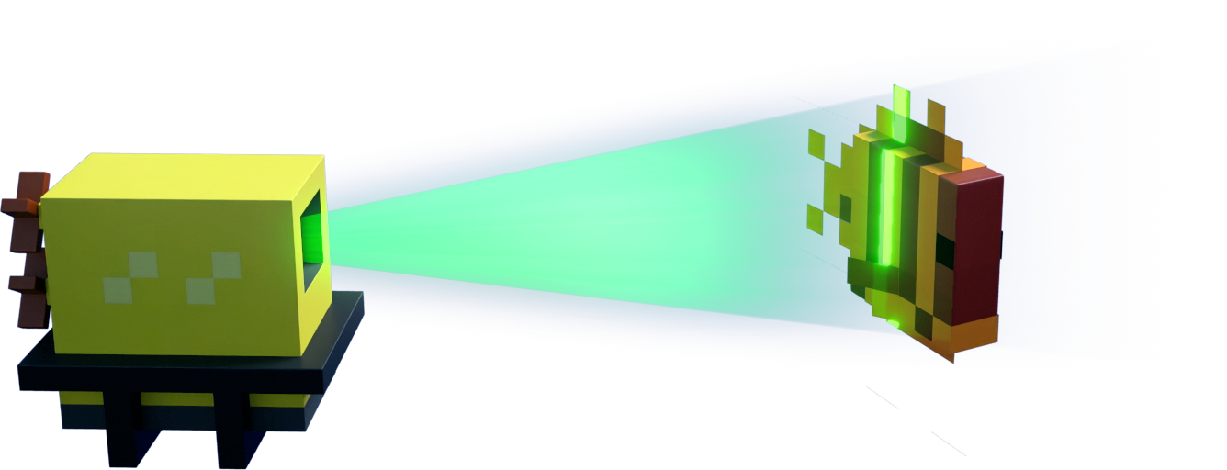
Activity 1: Solving Problems
with AI
What is a big problem you would like to see AI “solve?”
For this activity, think of a big problem that our world is facing today. It could be related to the environment, health, education, or any other area you care about. Use this worksheet to brainstorm how AI could be part of the solution.
Notes:
elementary students can do this in partnerships or as a whole class

Slide 21

Activity 2: Hour of Code-AI
for Good
In this activity, you will work in a Minecraft world to battle a forest wildfire. Although wildfires are labeled as natural disasters, only 10-15% of forest fires occur on their own. The other 85-90% are caused by human error. In this activity, you will build a solution.

Slide 22


Further Learning
Elementary and Grades 6 and up:
How AI Works- (code.org) Lesson 6: Algorithmic Bias
What is algorithmic bias? (Anti-Defamation League)

