Slide 1





Teachers Notes
Questions to Discuss
Video to watch
Activities to complete
Instructions
If you would like to edit these slides, please make a copy for personal use.
Please refer to the lesson plan and discussion guide when facilitating this lesson.

Slide 2



Slide 3


What will we learn today?
I will identify the definition of artificial intelligence
I will identify how artificial intelligence is created
I will identify ways we can detect that the information we receive from artificial intelligence is correct

Slide 4


Chicken's feathers are ruffled because of all this AI chitter-chatter. Time for Chicken's course on artificial intelligence!

Slide 5



What do you know about
Artificial Intelligence (AI)?
Turn and Talk
What do you think of when you hear the words “artificial intelligence?” Do you think of any devices or objects we use that may have artificial intelligence?
Notes:
pre-video questions

Slide 6


These are examples of artificial intelligence we may see in our everyday lives. Can you think of others?
Map applications use data, traffic patterns, and user preferred routes to help people travel.
Movie and Videogame platforms make suggestions you may like based on previous games you played and songs you have previously enjoyed.

Slide 7
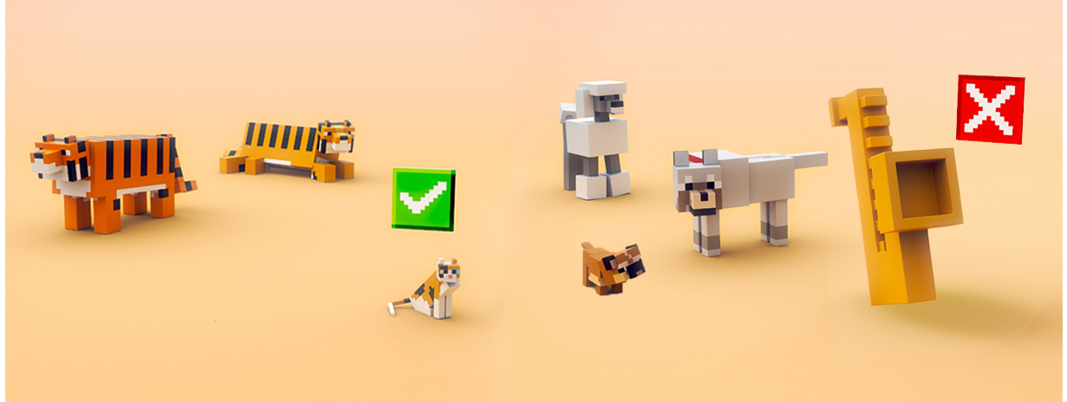
What is artificial intelligence?
Artificial Intelligence is a branch of Computer Science that …refers to programs or machines that simulate tasks that typically require human intelligence,
such as:
The most common form of artificial intelligence we use in our everyday lives in called predictive artificial intelligence. We will learn more about this today with Chicken!
recognizing patterns
making predictions
generating content

Slide 8

Preview the Vocabulary
Look at the word, do you know the meaning?
programmer
pattern recognition
prediction
AI models
Artificial Intelligence
Machine Learning

Slide 9


Slide 10



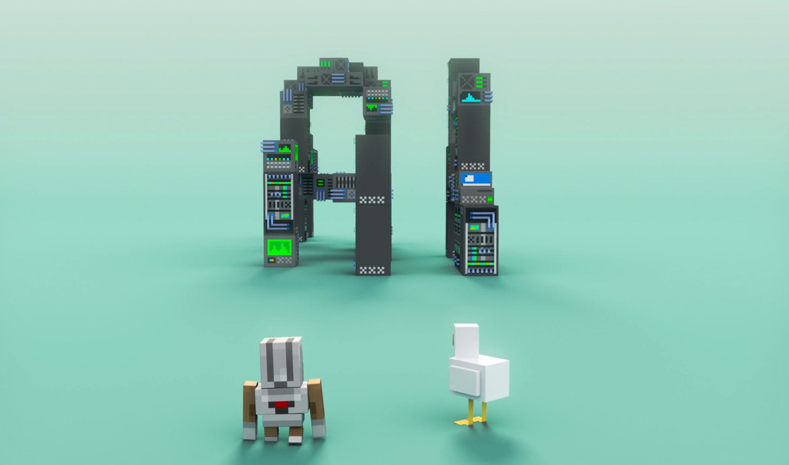
Hey, Chicken! What is artificial
intelligence and how does it work?

Slide 11

Big Question: Is artificial
intelligence helpful?
v
1. Do you think finding information is a lot like fishing?
2. How can artificial intelligence help us?
During video discussion (0:00-0.30)
Notes:
During video discussion: 0-.30

Slide 12

Big Question: How is artificial
intelligence created?
v
3. What is the first step for Chicken (the AI Model) to be trained? Who does this training?
4. Let’s think about Chicken training on huge amounts of information on “lots of different things,”
why is this important?
Notes:
During video discussion (0:30-1.01)

Slide 13
Big Question: How is artificial
intelligence created?
v
5. What happens after Chicken is done looking at information?
6. How does the AI model find patterns?
7. Let’s think about one of the examples that Chicken gave us, why would books about tigers mention cats, but websites about cats, rarely mention cars?
Notes:
During video discussion (1:02-2:12)

Slide 14


Big Question: How is artificial
intelligence created?
v
8. Why might an AI tool predict that whales live in lakes?
9. Do you think AI is always correct? Can you think of some ways we can check if AI is correct?
Notes:
During video discussion (1:02-2:12)

Slide 15

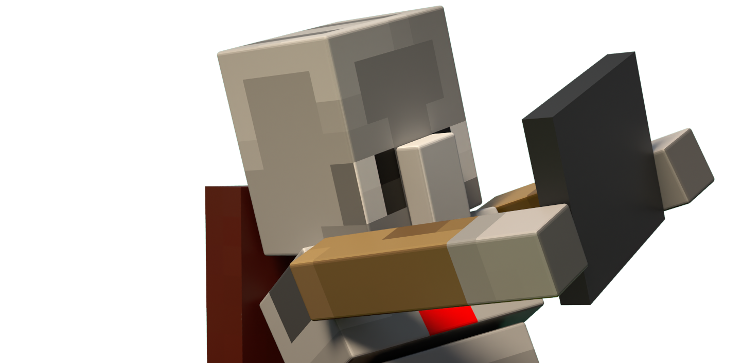

Slide 16


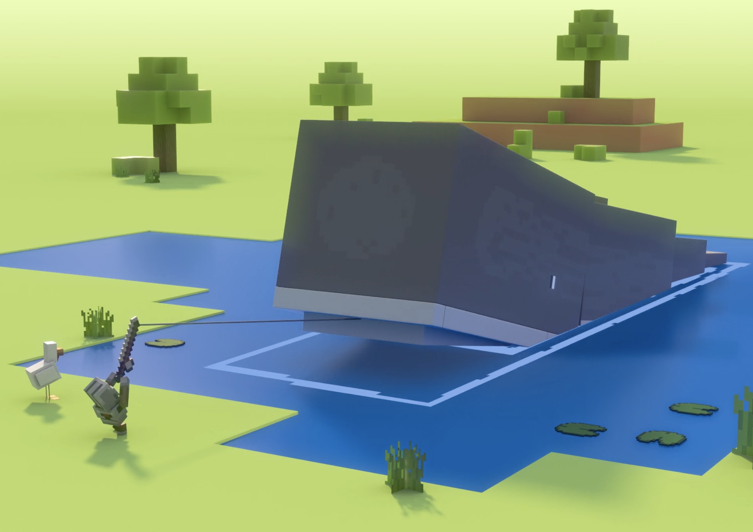
Review the Lesson Big Ideas
Predictive AI Models
The AI tools that we have discussed today use predictive models.
Predictive models predict something based on a set of features. For example, a whale may be predicted to live in a lake because the data collected has whales living in water and a lake is a body of water.
We know that whales cannot live in lakes!
Have you ever had an AI tool provide you with an incorrect or silly answer?

Slide 17


Review the Lesson Big Ideas
Machine Learning
Information can be:
Images
Text
Videos
In the video, we saw Chicken receiving a lot of information. When artificial intelligence does this, it is called machine learning. A programmer can provide a lot of different types of information to an AI model. Since computers are not humans, this is how it “learns.”
Can you think of other types of information?

Slide 18
Review the Lesson Big Ideas:
Is it AI or Not?
AI Tools
AI gains knowledge, then adapts and improves over time. It uses data (information) and makes decisions and predictions based on patterns.
Maps looking at traffic data
Movie apps making suggestions on your likes or dislikes
Social Media showing ads based on the videos you watched
Non-AI Tools
Non-AI tools work by following pre-programmed instructions.
A calculator
A sprinkler system that waters a lawn according to a pre-programmed schedule
a built in spell-checker identifying misspelled words based on a dictionary

Slide 19

AI Foundations
What is AI foundations?
What does it mean to have social and ethical impacts?
AI foundations, also sometimes called AI literacy includes:
Understanding how AI works
Using AI responsibly
Recognizing its social and ethical impacts
Understanding AI’s potential benefits and risks and how to reduce the risks

Slide 20
Review Today’s Lesson Vocabulary
programmer
prediction
Artificial Intelligence
A person who writes programs for a computer.
A statement that something might happen or is expected to happen, such as the weather.
refers to programs or machines that imitate tasks that typically require human intelligence, such as:
recognizing patterns
making predictions
generating new content
Notes:
Students should add these words to their vocabulary tracker

Slide 21
Review Today’s Lesson Vocabulary
pattern recognition
AI Models
machine learning
the ability of machines to identify patterns in data, and then use those patterns to make decisions or predictions using computer algorithms.
a computer model designed to perform tasks that normally require human intelligence.
Predictive models predict something based on a set of features.
a subset of AI that deals with the ability of machines to learn from data and patterns without being programmed to do so.
Notes:
Students should add these words to their vocabulary tracker

Slide 22

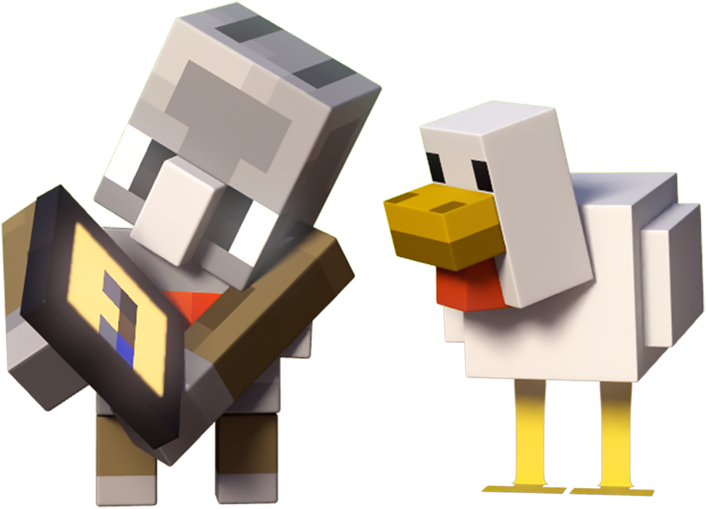
to deepen your knowledge of artificial intelligence

Slide 23


Activities 1 and 2: Checking
AI’s Information
In this activity, we are going to discuss ways we can check the information we receive from AI tools.
One way we can check information, is by using a different source. Let’s try this together. We will ask this AI tool a question, then we will see if we get the same answer from a reliable website.
For this example, let’s use the National Geographic Kids website!
What are some animals that have the word “American” in their name?
Let’s ask AI and then check the website!

Slide 24

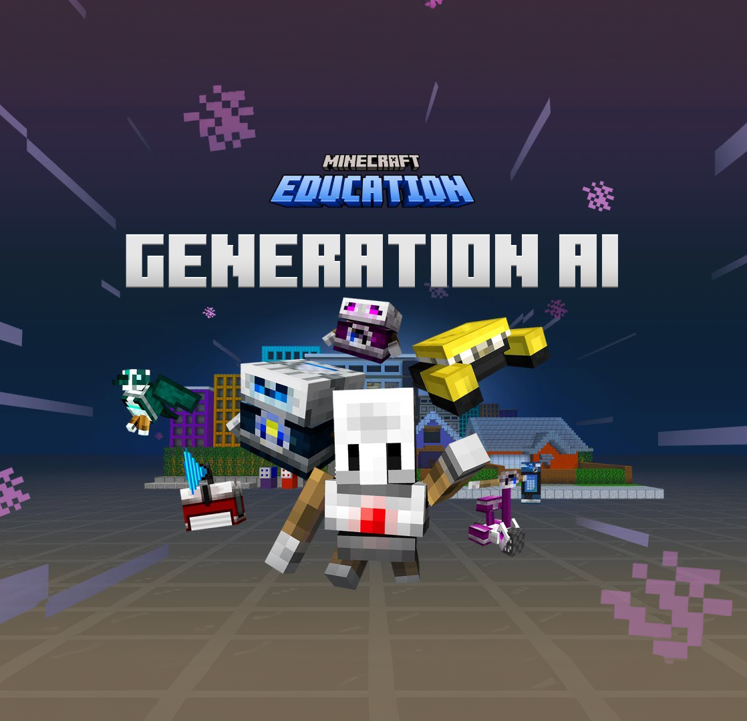
Activity 3: Generation AI
Hour of code: Generation AI
In this Minecraft Education activity, students will further their understanding of artificial intelligence and how it is shaping our world. Students will also begin to recognize the 6 principles that guide AI development and use.

Slide 25


Further Learning
Elementary:
PBS Kids Sci Girls (Code Quest)
Code.org’s AI for Oceans
Grades 6 and up:
Code.org’s AI and Machine Learning

