Slide 1

WHEEL OF STEVE: HOW TO PLAY
Notes
  In order for the game to function correctly, this document must be opened in the PowerPoint desktop app.
  This trivia is intended primarily for students in grades 6-12.
Divide your class into teams and decide which order the teams will play in.
Click the Spinner Wheel on slide 2 once to start it spinning. Click the Spinner Wheel again to stop the spin and select a category, which will be indicated by the arrow.
The active team can choose any question within the selected category that has not yet been chosen. Clicking the number value of the question will navigate you to the question.
The active team has 10 seconds (or any duration that suits your class) to answer the question. Once they’ve responded, click the Answer button to reveal the answer. If they are correct, they receive the point value of the question. If they are incorrect, they receive no points.
Play now passes to the next team in the play order. Click the Return to Spinner Wheel button and repeat Steps 2-4 until the entire game board has been selected.
If the Spinner Wheel lands between categories or on a category that has already been cleared, spin again.

Slide 2

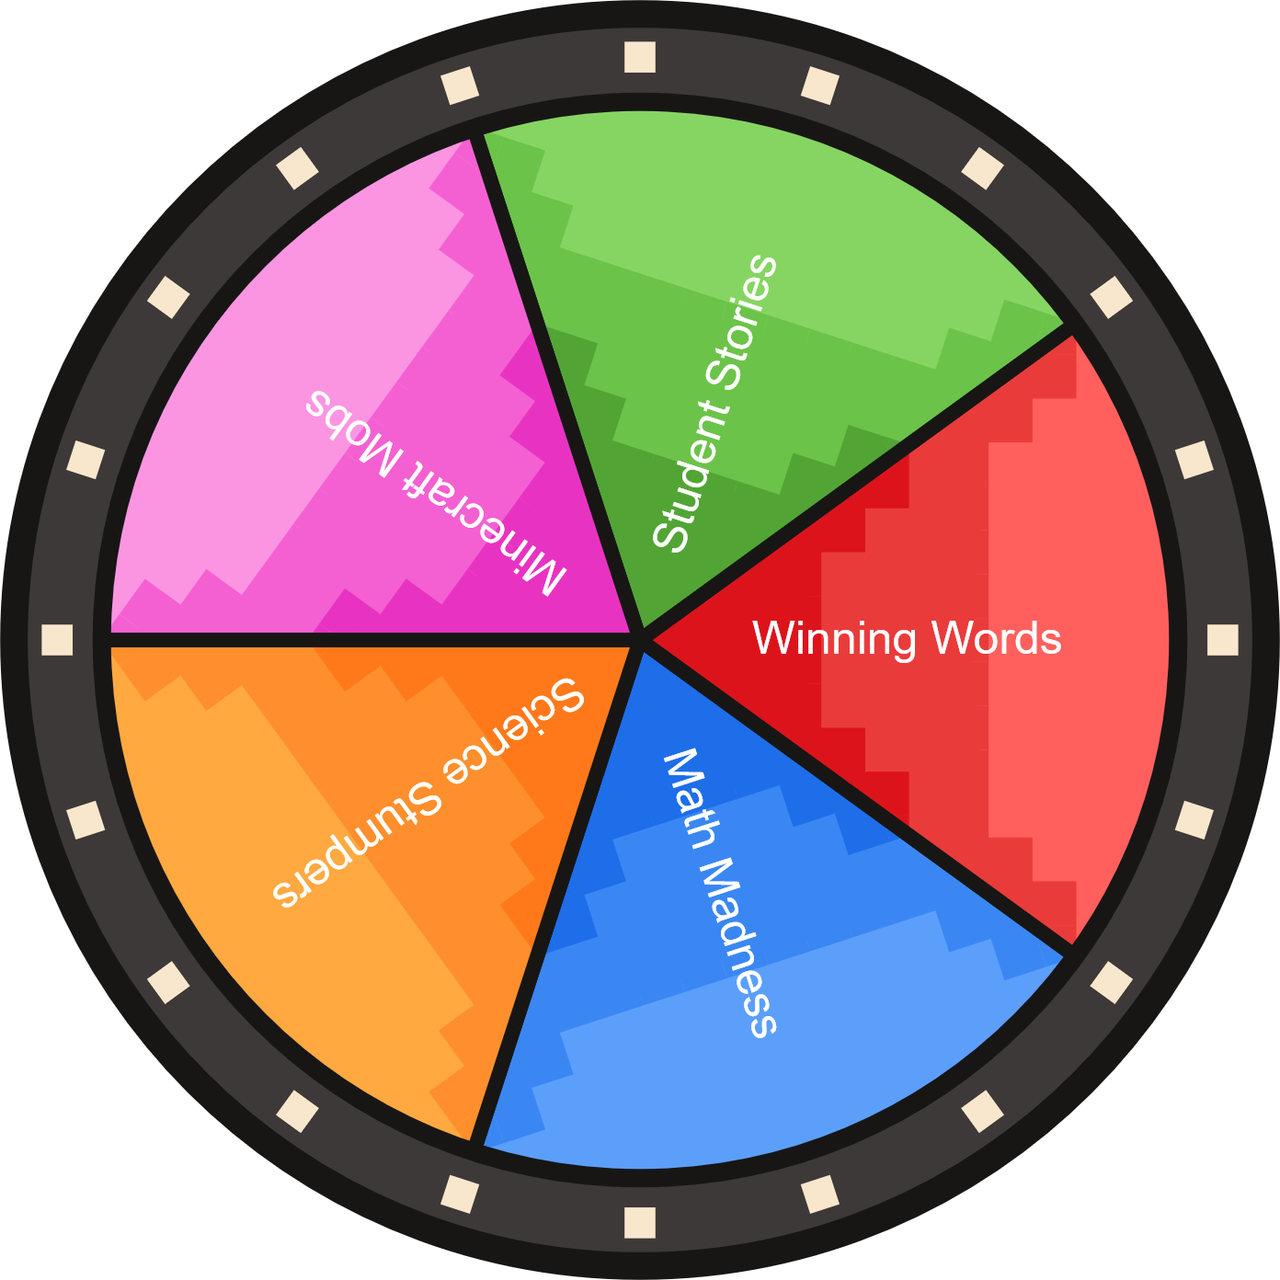



Game Board ►

Slide 3


Minecraft Mobs | Science Stumpers | Math Madness | Winning Words | Student Stories
100 | 100 | 100 | 100 | 100
200 | 200 | 200 | 200 | 200
300 | 300 | 300 | 300 | 300
400 | 400 | 400 | 400 | 400
500 | 500 | 500 | 500 | 500

Slide 4
MINECRAFT MOBS
This Minecraft Education-specific mob helps teach students how to code.
Answer
Back to Spinner Wheel ►

Slide 5
The Agent
Back to Spinner Wheel ►

Slide 6
MINECRAFT MOBS
This iconic green mob might sneak up on you…and then explode!
Answer
Back to Spinner Wheel ►

Slide 7
Creeper
Back to Spinner Wheel ►

Slide 8
MINECRAFT MOBS
When this mob isn’t busy laying eggs, it likes to hang out with its friend the Agent to help teach students about AI.
Answer
Back to Spinner Wheel ►

Slide 9
Chicken
Back to Spinner Wheel ►

Slide 10
MINECRAFT MOBS
This hostile mob uses a bow and arrow.
Answer
Back to Spinner Wheel ►

Slide 11
Skeleton
Back to Spinner Wheel ►

Slide 12
MINECRAFT MOBS
This spooky-looking monster is the only mob that naturally spawns in all three Minecraft dimensions.
Answer
Back to Spinner Wheel ►

Slide 13
Enderman
Back to Spinner Wheel ►

Slide 14
SCIENCE STUMPERS
This is the name for the type of energy we can capture from the sun.
Answer
Back to Spinner Wheel ►

Slide 15
Solar
Back to Spinner Wheel ►

Slide 16
SCIENCE STUMPERS
This branch of science studies living things like animals and plants.
Answer
Back to Spinner Wheel ►

Slide 17
Biology
Back to Spinner Wheel ►

Slide 18
SCIENCE STUMPERS
This space telescope, launched in 2021, is NASA’s successor to the Hubble Space Telescope.
Answer
Back to Spinner Wheel ►

Slide 19
James Webb Space Telescope
Back to Spinner Wheel ►

Slide 20
SCIENCE STUMPERS
This evolutionary process helps organisms to survive in specific conditions and environments.
Answer
Back to Spinner Wheel ►

Slide 21
Adaptation
Back to Spinner Wheel ►

Slide 22
SCIENCE STUMPERS
In computer science, this concept refers to a defined process or set of rules intended to accomplish a specific task.
Answer
Back to Spinner Wheel ►

Slide 23
Algorithm
Back to Spinner Wheel ►

Slide 24
MATH MADNESS
This mathematical operation is the opposite of addition.
Answer
Back to Spinner Wheel ►

Slide 25
Subtraction
Back to Spinner Wheel ►

Slide 26
MATH MADNESS
To find the area of a rectangle, you’ll need to multiple these two values.
Answer
Back to Spinner Wheel ►

Slide 27
Length and Width
Back to Spinner Wheel ►

Slide 28
MATH MADNESS
In algebra, these symbols take the place of unknown values in an equation.
Answer
Back to Spinner Wheel ►

Slide 29
Variables
Back to Spinner Wheel ►

Slide 30
MATH MADNESS
In geometry, this constant represents the ratio of a circle’s circumference to its diameter
– approximately 3.14.
Answer
Back to Spinner Wheel ►

Slide 31
Pi (π)
Back to Spinner Wheel ►

Slide 32
MATH MADNESS
Solve for x:
28 = 3x - 5
Answer
Back to Spinner Wheel ►

Slide 33
11
Back to Spinner Wheel ►

Slide 34
WINNING WORDS
This term describes a word that means very nearly the same thing as a different word.
Answer
Back to Spinner Wheel ►

Slide 35
Synonym
Back to Spinner Wheel ►

Slide 36
WINNING WORDS
In grammar, this is the name for the person/place/thing performing the action of a sentence.
Answer
Back to Spinner Wheel ►

Slide 37
Subject
Back to Spinner Wheel ►

Slide 38
WINNING WORDS
This part of speech consists of words that modify or describe people, places, or things.
Answer
Back to Spinner Wheel ►

Slide 39
Adjectives
Back to Spinner Wheel ►

Slide 40
WINNING WORDS
This literary device involves assigning human traits to nonhuman entities, or representing an abstract concept in a human form.
Answer
Back to Spinner Wheel ►

Slide 41
Personification
Back to Spinner Wheel ►

Slide 42
WINNING WORDS
This literary device involves the repetition of initial consonant sounds, as in this sentence: “The whales wallowed in the waves.”
Answer
Back to Spinner Wheel ►

Slide 43
Alliteration
Back to Spinner Wheel ►

Slide 44
STUDENT STORIES
What are you most excited about for this school year?
Answer
Back to Spinner Wheel ►

Slide 45
We’re excited for that, too!
Back to Spinner Wheel ►

Slide 46
STUDENT STORIES
Describe a project from the past year that you’re proud of.
Answer
Back to Spinner Wheel ►

Slide 47
Wow, that’s awesome!
Back to Spinner Wheel ►

Slide 48
STUDENT STORIES
Describe a time that a teacher or a friend helped you find a solution to a problem.
Answer
Back to Spinner Wheel ►

Slide 49
We all need a little help sometimes!
Back to Spinner Wheel ►

Slide 50
STUDENT STORIES
Describe something you appreciate about one of your friends.
Answer
Back to Spinner Wheel ►

Slide 51
That sounds like a good friend!
Back to Spinner Wheel ►

Slide 52
STUDENT STORIES
What is one goal that you would like to achieve this year?
Answer
Back to Spinner Wheel ►

Slide 53
You can do it!
Back to Spinner Wheel ►

